Slide 1
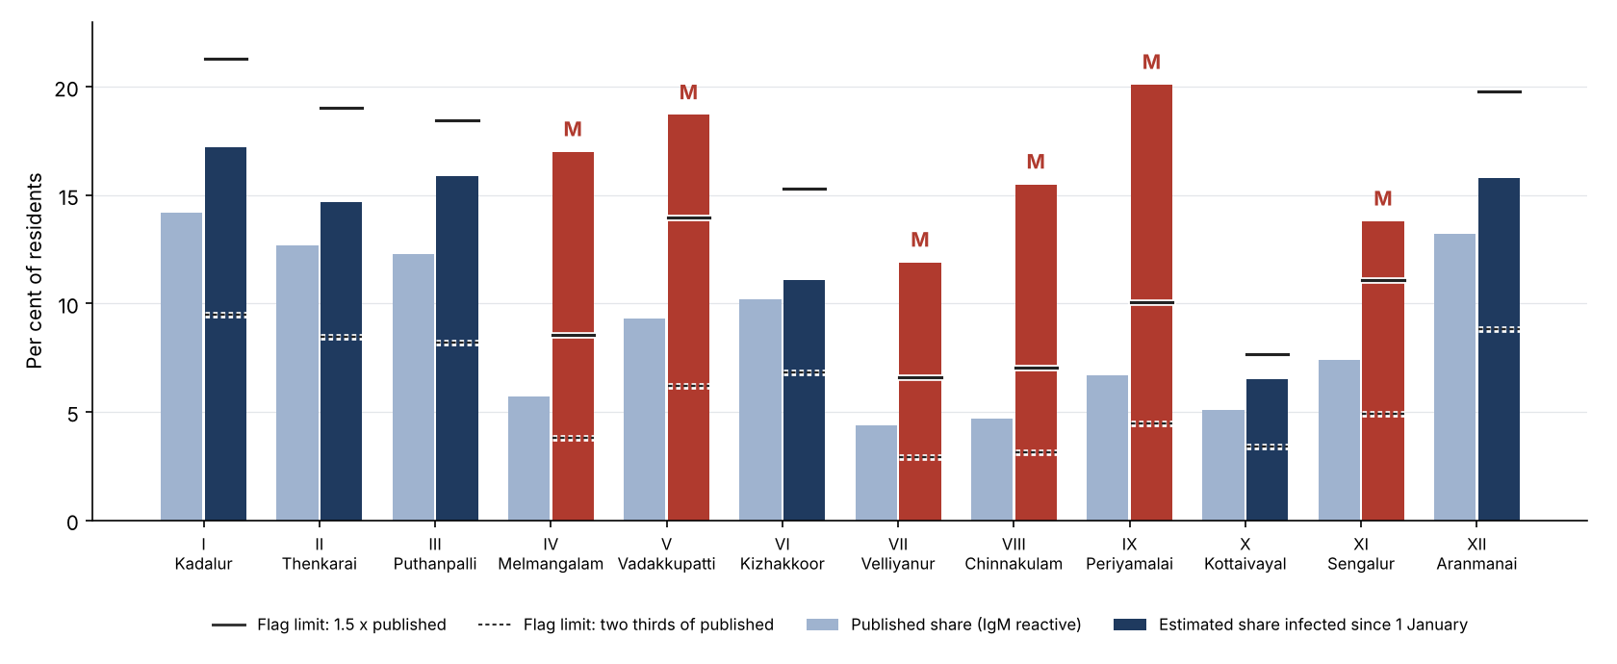
Six of the 12 zones' published 2027 infection shares carry the misclassification flag: their IgM shares stand for under two thirds of the residents infected since January
Flagged (M): IV Melmangalam (5.7% published, 17.0% estimated), V Vadakkupatti (9.3% published, 18.7% estimated), VII Velliyanur (4.4% published, 11.9% estimated), VIII Chinnakulam (4.7% published, 15.5% estimated), IX Periyamalai (6.7% published, 20.1% estimated), XI Sengalur (7.4% published, 13.8% estimated). The other zones' values stand within the tolerance.
Source: 2027 household serosurvey (SERO-D1, bulletin 52/2027); IgM ELISA lot verification, Department of Microbiology, NGMC; city dengue line list, 8 January 2028. Flag M under SOP-EPI-07. City Epidemiology Cell.
1

