Slide 1
Two of the six new broker posts go to Dorval and one to Calgary; three are held to the 2028 review
Desk | Broker posts at 1 January 2027 | New posts placed | Forecast 2027 formal entries, average month | Formal entries a month per broker post after the review
Mississauga | 7 | 0 | 3,750 | 535
Dorval | 5 | 2 | 3,600 | 515
Richmond | 6 | 0 | 3,100 | 515
Calgary | 4 | 1 | 2,600 | 520
Winnipeg | 3 | 0 | 1,500 | 500
Posts placed one at a time to the highest load while it exceeds the standard 560 (BRK-STD-03 4.5): Dorval, Calgary, Dorval. After three, the highest load is Mississauga at 535, so three posts are held.
Forecast on the 2027 network plan, the line at CAD 3,300: goods that keep their invoice-currency values re-routed at the plan's rates (USD 1.34, EUR 1.68); Calgary's US-dollar goods and the Chinese goods at Mississauga and Richmond keep their CAD values and their routes.
Brokerage Workforce Planning, establishment review 2027. Sources: BRK-STD-03 rev. 4; network plan 2027; high-value check extracts October 2024 to September 2026.
1

Slide 2
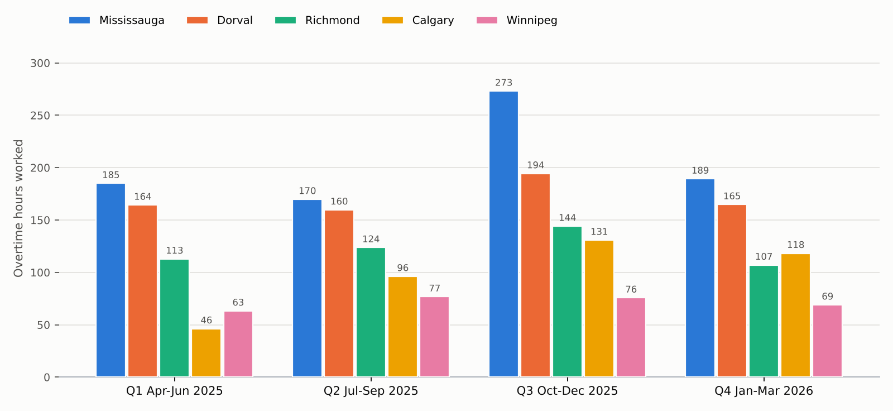
Mississauga worked the most overtime of the five desks in every quarter of 2025-26
Overtime at time and a half and double time, and call-backs at the time worked, on the desk each broker was assigned to that day. Source: time and attendance exports, HR assignment changes.
2

