Slide 1
2027 contribution to the Trust: $1,250,000
Recommended: the Participating Entities contribute $1,250,000 for 2027, the expected cost of the Claims that will be first made against the Trust in its first Plan Year
Participating Entity | Joins the Trust | Months in the Trust in 2027
Tolliver Falls Hospital | 1 January 2027 | 12
Alderwick Medical Center | 1 April 2027 | 9
Corvane Medical Group | 1 July 2027 | 6
Brennick Community Hospital | 1 October 2027 | 3
The Trust is claims-made, each entity's Transition Date its Retroactive Date: in 2027 it pays only for the Claims made by 31 December from incidents after the entity joined.
Those are the Claims the System's experience makes within the year: harm disclosed and settled within weeks of the care, which is costly, and program requests a few months on, which settle small. The demands and suits that carry most of the experience's cost come a year or more after the care, after 2027 for every entity.
Each 2016 to 2024 experience Claim was costed at its own delay from incident to first making against the days each entity is in the Trust in 2027, within its specialty class.
No provision for expenses, investment income, excess insurance or margin (funding policy 3.5).
Corvane Health, Risk Management and Insurance | Trustees of the Corvane Professional Liability Trust, 10 November 2026 | 1

Slide 2
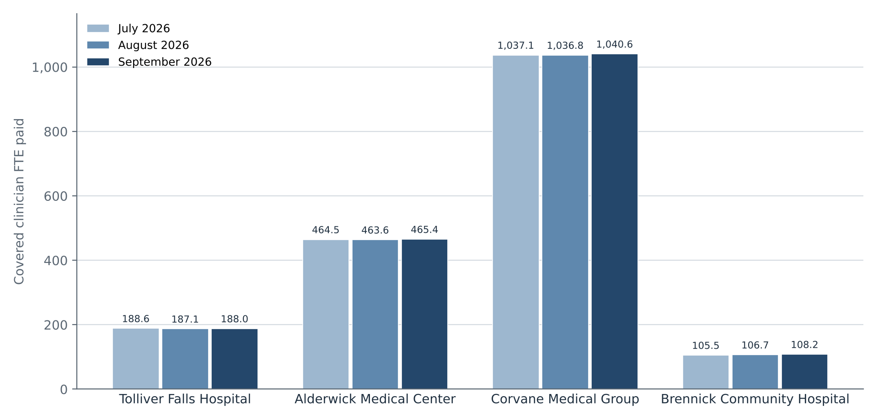
Corvane Medical Group carries 58% of the covered clinician FTE the payroll paid in September
Covered clinician FTE the payroll paid at each entity, July to September 2026 (HCM pay lines)
Source: HCM clinician pay lines run 2 October 2026; hours paid over 173.33 a month at 1.0 FTE, residents' and fellows' additional positions left out, entity of the cost centre charged.
Corvane Health, Risk Management and Insurance | Trustees of the Corvane Professional Liability Trust, 10 November 2026 | 2

