Slide 1
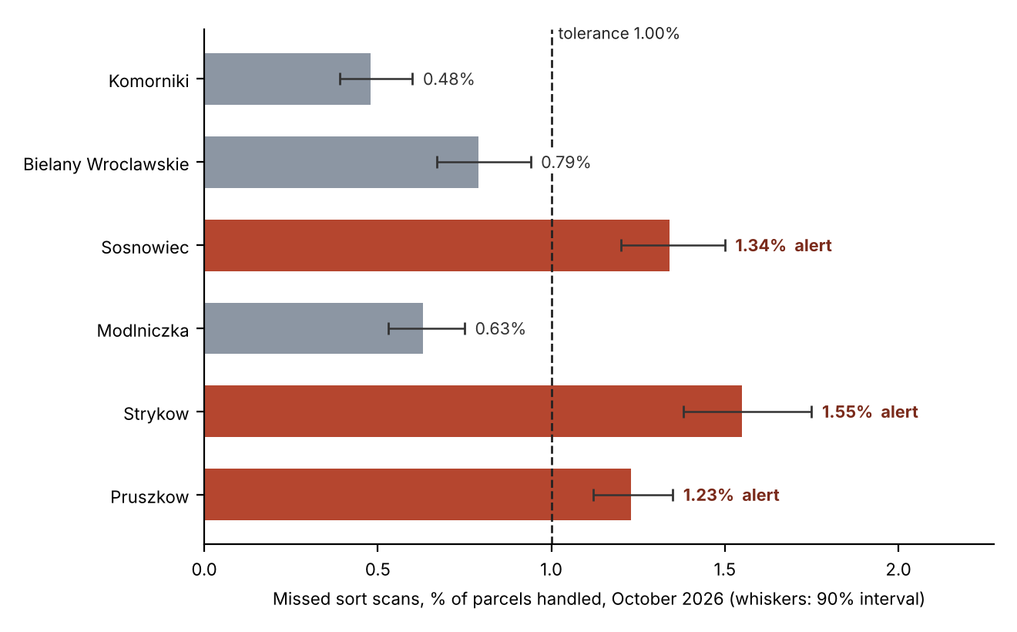
Scan alerts, October 2026: fire at Sosnowiec, Strykow and Pruszkow
TDS-4 v4.1, tolerance 1.00% of parcels handled. Platform extract 6 Nov 2026, 07:40.
Hub | Parcels | Missed | Rate | 90% interval | Alert
Komorniki | 12,600 | 61 | 0.48% | 0.39-0.60 | -
Bielany Wroclawskie | 11,963 | 95 | 0.79% | 0.67-0.94 | -
Sosnowiec | 16,530 | 222 | 1.34% | 1.20-1.50 | fires
Modlniczka | 13,628 | 86 | 0.63% | 0.53-0.75 | -
Strykow | 12,178 | 189 | 1.55% | 1.38-1.75 | fires
Pruszkow | 24,425 | 301 | 1.23% | 1.12-1.35 | fires
A parcel without a sort event is charged to the hub whose trailer it came off at its delivery depot.
Strykow sorted part of Pruszkow's flow by hand on its heavy nights and trucked it to the Warsaw depots.

