Slide 1
Fund the winter guarantee account with $1,650,000 at go-live
4,700 drivers expected to complete 40 trips between 4 and 31 January 2027, at $350 each
Expected to qualify | Drivers
December 2026 roster | 2,680
Last winter's drivers back by 3 January | 1,010
Last winter's drivers due back 4 to 31 January | 970
Other returning and new drivers | 40
All drivers | 4,700
Why it is above last January
Last winter's recruitment campaign put about 2,200 new drivers on the road in February and March 2026. Most stopped driving in March or April and took no trip from May to October.
They are coming back with the winter: about 1,100 of last winter's drivers were back on the road by 3 January. In each of the last three winters January brought back about 1.1 drivers for every one back in November and December, so about 1,200 more are due inside the window.
Priced at last January's shares, last winter's drivers account for about 2,000 of the 4,700.
Expected total at $350 a qualifying driver, to the nearest $50,000 (finance, 30 December 2026). Returns and recoveries come back to the account and are left out. Data to the extract run of 3 January 2027. Workings: guarantee_fund_jan2027.xlsx.
Larch Rides Driver Supply | Winter guarantee 2027 funding | 3 January 2027
1

Slide 2
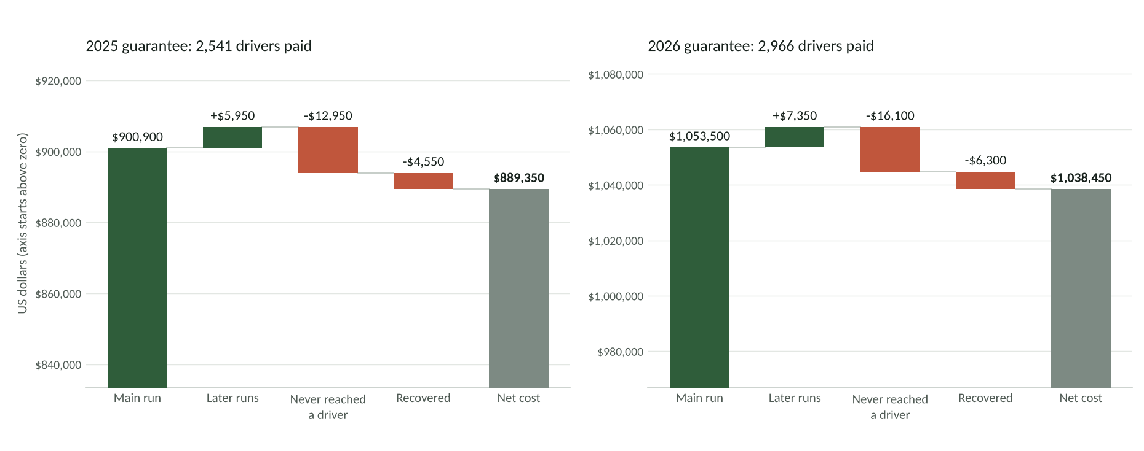
The 2026 guarantee cost $1,038,450 after returns and recoveries
Each guarantee from its main run to its net cost, as Payments Operations books it: returns never paid out again and recoveries booked to the guarantee of the payout they reverse.
Main runs of 14 February 2025 and 13 February 2026, the adjustment runs to June 2026, the bank's ACH return report and the payout events log. Drivers paid: people who kept a payment.
Larch Rides Driver Supply | Winter guarantee 2027 funding | 3 January 2027
2

