Slide 1
Request 35 paid moderator FTE for 2027
9 FTE above finance's 2027 envelope of 26 FTE (27 FTE funded for 2026)
Site | 2027 need (FTE)
Frontend & Web | 5
Mobile Apps | 2
Data & ML | 7
Databases | 5
Infrastructure & DevOps | 5
Game Development | 2
Security | 4
Embedded & Hardware | 3
Scientific Computing | 2
Request | 35
Why the need rises
Every community review item goes to the volunteer reviewers first and reaches the paid team only when no volunteer has reviewed it in 72 hours. A reviewer clears about 40 items a month when the inbox outruns the pool.
Each site's pool loses about 2 per cent of its reviewers a month, and almost no member has been granted review access since late 2024 (2,871 new reviewers in 2024, 70 since).
Data & ML, Databases, Infrastructure & DevOps and Game Development, which have sent the paid team almost nothing since January 2024, run short of reviewers from October 2026. Security, Embedded & Hardware and Scientific Computing are short already; Frontend & Web and Mobile Apps stay covered.
Priced at the 2027 standards (close votes at 2.0 minutes, down from 5.0), the nine sites need 35 FTE.
Need as the council charter defines it (section 4), on the 2027 question plan of 18 September 2026; one FTE is 1,600 hours. Data through 30 September 2026, pulled 8 October 2026. Workings: moderation_pool_2027.xlsx.
Millrind moderation operations | 2027 paid moderation pool request | October 2026
1

Slide 2
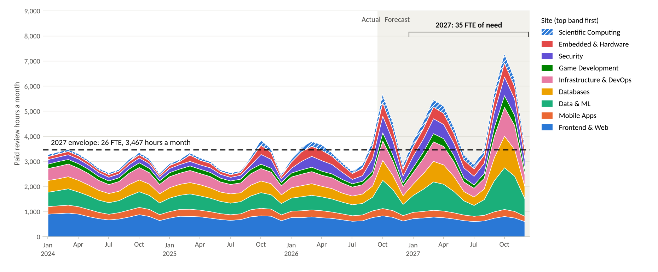
2027 needs 35 FTE of paid review hours against an envelope of 26
Paid review hours a month by site, at the handle-time standards in force (close votes at 2.0 minutes from January 2027, 5.0 before). The rise through 2027 is volunteer cover running out on more sites.
Moderator flags handled and community items reaching the paid team. Actual to September 2026; forecast from October 2026 on the question plan and each site's reviewer pool. Monthly figures: moderation_pool_2027.xlsx, Monthly hours.
Millrind moderation operations | 2027 paid moderation pool request | October 2026
2

