Slide 1
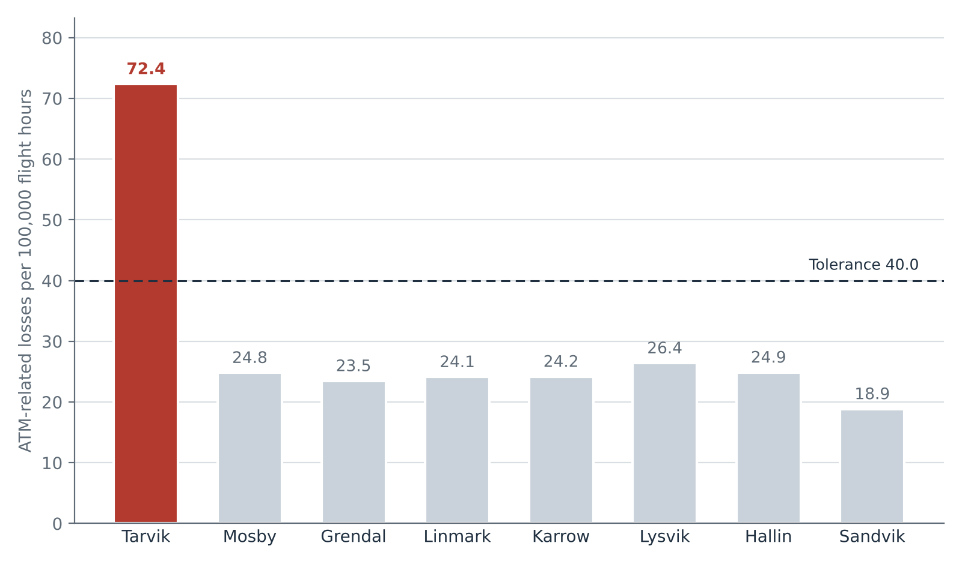
Tarvik will run over the summer 2027 tolerance; no other sector will
Forecast ATM-related losses of separation per 100,000 flight hours, planning traffic issue 1 (9 Oct 2026), against the 40.0 tolerance of HACC-SAF-PLN-03 cl. 4.1
Tarvik 72.4
The new Brekka base sends its departures and arrivals through Tarvik's trunk-airway levels: 48,545 pairs of flights whose levels change order in the planning traffic, against 9,682 in summer 2026, on 16,414 flight hours against 14,957.
Every other sector is at or under 26.4.
Holmvik ACC Safety Office | Unit Safety Review Board, 4 November 2026 | Summer 2027 sector plan | 1

Slide 2
Forecast by sector: only Tarvik is above 40.0
Summer 2027 (1 June to 31 August, local time), planning traffic issue 1; forecast before any measure under cl. 4.2
Sector | Planning flight hours | Pairs changing level order | Forecast ATM-related losses | Forecast rate per 100,000 FH | Tolerance
Tarvik | 16,414 | 48,545 | 11.9 | 72.4 | 40.0
Mosby | 9,633 | 9,768 | 2.4 | 24.8 | 40.0
Grendal | 14,343 | 13,752 | 3.4 | 23.5 | 40.0
Linmark | 10,233 | 10,088 | 2.5 | 24.1 | 40.0
Karrow | 7,136 | 7,049 | 1.7 | 24.2 | 40.0
Lysvik | 14,962 | 16,137 | 3.9 | 26.4 | 40.0
Hallin | 7,183 | 7,299 | 1.8 | 24.9 | 40.0
Sandvik | 10,116 | 7,793 | 1.9 | 18.9 | 40.0
All sectors | 90,021 | 120,431 | 29.5
Forecast losses: 2.45 ATM-related losses per 10,000 pairs (the record since 1 January 2025, all eight sectors) times each sector's pairs in the planning traffic. A pair is two flights in the sector at the same time whose levels change order while both are in it, from entry and exit levels taken as a straight line.
Flight hours: sector entry to exit, every flight of the planning traffic (cl. 3.5).
Holmvik ACC Safety Office | Unit Safety Review Board, 4 November 2026 | Summer 2027 sector plan | 2

Slide 3
Losses follow the pairs whose levels change order, not the hours flown
ATM-related losses of separation (SMI, ATM contribution D or I), 1 January 2025 to 30 September 2026
Sector | ATM-related losses | Flight hours | Pairs changing level order | Losses per 100,000 FH | Losses per 10,000 pairs
Tarvik | 12 | 87,210 | 48,966 | 13.8 | 2.45
Mosby | 12 | 54,763 | 49,331 | 21.9 | 2.43
Grendal | 17 | 81,666 | 68,214 | 20.8 | 2.49
Linmark | 13 | 58,179 | 50,132 | 22.3 | 2.59
Karrow | 10 | 41,261 | 41,094 | 24.2 | 2.43
Lysvik | 17 | 77,829 | 73,504 | 21.8 | 2.31
Hallin | 6 | 39,742 | 24,560 | 15.1 | 2.44
Sandvik | 9 | 57,563 | 36,493 | 15.6 | 2.47
All sectors | 96 | 498,213 | 392,294 | 19.3 | 2.45
Every one of the 96 ATM-related losses was two aircraft in the sector together with one climbing or descending through the other's level. Losses per pair hold between 2.31 and 2.59 in every sector; losses per 100,000 flight hours run from 13.8 to 24.2.
The 10 SMI with no ATM contribution (code N, crew deviations from a correct clearance) are outside the indicator (cl. 3.4). Source: occurrence export and FDPS archive, Data and Analytics extract of 12 October 2026.
Holmvik ACC Safety Office | Unit Safety Review Board, 4 November 2026 | Summer 2027 sector plan | 3

