Slide 1
The 2026 efficiency grant round: which measures to fund
Energy Services for the Committee for Climate and Environment, meeting of 9 July 2026
Fund insulation and heating optimisation in the 2026 round; do not fund heating controls.
Insulation saved 16% of a building's normal-weather gas use in the 2019 pilot and comes to €90 of grant a tonne of CO2 on this year's applications; heating optimisation saved 6% at €90 a tonne. Heating controls saved 2% and would cost €220 a tonne, over the €120 limit.
Once the offer closes on 30 June the funded round should come to about €8 million of grant and 90,000 tonnes of CO2 over the measures' lives (386 funded applications for €3,250,000 were in by 12 June).
The pilot's works saved about 3,500 tonnes of CO2 in the 2025/26 season.

Slide 2
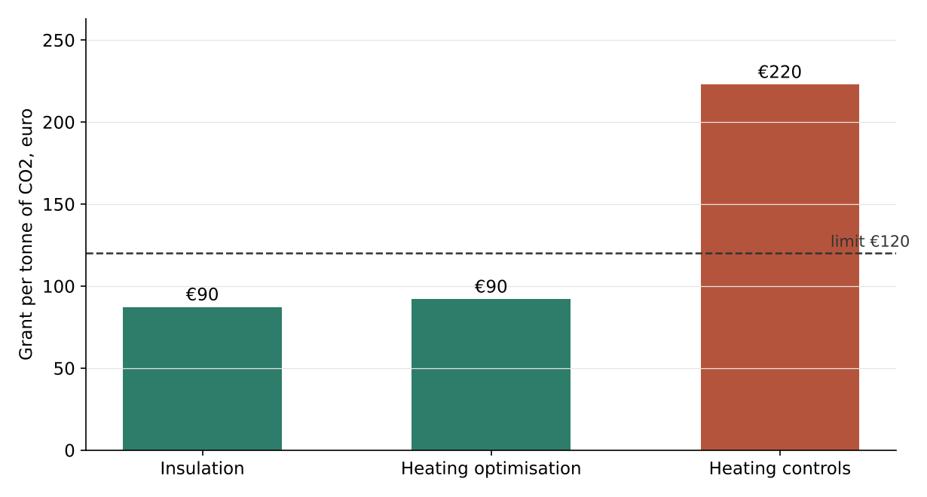
Grant per tonne of CO2 on the 2026 applications
Saving rate from the 2019 pilot; the plan's appraisal
Measure | Saving rate | Grant per tonne | Fund
Insulation | 16% | €90 | yes
Heating optimisation | 6% | €90 | yes
Heating controls | 2% | €220 | no

Slide 3
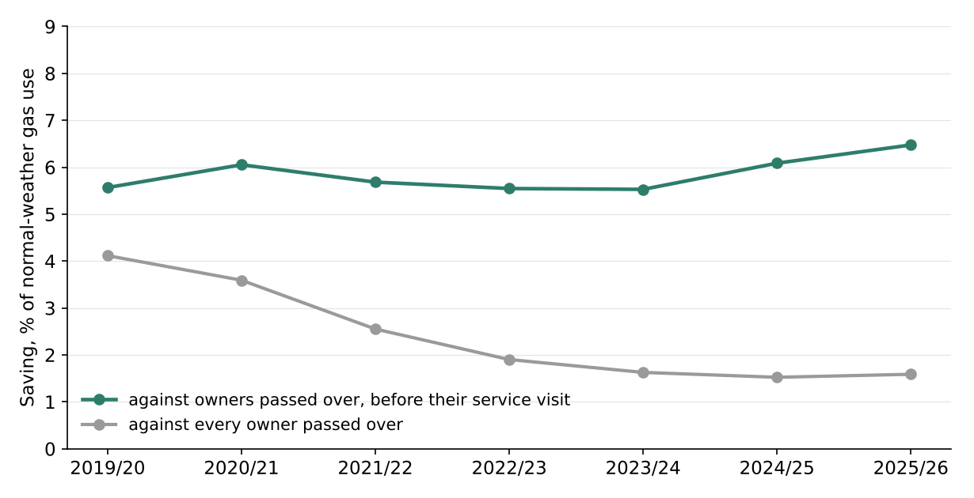
What the pilot's works saved
Heating optimisation, saving by season since the works
The pilot's places were drawn by lot, so the owners the draw passed over show what the works buildings would have used without the works.
From August 2019 most of them had a service visit, district by district (1,056 of 1,535 by April 2026), and no building with pilot works had one. After a visit a building's normal-weather use stays about 7% lower than unvisited buildings'.
Set against every passed-over owner, heating optimisation's saving seems to fade from about 4 points to under 2. Against passed-over owners not yet visited it holds at about 6 points, with no trend.

Slide 4
The 2026 round
Applications received by 12 June; the offer is open to 30 June
Measure | Applications | Grant | Lifetime tonnes | Grant per tonne | Fund
Insulation | 156 | €2,500,000 | 28,580 | €90 | yes
Heating optimisation | 230 | €750,000 | 8,170 | €90 | yes
Heating controls | 484 | €850,000 | 3,800 | €220 | no
Funded, received by 12 June | 386 | €3,250,000 | 36,760
Funded, once the offer closes |  | about €8 million | about 90,000
A response to the offer comes with a contractor's quote, and a quote for insulation needs a survey: in 2019 38% of the insulation responses, 58% of the heating optimisation responses and 80% of the heating controls responses had come in by the same day after the notice. The round once the offer closes scales each funded measure's applications by its own share.
Each funded application is listed with its expected saving and lifetime tonnes in retrofit_round_2026.xlsx.

Slide 5
Basis
Gas use per building and season (1 May to 30 April) from the meter reads, converted to kWh and normalised to long-term average weather as in the benchmarking notices.
Saving rate as the climate action plan's 4.2 sets it: each works building's use as a share of its 2018/19 use, against the average of that share over the owners the draw passed over who had not yet had a service visit, every season from 2019/20 to 2025/26, averaged and taken in whole per cent.
Appraisal as in the climate action plan, section 4.4: the saving rate times each application's reference consumption, 0.201 tonnes of CO2 per MWh, service lives of 30, 15 and 10 years; a measure is funded at €120 of grant a tonne or less.
The round once the offer closes: each funded measure's applications received by 12 June, scaled by the share of the 2019 responses for that measure in by the same day after the notice.
The 2025/26 saving: each measure's rate on what its works buildings would have used that season without the works (their use divided by one less the rate), at the plan's factor.

