Slide 1
Niittylä: 17 battery-electric buses for 2027, the night supply sets the number
Order 17 Lintula L12E buses for the weekday blocks M101, M107, M108, M113, M116, M119, M122, M123, M125, M129, M134, M135, M137, M140, M142, M146, M148.
23 of the 48 weekday blocks stay within the design-day limit of 390 kWh (85 per cent of 459 kWh usable after the first winter); the night period's 690 kW recharges 17 of them, in the plan's priority order; M145, next on the list, does not fit with them.
The remaining blocks stay on diesel until the connection is reinforced (earliest Q4 2028).
Order by 15 January 2027 for delivery in August to September 2027 (quotation 26-0931).
Vehkasalon Liikenne Oy | Niittylä 2027 order | board 21 January 2027 | 1/3

Slide 2
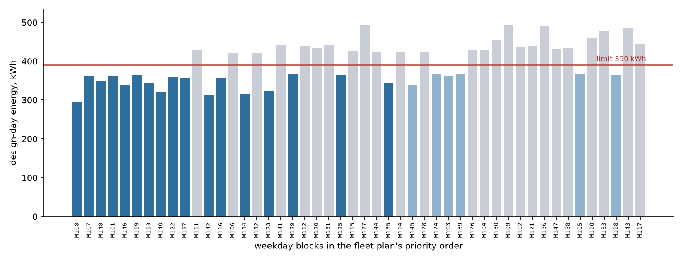
23 of 48 weekday blocks stay under the design-day limit; the night recharges 17
Dark: assigned. Light blue: within the limit but beyond the night's capacity. Grey: over the limit. Energies from the pilot's own records carried to every block by its diesel use, with the heating the 2027 model takes from the battery.
Vehkasalon Liikenne Oy | Niittylä 2027 order | board 21 January 2027 | 2/3

Slide 3
What the figures rest on
Diesel use per block, tank to tank over the dispatch log, 11/2025 to 10/2026: 37.2 to 62.4 l/100 km; the nine pilot blocks average 46.2 against 49.1 for the other 39.
The pilot buses' fuel heaters supplied about 4.3 kW of cabin heat at -15 C; the 2027 model heats electrically, so its design-day energy carries it (12.4 kW of heating in all).
First-winter loss of usable battery on our own buses: 4.3 per cent; usable battery for planning 459 kWh.
Design night: 6.7 MWh at the connection point for the 17 buses (9.1 MWh with all 23 qualifying blocks on charge, against 6.90 MWh in the night period); on a -15 C night each bus also takes about 3.5 kW on charge to keep its battery warm.
Business case: the 17 blocks burn about 294,000 litres of diesel a year.
Vehkasalon Liikenne Oy | Niittylä 2027 order | board 21 January 2027 | 3/3

