Slide 1
Commercial property credit loss: the 2027 plan line
Credit Risk, for the executive committee, February 2027
Plan €2 million of credit loss on commercial property lending in 2027.
The line covers the 2,260 facilities performing at 31 December 2026 (exposure €1.84 billion): each facility's master-scale chance of default times its CRE-LGD-3 loss, as if it defaulted on 1 January 2027.
On the values the property register carries the model gives €0.22 million. Those values are index roll-forwards of old inspections; when a borrower defaults the bank's inspection has come in below them, the more so the longer since the last inspection.

Slide 2
The plan line by lending book
Lending book | 2027 expected credit loss
Investment lending | €1.25 million
Owner-occupied lending | €0.75 million
Commercial property | €2 million
Owner-occupied hotels, pubs, nursing homes and childcare centres lose more of their value when the business behind them fails: at the same distance from the last inspection, their inspection at default has come in about 4 points lower than an investment property's.

Slide 3
The five facilities expected to cost the bank most in 2027
Facility | Lending book | Grade | Exposure | Expected loss
AB322222580 | Investment | 8 | €4,657,000 | €110,067
AB316705961 | Owner-occupied | 8 | €2,258,000 | €57,448
AB321158994 | Owner-occupied | 5 | €9,500,000 | €37,941
AB325355079 | Owner-occupied | 7 | €2,044,000 | €36,941
AB322344238 | Investment | 8 | €1,106,000 | €32,225

Slide 4
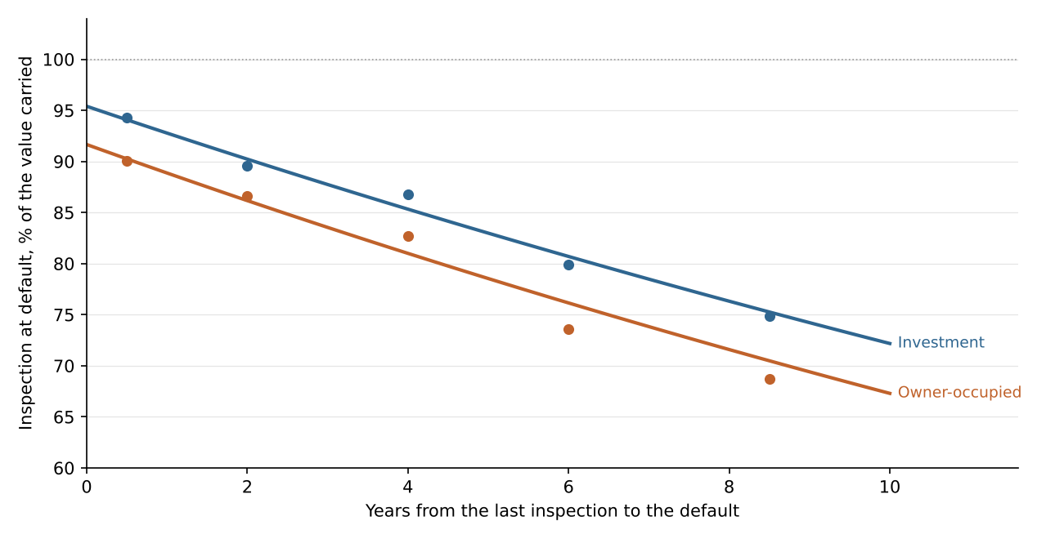
What the bank's own defaults show
Defaults since 2012: the inspection at default against the value carried on the default date
A year after the last inspection, the bank's inspection at default comes in at 93% of the value carried for investment property and 89% for owner-occupied (the fitted line).
Eight years after it, 76% and 72%.
26% of the year-end book's exposure rests on an inspection seven or more years old, against fewer than one in ten of the properties in the record.

Slide 5
Basis
Population: commercial property facilities performing at 31 December 2026; facilities in default and 2027 lending sit in other lines.
Chance of default: the 2025 master scale at each facility's year-end grade.
Exposure: the year-end balance. Loss: CRE-LGD-3, max(0, EAD - (1 - 22%) x V) / EAD, with V the expected value of the security at default, shared between facilities in proportion to exposure.
V: the register's carried value times the expected ratio of the inspection at default to the value carried, by years since the last inspection and lending book, fitted on the defaults since 2012.
Property prices held at their latest published level through 2027.

