Slide 1
PROBLEM STATEMENT:
To gauge the pulse of customers about the bank on social media networks and help business to take corrective actions for better customer experience.

Slide 2
PROJECT DESCRIPTION:
The “SentitteR” is a system to manage Social Media (Twitter in POC) in real time and classify the polarity of the tweets posted by customers on JPMC official twitter page(s) into positive, negative and neutral.
This is the first step for building an in-house chase product “SMAC (Social Media Analytics on Cloud)” which can be a potential replacement to the third party vendor product “Sprinklr”
Sprinklr is a social media management system for the enterprises

Slide 3




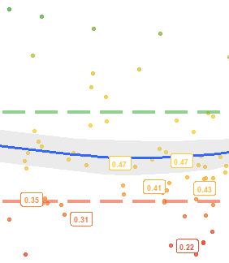

SOLUTION DESIGN:
Keyboard Input
Tweets Retrieval
Data Pre-processing
R API is used to connect to twitter, cleansed the data using R Packages, applied ML algorithms (tf_idf, Lasso) to classify the tweets and present sentiment in graphical representation.
Graphical Representation
Classify Tweets
ML Algorithm

Slide 4
BENEFITS & SAVES:
Integrated platform for interacting with all Social Media Networks
Utilizing the latest Machine Learning Algorithms for better predictability and accuracy
Scalable in terms of new user logins/New social media accounts and most importantly to Cloud
Can be customized as per firm needs with quick turn around time
Low Risk as data will be in-house

