Slide 1
Employee Management Software
User Manual V1.0
By,
Sathya Narayanan Krishnan

Slide 2
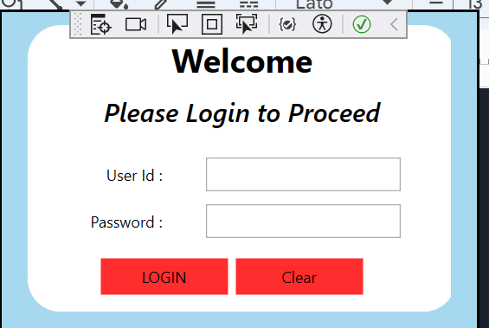
How to run the Project ?
You could unzip the file and will be able to Run the Solution File
User Id : admin
Password : admin

Slide 3
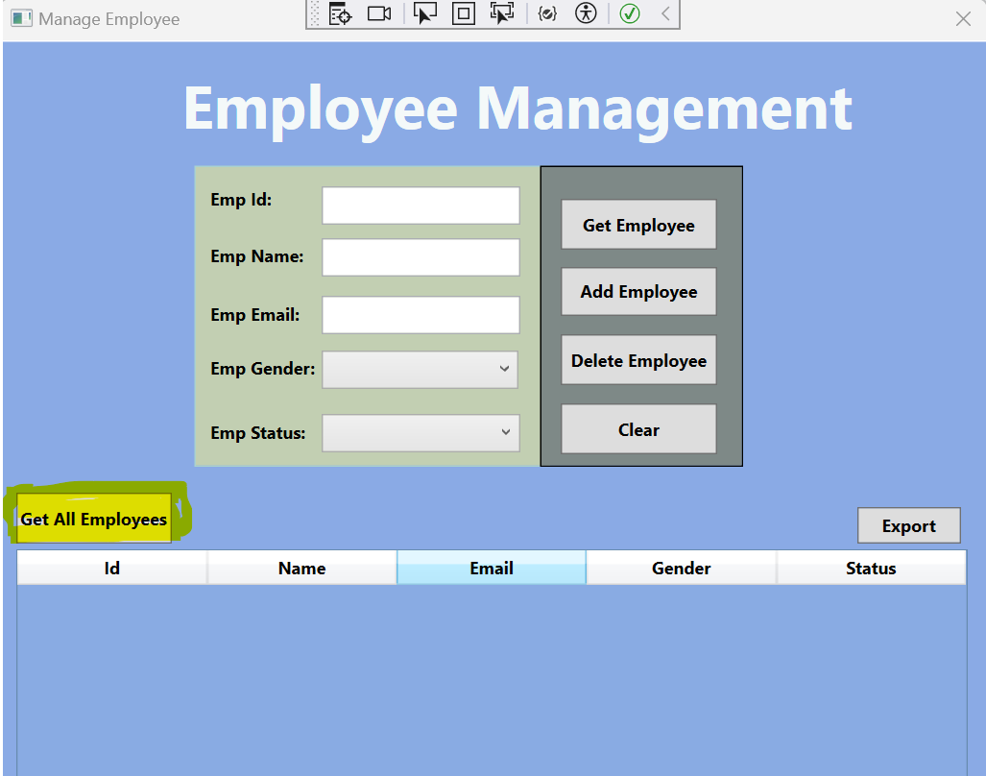
How to get all the details of the Employee ?
Kindly Select on “Get All Employees”

Slide 4
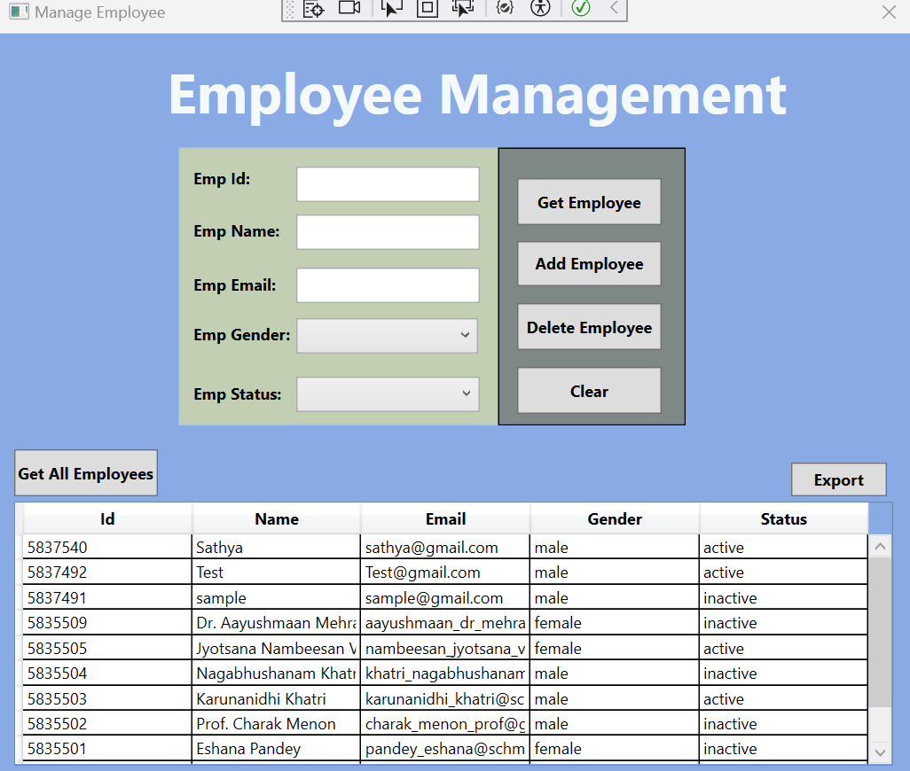
Output of “Get All Employees”

Slide 5
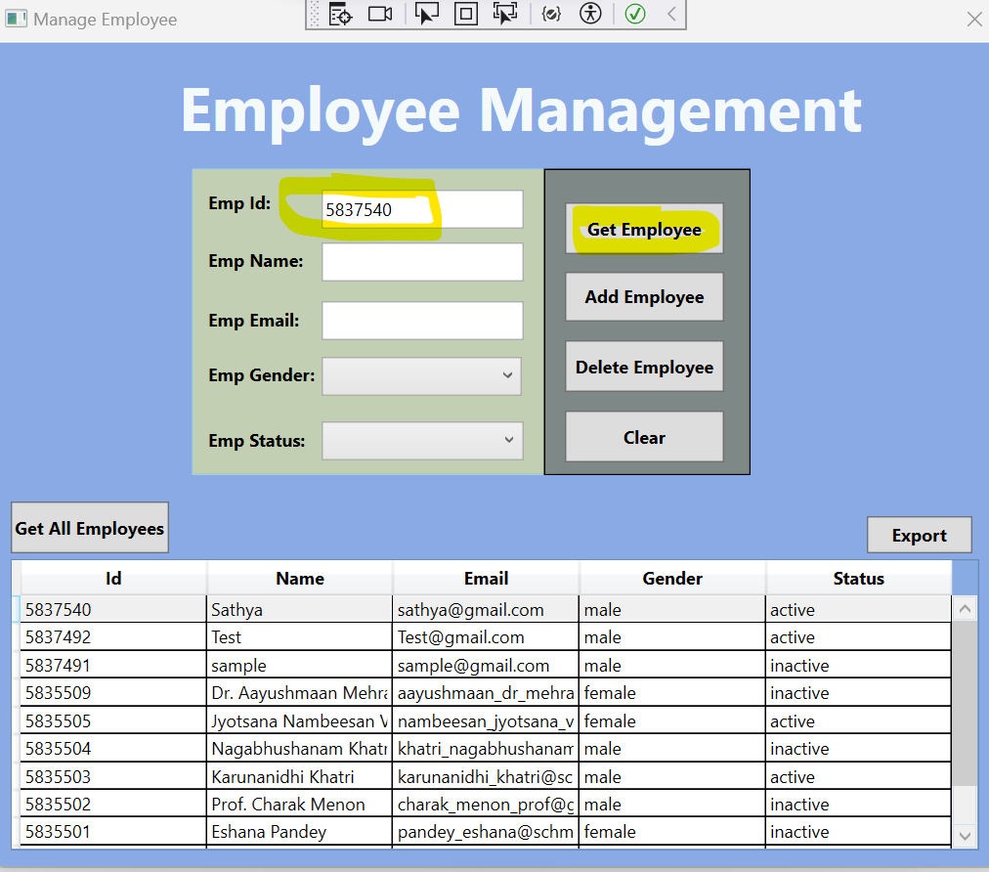
Search Employee by Employee ID,
After giving the input Emp Id , you could click on ”Get Employee”

Slide 6
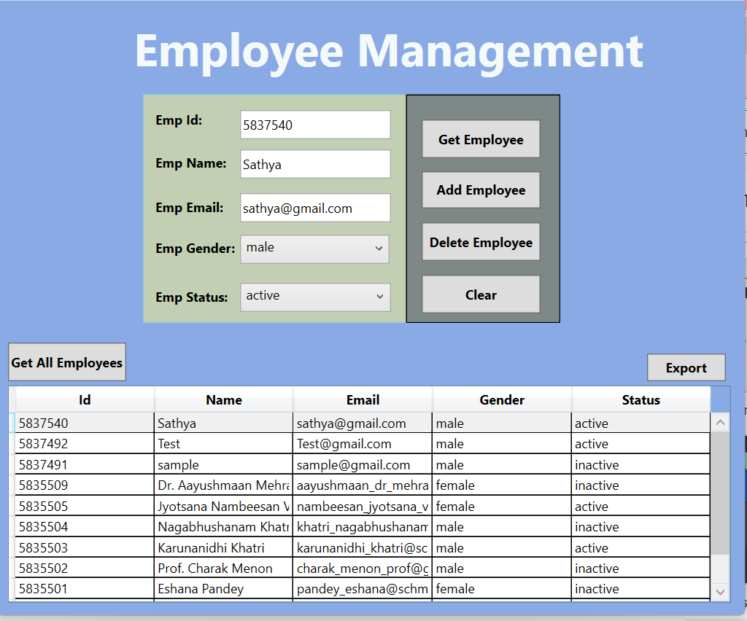
Output of “Get Employee”

Slide 7
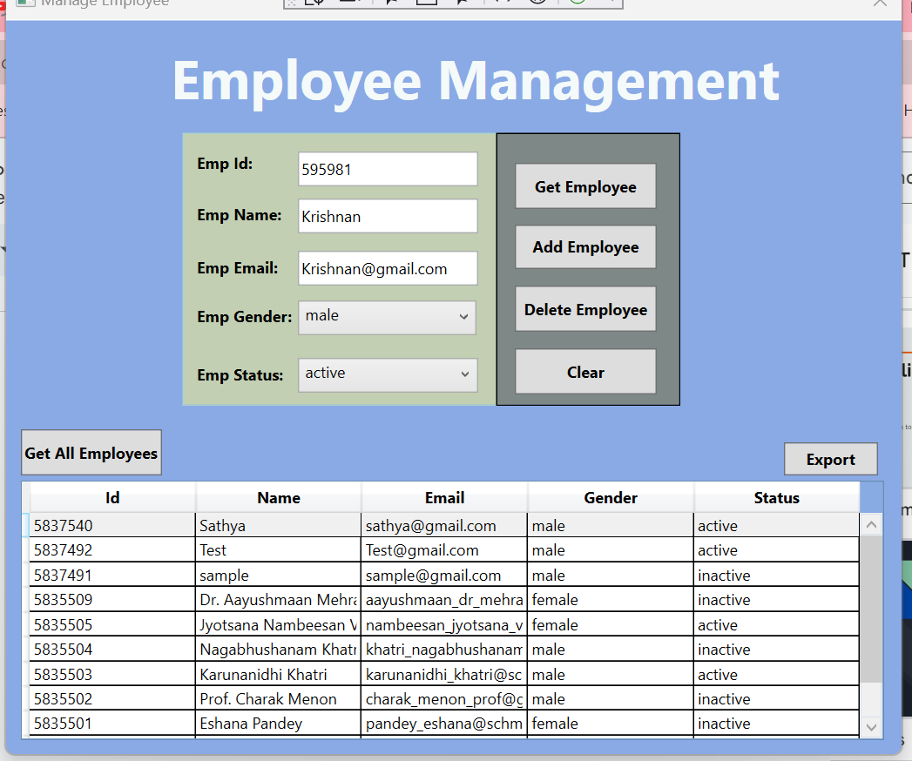
Adding a Employee
Request to fill all the fields and click on “Add Employee”

Slide 8
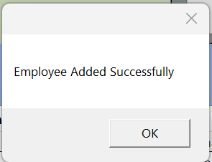
Output of “Add Employee”
It will Pop up,

Slide 9
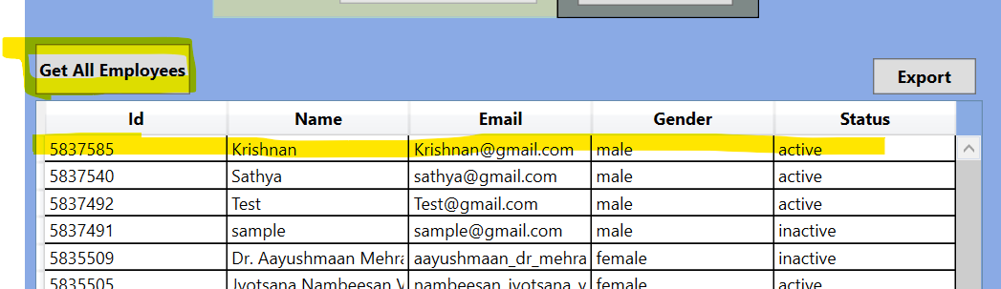
Kindly click on “Get All Employees” to see the updated list of Employee’s

Slide 10
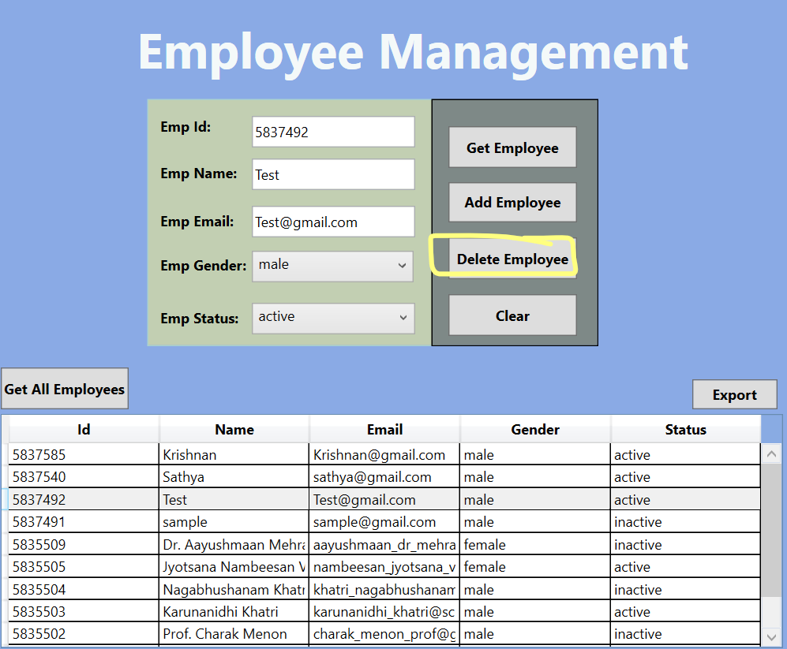
Delete of an Employee
Kindly click on “Delete Employee” to Delete the Employee from the Employee Database

Slide 11
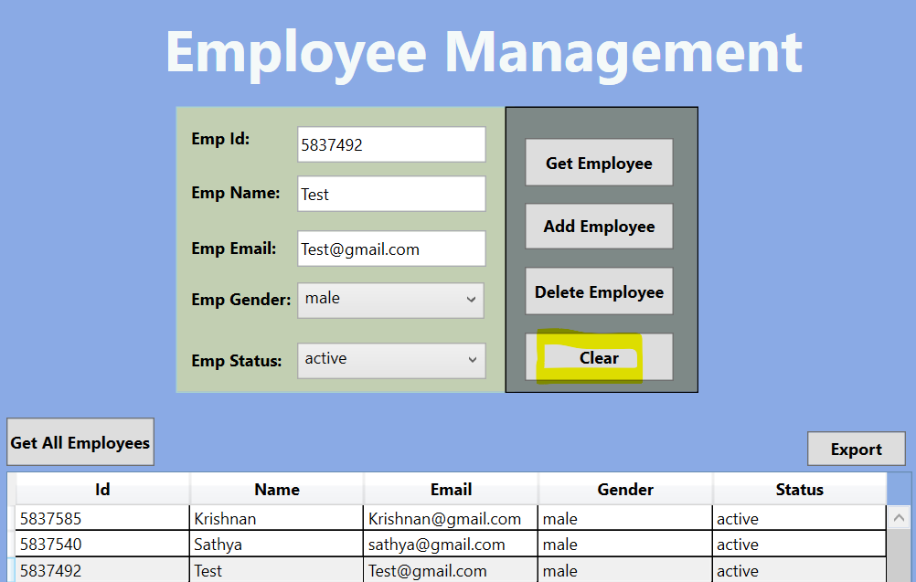
“Clear” - Clear all the Inputs in all the Fields

Slide 12
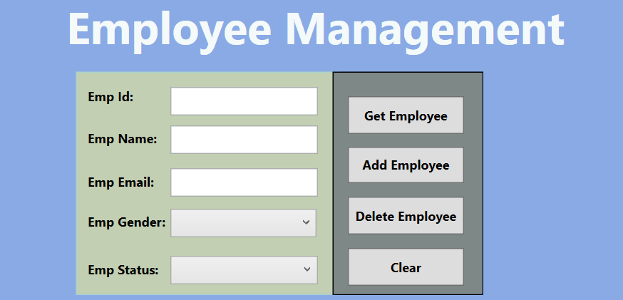
Output of “Clear”,

Slide 13
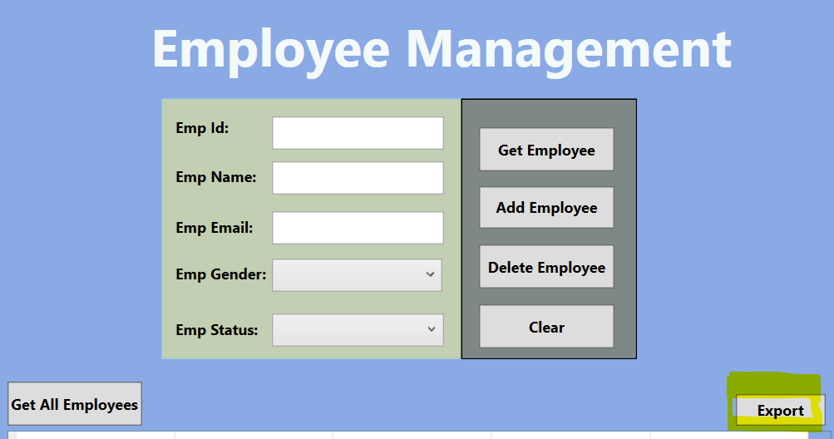
“Export” - Exports all the output to a csv file

Slide 14
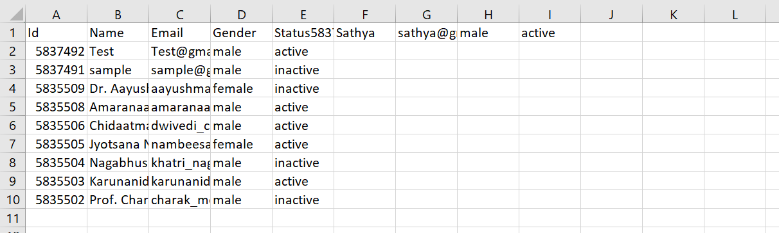
“Export”
Note :
“C:\Downloads” - Please create a Folder “Downloads” in the “C” Drive if it does not exists.

Slide 15
Thank You !

