Slide 1
Classifying the survival of patients with heart failure using Various Machine Learning Algorithms
Presentation On
Department of Information Science and Engineering
Software Engineering
Under the Guidance of
Prof. Umesh K K
Presented by
Sathya Pramod DS

Slide 2
Contents
Introduction
Literature survey
Problem Statement
About Dataset
Design Workflow
Implementation
Result Analysis
Conclusion

Slide 3
Introduction
Heart disease is the Leading cause of death worldwide. Heart failure (HF) occurs when the heart cannot pump enough blood to meet the needs of the body.
The outcomes of this system provide the chances of occurring heart disease in terms of percentage.
Heart disease can be observed over a period of months or years due to several living conditions of patients. Machine Learning has a strong potential in automated diagnosis of various diseases.
Heart disease is very dangerous if not immediately treated on time, and may be fatal

Slide 4
Literature Survey
TITLE OF THE PAPER | AUTHORS | YEAR | DOMAIN | TECHNIQUES/ALGORITHMS USED | INFERENCE/ CONCLUSION
Analysis of data mining techniques for heart disease prediction | Marjia Sultana, Afrin Haider and Mohammad ShorifUddin | 2016 | Data Mining | Pre-processing of these data sets, from high dimensional to low dimension Algorithm: Bayes | An approach proposed in have worked to improved the accuracy and time complexity.
An Analysis on Performance of Decision Tree Algorithms in heart disease | T. M. Lakshmi, A. Martin, R. M. Begum, and V. P. Venkatesan | 2017 | Machine Learning | Decision Tree | Decision accuracy=69%

Slide 5
Literature Survey
TITLE OF THE PAPER | AUTHORS | YEAR | DOMAIN | TECHINIQUES /ALGORITHM | INFERENCE/CONCLUSION
Deep Learning in neural networks: An overview in heart disease | J. Schmidhuber | 2018 | Deep Learning | Multi-layer Perceptron classifier. | Accuracy =64%
Prediction of Heart Disease Using Machine Learning Algorithms | Santhana Krishnan.J, Geetha.S | 2019 | Machine Learning | Decision Tree, KNN, Naive Bayes Algorithm | Accuracy: Decision Tree=68% KNN =78% Naïve Bayes =65%

Slide 6
Literature Survey
TITLE OF THE PAPER | AUTHORS | YEAR | DOMAIN | TECHINIQUES /ALGORITHM | INFERENCE/CONCLUSION
Prediction of risk score for heart disease using associative classification and hybrid feature subset selection | M. A. Jabbar, P. Chandra, and B. L. Deekshatulu | 2016 | Data Mining | Apriori | We employed associative classification to improve the accuracy of classification. Associative classification is fit to application like medical data mining.
Machine learning can predict survival of patients with heart failure from serum creatinine and ejection fraction alone | Davide Chicco & Giuseppe Jurman | 2020 | Machine Learning | KNN, SVM, Random Forest, Decision tree | Accuracy: Decision Tree=64% KNN =78% SVM =65% Random Forest=70%

Slide 7
Problem Statement
Classification survival of patients with heart failure based on various machine learning algorithms like Support Vector machine, Decision Tree, Random Forest and Multi-layer Perceptron classifier.

Slide 8
About Dataset
The Heart failure clinical records dataset consists of 300 instances and 13 attributes collected from UCI machine learning repository.
Attribute Information:age, anemia, high blood pressure , creatinine phosphokinase (CPK) , diabetes , ejection fraction , platelets , sex , serum creatinine , serum sodium , smoking , time , death event .

Slide 9
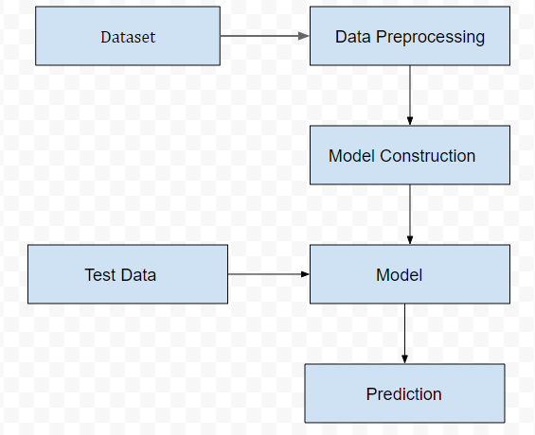
Design Workflow
The purpose of this project is to propose a method for building a model for Survival of heart patients using various machine learning algorithms.

Slide 10
Workflow
In the first step, we collect the data from the repository and categorized the dataset.
Second step we preprocess the data like cleaning the data, handling missing values, converting data using label encoder and transform the data.
Third step model is trained to predict the unseen data. The training model used 80% of the data and 20% is for test model.
In the final step the we predict the accuracy of survival of heart patients.

Slide 11
Implementation
Using 4 machine learning algorithms:
- Decision Tree Classifier
SVM
Random Forest
MLP
Performance of different machine learning models in analysed by using metrics such as:
- Confusion Metric - Recall
- Accuracy - Precision
- F1-score - Support

Slide 12
Result Analysis
The accuracies Obtained for various Machine Learning Algorithms is as follows:
SVM accuracy : 76%
Decision Tree : 75%
Random Forest: 80%
MLP Classifier: 73%

Slide 13
Conclusion
Machine Learning algorithms like support vector machine, Decision Tree, Random Forest, MLP Classifier in neural networks have been used for classification. The comparison of these algorithms has been done based on accuracy which is found through classification report.
For the evaluation, it seems that Random forest has given the highest accuracy .

Slide 14
Thank You

