Slide 1
Machine Learning application and classify the survival of patients with heart failure
Presentation On
Department of Information Science and Engineering
Software Engineering
Under the Guidance of
Dr. Umesh K K
Presented by
Sathya Pramod DS

Slide 2
Contents
Introduction
Problem Statement
About Dataset
Design Workflow
Implementation
Result Analysis
Conclusion

Slide 3
Introduction
Heart failure is the Leading cause of death worldwide. Heart failure (HF) occurs when the heart cannot pump enough blood to meet the needs of the body.
The outcomes of this system provide the chances of occurring heart failure in terms of percentage.
Heart failure can be observed over a period of months or years due to several living conditions of patients. Machine Learning has a strong potential in automated diagnosis of various diseases.
Heart failure is very dangerous if not immediately treated on time, and may be fatal

Slide 4
Problem Statement
Classify survival of patients with heart failure based on various machine learning algorithms like Support Vector machine, Decision Tree, Random Forest and Multi-layer Perceptron classifier.

Slide 5
About Dataset
The Heart failure clinical records dataset consists of 300 instances and 13 attributes collected from UCI machine learning repository.
Attribute Information:age, anemia, high blood pressure , creatinine phosphokinase (CPK) , diabetes , ejection fraction , platelets , sex , serum creatinine , serum sodium , smoking , time , death event .

Slide 6
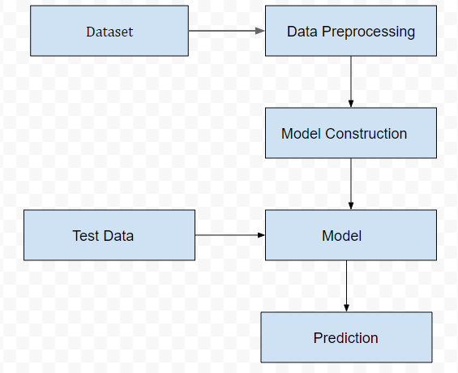
Design
The purpose of this project is to propose a method for building a model for Survival of heart patients using various machine learning algorithms.

Slide 7
Design
In the first step, we collect the data from the repository and categorized the dataset.
Second step we preprocess the data like cleaning the data, handling missing values, converting data using label encoder and transform the data.
Third step model is trained to predict the unseen data. The training model used 80% of the data and 20% is for test model.
In the final step the we predict the accuracy of survival of heart patients.

Slide 8
Implementation
Using 4 algorithms:
- SVM
Decision Tree Classifier
Random Forest
MLP
Performance of different machine learning models in analysed by using metrics such as:
- Confusion Metric - Recall
- Accuracy - Precision
- F1-score - Support

Slide 9
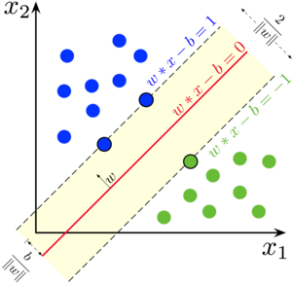
Support Vector Machine

Slide 10
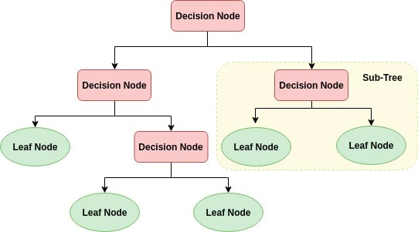
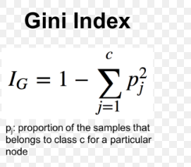
Decision Tree

Slide 11

Random Forest

Slide 12
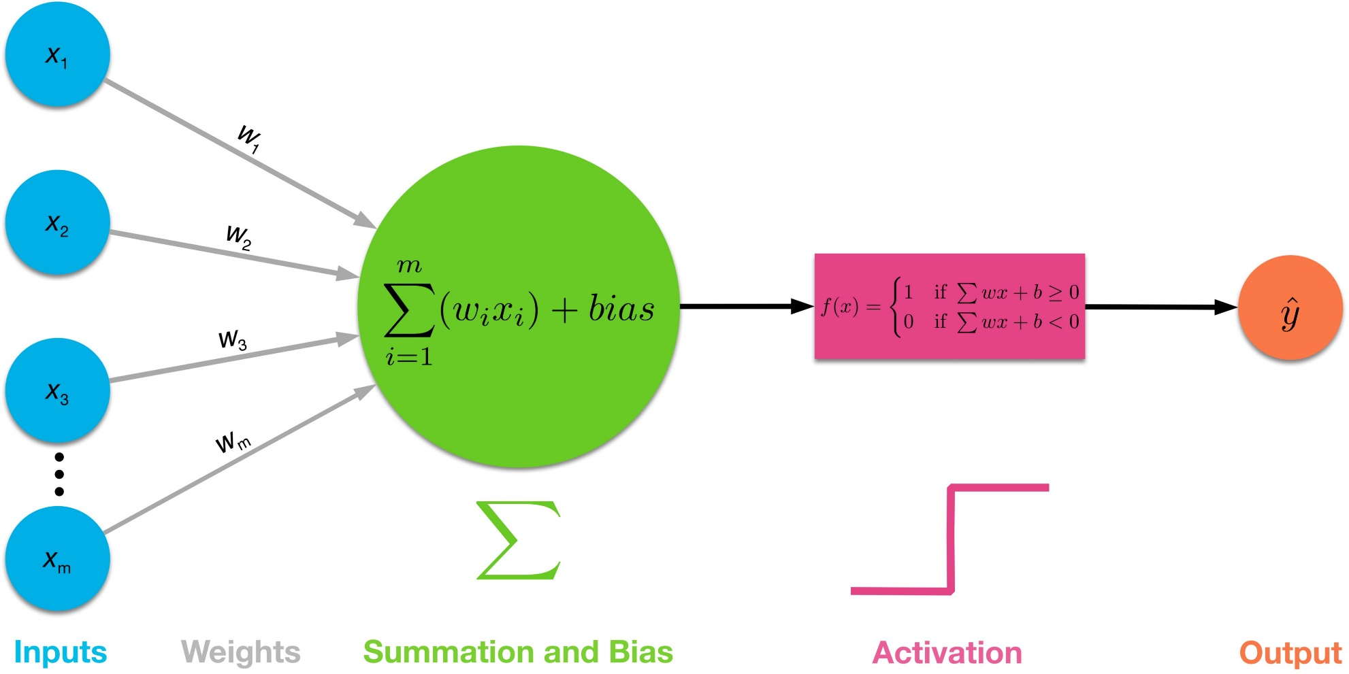
MLP

Slide 13
Result Analysis
The accuracies Obtained for various Machine Learning Algorithms is as follows:
SVM accuracy : 76%
Decision Tree : 75%
Random Forest: 80%
MLP Classifier: 75%

Slide 14
Conclusion
Machine Learning algorithms like support vector machine, Decision Tree, Random Forest, MLP Classifier in neural networks have been used for classification. The comparison of these algorithms has been done based on accuracy which is found through classification report.
For the evaluation, it seems that Random forest has given the highest accuracy .

Slide 15
Thank You

