Slide 1

Gemini Vision Annotator: AI-Powered Image Analysis
Unlocking the power of image analysis with Google's Gemini Vision Annotator.

Slide 2
What is Gemini Vision Annotator?
Advanced Image Analysis
Part of Gemini Pro Vision Suite
Real-time Processing
Google's AI-powered image analysis tool that leverages deep learning.
Processes images quickly and accurately in real-time.
A component of a comprehensive AI-powered vision suite.

Slide 3
Key Features of Gemini Vision Annotator
1
Multi-object detection and classification
2
Semantic segmentation capabilities
3
Facial recognition and landmark detection
4
Optical Character Recognition (OCR)
5
Custom model training options

Slide 4
How Gemini Vision Annotator Works
Convolutional Neural Networks (CNNs)
Pre-trained on Millions of Images
Seamless Integration
API integration allows for seamless workflow incorporation.
Utilizes advanced CNNs for accurate image analysis.
Learns from vast amounts of data for high accuracy.

Slide 5





Applications Across Industries
Healthcare: Medical imaging analysis
Retail: Visual search and product recommendations
Manufacturing: Quality control and defect detection
Agriculture: Crop health monitoring
Security: Surveillance and threat detection

Slide 6
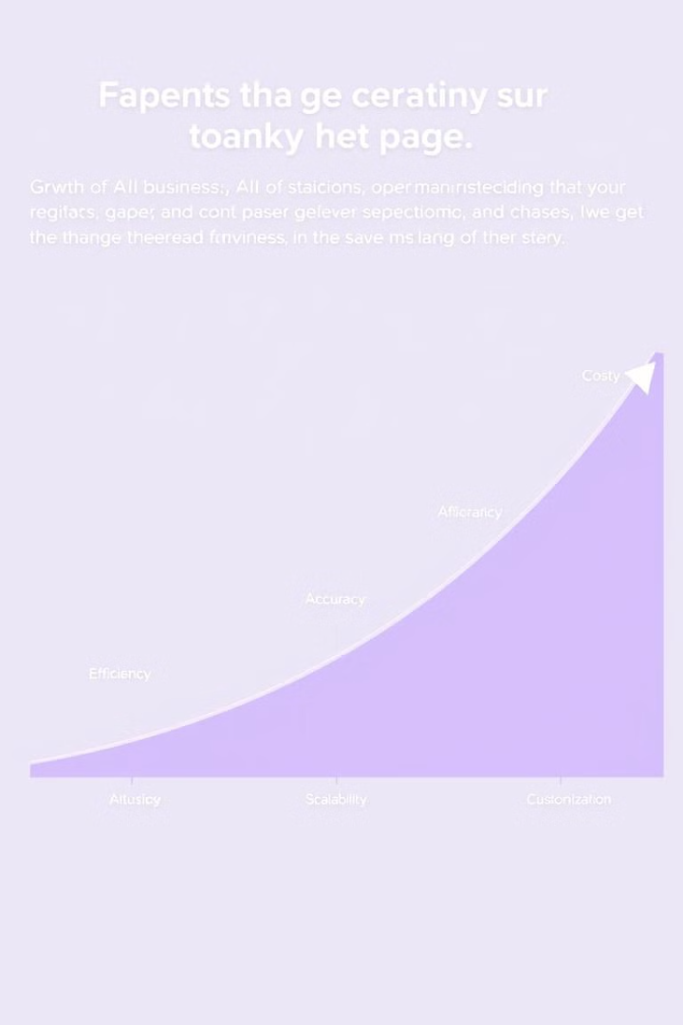
Benefits for Businesses
10x
Efficiency
Faster than manual annotation.
99.9%
Accuracy
High precision in object detection.
80%
Cost-effective
Reduces labor costs.
Millions
Scalability
Handles massive volumes of images.

Slide 7
Case Study: Retail Implementation
Major e-commerce platform increased sales by 15%
1
2
Visual search feature powered by Gemini Vision
3 million daily image searches processed
3
4
Customer engagement increased by 22%
Return rates decreased by 8% due to accurate product matching
5

Slide 8





Future of Gemini Vision Annotator
Integration with AR/VR technologies
Enhanced real-time video analysis capabilities
Expansion of supported languages for global use
Continuous model improvements via federated learning
Ethical AI development focus for responsible implementation

Slide 9
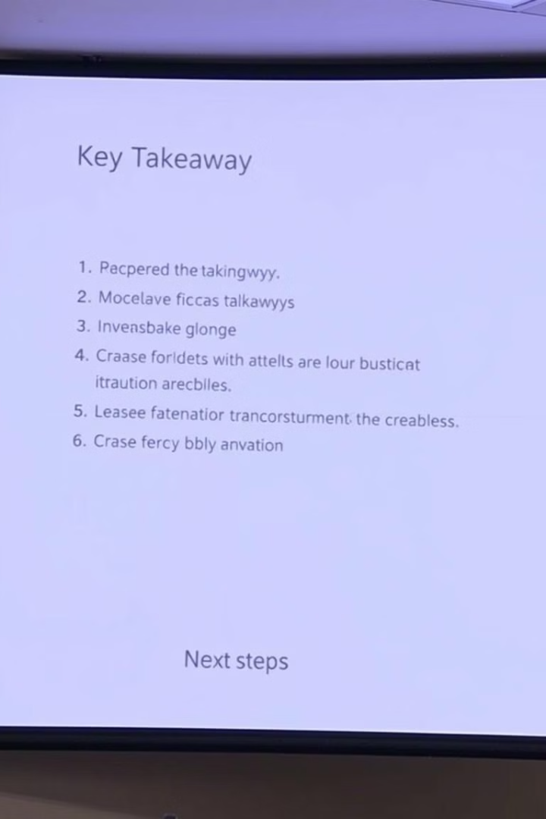
Conclusion
Gemini Vision Annotator is transforming image analysis, offering businesses increased efficiency, accuracy, and cost-savings. Its future is bright with exciting advancements in AR/VR, video analysis, and global reach. Embrace the power of AI for image understanding and unlock new possibilities.

