Slide 1

Contact-Manger
A backend web application that centralizes contact management — store, search, and categorize your professional and personal contacts in one secure place.
NODE.JS
EXPRESS
MONGODB
JWT

Slide 2



Team Members
R. Madhan
S. Swetha
Packages installer
Database organizer
Manages software installations, dependencies, and environment setup to ensure smooth and error-free project execution across systems.
Designs, structures, and maintains databases to ensure data integrity, security, and efficient access for applications.
L. Sathyaraj
LEAD DEVELOPER
Full-stack expert crafting scalable, Leads end-to-end development, ensuring quality, scalability, and seamless team execution.
M. Mahesh
N. Manikandan
Tester
API Execution
Identifies bugs and ensures product quality by conducting thorough testing, improving reliability and user experience.
Develops and manages APIs, ensuring seamless communication between systems and smooth data flow across applications.

Slide 3

Who It's For & What It Does
Target Users
Freelancers, small business owners, students, event organizers, and anyone seeking a privacy-focused contact solution.
Core Objectives
Secure authentication & data isolation
Full CRUD contact operations
Flexible tag-based categorization
Fast search & filtering
Responsive, cross-device experience

Slide 4
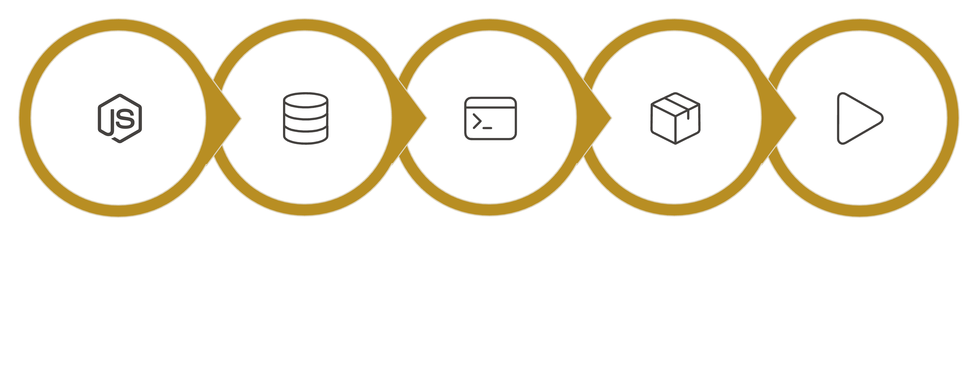
Project Setup — Step by Step
Install Node.js
Install MongoDB
Start dev server
npm init -y
Install deps
After setup, create server.js, add "type": "module" to package.json, then run npm run dev and open http://localhost:5000 to confirm the backend is running.

Slide 5
Prerequisites
Software Requirements
Knowledge Requirements
Software
Purpose
JavaScript ES6+ syntax
Node.js & Express.js for RESTful APIs
MongoDB & Mongoose ODM
JWT authentication & bcrypt hashing
Git version control workflow
Node.js
JavaScript runtime
MongoDB
NoSQL database
npm
Package manager
Git
Version control
VS Code
Code editor

Slide 6

Project Architecture
Three-Tier Backend Structure
Node.js + Express
RESTful API, JWT middleware, MVC pattern, input validation & error handling
MongoDB Database
Document-based NoSQL storage with Mongoose ODM — two collections: Users and Contacts

Slide 7
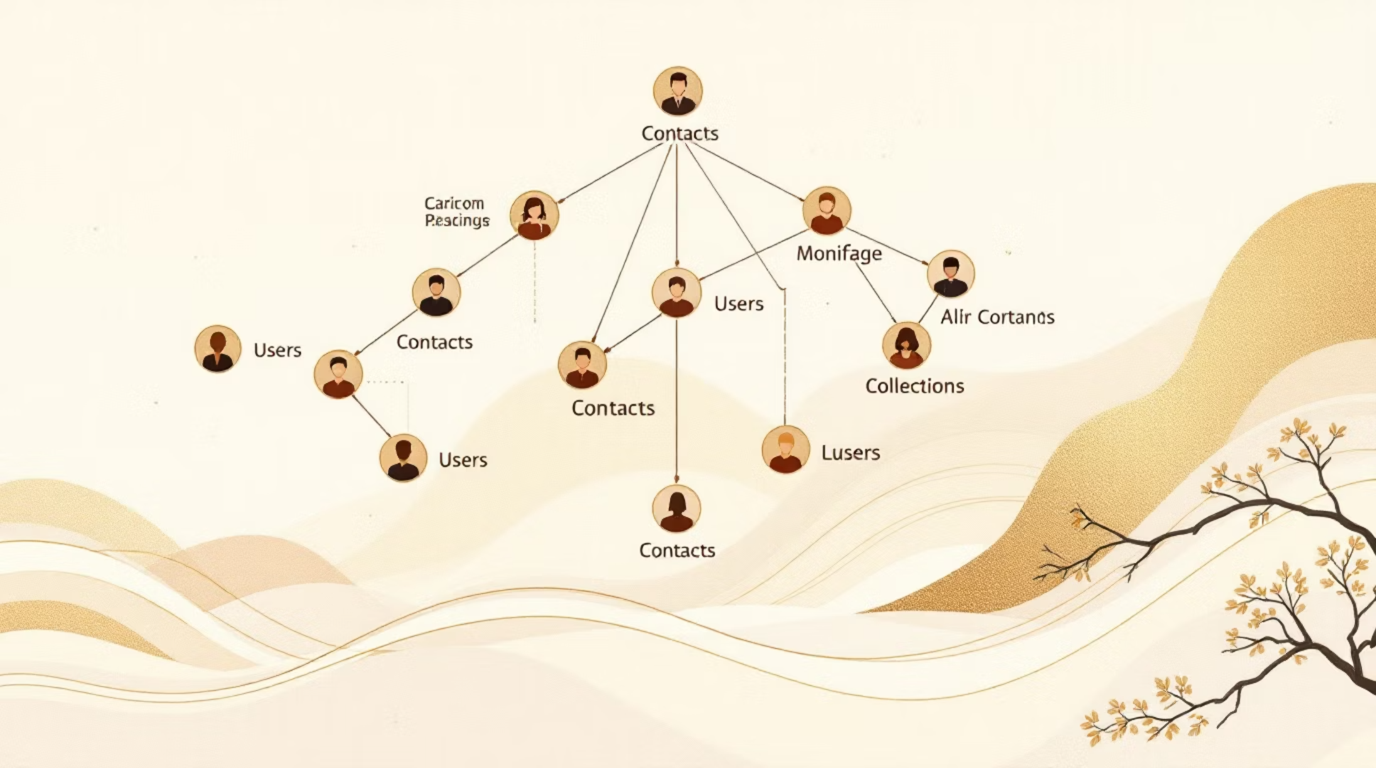
Technical Architecture
Backend Layers
Controllers: Business logic for auth & CRUD
Models: Mongoose schemas for data structure
Routes: API endpoints with HTTP methods
Middleware: JWT verification, error handling, validation
Database Collections
Users: _id, name, email, hashed password, timestamps
Contacts: _id, userId (FK), name, email, phone, notes, tags[], timestamps
Indexes on email, userId, name, and tags for optimized search

Slide 8
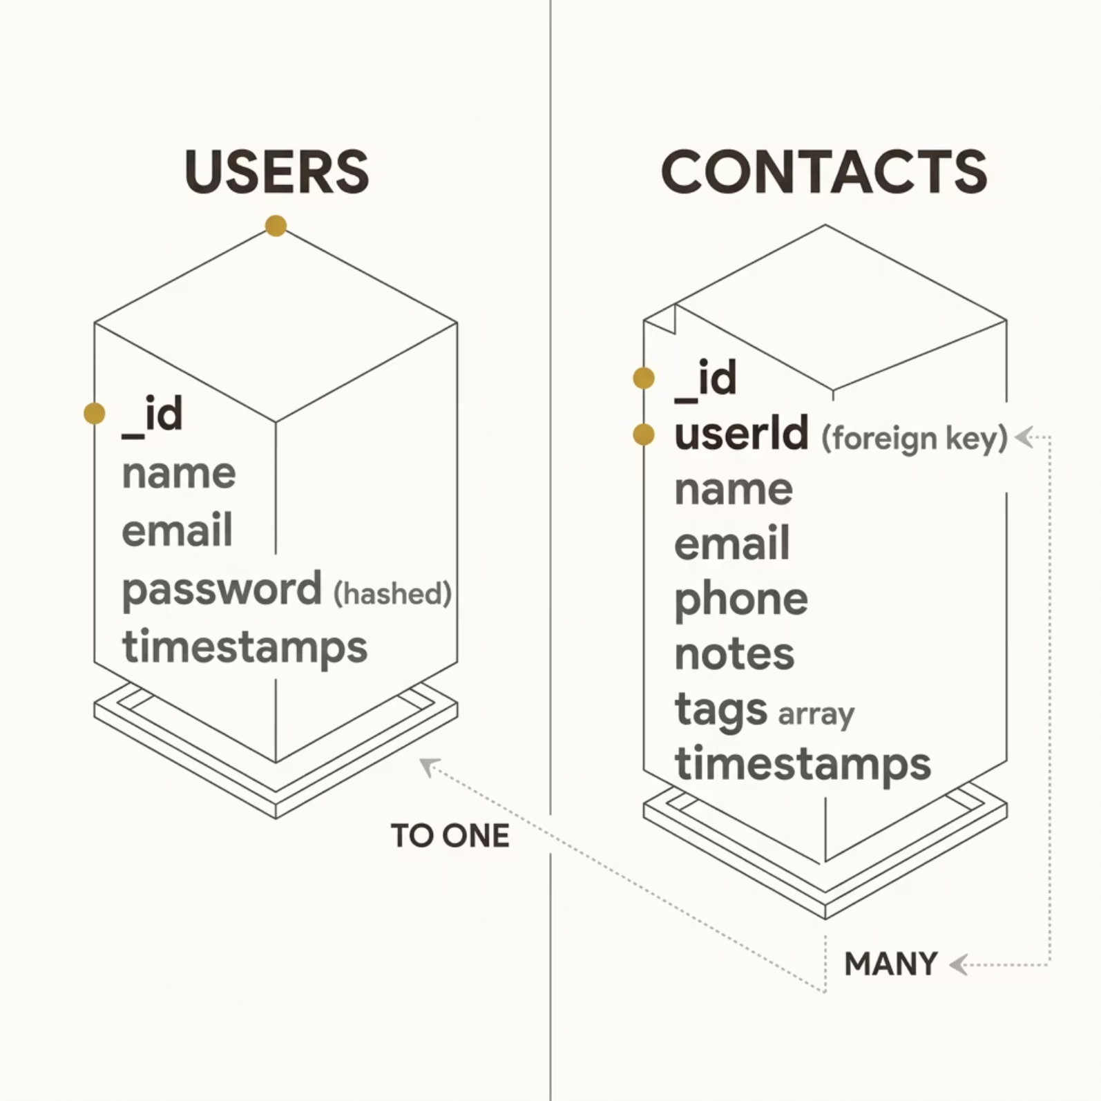

Database Schema
Users Collection
_id, name, email, password (hashed), timestamps
Contacts Collection
_id, userId (FK), name, email, phone, notes, tags[], timestamps
Indexes
email (unique), userId, name, tags

Slide 9
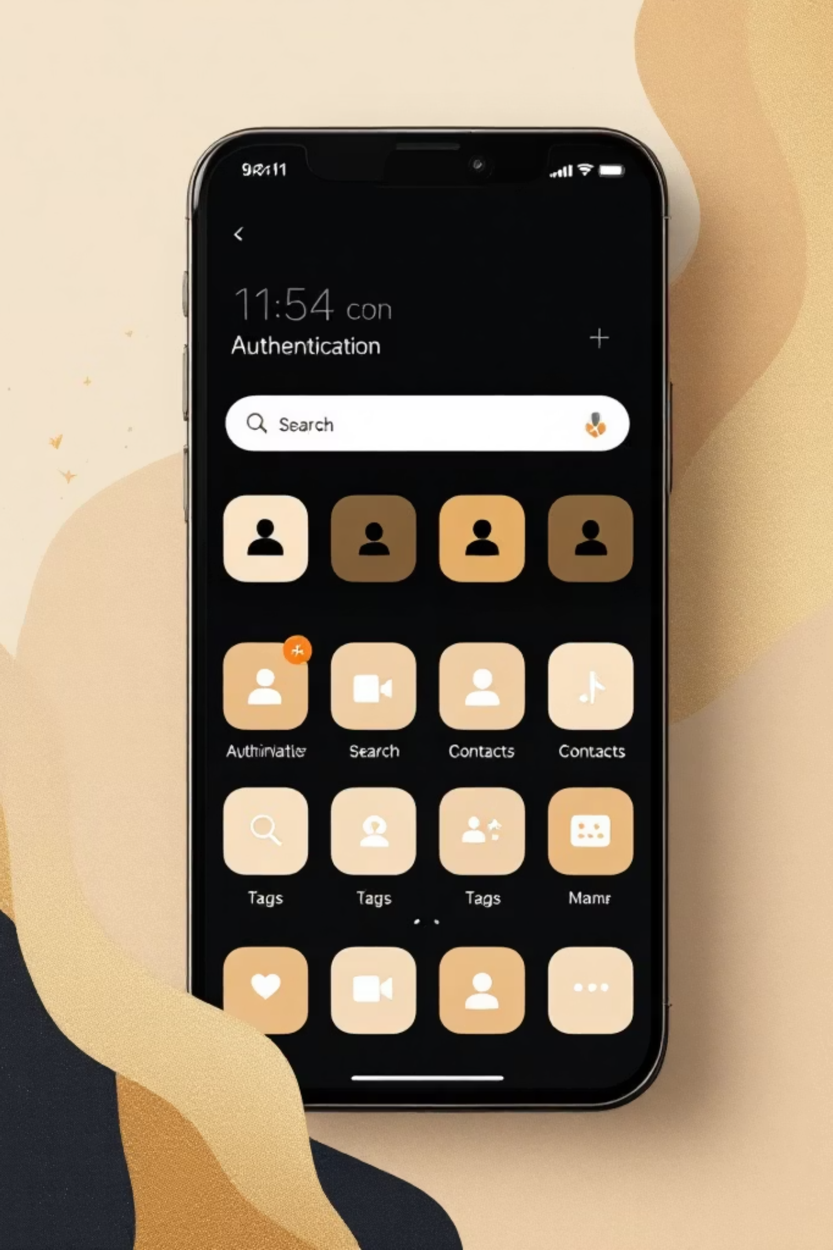
Core Features
User Authentication
JWT-based registration, login, and session management with bcrypt password hashing
Contact CRUD
Create, read, update, and delete contacts with full validation and error handling
Tag Categorization
Organize contacts with multiple tags (Work, Family, Friends) and filter by category
Real-time Search
Debounced search across name, email, and tags with instant results

Slide 10
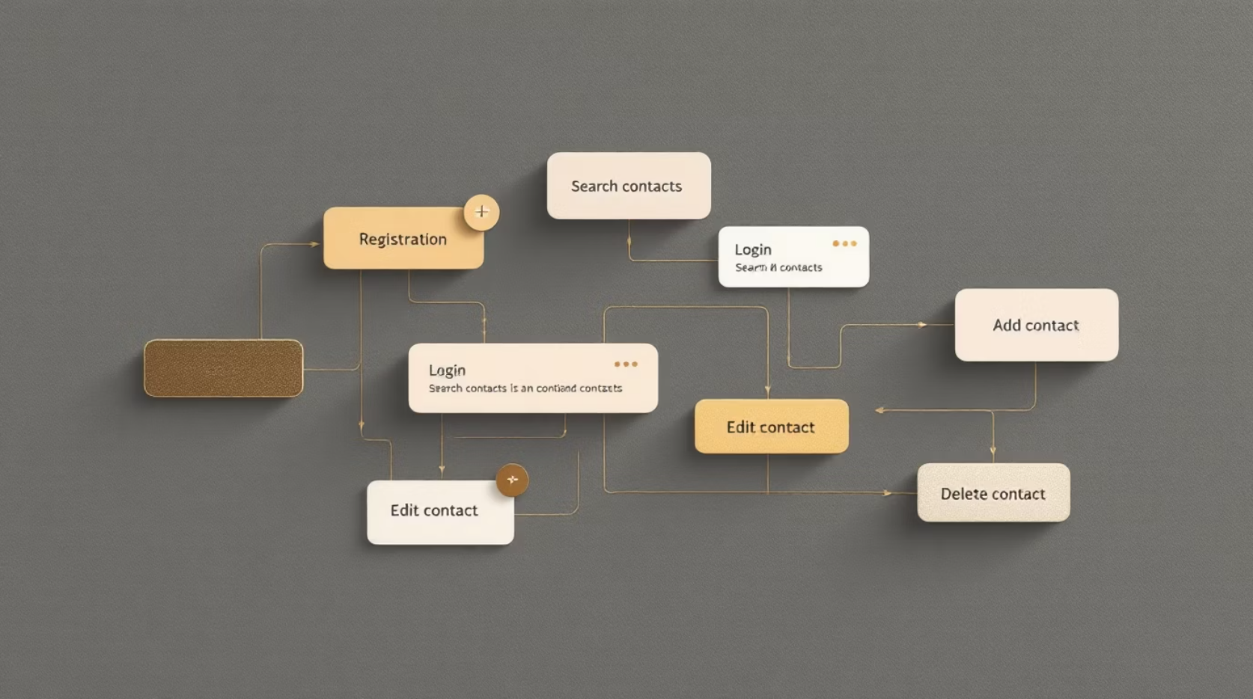
User Flow & Responsibilities
User Actions
01
Register
Sign up with name, email, and password
02
Login
Authenticate with email and password
03
Search
Find contacts by name, email, or tags
04
Add Contact
Store name, email, phone, notes, and tags
05
Edit / Delete
Update or remove any existing contact

Slide 11





Project Setup & Execution
Install Tools
Configure Server
Node.js, MongoDB, Express, Mongoose, Cors
Create index.js, set up .env, configure CORS & body-parser
Build API
Run & Test
Auth routes, CRUD routes, Mongoose schemas & models
npm start → verify PORT & DB messages → test with Postman/Thunder Client
Successful startup shows "Running on PORT" and "Database connected" messages. Use Postman or Thunder Client to test all API endpoints.

Slide 12
API Execution
Register API
Login API
Create Contact
User registration with validation
JWT token returned on success
New contact stored with tags
Update Contact
Delete Contact
Search Contact
Existing record modified
Record removed from DB
Filtered results by name/email/tags
Get Current User
Authenticated user data returned
🎬 Project Demo Video | 💾 Source Code

