Slide 1
Data pipeline for Amazon Customer Review Analysis
Submitted by
Sathya
Data Engineering

Slide 2
Problem Statement
Analyzing customer reviews for Amazon products.
Clean the data
Load it into a remote SQL database (such as AWS RDS, TiDB, or any other online SQL service)
Run various SQL-based analytical queries to derive meaningful insights from the dataset.

Slide 3
Technologies
Python
SQL
Pyspark
AWS(S3,RDS)
PowerBI
Google Colab
GitHub

Slide 4
Task 1: Data Extraction
Created a AWS S3 bucket and the data is stored in Parquet format
Extracted the data using PySpark into a working environment

Slide 5
Task 2: Data Cleaning and Preprocessing
Cleaned the data with following operations:
Remove duplicates.
Handle missing or null values by either dropping or filling them.
Correct data types (e.g., ensuring review_date is in a Date format, star_rating is an integer, etc.).
Standardize fields like product category, marketplace, etc. to avoid inconsistencies.

Slide 6
Task 3: Data Transformation
Converted review_date to a standardized date format (e.g., YYYY-MM-DD).
Normalized the text fields like review_body and review_headline to handle case sensitivity and remove unwanted characters.
Created additional features (e.g., "review_month" from review_date).

Slide 7
Task 4: Load Data into Remote DB
Created a table named “review” with queried columns
Created indexing on product_title, customer_id, review_date
Using SQL INSERT INTO in python with pandas, the cleaned and transformed data was successfully loaded into remote database AWS RDS

Slide 8
Task 5: Analytical Query Setup
Performed the following SQL operations:
The Average Review Ratings Per Month for Each Product
The Total Number of Votes Per Product Category
Products with the Word "Awful" Occurring Most Frequently in Reviews
Same Query for the Word "Awesome" Instead of "Awful“
Find the Most Controversial Reviews
Find Users Who Wrote the Most Reviews
Most Commonly Reviewed Product Per Year
Top 10 Products with the Most Reviews.

Slide 9
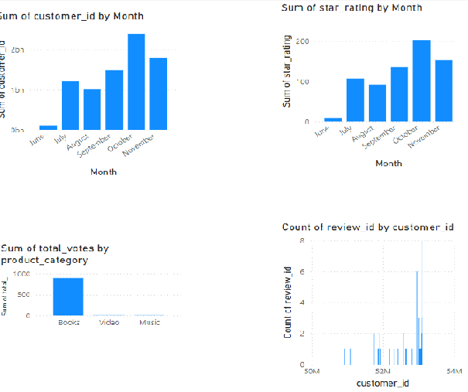
Reporting using PowerBI

Slide 10
Conclusion
Loaded and retrieved the data from AWS S3.
Cleaned and transformed using pyspark.
Loaded the cleaned parquet file to AWS RDS.
Performed required analytical operations using python and mysql queries.

Slide 11
THANK YOU

