Slide 1
Sales and Customer Data Analysis with BI Dashboard
Submitted by
Sathya

Slide 2
Project Overview
This project focuses on analyzing sales and customer data to generate meaningful business insights.
It uses PySpark and Spark SQL for data cleaning, transformation, and analysis, with Google Sheets for dashboard visualization and reporting.
The project also explores predictive sales forecasting using historical monthly sales data to understand potential future revenue trends.

Slide 3
Tech Stack
Python
Pyspark
Pandas
Spark SQL
Google Colab
gspread
Google Sheet
GitHub

Slide 4
Dataset
1. Sales Dataset
data_analytics_sales_dataset.
Contains sales-related information used for:
Calculating total sales
Product performance
Regional sales comparison
Expense and profit analysis
Payment mode analysis
Monthly sales forecasting

Slide 5
Dataset
2. Customer Dataset
  customer_analytics_dataset
Contains customer-related information used for:
Customer segmentation
Age-group spending analysis
Customer feedback analysis
Spending behavior
Membership analysis

Slide 6
Project Workflow
Load sales and customer datasets to Google Colab
Converting the source data to CSV
Clean and Transform data using PySpark.
Perform aggregations and analysis using Spark SQL.
Calculate sales, profit, and customer metrics.
Analyze historical monthly sales patterns.
Prepare data for predictive sales forecasting.
Export analysis results to Google Sheets.
Build KPI cards, charts, and interactive dashboard filters.
Present business insights through visual reports.

Slide 7
Results
Level 1 Dashboard
https://docs.google.com/spreadsheets/d/1Z5EnKKsHJeMpmVvw3ebRcw4pNdHDTQpeHMy-eONTplY/edit?usp=sharing
Level 2 Dashboard
https://docs.google.com/spreadsheets/d/1yGEBeOzExrOVdW1cYnWclaBbXy5fmlHD-sThrDJbBxs/edit?usp=sharing
Level 3 Dashboard
https://docs.google.com/spreadsheets/d/1mpcMjWRf3IMQX8g-cJNQGComYNXwe46RDVsOXti76jc/edit?usp=sharing
Github
https://github.com/sathyarsk/Sales_Data_Analytics_With_BI_Dashboard

Slide 8
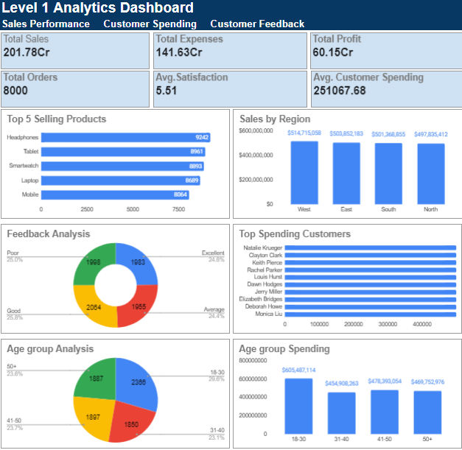
Level 1 Analytics Dashboard

Slide 9
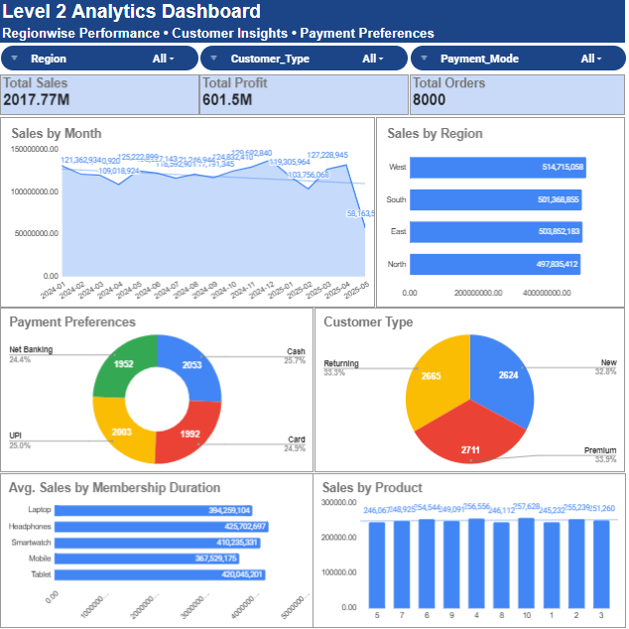
Level 2 Analytics Dashboard

Slide 10
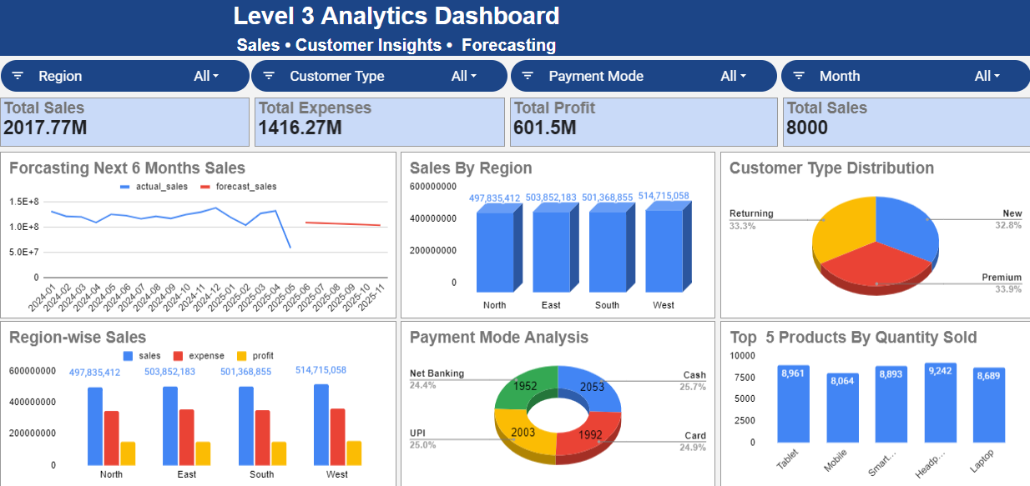
Level 3 Analytics Dashboard

Slide 11
Conclusion
Successfully analyzed sales and customer datasets using PySpark and Spark SQL.
Developed key business metrics to monitor sales, profit, and order performance.
Identified customer spending patterns, regional sales trends, product performance, and payment preferences.
Built a Google Sheets dashboard with KPI cards, charts, and interactive filters.
Explored predictive sales forecasting to understand potential future revenue trends.

Slide 12
THANK YOU

