Slide 1
Quitq
Fullstack E-Commerce application

Slide 2
Quitq
Quitq is a comprehensive application designed to facilitate e-commerce transactions between buyers and sellers.

Slide 3
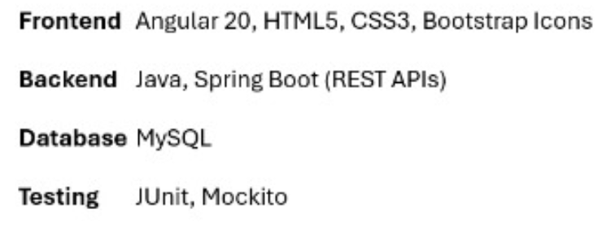
Quitq

Slide 4

Quitq
User
Seller
Admin

Slide 5
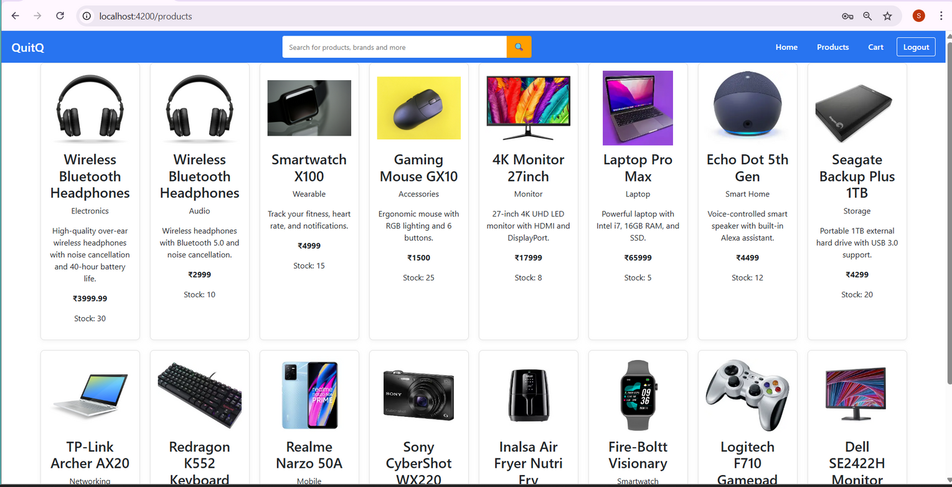
Glimpse of Quitq Frontend

Slide 6
Quitq
User - In quitq user can register , login , buy products, add them to cart, browse products , view their order history
Seller- seller can add products and edit products and also view the details of the product
Admin- Admin can manage users and sellers , manage in the sense he/she is able to delete users and sellers

Slide 7
Quitq
THANK YOU

