Slide 1
Algorithms

Slide 2
Basic Terminology
Data
represents an atomic value or collection of facts that could lead to contextual information .
e.g. a unit value 40 or a collection such as [(35, 19), (35, 18), (30, 18), (29, 18), (29, 17)] doesn't make sense in isolation but are referred to as data nonetheless.
It's only when we associate respective contexts like the price of apples per kg. or 5-day temperature forecast, do we harness information out of the raw data.

Slide 3
Database
Database
an organized record of data so as to use it efficiently, nevertheless usually stored in hard disk or permanent memory as opposed to data structures being stored usually in RAM or volatile memory.

Slide 4
Algorithms
is a step-by-step set of instructions for doing stuff such as making an omelet, playing rugby, checking primes, and reading this article. From washing machines to self-driving cars to every deterministic action ever taken can be expressed as algorithms.

Slide 5
Asymptotic Complexity
determines how fast an algorithm can compute (with respect to input) when applied over a data structure.

Slide 6
Types of DataStructures
Data structure are associated with array or a linked list.
There are two types of Data Structures
The primitive Data Structures
Non-primitive Data Structures

Slide 7
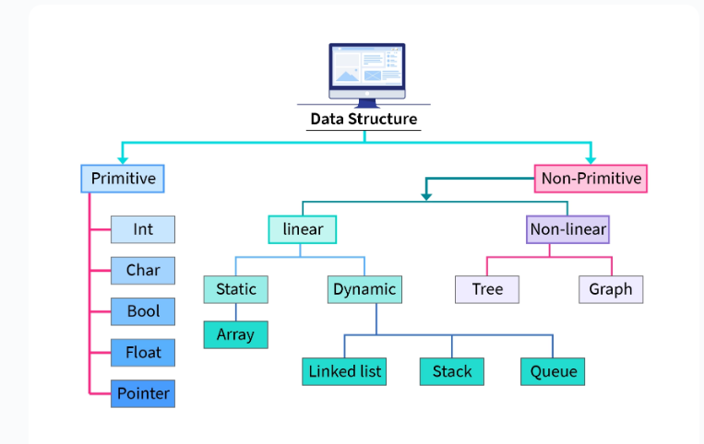

Slide 8
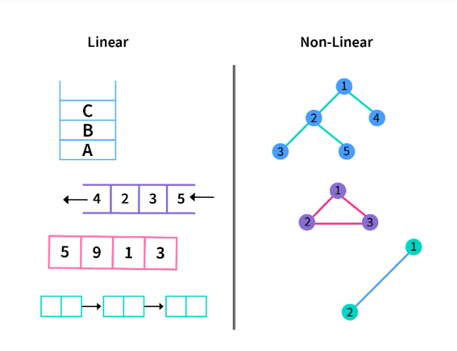
Non-Primitive Data Structures

Slide 9
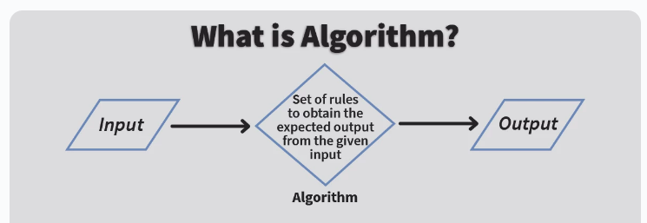
Algorithm
An algorithm is defined as a set of rules or a step-by-step procedure that are to be executed in a specific order to get the desired output.

Slide 10
Algorithm is a finite set of steps carried out in a spaecific time for specific problem-solving operations. Especially by a computer.
Algorithms are independent of programming languages and are usually represented by using flowcharts or pseudocode.
Note: Pseudocode is nothing but the description of the logic or the code in plain, simple language.

Slide 11
Characteristics of Algorithm
Unambiguous
Input
Output
Finiteness
Effectiveness
1.Time Complexity
2. Space Complexity
Language Indipendent

Slide 12
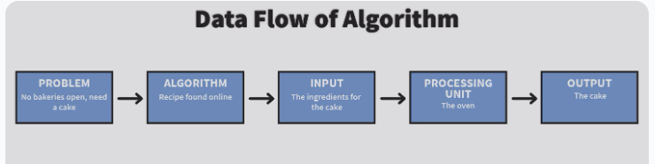
Data flow of an Algorithm
Problem- The problem can be any real world or a programmable problem. The problem statement usually gives the programmer an idea of the issue at hand, the available resources and the motivation to come with a plan to solve it
Algorithm- After analysing the problem, the programmer designs the step by step procedure to solve the problem efficiently. This procedure is the algorithm
Input- The algorithm is designed and the relevant inputs are supplied
Processing Unit- The processing unit receives these inputs and processes them as per the designed algorithm
Output- Finally, after the processing is complete, we receive the favourable output of our problem statement

Slide 13
Why do we need Algorithms
Scalability– When we have big real-world problems, we cannot tackle them on the macro level. We need to break them down into smaller steps so that the problem can be analyzed easily. Thus, algorithms facilitate scalability
Performance– It is never easy to break down big problems into smaller modules. But algorithms help us achieve this. They help us make the problem feasible and provide efficient performance driven solutions

Slide 14
How to write algorithm
Example 1: Design an algorithm to accept three numbers and print their sum.
Step 1-START
Step 2- Declare variables x,y,z and sum
Step 3- Read the value of x,y and z
Step 4- Add x,y and z
Step 5-Store the output of Step 4 in sum
Step 6-Print sum
Step 7- STOP

Slide 15
Example 2: Design an algorithm to find the factorial of a number and print it.
Step 1-START
Step 2- Declare variables fact, num and i
Step 3- Initialize variables as: fact->1 and i->1
Step 4- Read the value of num
Step 5-Repeat the steps until num=i
5.1- fact->fact*i
5.2- i->i+1
Step 6- Print fact
Step 7- STOP

Slide 16
Time Complexity
What is Time Complexity?
Time complexity can be defined as the amount of time taken by an algorithm to execute each statement of code of an algorithm till its completion with respect to the function of the length of the input

Slide 17
Asymptotic Notations
Big O(expression): The Big-O notation is used to define if the set of functions is going to grow slower than or at the same rate with respect to the expression. This is how we define the worst case of an algorithm's time complexity. This also elaborates on the the maximum amount of time required by an algorithm considering all input values.
Omega(expression) The Omega notation is used to define if the set of functions is going to grow faster than or at the same rate with respect to the expression. This is how we define the best case of an algorithm's time complexity. This also elaborates on the the minimum amount of time required by an algorithm considering all input values.
Theta(expression) The Theta notation is used to define consist if the set of functions is going to lie in both O(expression) and Omega(expression). This is how we define the average case of an algorithm's time complexity. This also elaborates average bound of an algorithm.

Slide 18
import java.io.*;
class Main{
public static void main(String[] args)
{
System.out.print("Hello World");
}
}

Slide 19
class Test{
public static void main(String[] args)
{
int i, n = 8;
for (i = 1; i <= n; i++) {
System.out.printf("Hello World !!!\n");
}
}
}

Slide 20
Exampme 1
int sum(int a[ ], int n) // n is the size of array a
{
int x=0; // x takes 4 bits as integer variable
for (int i=0; i<n; i++) //i takes 4 bits as integer variable { x=x+a[i]; } return x;
}

