Slide 1
MATERIAL UI

Slide 2
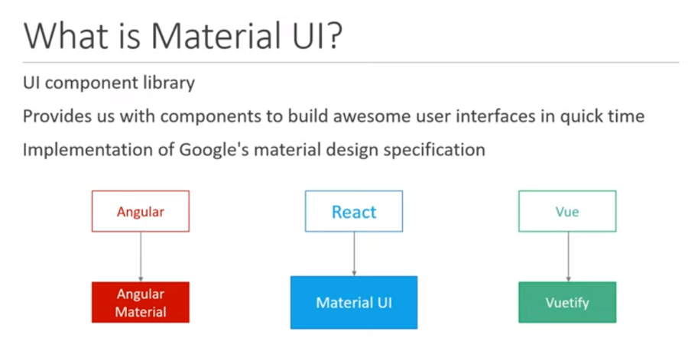
INTRO

Slide 3
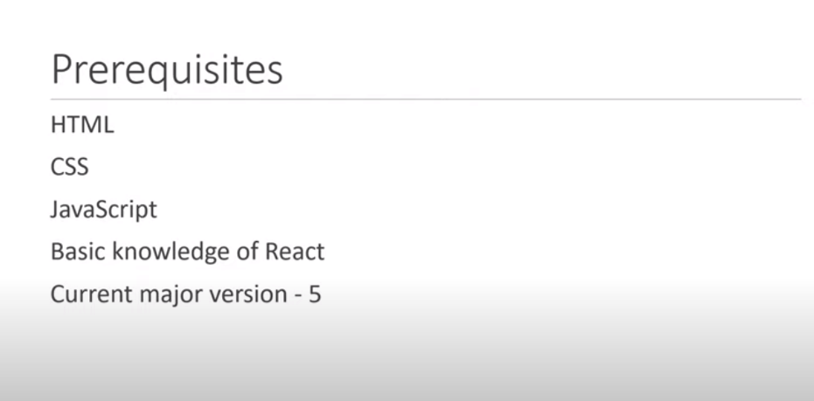
prequisites

Slide 4
Advantages of UI
Beautiful by default
Ship faster
Customizability
Cross-team collaboration
Trusted by thousands of organizations

Slide 5
Material UI Vs Material Base
Material UI and MUI Base feature many of the same UI components, but MUI Base comes without any default styles or styling solutions.
Material UI is comprehensive in that it comes packaged with default styles, and is optimized to work with Emotion (or styled-components).
MUI Base, by contrast, could be considered the "skeletal" or "headless" counterpart to Material UI—in fact, Material UI v6 will use MUI Base components and hooks for its foundational structure.

Slide 6
Installation
npm
npm install @mui/material @emotion/react @emotion/styled
With styled-components
npm
npm install @mui/material @mui/styled-engine-sc styled-components

