Slide 1
Props, states, list, keys,events
Components

Slide 2
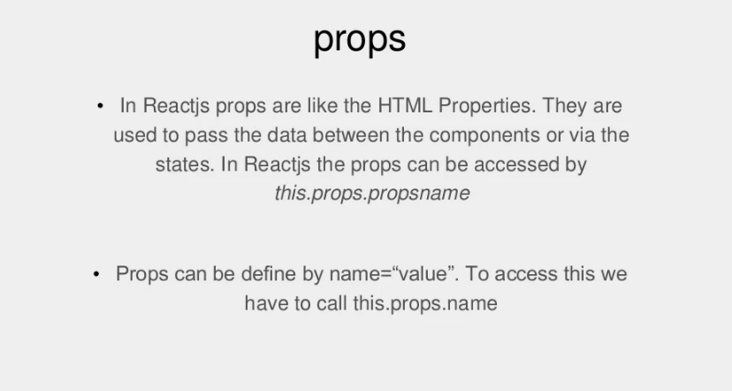
props

Slide 3
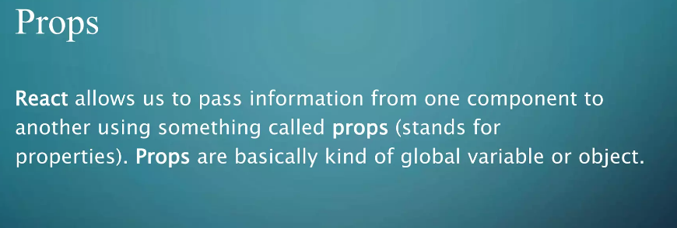
Syntax:
<Component name = "HelloProp" />

Slide 4
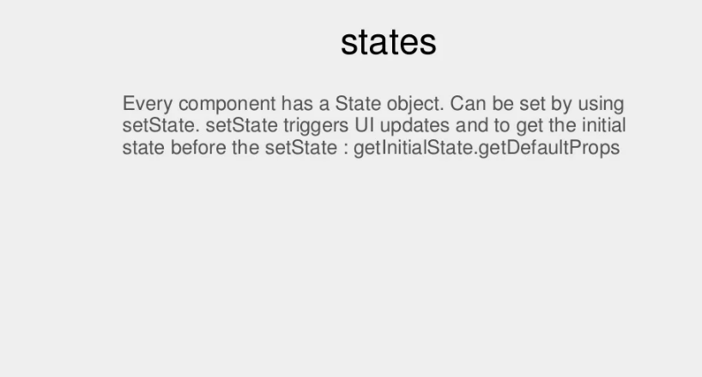
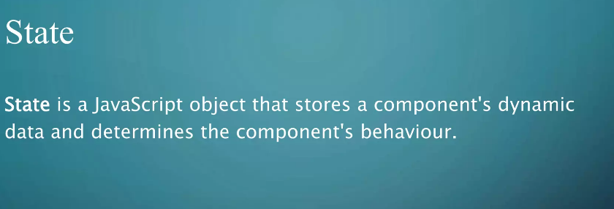
states

Slide 5
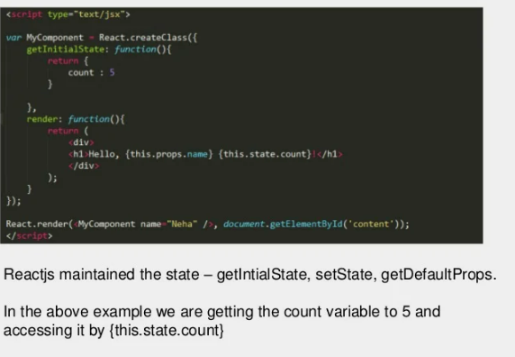
Ex:

Slide 6
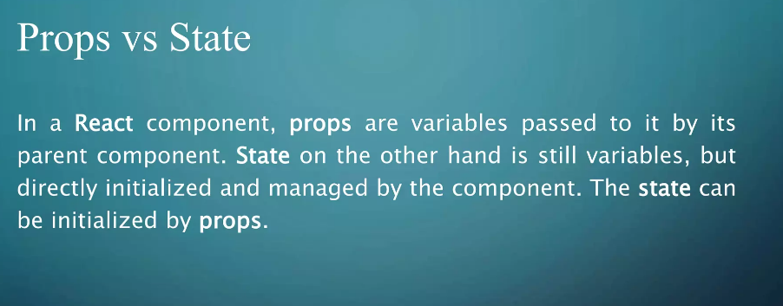
differences

Slide 7
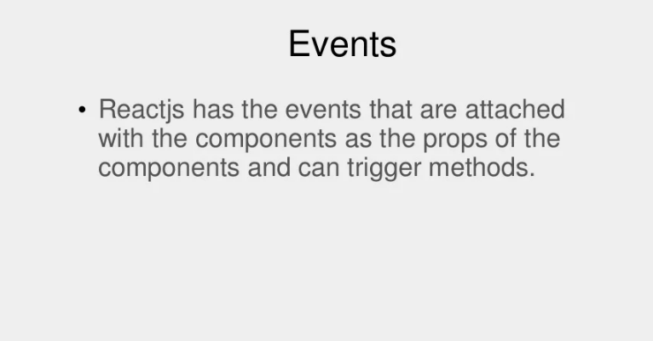
events

Slide 8
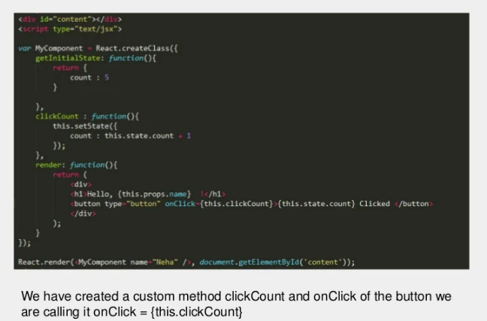
events

Slide 9
Lists
Lists are used to display data in an ordered format and mainly used to display menus on websites.
Lists can be created in a similar way as we create lists in JavaScript.
he map() function is used for traversing the lists.
Syntax:
const lists = myList.map((myList)=>{
return <li>{myList}</li>;

