Slide 1
Reactjs

Slide 2
What is react?
React JS is a JavaScript library for creating user interfaces, making development of UI components easy and modular.
React JS was created by Jordan Walke, a software engineer at Facebook and open sourced to the world by Facebook and Instagram.

Slide 3
Feature of React
The Key feature of React are:
Component-based
Virtual DOM
Unidirectional data flow
JSX syntax
SEO Performance

Slide 4
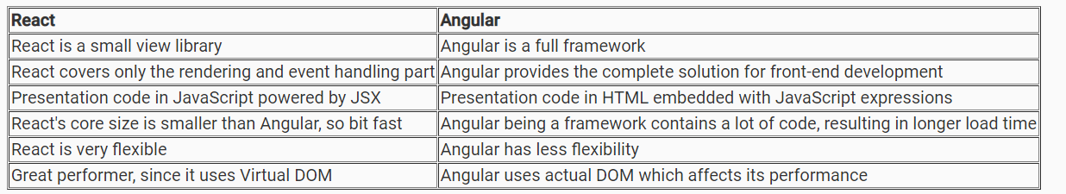
React Vs Angular
Angular is one of the popular frameworks used for UI development. Let us compare React and Angular in brief:

Slide 5
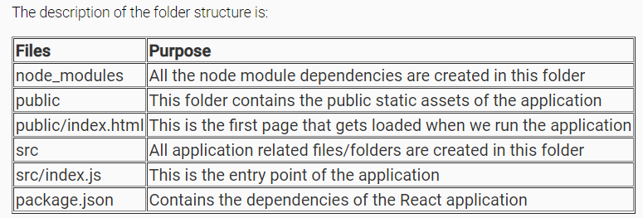
Create-react-app
We can use the create-react-app tool which provides a modern build setup allowing us to quickly create and run React applications with minimal configuration. create-react-app is a command-line interface (CLI).
To install create-react-app, follow the below steps:
1.Install node.js with version 10+ from Node.js official site or from Software House.
D:\> node -v
v10.15.0
2. Install create-react-app by running the following command:
D:\>npm install -g create-react-app
3. Once the installation is done, create a React app using the below command:
D:\>create-react-app my-app

Slide 6
4. To run the application, navigate to the folder my-app and run the command as shown below:
D:/>my-app>npm start
After successful compilation, the application will be loaded in the browser at the port "http://localhost:3000" as shown below.
React application can also be created using create-react-app using the below command:
npx create-react-app my-app
where my-app is the name of the application

Slide 7
Rendering Elements to DOM
Observe the file src/index.js
ReactDOM.render(<App />, document.getElementById('root'));
ReactDOM.render is used to render an element or component to the virtual DOM.
The first argument specifies what needs to be rendered
The second argument specifies where to render.
The root element is present inside index.html
<body>
<noscript>You need to enable JavaScript to run this app.</noscript>
<div id="root"></div>
</body>
We can render elements also using the render method as shown below.
ReactDOM.render(<h1>Hello React!<h1/>, document.getElementById('root'));

Slide 8
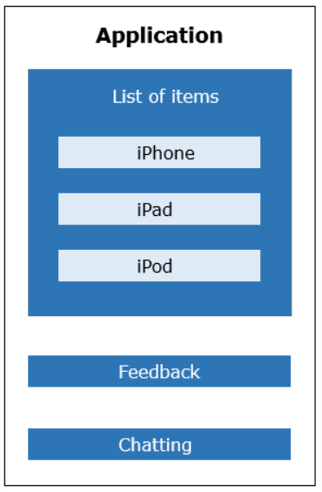
Why Components?
Let's have look at the below application where we have different sections as a list of items, feedback, and chatting.
We have the following challenges in developing this
application:
1. Entire page will get re-rendered even when a section
of the page (eg. feedback section) undergoes changes
2. We will have to re-write code for each item even
though they have similar behavior
3. We will have to take additional care to make sure
that the functionality of one part of the application do
not interfere with another part
**If we implement the above wireframe by dividing
them into components - encapsulating its own data
and presentation logic then we can achieve
modularity and re-usability.

Slide 9
What id React Component
React components are the fundamental unit of any React application. They are capable of encapsulating data and view as a single unit. These components can work in conjunction with each other.
Components make code reusable, testing easy, and can take care of separation of concerns.
The capability of creating own components is a major productivity boost to any web application development.
Here, in ReactJS, components reside in virtual DOM and these components will be available as nodes in actual DOM.

Slide 10
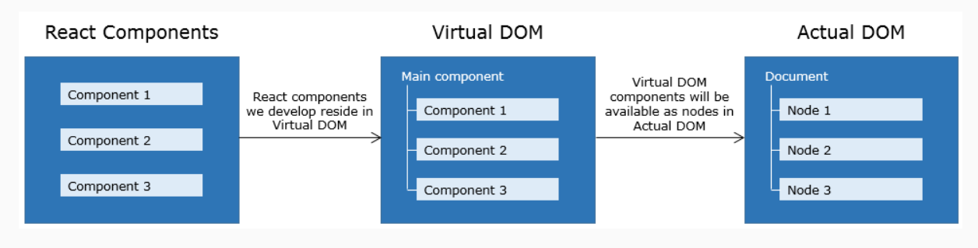
Before discussing the creation of components, let’s discuss what is Virtual DOM and why React uses Virtual DOM.

