Slide 1
DATA ANALYST
Task Presentation
By:
SATHYA V Data Analyst
september 1

Slide 2
CONTENTS
ACKNOWLEDGEMENT
BEGINNER LEVEL
CONCLUSION
2

Slide 3
ACKNOWLEDGEMENT
Institutional & Academic Support: We would like to express our sincere gratitude to our institution, faculty members, and mentors for their continuous guidance, valuable feedback, and encouragement throughout the duration of this project.
Data & Tool Providers: We acknowledge the providers of the Starbucks nutritional dataset (starbucks_drinkMenu_expanded.xlsx) for supplying the dietary data, as well as the developers of Python, Pandas, and Power BI for providing the powerful analytical and visualization tools used to execute this study.
3

Slide 4
BEGINNER LEVEL
Task: Comprehensive Analysis of Data Visualization Techniques using Matplotlib and Seaborn
Analyzed data visualization techniques using Matplotlib and Seaborn in Python.
Created various types of visualizations
  Bar chart
  Scatter plot
  Pie chart
  Box plot
  Pair plot

Slide 5
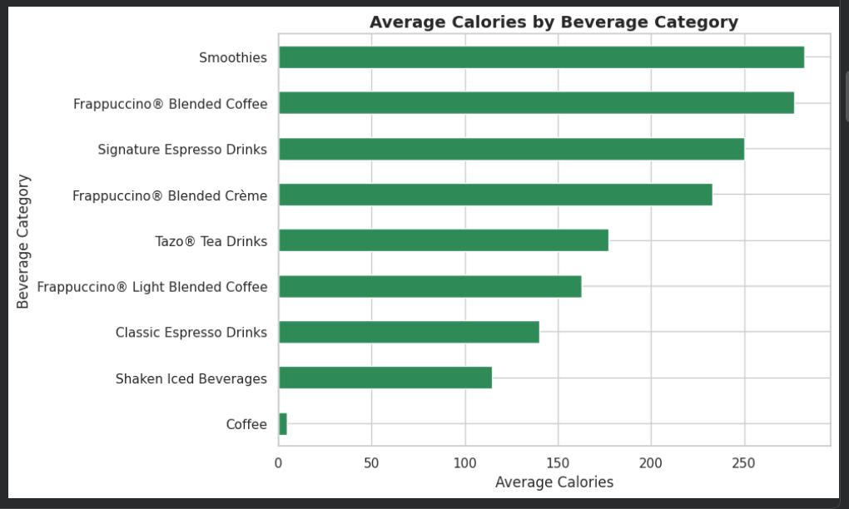
Bar Chart
Key Takeaway: Compares the average caloric content across different Starbucks beverage categories using a horizontal bar chart.
What it Tells: Highlights which specific drink categories have the highest average energy levels per serving, establishing baseline caloric trends across the menu.
Business Insight: Helps identify high-calorie categories to guide targeted menu optimization and nutritional awareness.

Slide 6
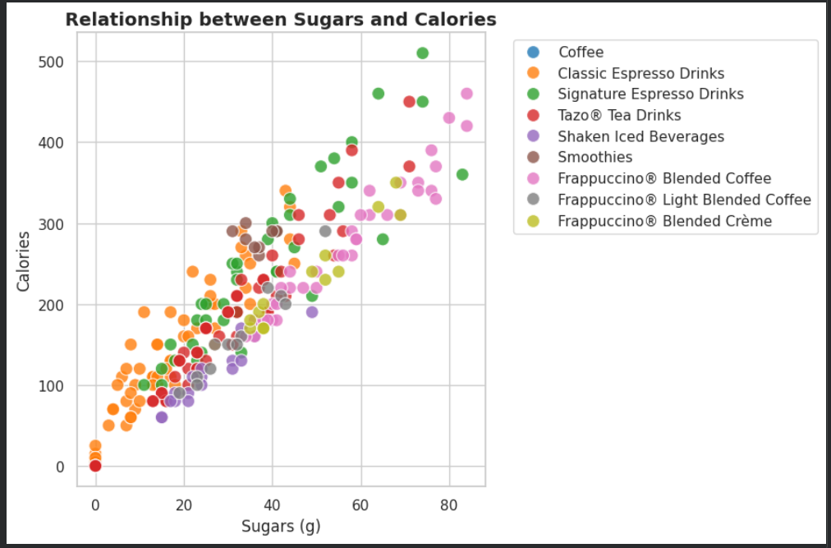
Scatter Plot
Key Takeaway: Maps the direct correlation between sugar content (grams) and total calories across all beverages.
What it Tells: Demonstrates a clear positive correlation—as sugar levels increase, total calories rise proportionally, with specialty blended drinks clustering at the higher end.
Business Insight: Pinpoints the primary driver of high caloric counts, supporting recommendations to introduce lower-sugar alternatives.

Slide 7
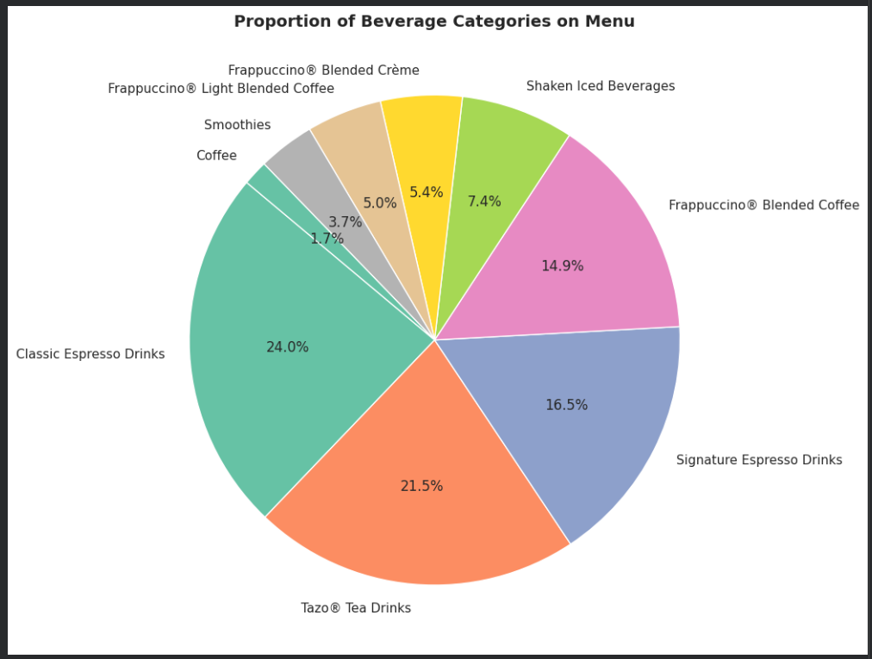
Pie Chart
  Displays the percentage share and proportional distribution of different beverage categories across the entire Starbucks menu.
What it Tells:
  Highlights which specific drink categories dominate the menu in terms of total item volume (e.g., showing which category holds the largest or smallest product share).
Business Insight:
  Helps management and analysts evaluate product concentration and menu variety to see if certain categories are over-represented compared to others.

Slide 8
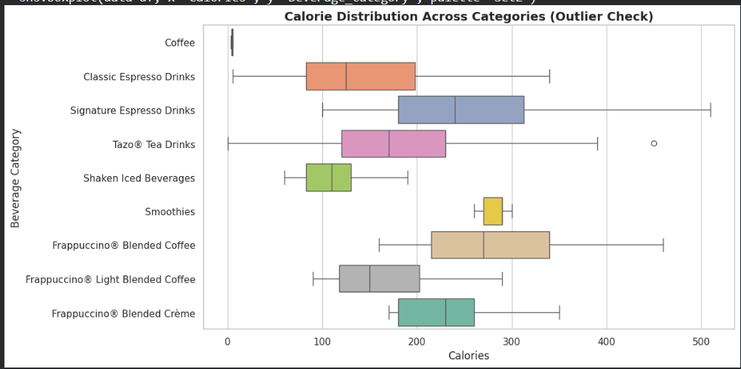
Box Plot
Key Takeaway: Analyzes the spread, median, and quartile distribution of calories within each beverage category.
What it Tells: Effectively isolates outliers (extreme high-calorie or low-calorie menu items) that deviate from standard category averages.
Business Insight: Uncovers "hidden calories" in specialty items, providing actionable data for default recipe modifications and portion control.

Slide 9
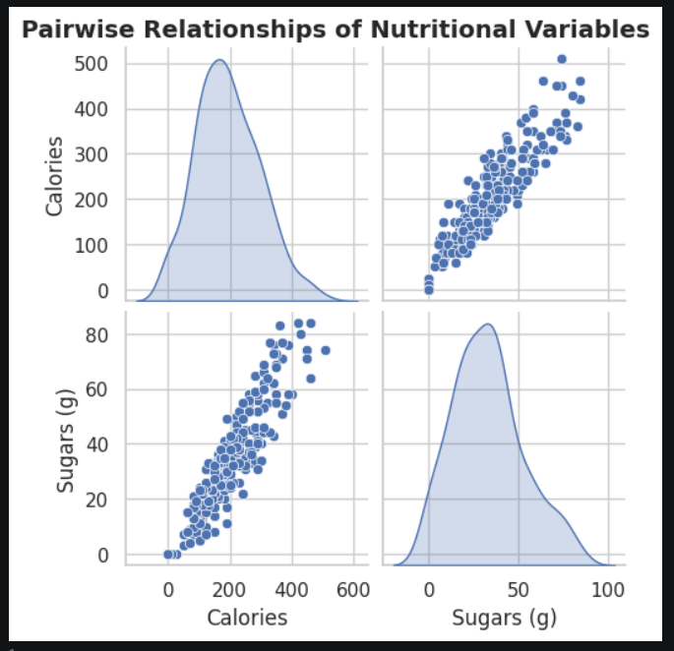
Pair Plot
Key Takeaway:
  Visualizes the simultaneous pairwise relationships and distribution patterns across multiple nutritional metrics (Calories, Sugars, Total Fat, and Caffeine).
What it Tells:
  Displays scatter plots for every combination of variables to check for correlations, while the diagonal plots show the individual distribution curve (KDE) of each metric.
Business Insight:
  Provides a comprehensive multi-dimensional overview of how different nutritional components interact across the Starbucks menu items at a single glance.

Slide 10

CONCLUSION
• Comprehensive Data Insights: The Starbucks Beverage Menu Analysis successfully demonstrated how raw nutritional data (Calories, Sugars (g), Total Fat (g), and Caffeine (mg)) can be transformed into actionable business intelligence.
• Identification of High-Calorie Segments: Exploratory data analysis and statistical modeling revealed that specialty blended beverages and frappuccinos represent the primary high-calorie and high-sugar outliers on the menu.
• Promotion of Healthy Alternatives: By highlighting light, low-calorie options (such as plain brewed coffees and teas), the project provides a framework for empowering customers to make informed, health-conscious dietary choices.
12

Slide 11
Thank you

