Slide 1


Slide 2


Slide 3
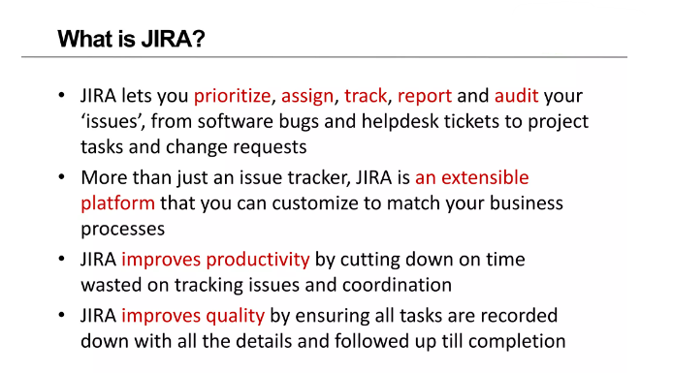

Slide 4
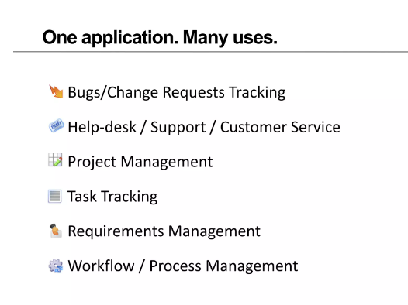

Slide 5
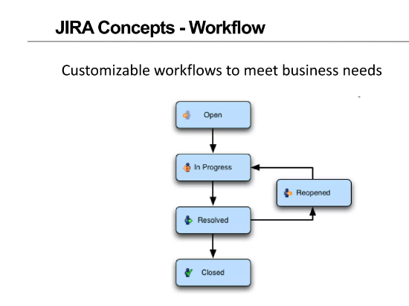

Slide 6
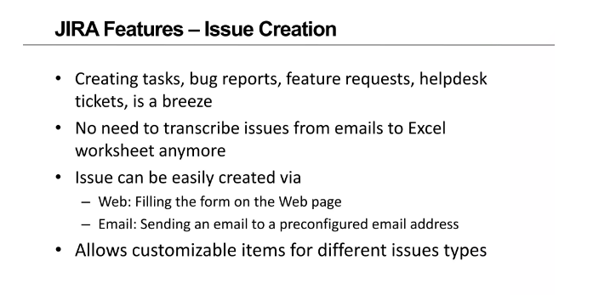

Slide 7
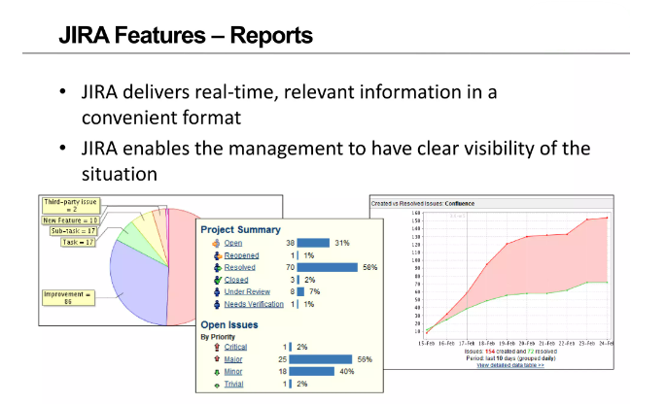

Slide 8
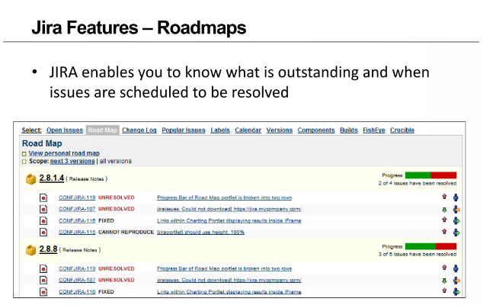

Slide 9
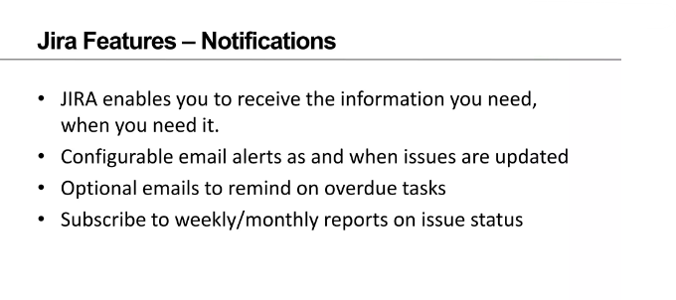

Slide 10
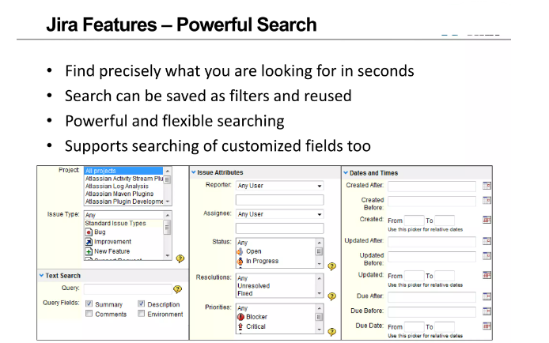

Slide 11
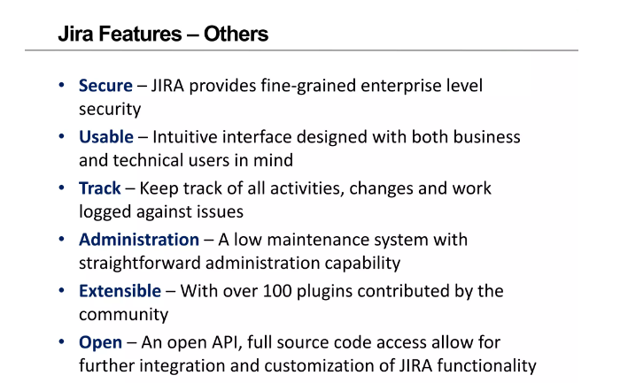

Slide 12
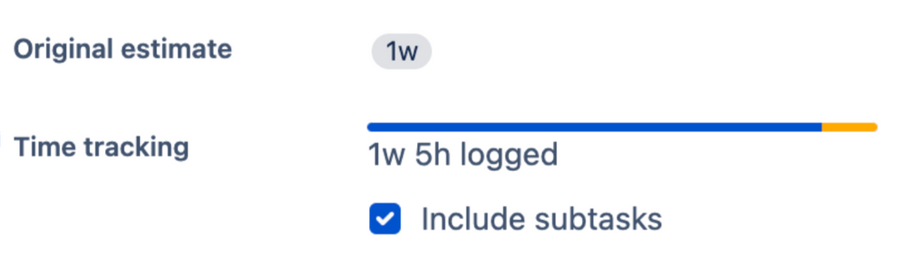

1. Made for agile teams 🛸
2. Good at tracking projects 🚂
3. Track time with colors 🎨
4. Search options are many 🗂️
5. Jira reports are the bomb 📊
6. Jira add-ons are endless ♾️
7. Jira integrates with other products ✔️
8. Jira is good on mobile 📱
9. Assign based on your team 🔒
10. Roadmaps make things simpler 🛣️
11. Save time with Jira templates 🗄️
12. Customize your Jira dashboard 🪡
13. Manage portfolios with Jira 🔮

Slide 14
Thank You

