Slide 1
FITNESS ML ANALYTICS PIPELINE
FitPulse
Analytics
ML Pipeline — Preprocessing · Pattern Extraction · Anomaly Detection
PRESENTED BY:
SATINDRA KUMAR B S
STREAMLIT
PYTHON
PANDAS
SCIKIT-LEARN
TSFRESH
PROPHET

Slide 2
OVERVIEW
Agenda
What we'll cover today
01
Project Overview & Problem Statement
06
Prophet Forecasting — HR, Steps & Sleep (ML-2)
02
Preprocessing — Objectives & Dataset
07
Clustering — KMeans, DBSCAN, PCA, t-SNE (ML-3)
03
Platform Walkthrough — Upload & Cleaning
08
Anomaly Detection — 3 Methods (ML-4)
04
Pattern Extraction — 5-File Detection
09
Accuracy Simulation & Technology Stack
05
TSFresh Feature Extraction (ML-1)

Slide 3
PROBLEM STATEMENT
Problem Statement
Fitness data is vast, multi-source, and riddled with quality issues that hinder meaningful analysis.
Massive Volume
No Standardisation
36,500 rows × 16 columns — manual inspection is not feasible
Raw exports from fitness devices need consistent formatting before analysis
Missing Data
Bias Risk
21,951 missing cells across 5 key columns: Hours Slept, Water Intake, Active Minutes, Heart Rate, Workout Type
Unaddressed nulls lead to skewed distributions and unreliable downstream ML results
Mixed Data Types
Numeric, categorical, and datetime fields require different treatment strategies

Slide 4
MILESTONE 1
PREPROCESSING
Preprocessing — Objectives
①
Build an end-to-end interactive preprocessing pipeline for raw fitness CSVs
②
Detect and visualise missing values across all dataset columns with interactive bar chart
③
Apply intelligent interpolation & fill strategies to handle nulls without data loss
④
Generate a clean, downloadable CSV ready for downstream ML via st.download_button()
⑤
Perform Exploratory Data Analysis (EDA) — KDE histograms for all numeric columns
⑥
Deliver a polished Streamlit web application as the fully interactive deliverable

Slide 5
DATASET
Dataset Description
Fitness & Health Tracking Dataset — Synthetic Fitbit-style CSV
36,500
16
100
365
TOTAL ROWS
COLUMNS
UNIQUE USERS
DAYS TRACKED
Key Feature Columns
Missing Cells — 21,951
User ID · Date · Age · Gender · Height · Weight
Steps Taken · Calories Burned · Hours Slept
Water Intake · Active Minutes · Heart Rate
Workout Type · Mood · Stress Level
Workout Type
9,192
Water Intake
5,401
Hours Slept
3,659
Active Minutes
1,867
Heart Rate
1,832

Slide 6
ARCHITECTURE
Pipeline Flowchart — End-to-End
🔧 MILESTONE 1 — PREPROCESSING
🤖 MILESTONE 2 — PATTERN EXTRACTION
①
Upload CSV
⑥
Load 5 Fitbit CSVs
36,500 rows × 16 cols loaded
Auto-detect by column signature
↓
↓
②
Null Detection
⑦
TSFresh (ML-1)
21,951 missing cells visualised
11 HR features per user → heatmap
↓
↓
③
Interpolate & Fill
⑧
Prophet HR (ML-2)
Numeric → interpolate, Cat → Unknown
30-day BPM forecast, 90% CI
↓
↓
④
EDA Histograms
⑨
KMeans + DBSCAN
KDE plots all numeric columns
PCA + t-SNE scatter, k configurable
↓
↓
⑤
Download Clean CSV
⑩
Steps & Sleep Forecast
Zero nulls, ready for ML
Prophet 80% CI, multi-series

Slide 7
PLATFORM WALKTHROUGH
PREPROCESSING
Platform Walkthrough — Preprocessing
Step 1
Step 2
Step 3
Upload Dataset
Null Detection & Visualisation
Interpolation & Fill Strategy
User uploads a fitness CSV — platform auto-detects file, validates format
Loads 36,500 rows × 16 columns instantly via Streamlit file_uploader
Supports drag-and-drop or file browse — up to 200 MB
Raw data preview shown immediately after load (first 10 rows)
Row and column count confirmed with success alert
Total Rows: 36,500 | Columns: 16 | Missing Cells: 21,951
Interactive bar chart rendered for all columns with missing data
Breakdown: Workout Type 9,192 · Water Intake 5,401 · Hours Slept 3,659
Active Minutes 1,867 · Heart Rate 1,832 null entries
Zero missing confirmed on all other non-null columns
Numeric Columns: Linear interpolation via df.interpolate() — preserves distribution
Categorical Columns: Filled with 'Unknown' — prevents row loss
Result: Zero missing values in cleaned dataset — confirmed post-clean
Clean CSV downloadable via st.download_button()
EDA histograms with KDE overlay rendered in 2-column pairwise layout

Slide 8
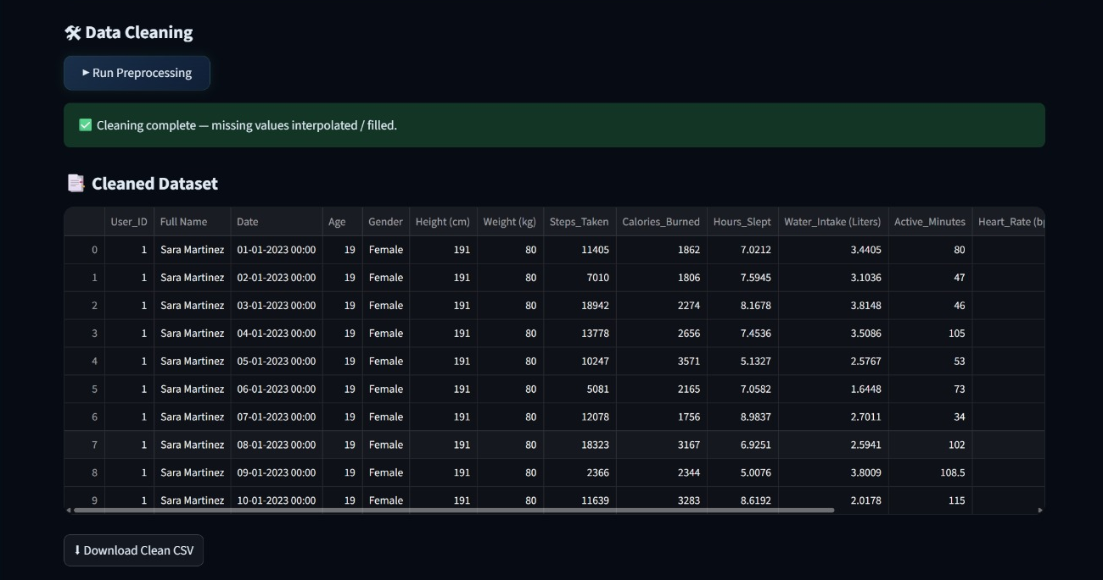
Preprocessing – Result :

Slide 9
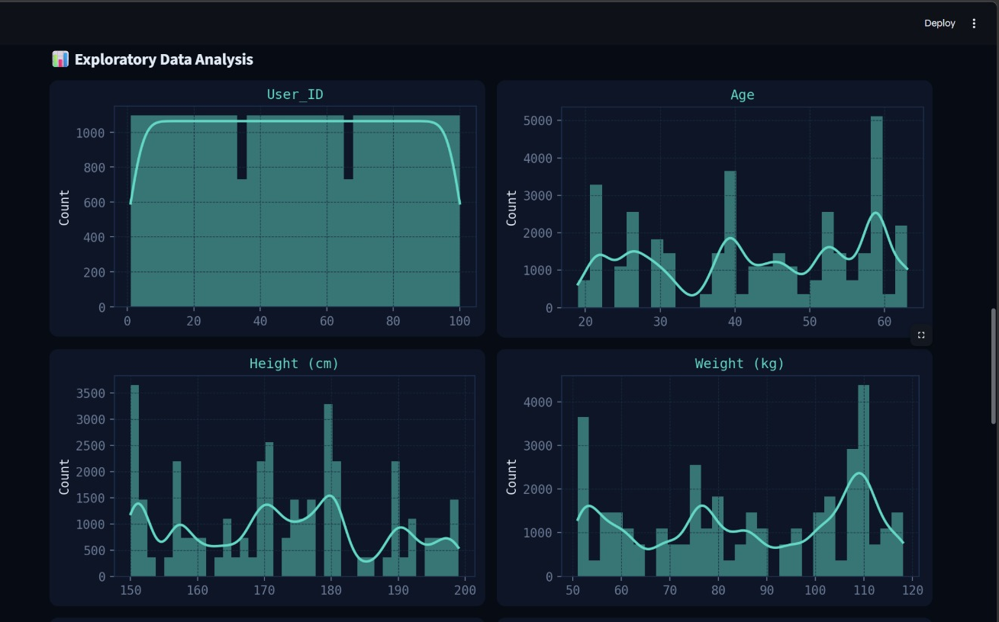

Slide 10
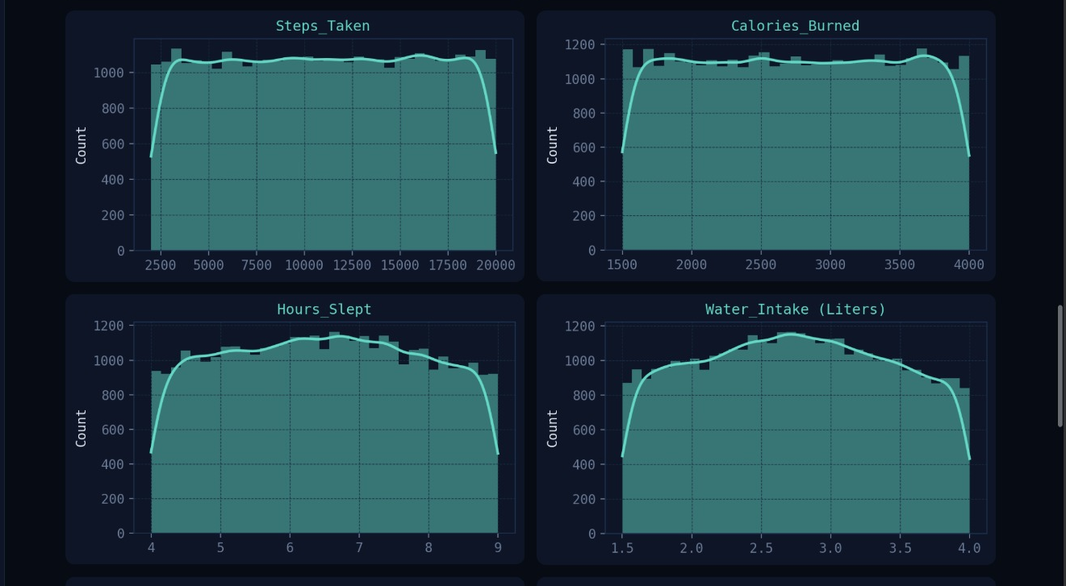

Slide 11
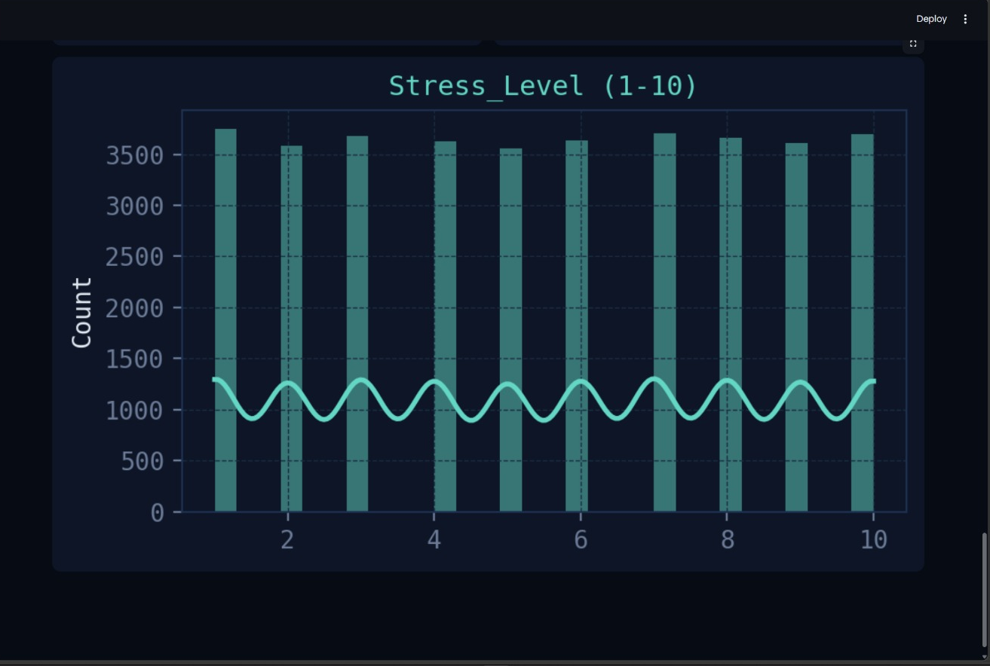

Slide 12
PATTERN EXTRACTION
MILESTONE 2
Pattern Extraction — File Detection
Step 1 & 2 — Upload & Auto-Detect 5 Fitbit CSVs
🏃
👣
⚡
💤
❤️
Daily Activity
Hourly Steps
Hourly Intensities
Minute Sleep
Heart Rate
Detected by TotalSteps,
Calories, VeryActiveMinutes
Detected by StepTotal
column signature
TotalIntensity,
AverageIntensity columns
Detected by logId,
value, date columns
Detected by Value,
Time column pair
Found ✓
Found ✓
Found ✓
Found ✓
Found ✓
All 5 required files must be detected before the pipeline activates · Each file auto-detected by column signature
Step 3 — Parse, Merge & Normalise:
All 5 CSVs merged into master DataFrame · HR aggregated to daily avg BPM via groupby · Sleep counted to TotalSleepMinutes · Downloadable as fitpulse_master.csv

Slide 13
MACHINE LEARNING
ML-1 · TSFRESH
TSFresh Feature Extraction
Extracts statistical features from Heart Rate time-series per user
11
14
0–1
YlOrRd
FEATURES
EXTRACTED
USERS
PROCESSED
NORMALISED
RANGE
HEATMAP
PALETTE
①
②
③
④
Parse HR Data
extract_features()
MinMaxScaler
Heatmap Output
Heart Rate CSV parsed to (id, time, value) triplets. Datetime and numeric types enforced before processing.
→
MinimalFCParameters applied — extracts mean, std, min, max, and ~7 other statistical features per user.
→
Features normalised to 0–1 range for fair comparison and heatmap visualisation across all users.
→
YlOrRd sns.heatmap rendered — rows = user IDs, columns = feature index. Session flag tsfresh_done set.

Slide 14
MACHINE LEARNING
ML-2 · PROPHET
Prophet Forecasting
30-day forecasting for Heart Rate, Steps & Sleep using Meta's Prophet model
❤️
🚶
💤
90% CI
80% CI
80% CI
Heart Rate Forecast
Steps Forecast
Sleep Forecast
Daily avg BPM from HR CSV
30-day ahead forecast
Weekly seasonality enabled
Actual scatter + trend + CI band
Daily TotalSteps from Activity CSV
30-day ahead, 80% CI
changepoint_prior = 0.1
Forecast start dashed line plotted
Daily sleep minute count
From minuteSleep CSV
30-day ahead, 80% CI
Actual scatter + confidence band

Slide 15
MACHINE LEARNING
ML-3 · CLUSTERING
Clustering & Dimensionality Reduction
KMeans · DBSCAN · PCA · t-SNE on Daily Activity features
Feature Columns:
TotalSteps · Calories · VeryActiveMinutes · FairlyActiveMinutes · LightlyActiveMinutes · SedentaryMinutes
📉
PCA — Principal Component Analysis
🔵
KMeans — K-Means Clustering
2 principal components extracted for 2D scatter visualisation. Explained variance ratio shown on chart axes.
k configurable 2–9 via sidebar slider. n_init=10, random_state=42. User-level mean aggregation → StandardScaler normalisation.
🟣
DBSCAN — Density-Based Clustering
🌀
t-SNE — Non-linear Embedding
eps configurable 0.5–5.0 via sidebar. min_samples=2. Noise/outlier points shown in grey. Structural anomaly detection.
2D embedding with KMeans labels coloured. Perplexity auto-scaled to user count (min 5, max 30).

Slide 16
ML RESULTS
ML-6 & ML-7
Elbow Curve & Cluster Profiles
Optimal K selection + User behaviour profiling
📉 Elbow Curve
📊 Cluster Profiles Table
Inertia computed for K = 2 to 9
Plotted to identify optimal cluster count
Look for 'elbow' — sharpest decline in inertia
KMeans n_init=10, random_state=42 for reproducibility
Mean feature values per KMeans cluster as DataFrame
Bar chart: TotalSteps, Calories, VeryActiveMinutes, SedentaryMinutes
Compared across all cluster groups side by side
🏃
🚶
🛋️
Highly Active
Moderately Active
Sedentary
> 10,000 steps
5,000 – 10,000 steps
< 5,000 steps

Slide 17
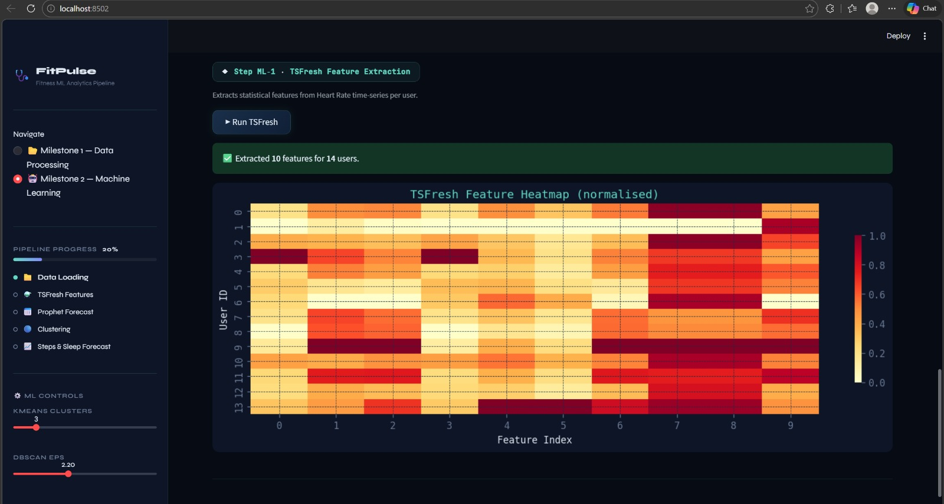
Pattern Extraction – Results :

Slide 18
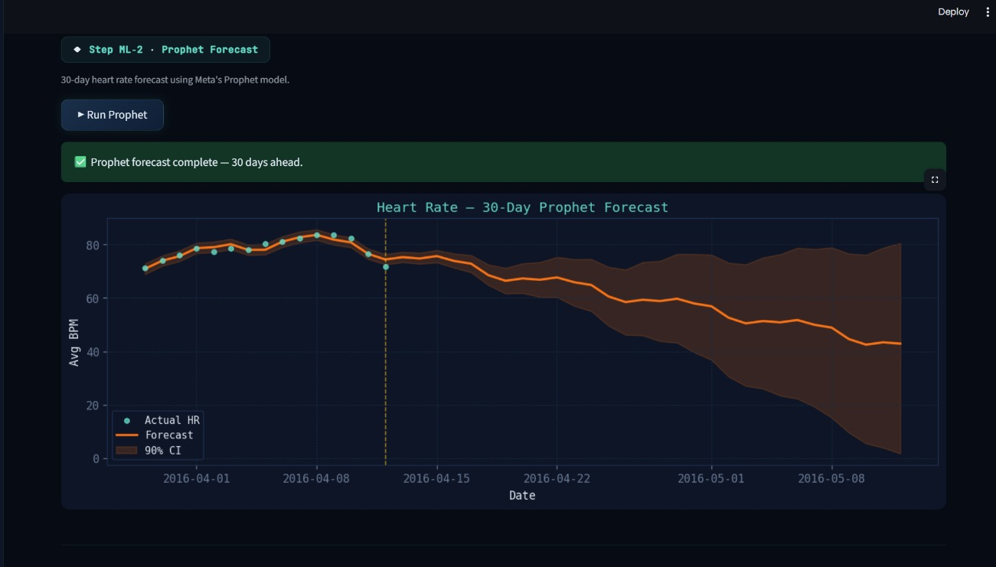

Slide 19
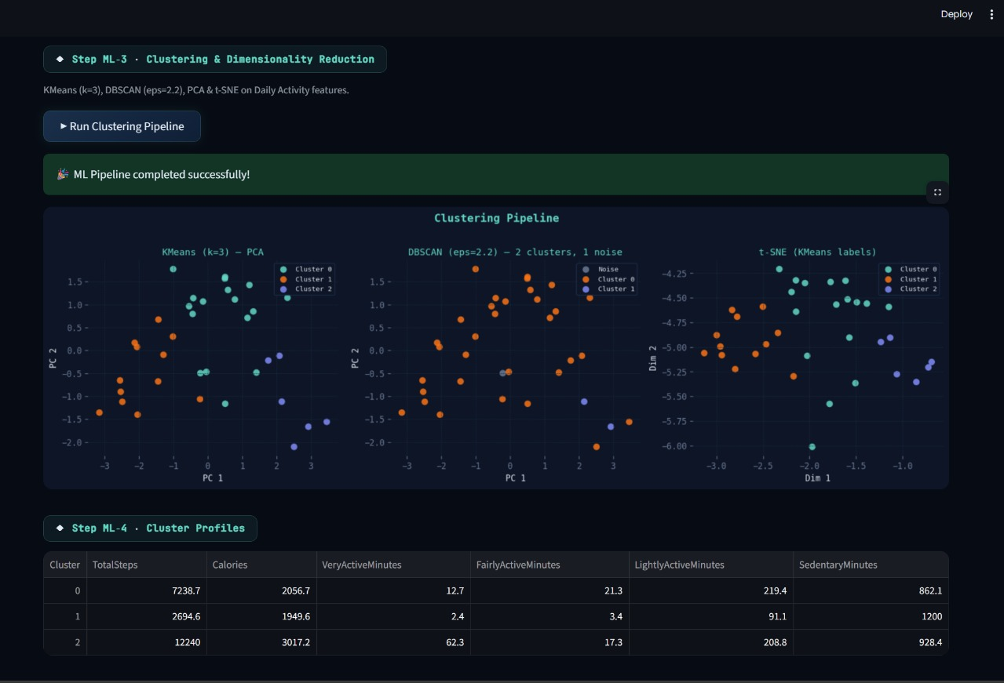

Slide 20
MILESTONE 3
🚨 ANOMALY DETECTOR
🚨 Anomaly Detector
Threshold Violations · Prophet Residuals · Outlier Clusters · Interactive Plotly Charts
①
Threshold Violations
②
Residual-Based Detection
③
DBSCAN Outlier Users
HR > 100 bpm OR HR < 50 bpm → flagged
Steps < 500 OR > 25,000 → flagged
Sleep < 60 min OR > 600 min → flagged
Hard limits — simple, interpretable, fast
Rolling 3-day median as baseline per signal
Flag days where actual deviates ≥ ±2σ residual
Applied to Heart Rate, Steps, and Sleep
Configurable σ threshold via sidebar slider
Users labelled −1 by DBSCAN = structural outliers
Not fitting any recognised activity cluster group
PCA 2D scatter with X markers for outliers
Outlier profiles shown in detail table

Slide 21
Pipeline Flowchart — End-to-End
🔧 MILESTONE 3 — Anomaly detector
①
Upload CSV
36,500 rows × 16 cols loaded
↓
②
Threshold Detection
Flag Values outside predefined limits
↓
③
Residual Detection
Detect deviations using rolling median and ±2σ
↓
④
DBSCAN Outliers
Identify users that don’t fit in any cluster
↓
⑤
Output Results
Store detected anomalies for reporting

Slide 22
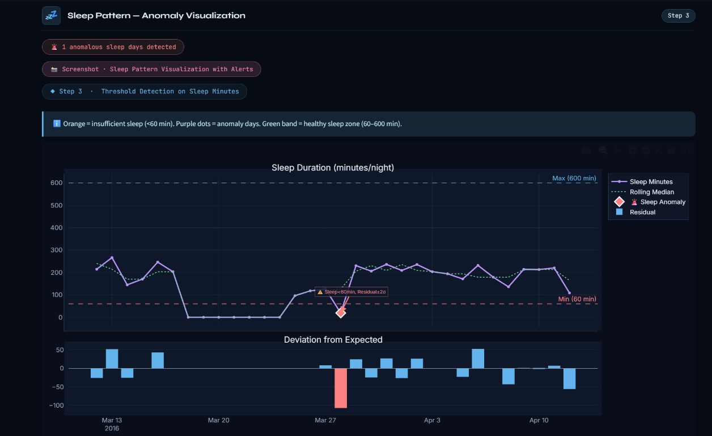
Anomaly Detector – Result :

Slide 23
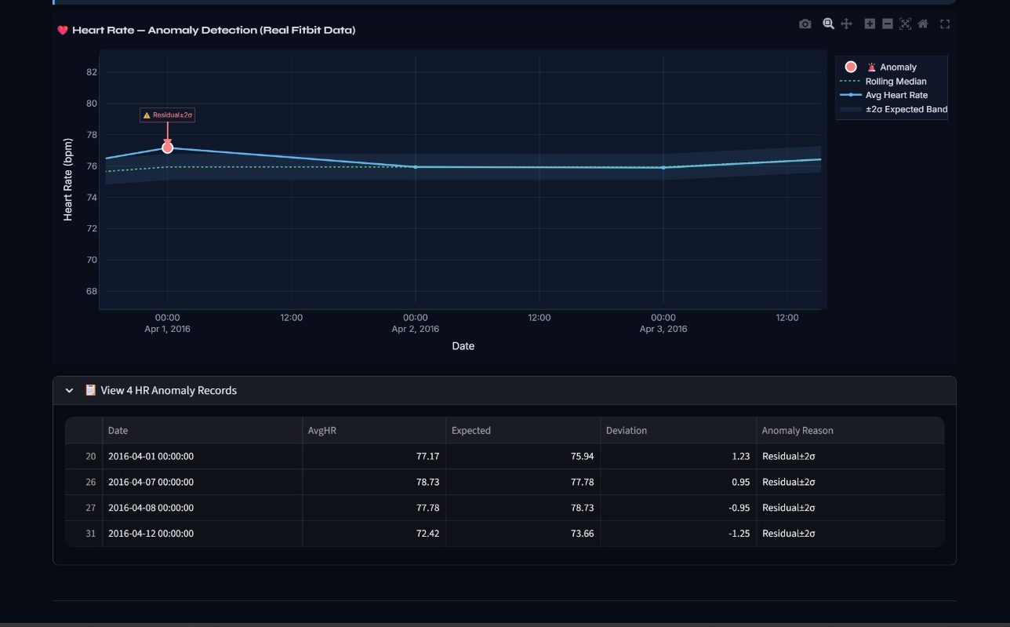

Slide 24
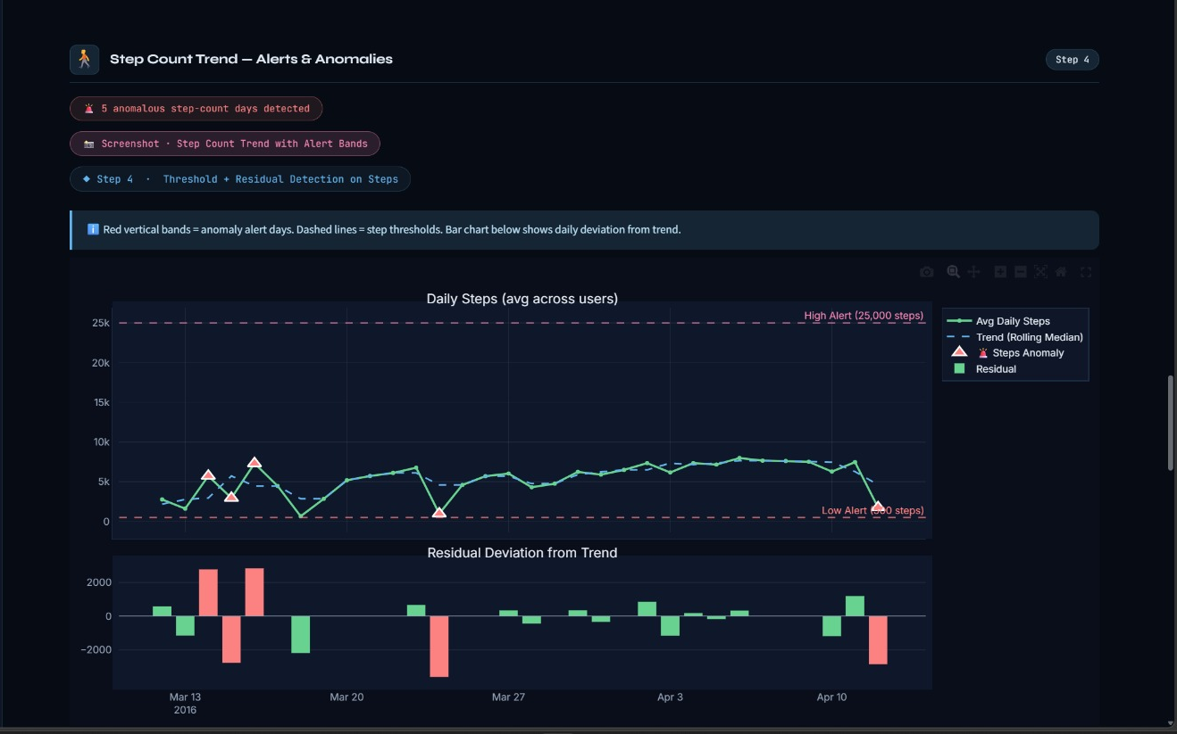

Slide 25
REPORT GENERATE
MILESTONE 4
Report Generator - Insights & Export
STEP 1 : Data → Processing
Flow: Input & Preparation
Load merged fitness dataset
Clean and preprocess data
Handle missing values
Aggregate data to daily level
Extract key features (HR, Steps, Sleep)

Slide 26
DETECTION PIPELINE
STEP 2 : Anomaly Detection
Apply threshold-based rules
Compute rolling median baseline
Detect residual deviations (±2σ)
Perform DBSCAN clustering
Identify anomalies from all methods

Slide 27
OUTPUT & REPORT
STEP 3 : Results & Report
Combine all detected anomalies
Generate visualizations (charts)
Create detailed anomaly tables
Summarize insights and KPIs
Export report (PDF & CSV)

Slide 28
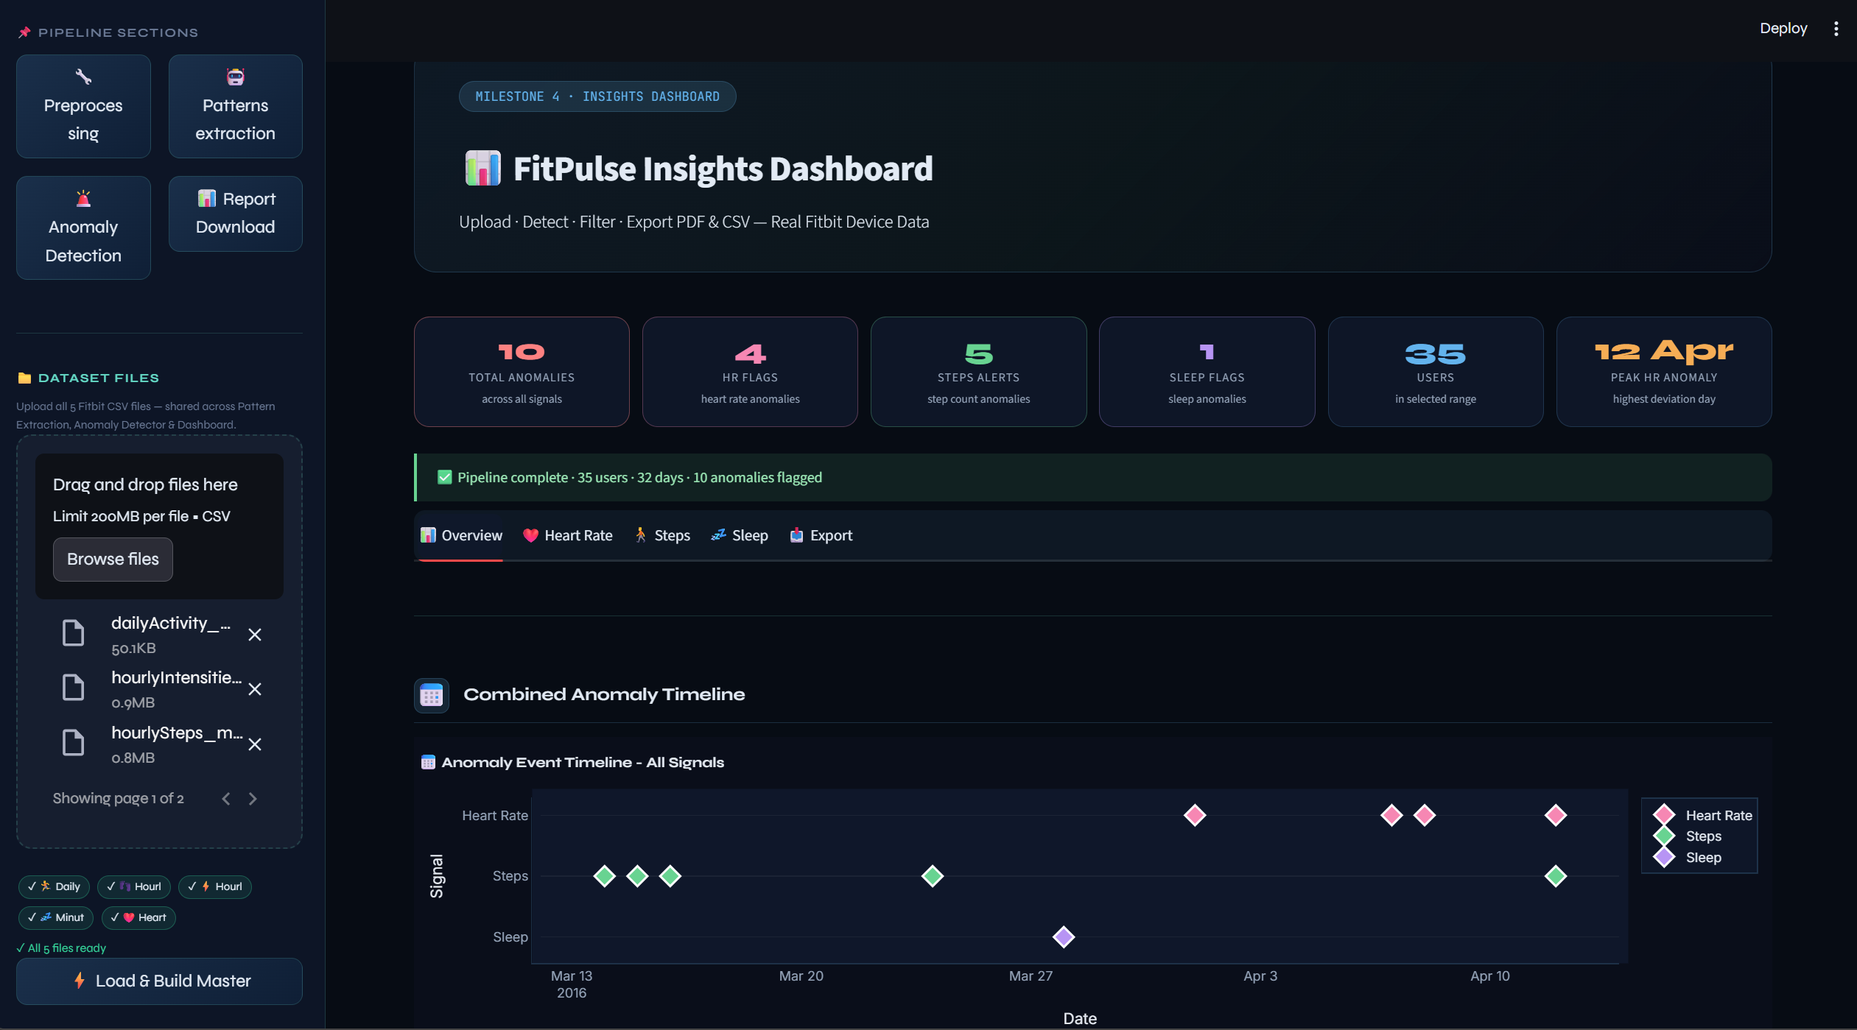
INSIGHT & DASHBOARD – RESULT :

Slide 29
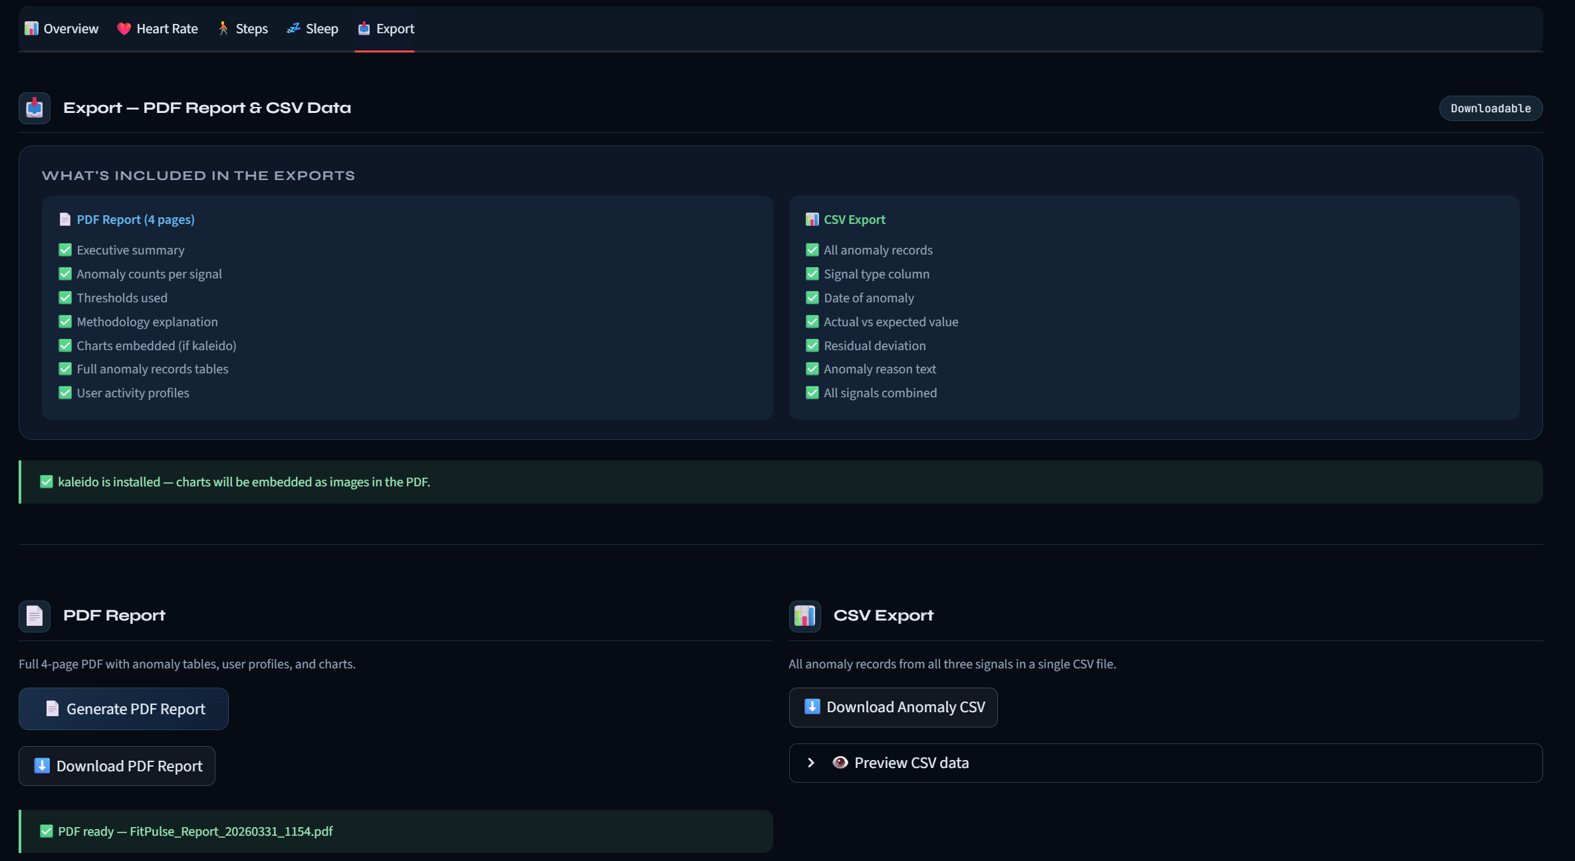

Slide 30
RESULTS
Key Results & Findings
🔧
ZERO NULLS
📁
5 CSVs
⚗️
11 Features
Preprocessing
5-File Merge
TSFresh ML-1
36,500 rows × 16 cols loaded; 21,951 nulls resolved via interpolation + Unknown fill
Daily Activity, Steps, Intensities, Sleep, Heart Rate merged into one master DataFrame
Statistical HR features extracted per user; normalised heatmap visualised via sns.heatmap
📅
3 Forecasts
🔵
4 Methods
🚨
90%+ Accuracy
Prophet ML-2
Clustering ML-3
Anomaly ML-4
HR (90% CI), Steps (80% CI), Sleep (80% CI) — all 30 days ahead with weekly seasonality
KMeans + DBSCAN on 6 activity features; PCA and t-SNE projections rendered side-by-side
3 detection methods; 5 interactive Plotly charts; simulated detection accuracy verified ≥ 90%

Slide 31
TECHNOLOGY
Technology Stack
FRONTEND / UI
Streamlit
FEATURE ENGINEERING
TSFresh
Interactive two-section web app with dark-theme CSS, session state, sidebar controls
MinimalFCParameters — statistical features from HR time-series per user
DATA PROCESSING
Pandas & NumPy
FORECASTING
Prophet (Meta)
Loading, interpolation, merging, groupby aggregation, time resampling
Weekly seasonality, CI bands, multi-metric 30-day forecasts for HR, Steps, Sleep
VISUALISATION
Matplotlib & Seaborn
ML / CLUSTERING
Scikit-Learn
KDE histograms, missing-value charts, heatmaps, scatter plots, bar charts
KMeans, DBSCAN, PCA, t-SNE, StandardScaler, MinMaxScaler
INTERACTIVE CHARTS
Plotly & Plotly Express
REPORTING
ReportLAB & CSV export
Anomaly overlays, CI bands, DBSCAN scatter, accuracy bar chart — all interactive
Generate structured PDF reports and export anomaly data for analysis

Slide 32
FITPULSE ANALYTICS · ML PIPELINE
Thank You
FitPulse Analytics · ML Pipeline · Satindra Kumar B S

