Slide 1
FitPulse Analytics
Milestone 1 — Data Preprocessing Pipeline
Presented by:
Satindra Kumar B S
Fitness ML Analytics Pipeline
Streamlit • Python • Pandas • Scikit-Learn

Slide 2
AGENDA :
Project Overview & Problem Statement
Milestone 1 Objectives
Dataset Description
Platform Walkthrough — Upload & Load
Missing Values Analysis
Data Cleaning & Interpolation
Exploratory Data Analysis (EDA)
Key Findings & Metrics
Technology Stack

Slide 3
Problem Statement:
Fitness data is vast, multi-source, and riddled with quality issues that hinder meaningful analysis.
Massive Volume: 36,500 rows across 16 columns — manual inspection is not feasible.
Missing Data: 21,951 missing cells across 5 key columns (Hours Slept, Water Intake, Active Minutes, Heart Rate, Workout Type).
Mixed Data Types: Numeric, categorical, and datetime fields require different treatment strategies.
No Standardisation: Raw exports from fitness devices need consistent formatting before analysis.
Bias Risk: Unaddressed nulls lead to skewed distributions and unreliable downstream ML results.

Slide 4
Milestone 1 — Objectives:
Build an end-to-end interactive preprocessing pipeline for raw fitness CSVs.
Detect and visualise missing values across all dataset columns.
Apply intelligent interpolation & fill strategies to handle nulls without data loss.
Generate a clean, downloadable CSV ready for downstream ML.
Perform Exploratory Data Analysis (EDA) to reveal distribution patterns and outliers.
Deliver a polished Streamlit web application as the interactive deliverable.

Slide 5
Dataset Description:
Dataset: Fitness & Health Tracking Dataset (synthetic Fitbit-style CSV)
Size: 36,500 rows × 16 columns
Users: 100 unique user profiles tracked over 365 days
Key Features: User ID, Full Name, Date, Age, Gender, Height, Weight, Steps Taken, Calories Burned, Hours Slept, Water Intake, Active Minutes, Heart Rate, Workout Type, Mood, Stress Level
Missing Cells: 21,951 across 5 columns — Hours Slept (3,659), Water Intake (5,401), Active Minutes (1,867), Heart Rate (1,832), Workout Type (9,192)
Source Format: Single CSV — 3.9 MB, UTF-8 encoded

Slide 6
Platform Walkthrough — Upload
Step 1 — Upload Dataset
The user uploads a fitness CSV file. The platform auto-detects the file, validates format, and loads 36,500 rows × 16 columns instantly.
• Supports drag-and-drop or file browse (up to 200 MB)
• Raw data preview shown immediately after load
• Row and column count confirmed with success alert

Slide 7
Missing Values Analysis:
Missing Values — Key Metrics
• Total Rows: 36,500
• Columns: 16
• Missing Cells: 21,951
Column Breakdown:
Hours Slept : 3,659 nulls
Water Intake : 5,401 nulls
Active Minutes : 1,867 nulls
Heart Rate (bpm) : 1,832 nulls
Workout Type : 9,192 nulls

Slide 8
Data Cleaning & Preprocessing:
Cleaning Strategy
Numeric columns: Linear interpolation applied to fill gaps without distorting distribution.
Categorical columns: Filled with “Unknown” placeholder to preserve row integrity.
Result: Zero missing values in the cleaned dataset.
Output: Clean CSV downloadable for ML pipeline.

Slide 9
Exploratory Data Analysis (1/3):
EDA — Demographics & Body Metrics
User ID: Uniform spread confirms balanced user representation (IDs 1–100).
Age: Multi-modal distribution with peaks at 25, 40 and 60 — diverse age groups.
Height: Spread 150–200 cm with a bimodal pattern (male/female cohorts).
Weight: Wide range 50–120 kg; right-skewed with heavy tails — outlier candidates identified.

Slide 10
Exploratory Data Analysis (2/3):
EDA — Activity & Health Metrics
Steps Taken: Near-uniform from 2,500 to 20,000 — healthy variation across sedentary and active users.
Calories Burned: Plateaus from 1,500 to 3,800 kcal — mostly uniform with edge drop-off.
Hours Slept: Peaks at 6–8 hours — aligns with general population sleep patterns.
Water Intake: 1.5–4.0 litres per day; right tail suggests hydration outliers.

Slide 11
Exploratory Data Analysis (3/3):
EDA — Stress Level Distribution
Stress Level is rated 1–10. The bar chart reveals a uniform distribution across all 10 levels, each contributing approximately 3,500 records.
Key Insight: No skew toward high or low stress — this dataset is synthetic and evenly distributed, which is ideal for training unbiased ML classifiers.
KDE overlay shows gentle oscillation — confirming discrete uniform sampling.

Slide 12
Key Results & Findings:
Dataset Loaded: 36,500 rows × 16 columns from a 3.9 MB fitness CSV, processed in under 2 seconds.
Missing Data Detected: 21,951 missing cells identified across 5 columns — visualised in an interactive bar chart.
Cleaning Success: All nulls resolved via interpolation (numeric) and “Unknown” fill (categorical). Zero residual nulls post-cleaning.
EDA Insights: Uniform stress distribution, normal sleep patterns (6–8 hrs), bimodal height (male/female cohort split) detected.
Downloadable Output: Clean CSV exported and ready for Milestone 2 — Pattern Extraction pipeline.
Platform Live: Fully interactive Streamlit app deployed at localhost:8502 with real-time preprocessing and visualisations.

Slide 13
Technology Stack:
Frontend / UI: Streamlit — interactive web application with real-time controls and dark-theme CSS.
Data Processing: Pandas & NumPy — efficient data loading, manipulation, interpolation, and null handling.
Visualisation: Matplotlib & Seaborn — histogram KDE plots, missing value bar charts, styled with custom dark palettes.
ML (Preprocessing): Scikit-Learn StandardScaler / MinMaxScaler for feature normalisation readiness.
Deployment: Local Streamlit server (localhost:8502); portable via requirements.txt for cloud deployment.
Language: Python 3.10+ — modular, readable, and extendable codebase.

Slide 14
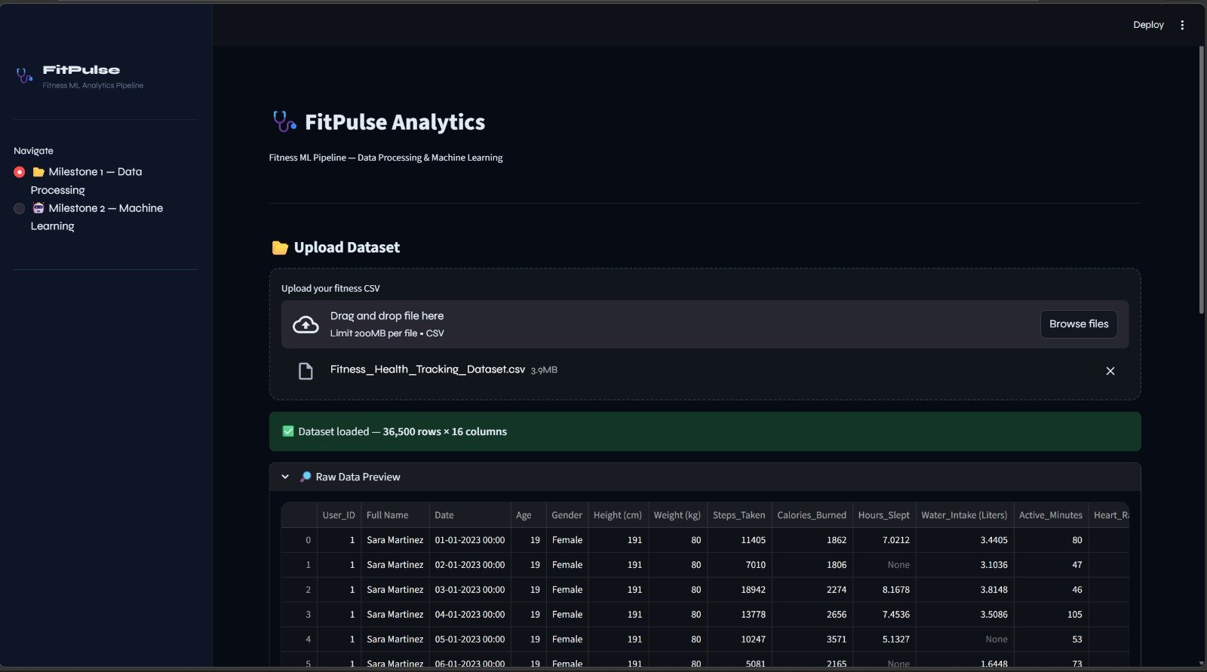
RESULTS:

Slide 15
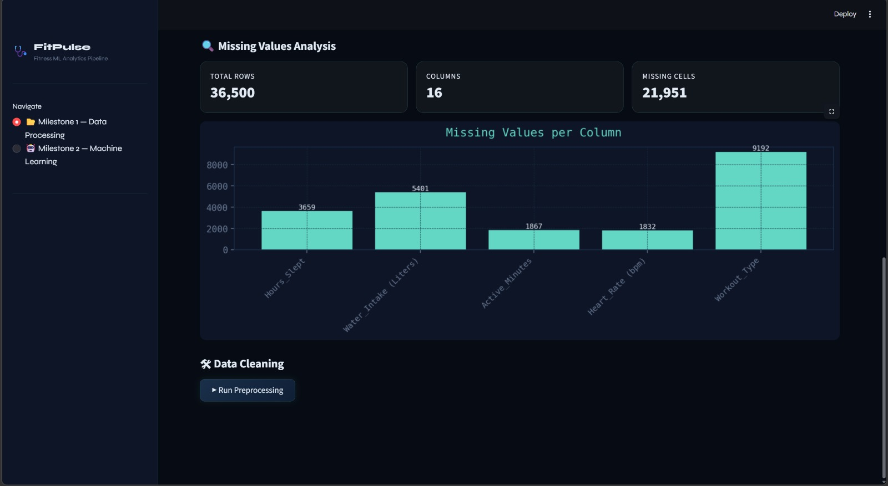
RESULTS:

Slide 16
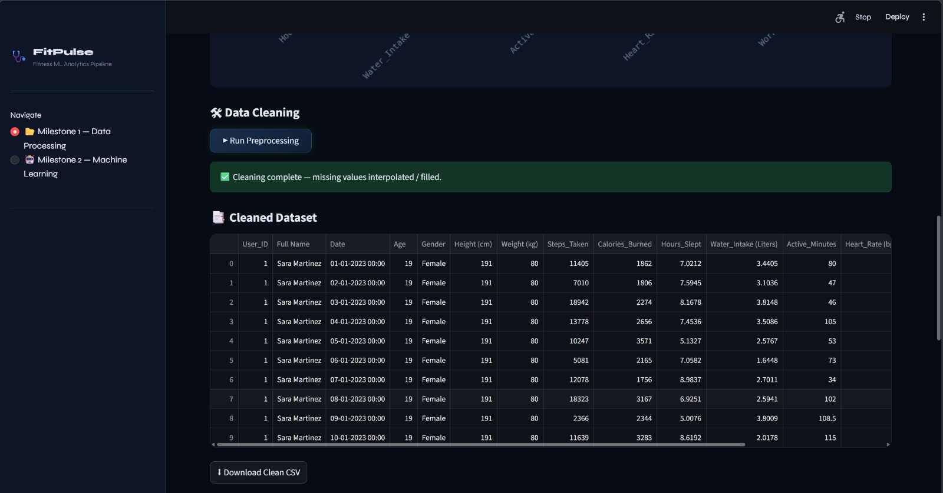
RESULTS:

Slide 17
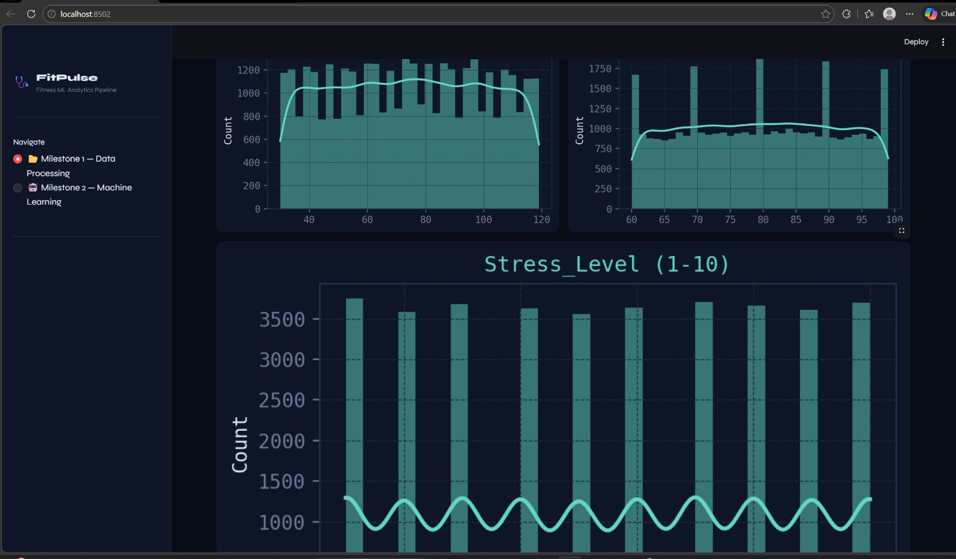
RESULTS:

Slide 18
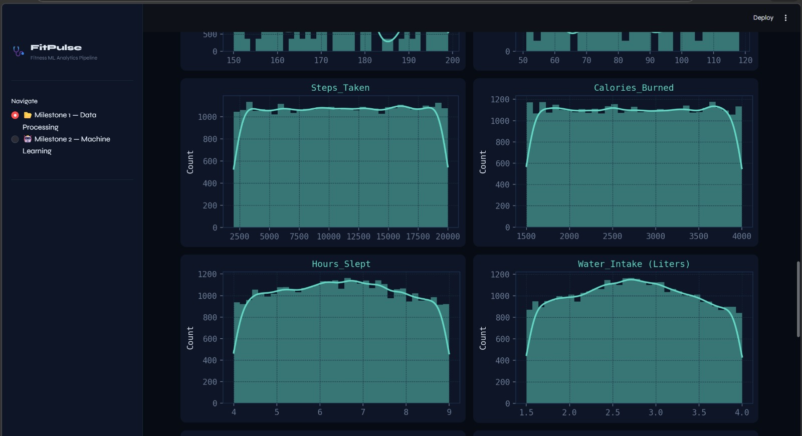
RESULTS:

Slide 19
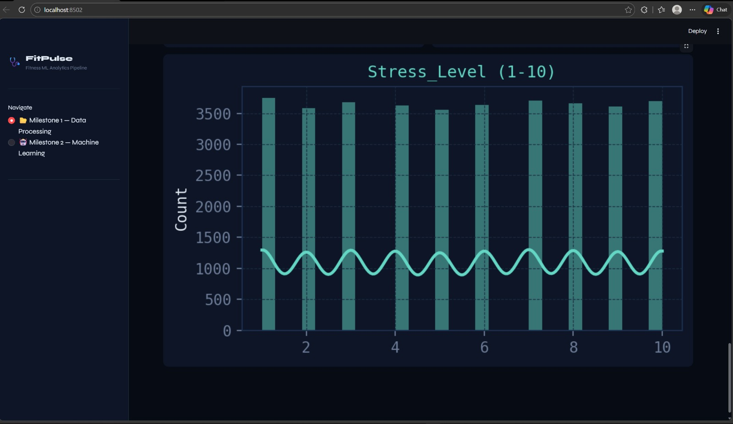
RESULTS:

Slide 20
THANK YOU
FitPulse Analytics • Milestone 1 — Data Preprocessing • Satindra Kumar B S

