Slide 1

AI FOR FOUNDATIONAL LEARNING HACKATHON
Saksham AI
A field coach for
India’s teacher mentors
Classroom evidence. Better conversations.
A clear next step for every visit.
CHALLENGE 5: SYSTEM CAPACITY
Notes:
Ideate-stage proposal. Nine content slides follow this cover. Working name: Saksham AI. The cover is an AI-generated editorial illustration, not a photograph of a real school or pilot. No claim of government endorsement. Team profiles are omitted because member details have not been supplied.

Slide 2
01 / PROBLEM UNDERSTANDING
The mentoring gap between a visit and a change
CRPs are expected to
help teachers improve
classroom practice.
THE DOCUMENTED NEED
India’s school supervision still gives substantial attention to compliance. The NITI Aayog report calls for stronger academic mentoring and CRP capacity.
Our focus is the moment after an observation: choosing useful feedback, discussing it well, and returning to the agreed practice.
It recommends regular classroom visits, follow-up support, and digital records of teaching practices.
Primary user: CRP / teacher mentor
Beneficiaries: teachers and early-grade learners
SAKSHAM AI
Sources: NITI Aayog, School Education System in India (2026), pp. 151–152; World Bank Coach (2021).
01
Notes:
Problem source: https://niti.gov.in/sites/default/files/2026-05/School-Education-System-in-India.pdf printed pp. 151–152 (PDF pp. 177–178). The report recommends stronger CRP mentoring, revised workloads and digital visit records. It is a research report, not an endorsement of Saksham. Coaching design source: https://blogs.worldbank.org/en/education/7-steps-facilitate-effective-one-one-support-teachers. The chosen post-observation bottleneck is our product hypothesis. No CRP interviews or impact results are claimed.

Slide 3
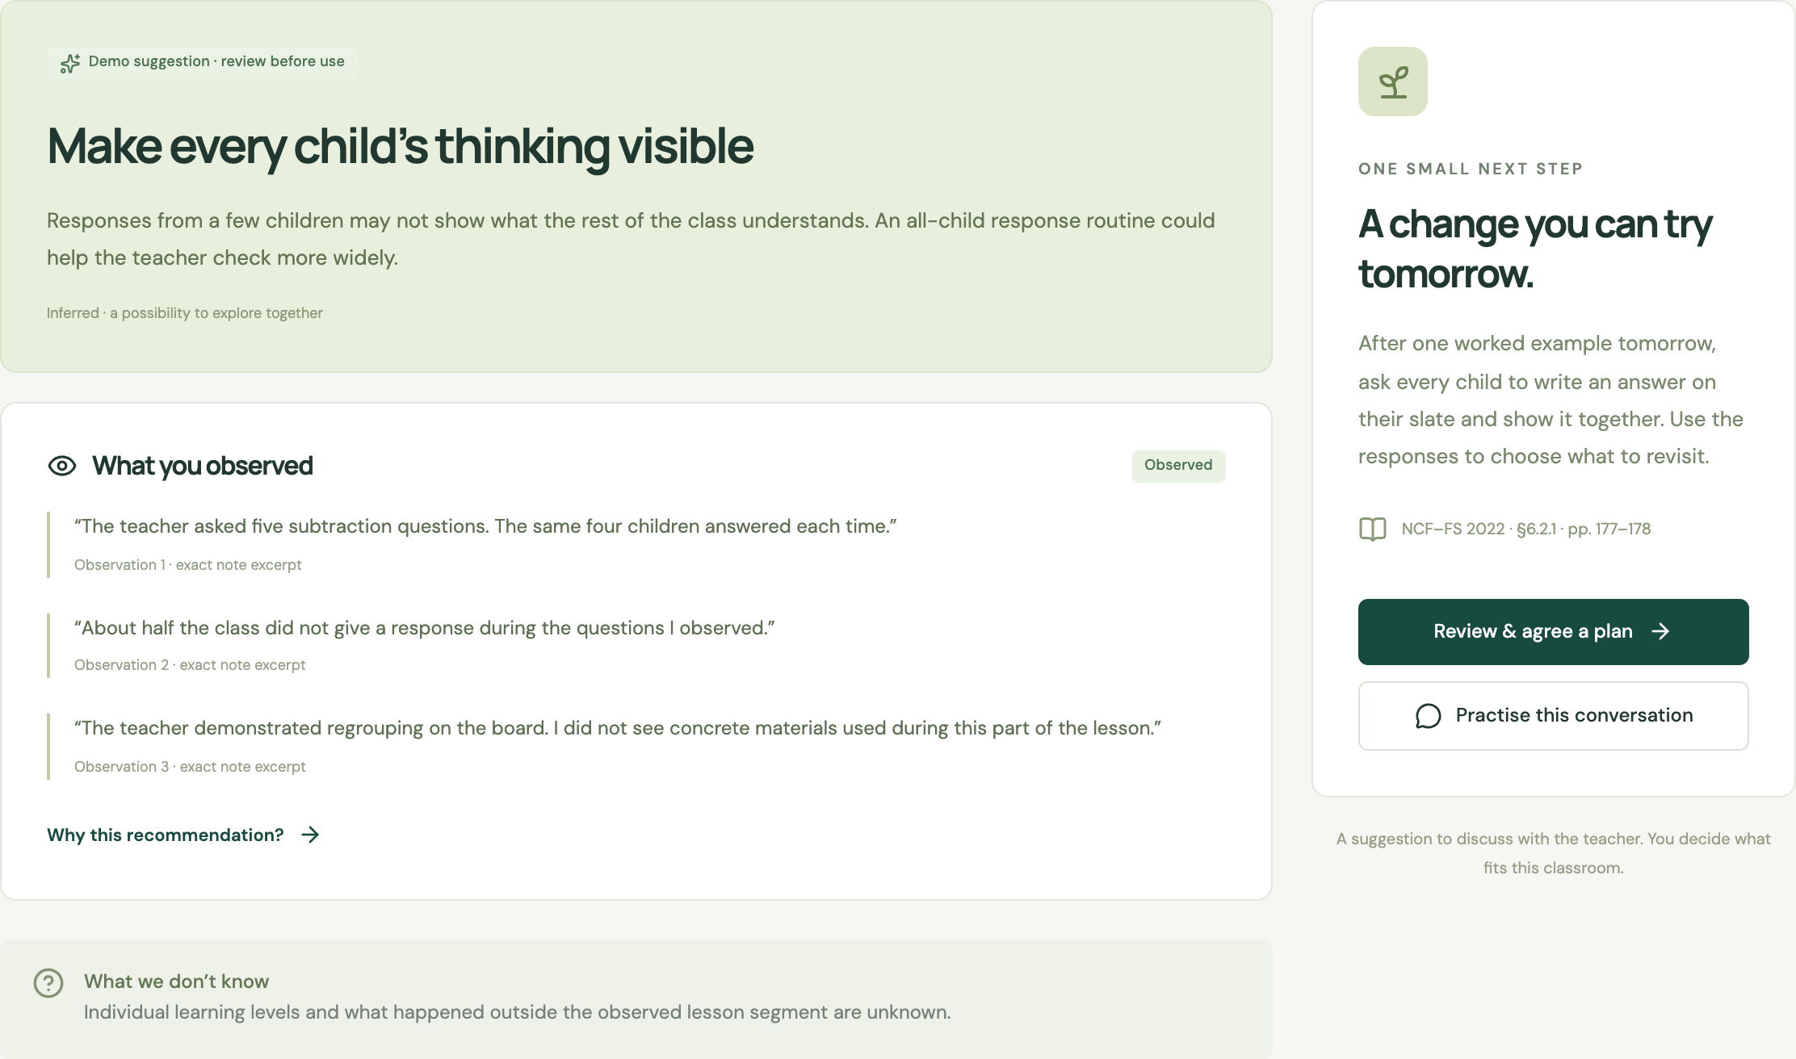
02 / PROPOSED SOLUTION
One observation becomes one usable coaching plan
01
Capture evidence
Speak or type what happened during a short lesson segment.
02
Choose one next step
Review the interpretation, its source, and a practice the teacher can try.
SAKSHAM AI
Actual prototype capture with fictional sample observations. Demo output shown; mentor review remains required.
02
Notes:
This is a screenshot of the working local prototype, captured in explicitly labelled demo mode. The seeded Grade 2 subtraction observations are fictional. Notes map to exact excerpts. The proposed live version uses Claude for contextual interpretation and recommendation generation. A resource citation does not prove that the model’s recommendation is pedagogically correct. Mentor and expert review remain necessary.

Slide 4
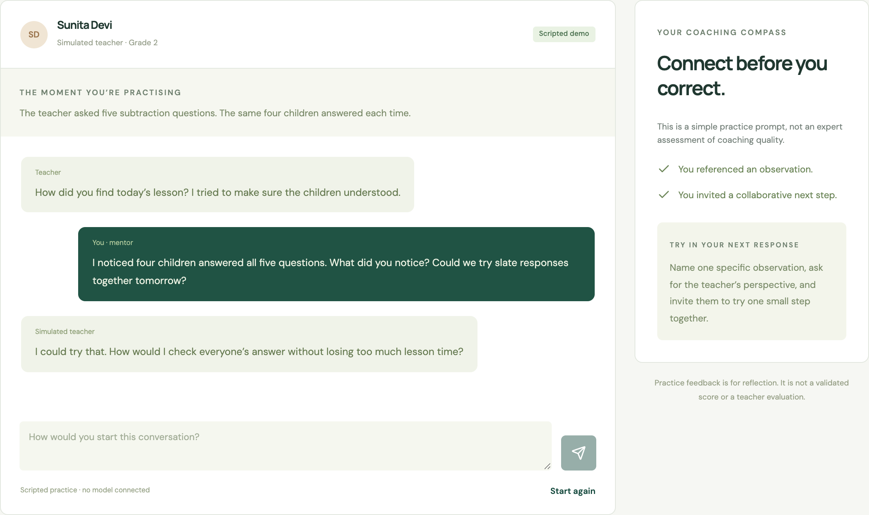
03 / PROPOSED SOLUTION
The mentor practises before the real conversation
AI takes the teacher’s role
The mentor rehearses a response grounded in the observation.
The coach gets feedback
On specificity, respectful inquiry, and a feasible next step.
SAKSHAM AI
Actual prototype capture. Scripted rehearsal shown. Adaptive Claude role-play is planned and requires validation.
03
Notes:
Screenshot from the local scripted demonstration. The proposed frontier-model capability is adaptive role-play conditioned on the current observation, with qualitative feedback on the mentor’s wording. The screenshot does not demonstrate validated AI scoring. No numeric coaching-quality scores are claimed. Existing simulation systems such as Mursion show that rehearsal itself is not novel; our intended differentiation is its connection to a CRP’s actual FLN observation and follow-up plan.

Slide 5
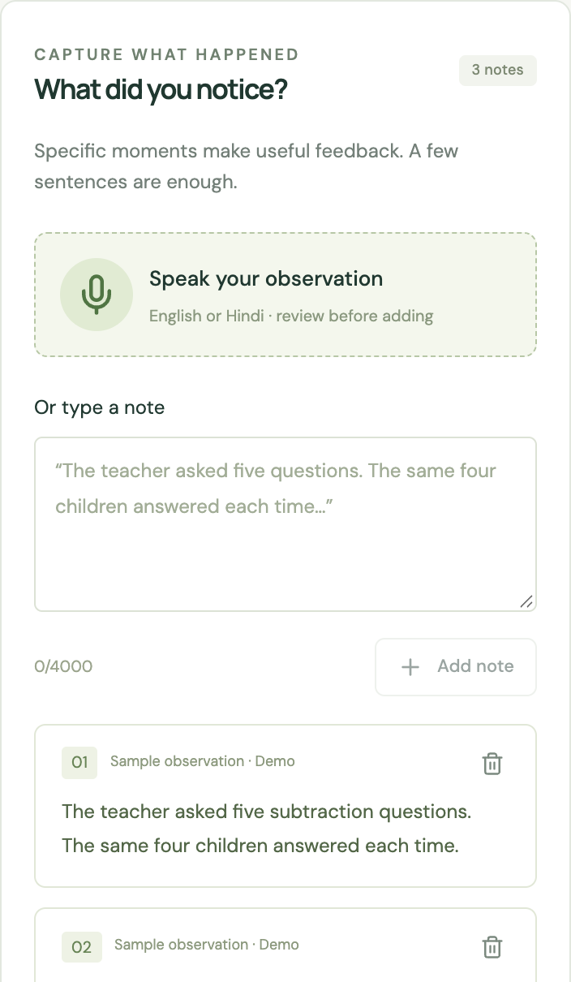
04 / USERS AND CONTEXT
Designed around the mentor’s field day
Meena, Cluster Resource Person
Supports early-grade teachers across a school cluster. Needs an observation she can use in a conversation, with minimal re-entry.
Field constraint | Product response
Limited time after a visit | A few notes and one coaching priority
Hindi or another local language | Hindi / English first; review the transcript
Intermittent connectivity | Device-local drafts; AI waits for connection
Trust and sensitive classroom data | Mentor notes, no continuous child recording
SAKSHAM AI
Meena is a fictional design persona. Constraints are design assumptions to validate with CRPs; voice support is browser-dependent.
04
Notes:
Design persona and constraints are assumptions for validation, not field-research findings. Intended primary user: Cluster Resource Person / Academic Resource Person / teacher mentor. Current prototype has partial Hindi UI and demo output, English/Hindi browser speech selection, typed note capture, and browser-local persistence. Browser speech may use a remote service and is not guaranteed offline. Planned second Indian language will depend on pilot context. Device storage is not a production multi-user database.

Slide 6
05 / USER JOURNEY
A complete loop around one teaching practice
Prepare
Observe
Reflect
Rehearse
Commit
Review the last
agreed practice
Capture short
mentor notes
Check evidence
and one next step
Practise the
conversation
Agree an action
and revisit date
At the next visit
THE AGREED PRACTICE
After a worked example, every child writes an answer on a slate.
“Did more children respond?
What did the teacher change
after seeing their answers?”
Mentor: co-plan the task and revisit in 14 days.
SAKSHAM AI
Illustrative Grade 2 scenario. A 14-day revisit is a proposed cadence, to be agreed locally; it is not an impact result.
05
Notes:
Workflow design, not an observed pilot journey. The teacher tries a whole-class slate response after a worked subtraction example. The mentor co-plans the task and returns to observe response participation and the teacher’s use of evidence. A completed visit is not evidence of improvement. Follow-ups are tracked in the local prototype; automatic reminders and system integrations are not implemented.

Slide 7
06 / INNOVATION AND DIFFERENTIATION
A distinct CRP workflow within an existing field
Approach | Published focus | Saksham’s proposed contribution
TeachFX | Lesson-audio analysis and teacher reflection | Mentor-authored field evidence, without requiring full-lesson audio
Mursion | Simulated conversations for educator skills | Rehearsal anchored to the current FLN observation and agreed action
DIKSHA / NISHTHA | Teacher professional learning resources | Relevant resource excerpts at the moment a mentor gives feedback
Our differentiation hypothesis
Hindi-first CRP support that connects evidence, coaching rehearsal and the next classroom visit.
SAKSHAM AI
Sources: TeachFX, Mursion and NCERT/DIKSHA public product pages. Comparison of stated focus, not an exhaustive feature audit.
06
Notes:
Sources accessed 19 September 2026: TeachFX https://teachfx.com/blog/tips-for-instructional-leaders; Mursion https://www.mursion.com/solutions/education/; NCERT NISHTHA https://ciet.ncert.gov.in/NISHTHA_Courses. TeachFX supports classroom audio analysis and coaching discussions. Mursion supports educator conversation simulation. DIKSHA/NISHTHA provides professional learning. We make no claim that these products lack all overlapping capabilities. Saksham’s context-specific combination is a hypothesis to test, not proof of first-in-market novelty or superior outcomes.

Slide 8
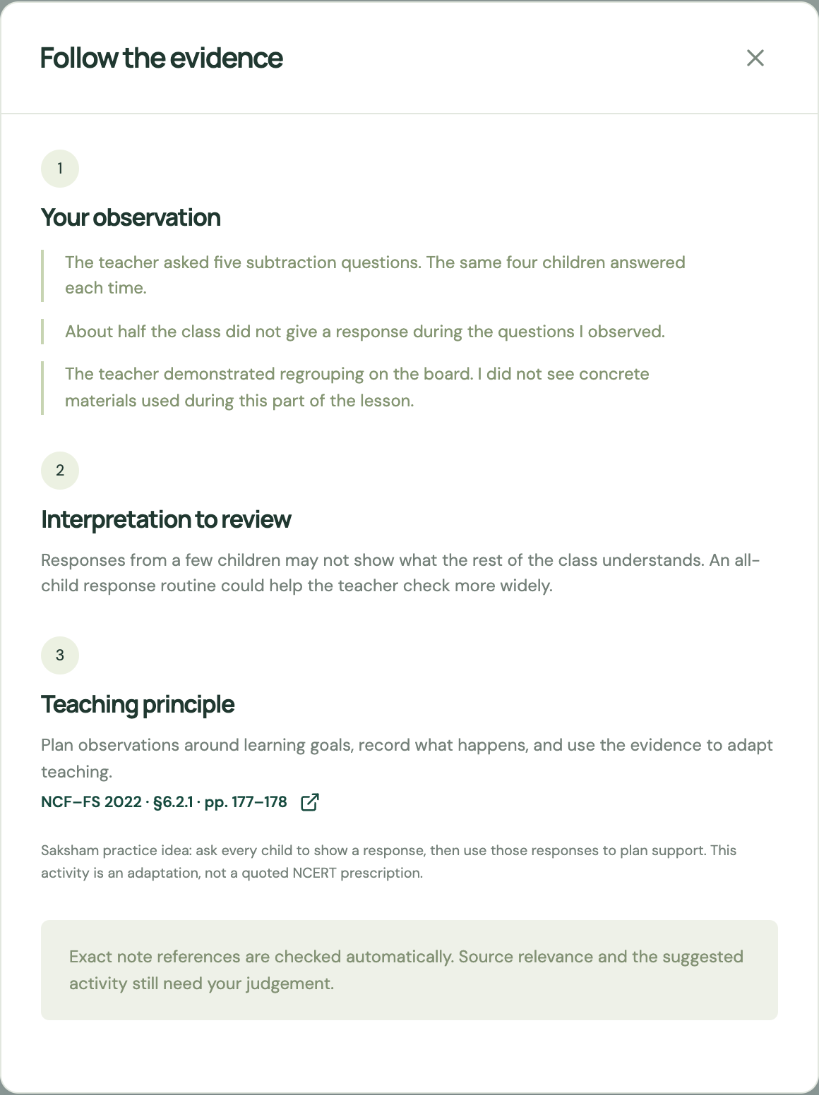
07 / INNOVATION AND TRUST
Every recommendation has an evidence trail
OBSERVED
“The same four children answered.”
INFERRED
The teacher may need a way to see
what the rest of the class understands.
UNKNOWN
Individual learning levels and what
happened outside this lesson segment.
SAKSHAM AI
Source principle: NCERT NCF–FS 2022, §6.2.1, pp. 177–178. The suggested activity is a Saksham adaptation.
07
Notes:
NCERT source: https://ncert.nic.in/pdf/focus-group/NCF-FS_2022EN.pdf section 6.2.1 printed pp. 177–178. It describes planned observation, recording concrete evidence, and reflection to inform teaching. Saksham’s slate-response activity is an adaptation, not a direct NCERT prescription. Exact quote matching and valid resource IDs are machine-checkable. Relevance, unsupported inference and instructional suitability require additional model checks, evaluation and human judgement. Do not rank teachers or infer capability, motivation or child diagnoses. Capture mentor notes without child-identifying data.

Slide 9
08 / TECHNOLOGY AND DATA FEASIBILITY
AI reasons over evidence before a mentor approves
Mentor notes
+ lesson context
Claude extracts
evidence + uncertainty
Retrieve reviewed
FLN source passages
Claude proposes
one coaching move
Offline: capture drafts
Online: model + retrieval
Agreed action
+ next-visit evidence
Claude role-play
+ coach feedback
Quote / source checks
+ mentor approval
DATA
IMPLEMENTATION
NCF–FS, NIPUN Bharat and permitted state FLN resources. Expert-reviewed scenarios for evaluation. No fine-tuning planned.
Next.js / TypeScript, server-side Claude, schema validation. Planned: PostgreSQL + pgvector, secure sync and multilingual speech.
SAKSHAM AI
Proposed production flow. Prototype uses fixed curated summaries; document retrieval, sync and multilingual ASR are build milestones.
08
Notes:
Architecture proposal. The local prototype currently uses React/Next.js, browser-local storage, Zod schemas, exact evidence-substring verification and curated resource summaries. A server-side Anthropic Messages route exists, but successful live-provider operation was not established in this session. Retrieval and PostgreSQL/pgvector are planned. NCF reference: https://ncert.nic.in/pdf/focus-group/NCF-FS_2022EN.pdf. Before indexing any material, verify licence/permission, version, section and language. Exclude identifying child information and establish consent, retention and access controls before any pilot. No child audio corpus or fine-tuning is needed for this MVP. No automatic teacher ranking. Live AI requires connectivity; a model failure must preserve notes and return a recoverable error.

Slide 10
09 / FEASIBILITY AND EVALUATION
A measurable path to a field pilot
What we will test
BUILD MILESTONES
By 27 September
Check | Proposed acceptance target
Evidence precision | ≥95% of cited claims supported
Expert agreement | ≥80% agreement on top coaching priority
Mentor usability | Median reviewed plan in ≤3 minutes
Submit the proposal and demonstrate the core interaction.
If shortlisted: by 1 November
Validate live AI and source retrieval. Test Hindi use and device constraints. Publish the testable build and demo.
40 synthetic cases, reviewed by FLN experts.
Then 5 consenting mentors across 10 paired visits.
Measure practice adoption separately from learning gains.
SAKSHAM AI
All sample sizes and thresholds below are proposed validation targets, not measured results. No pilot partners are confirmed.
09
Notes:
Evaluation plan only. Forty fictional/de-identified expert-reviewed scenarios should cover sparse evidence, contradictory notes, negation, Hindi/code-switching and attempts to elicit punitive judgements. Separate development cases from a held-out set. Define supported claims and use two expert reviewers for disagreements. Compare with an ungrounded LLM baseline. The proposed field sample is small and for usability/formative learning, not causal evidence of student impact. Time target measures the reviewed plan, not the classroom observation or teacher conversation. Proposed milestone dates follow the supplied hackathon guidelines. Current status: demo capture, evidence view, scripted rehearsal, commitments and reload persistence tested. Live Claude, expert endorsement, full Hindi localisation, secure multi-user deployment and offline reload resilience still require validation.

