Slide 1
TEAM 5 - JSS Hotel Booking System
Joe Savella
Sarthak Singh
Shuofei Wu

Slide 2
User Stories
As a guest, I want to be able to view rooms and their types.
As a guest, I want to be able to make a room reservation with the room type selected.
As a guest, I want to be able to review my reservation detail.
As a guest, I want to be able to pay for my hotel room booking.

Slide 4
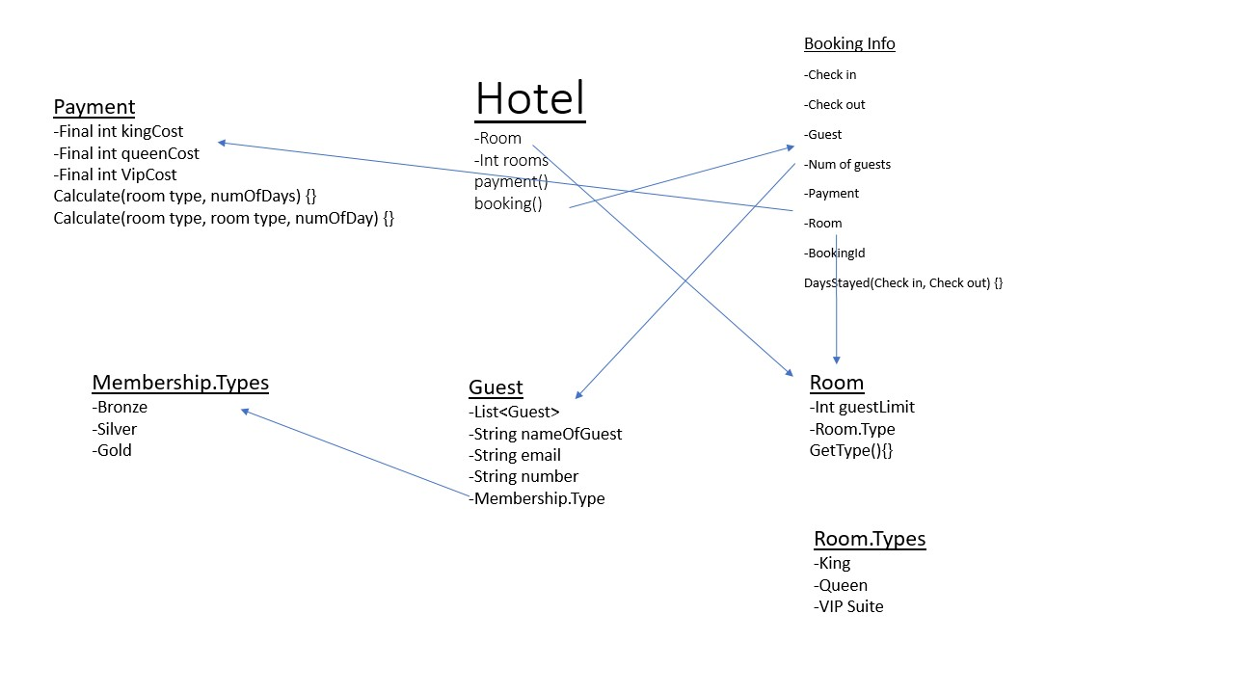
Initial Diagram for Hotel Reservation System

Slide 5
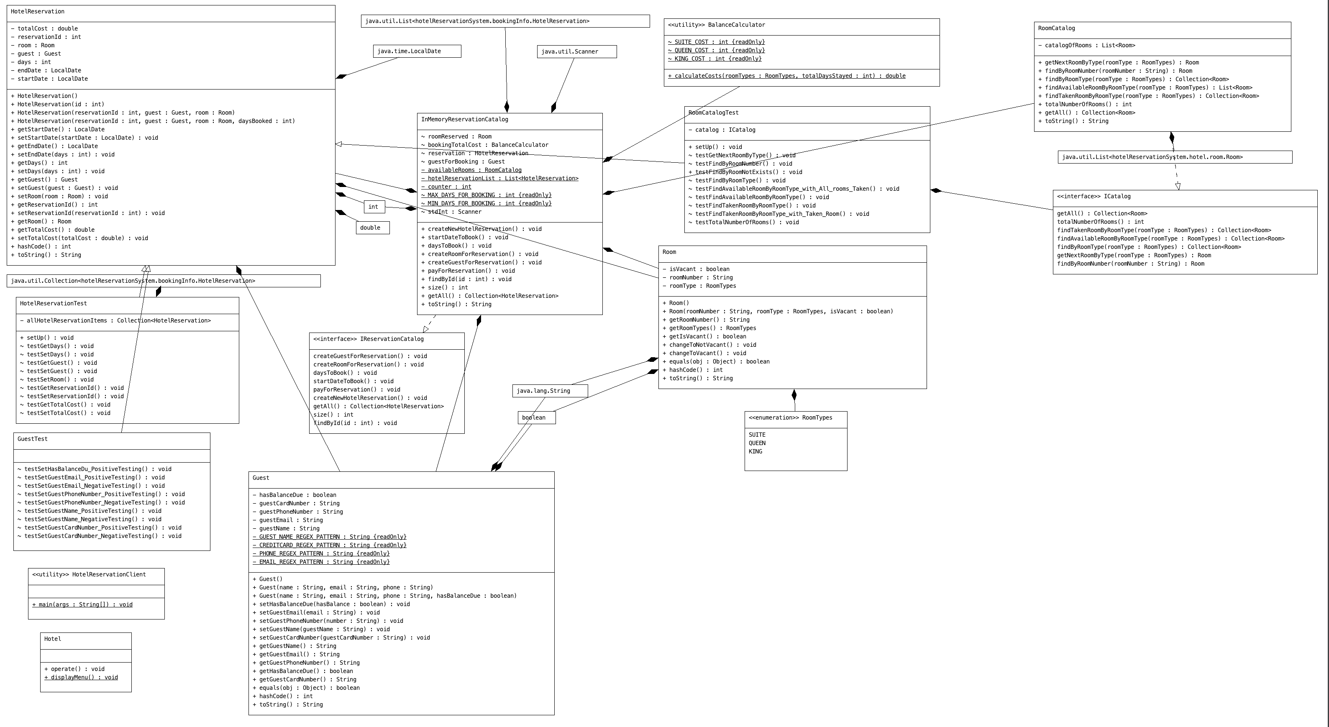
Final Diagram for Hotel Reservation System

Slide 6
Team Coordination
Project Creation:
-Most practical project idea
-Within scope of project requirements
Initial Diagram:
-Thought from the perspective of a user
-What functionality did we need to meet the above requirements identified
Coding:
-Open dialogue on development and design
-Identified requirements and chose to work on what we wanted individually
-Changes were agreed on first and made as a team
-Any roadblocks were tackled together
Testing:
-Done throughout development
-Usually done as a team

Slide 7
Coding Practices
-Single functionality at a time (coding small)
-Encapsulating conditionals
-Regularly refactored code to ensure no duplicated code existed (DRY)
-Unused code was deleted
-Large monolithic methods were broken down into smaller, more readable pieces
-Naming conventions were decided based on relevance and meaning
-Documentation, used comments where required and logical
-Minimized nested conditions
-Looking out for and fixing side effects
-Meaningful commits and messages (committing very frequently)
-Testing changes as a group before commit/push
Issues:
-git merge conflicts
-push/pull errors

Slide 8
Mistakes Made and Lessons Learned
Click "Commit" before "Updating Projects" or "Pull" or risk in losing work in local machine
Thoroughly test codes before pushing to Git or risk in blocking teammates
Be careful of handling edge cases

Slide 9
Q & A

