Slide 1
PHData project challenge.
Self introduction.
Project challenge overview.
Project details.
Code walk thru.
Code Execution using DataBricks and Snowflack.
Q/A
Review/Comments.

Slide 2
Project challenge overview
Northwoods Airlines is a client engaging in a proof of value (POV) project using Snowflake and Databricks.
Their Data Owners have provided us datasets containing airports, airlines, and flight

Slide 3
Project challenge overview
Total number of flights by airline and airport on a monthly basis.
On time percentage of each airline for the year 2015.
Airlines with the largest number of delays.
Cancellation reasons by airport.
Delay reasons by airport.
Airline with the most unique routes.

Slide 4
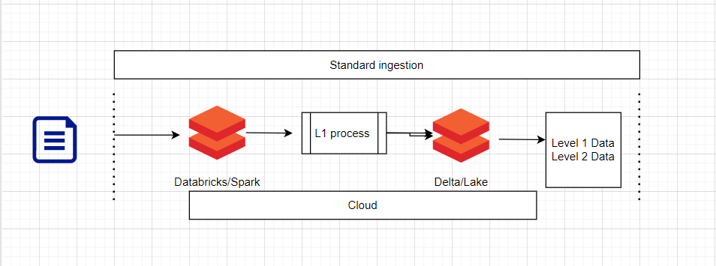
Project details
Code walk thru
Code Execution using DataBricks and Snowflack

Slide 5
Q/A ?

