Slide 1

Real Estate Price Prediction

Slide 2
About The Team
Satish Kumar- 200574904
Dhyan Trivedi- 200565531
Anmol Toor- 200578497
Harsh Bhadreshbhai Patel-200575814

Slide 3
Table of Content
Project Proposal: Deliver a short proposal document detailing the project scope, objectives, and intended approach.
Data Collection and Preparation: Get the data ready for analysis and modeling.
Exploratory Data Analysis (EDA) : Gain insights into the data and understand key patterns.
Model Selection and Building: Test various machine learning algorithms to find the best one for our project.
Hyperparameter Tuning: Fine-tune the chosen model to make it as accurate as possible.
Model Evaluation and Validation: Verify the model’s accuracy and reliability.
Model Deployment: Make the model usable in real-world or simulated settings.

Slide 4
Data Collection and Preparation
In this section, we imported the dataset, handled missing values, removed duplicates, visualized outliers, and encoded categorical features. Then, standardized numerical data to prepare it for analysis, resulting in a clean, ready-to-use dataset.

Slide 5
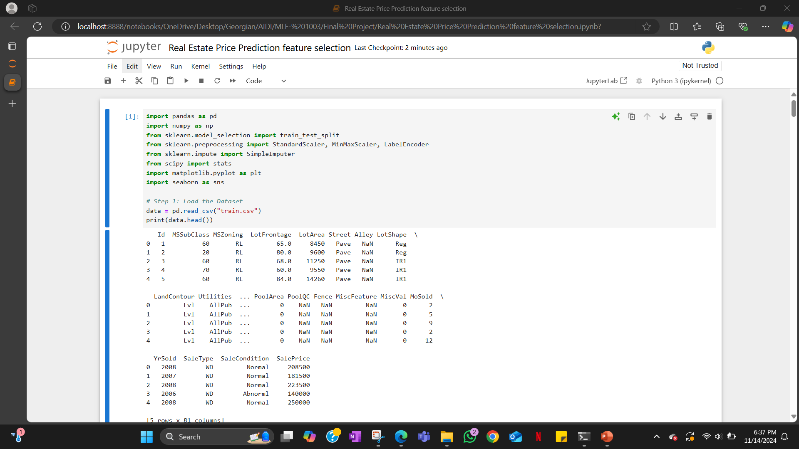

Slide 6
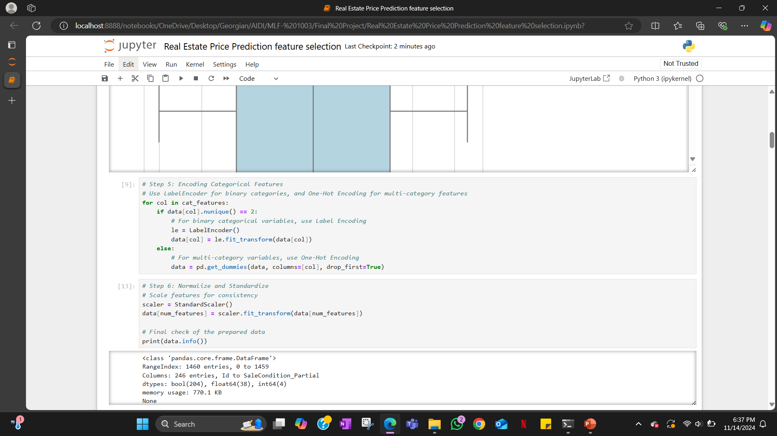

Slide 7
Exploratory Data Analysis (EDA)
In this section, we provided a visual overview of the dataset by displaying summary statistics, histograms for each numerical feature, and scatter plots showing relationships between key features and the target variable, `SalePrice`.
We also included a pair plot to examine relationships among selected features and a heatmap to highlight the top features most correlated with `SalePrice`. These visualizations helped identify patterns and correlations in the data for further analysis.

Slide 8
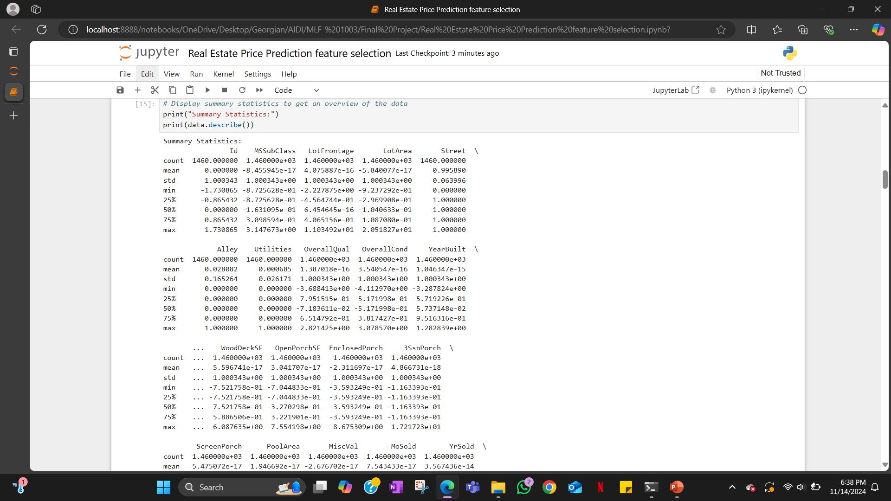

Slide 9
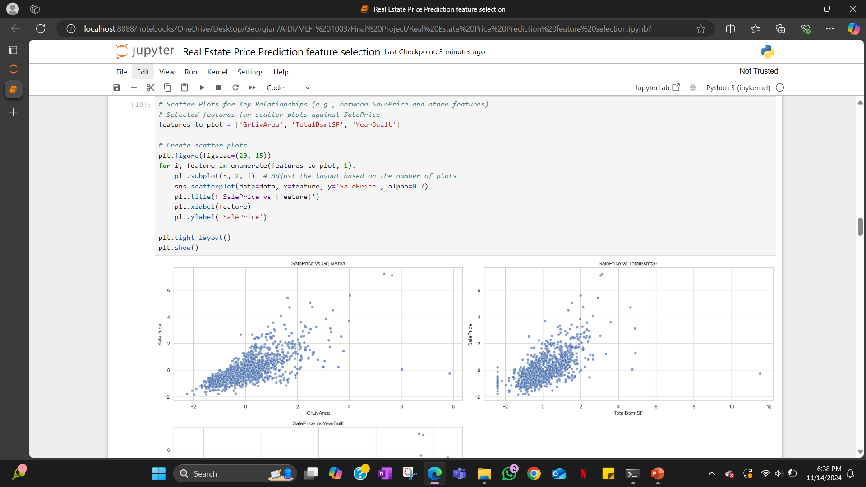

Slide 10
Model Selection and Building
In this section, we built and compared four different regression models to predict `SalePrice` using features from the dataset, splitting the data into training and testing sets. We trained each model, made predictions, and calculated performance metrics such as Mean Absolute Error (MAE), Mean Squared Error (MSE), and R-squared (R2) for each model.
Finally, displayed a table of these metrics, helping to compare the models' accuracy in predicting `SalePrice`.

Slide 11
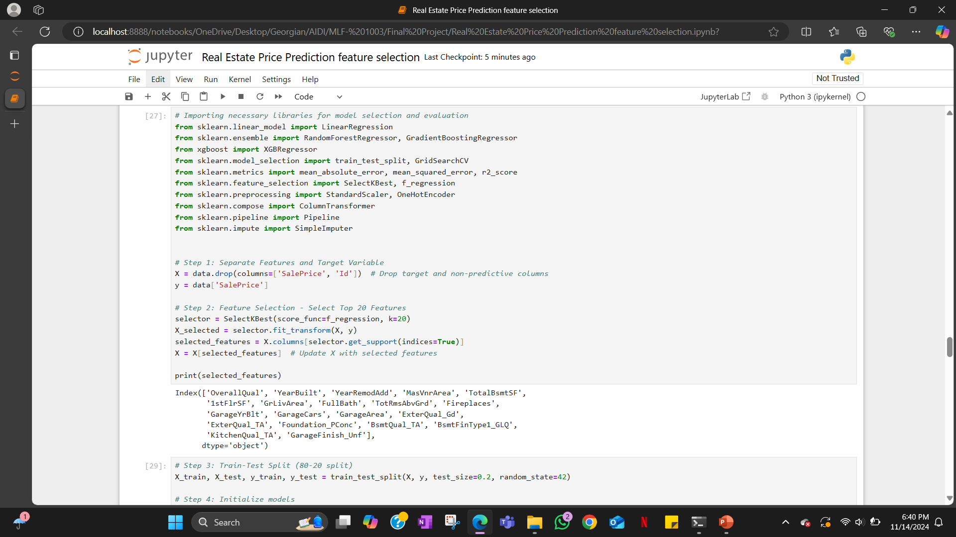

Slide 12
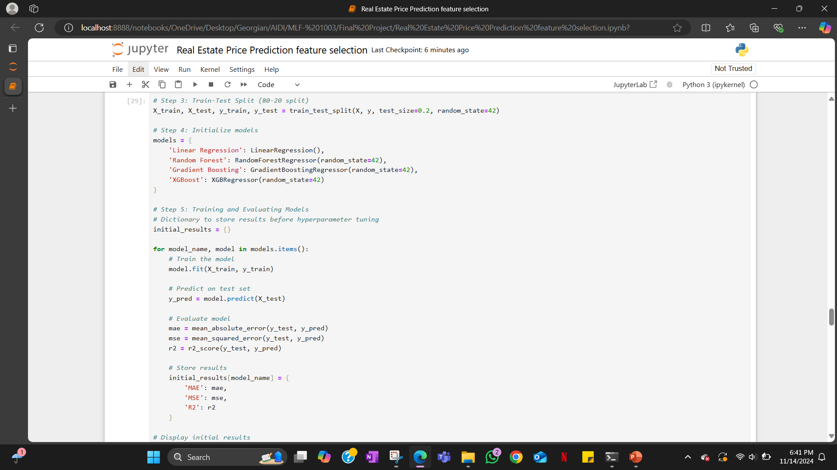

Slide 13
Hyperparameter Tuning
In this section, we performed hyperparameter tuning using GridSearchCV on selected models (Random Forest and XGBoost) to find the best parameter settings for improved performance.
Then, we evaluated the tuned models by predicting on the test data, calculating Mean Absolute Error (MAE), Mean Squared Error (MSE), and R-squared (R²), and stored the best parameters and performance metrics for comparison.
Finally, we displayed the summary of model performance before and after tuning.

Slide 14
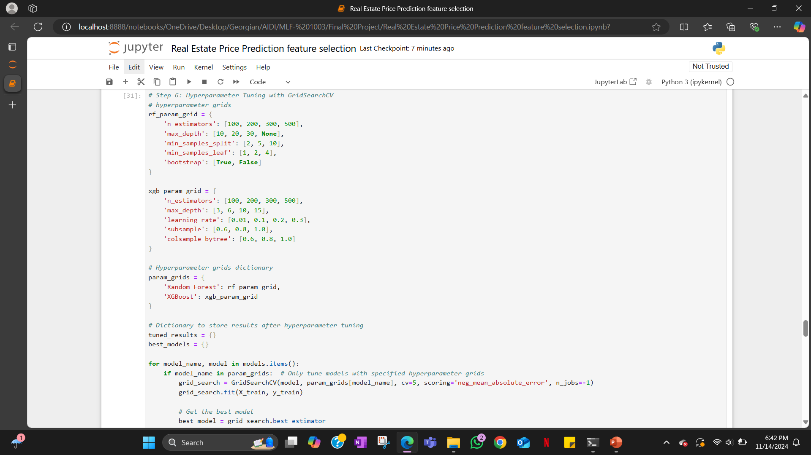

Slide 15
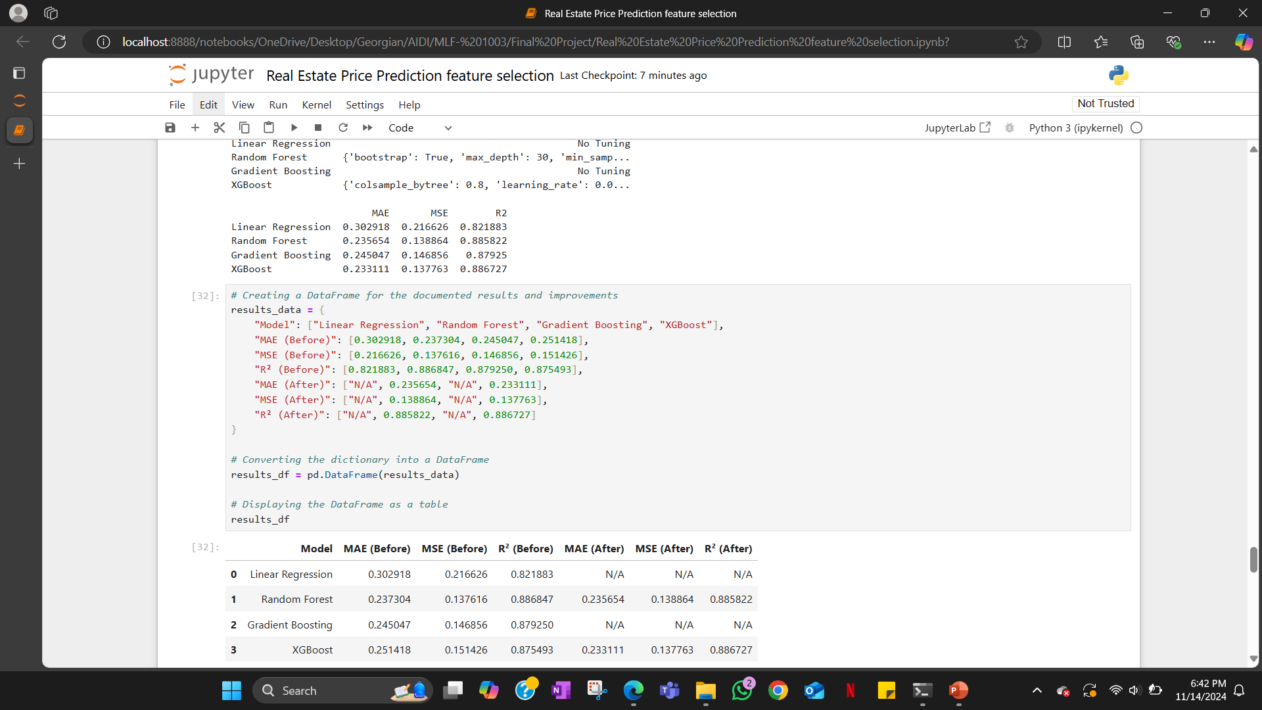

Slide 16
Model Evaluation and Validation
In this section, we trained the machine learning model (XGBoost) to predict house prices based on selected features like quality, area, and year of construction. We encoded categorical variables into numerical values, scaled the features for better model performance, and trained the XGBoost model on the training dataset. After training, it made predictions on the test data and saved the results (predicted house prices) into a CSV file which we saved in our local system.

Slide 17
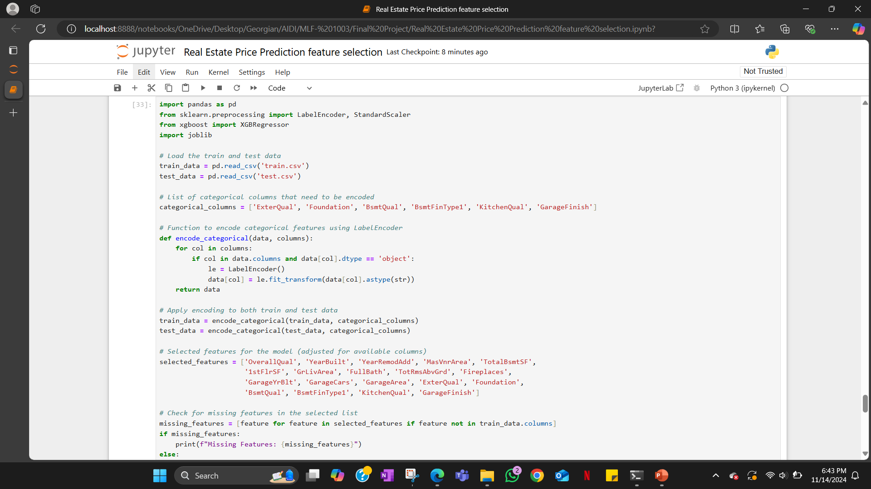

Slide 18
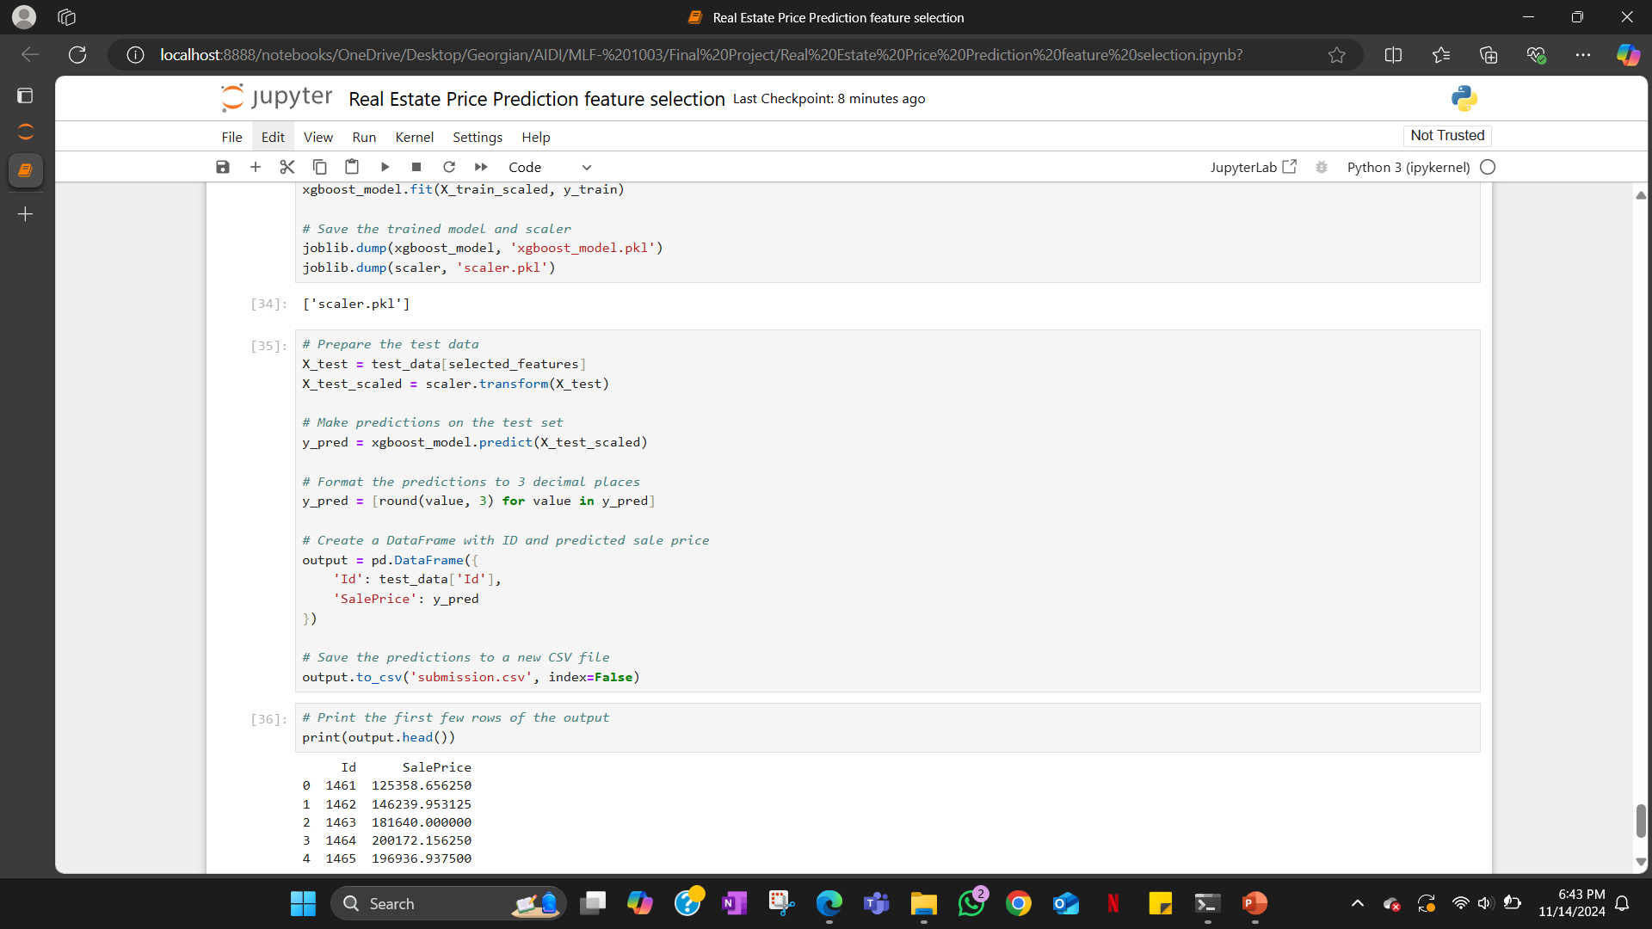

Slide 19
Model Deployment
In this section, we set up a simple web application using Flask, where the trained machine learning model (XGBoost) is used to predict real estate prices based on input features.
Our application has two main parts: one endpoint to accept data and return predicted house prices, and a home page displaying group details and a table of members. The application is designed to run locally or on a platform like Postman, and it uses joblib to load the saved model and scaler for making predictions.

Slide 20
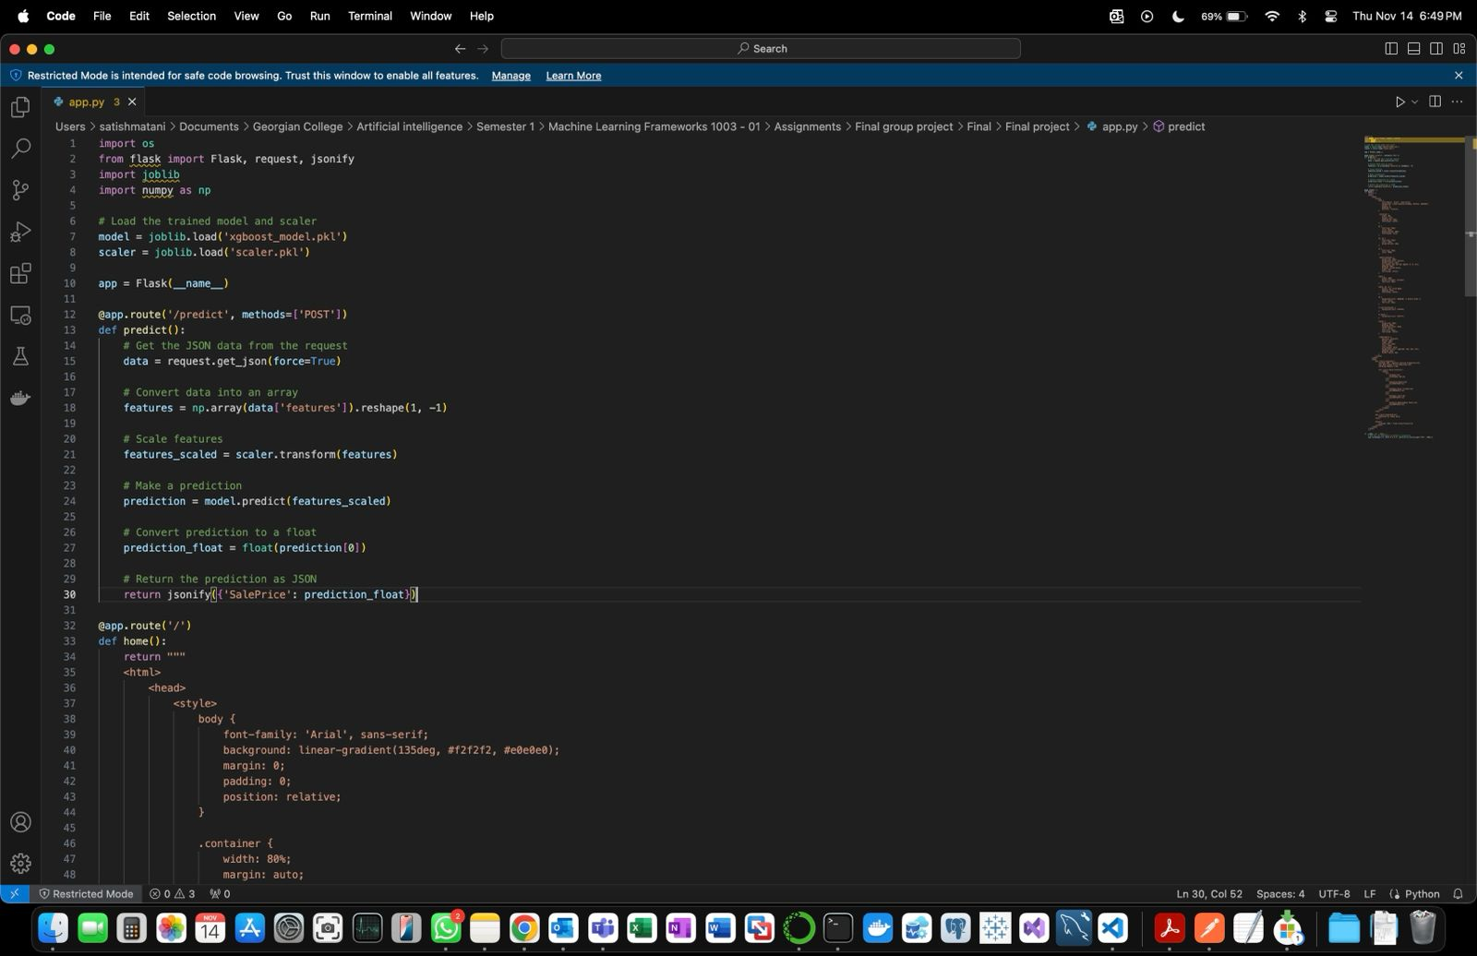

Slide 21
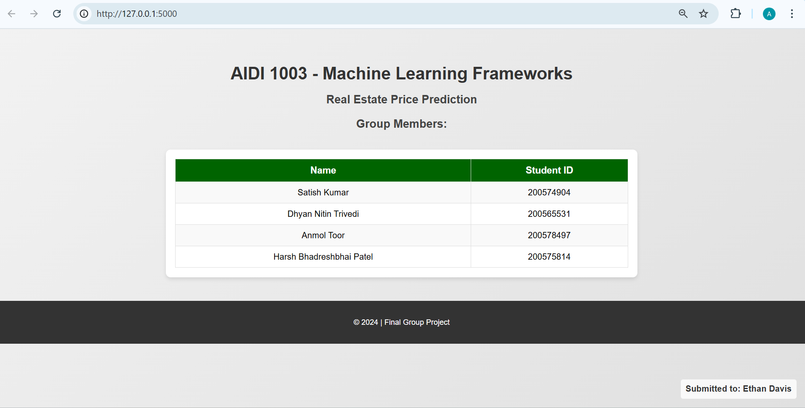

Slide 22
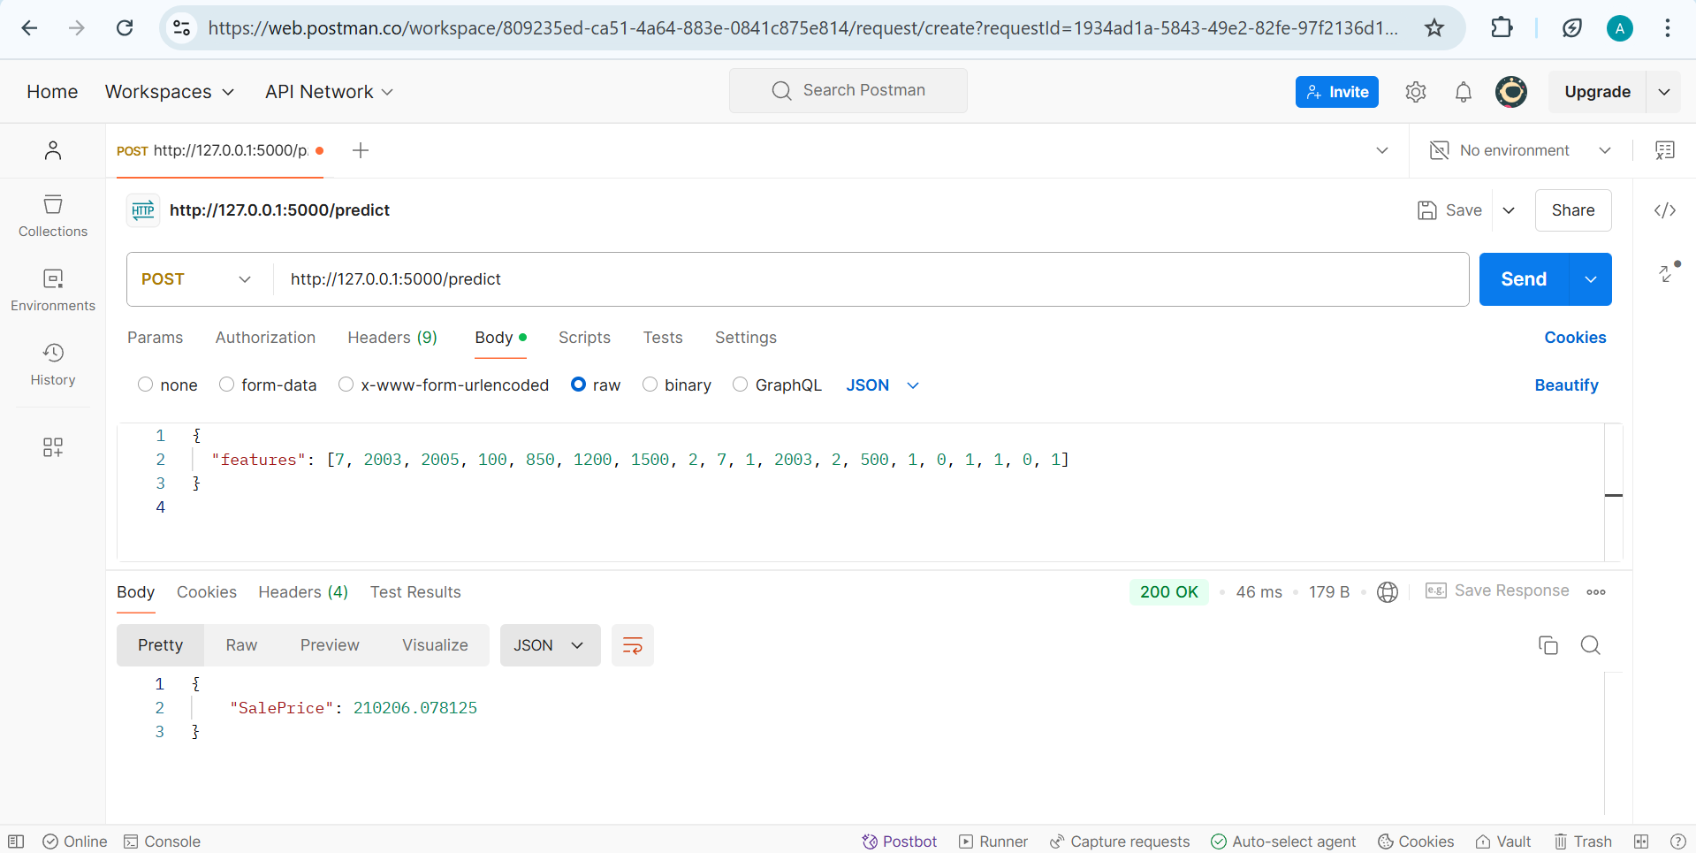

Slide 23

Github Link:
https://github.com/Anmol-toor/Real-Estate-Price-Prediction

Slide 24
Thank You

