Slide 1

common dynamic project errors and solutions

Slide 2
Steps to start Server in Eclipse IDE
Ensure that you have Server option in the view panel(bottom of the Screen)
Click on Servers then on the hyper Link (no servers available. Click this Link to create a new Server...)
Then Select Apache and select latest version of tomcat available over there (eg: Tomcat v 10.1 Server) then click on next (or) to setup Server run time Environment.
Set tomcat installation directory (Browse and select it from disk " D:\Program Files\Apache Software Foundation\" select the apache-tomcat folder xx.x.x version which should be same version selected in step 2).
Select JRE and set it to Workbench default JRE.
Click on Finish.

Slide 3
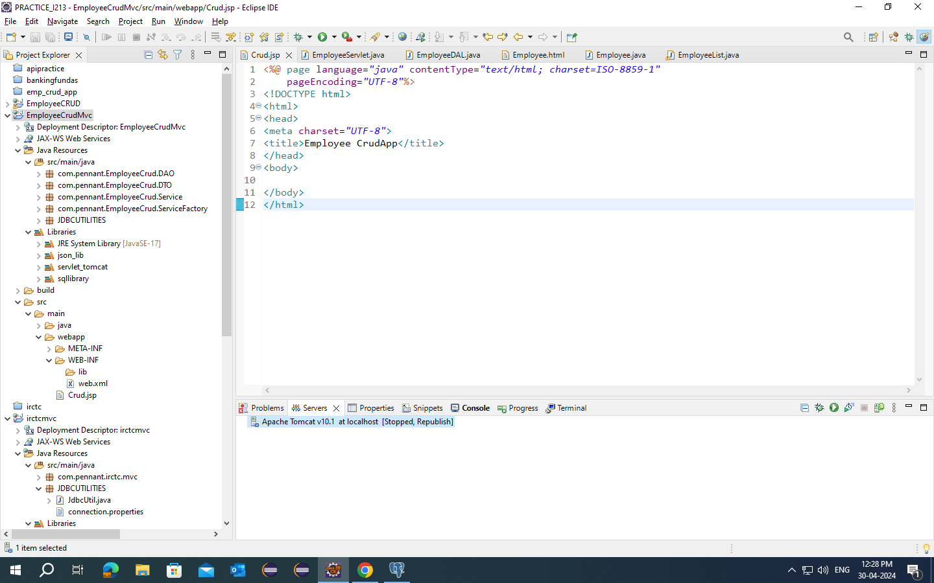
Steps to add your project to the Apache server
Click on Servers Select the running Server eg:
Right Click on the Server and Select Add and Remove then Select your project[s] that you want to deploy
Click on Finish.

Slide 4
Common status codes and their meaning
Status code | Meaning
100-199 | Information
200-299 | Success
300-399 | Redirection
400-499 | Client Side Error
500-599 | Server Side Error
=> Client side errors occurred when the client is requesting a resource that is not available(check URL patterns/filenames/relativepaths
=> Server side error occurs when there is an issue while processing the request it may be any logical errors(500- instantiation erorr occurs when the servlet doesn’t have public constructor occurs when you work with Servlet Interface).

Slide 5
Error : Selection is not in a valid module
To solve this issue you need to check whether the build path is properly configured or not
Click on your project folder press ALT + ENTER[↵] key.
Click on java Build Path.
Select Class Path then click on Add Library select WebApp Libraries Click on Next.
Select your Project folder in drop down and click on Finish.
As well as Select EAR Libraries and click Finish.

Slide 6
Error : certain JAR files not found (refer console)
Click on your Project Folder press ALT+ENTER[↵].
Select Deployment Assembly.
Click on Add.
Select Java Build Path Entries.
Select All the JAR's showing there.
Click on Finish.
Click Apply and Close.

Slide 7
Error : Project folder not showing to run on Server or not in list while adding to server
Click on your Project Folder press ALT+ENTER[↵].
Select Project Facet.
Select Dynamic Web Module Version below or equal to 5.0.
Click on Apply and Close.

