Slide 1

Data Visualisation in Tableau
Made By
Satish Rawat

Slide 2
Observations
Sentiment | Percentage | Influencer Count | Top 5 Influencer | Followers Count | Friends Count | Engagement Count | Retweet Count
Positive | 35.59% | 15 | Original, TimesNow, Guideforall, NDTV, Indiatoday | 2,855.14M | 8,266,332 | 80,803 | 1,113,156
Negative | 14.02% | 10 | Original, Babu_bhaiyaa, Republic, Rahulkanwal, TimesNow | 689.13M | 2,889,051 | 35,689 | 978,632
Neutral | 50.40% | 18 | Original, ShivAroor, IndiaToday, Republic, TimesNow | 2,785.42M | 11,314,787 | 124,987 | 6,337,340
Maximum number of tweets generated on 19 May 2019 during 10 AM to 8 PM

Slide 3
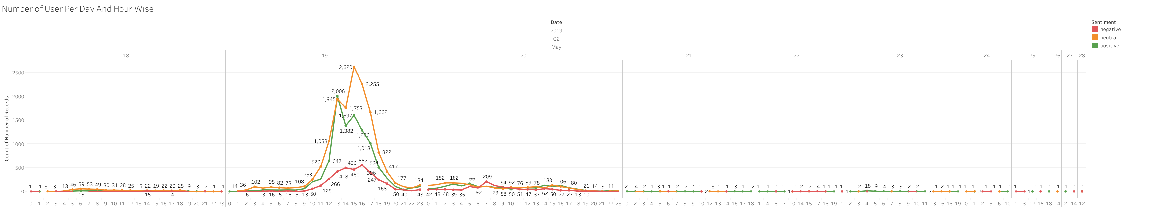
User Count Day Wise and Sentiment Wise

Slide 4
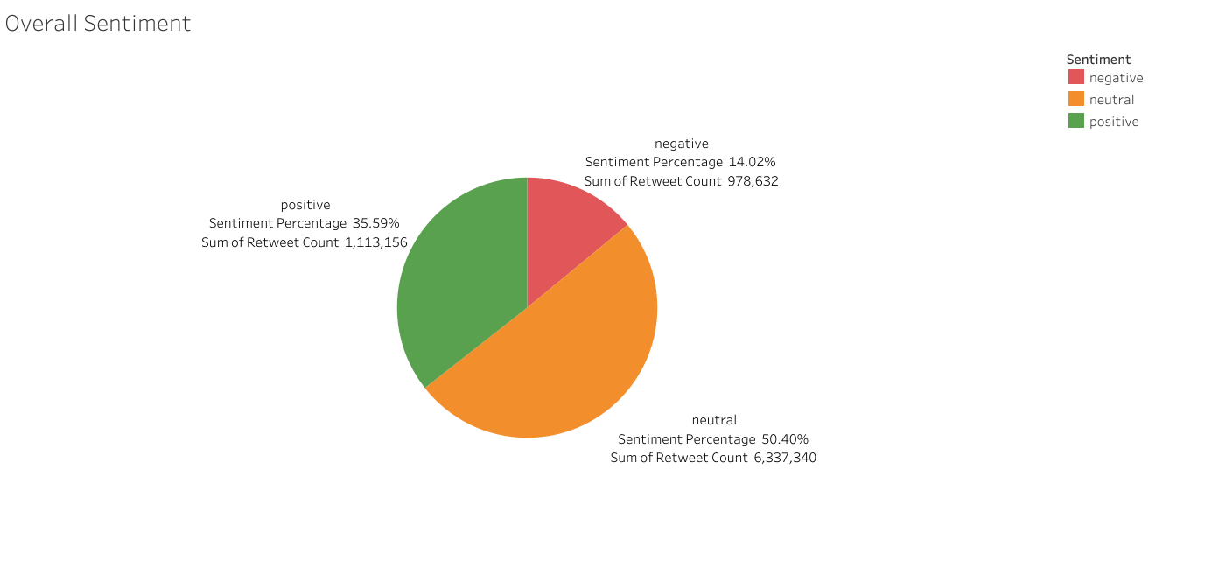
Overall Sentiment

Slide 5
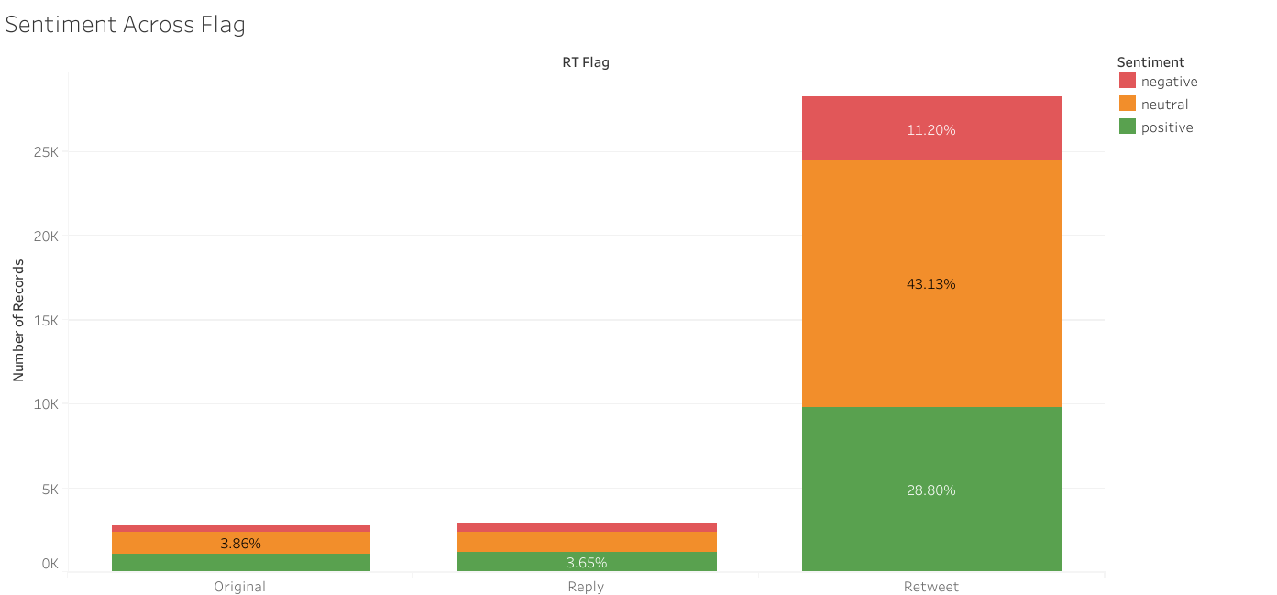
Sentiment Across RT Flag

Slide 6
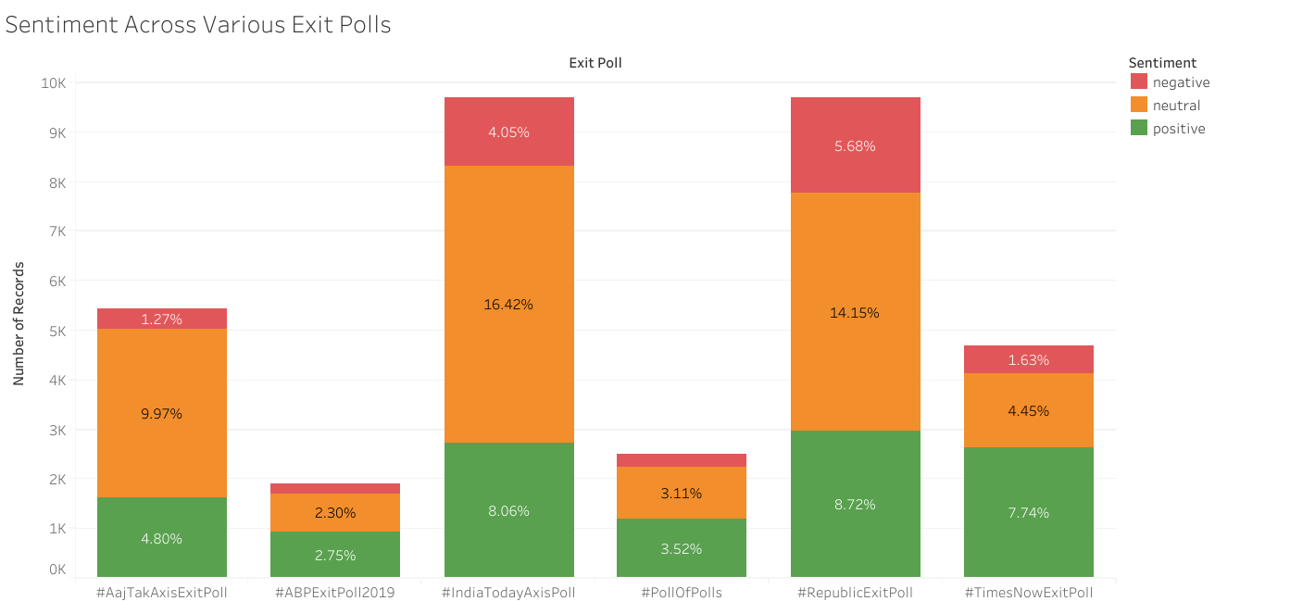
Sentiment Across Various Exit Polls

Slide 7
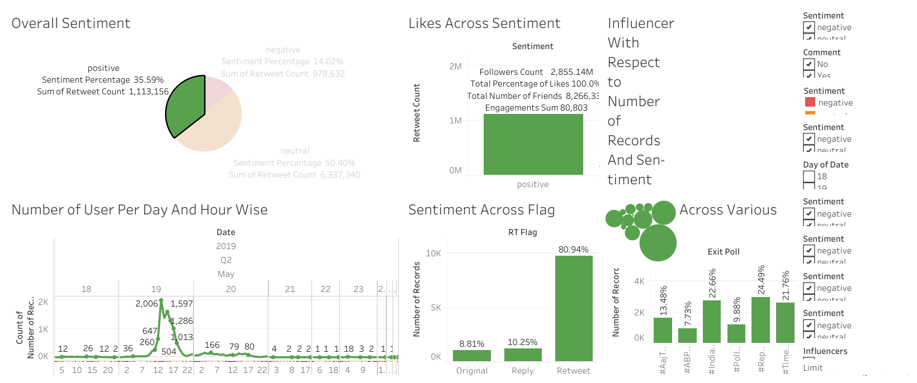
Positive Dashboard

Slide 8
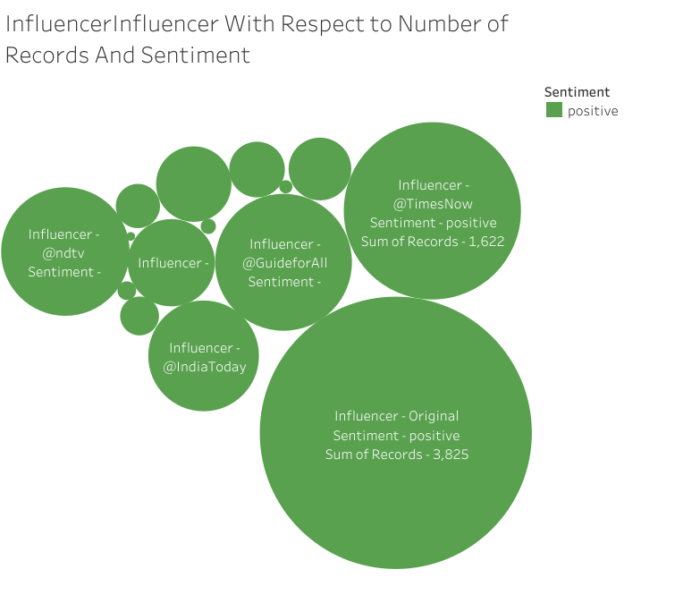
Positive Influencer Bubble Chart

Slide 9
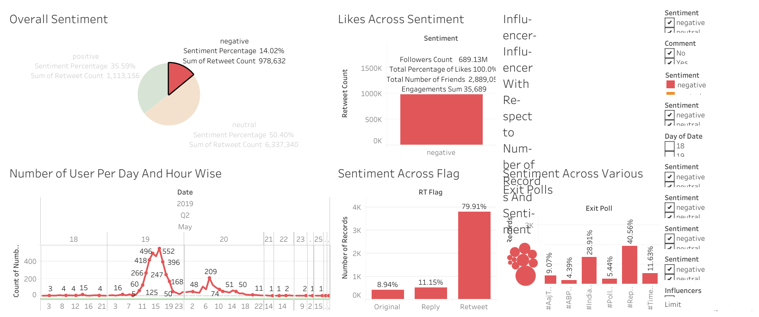
Negative Dashboard

Slide 10
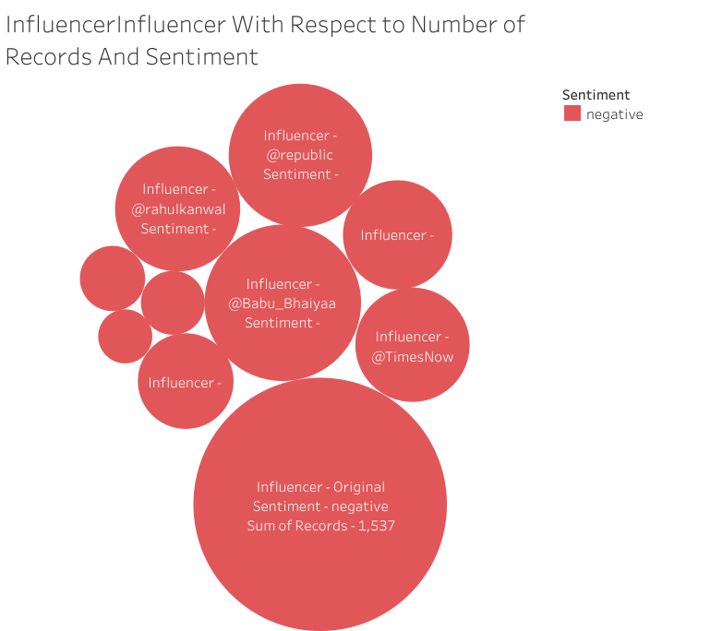
Negative Influencer Bubble Chart

Slide 11
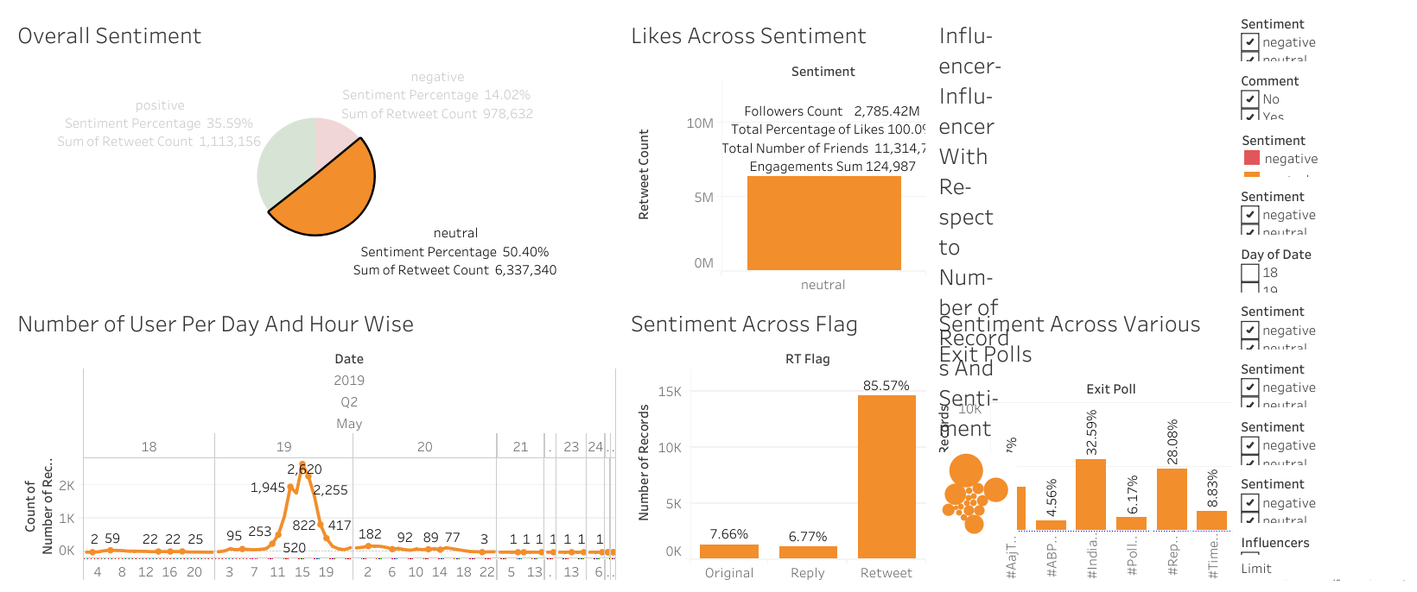
Neutral Dashboard

Slide 12
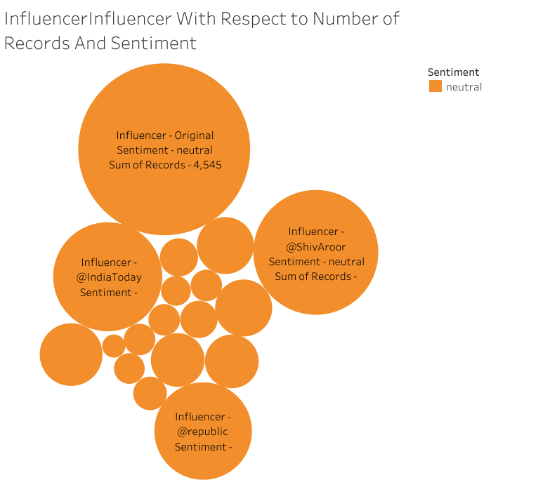
Neutral Influencer Bubble Chart

