Slide 1
Report on
Business Analytics Capstone Project
(Using R)
Domain – Telecom
Project ID : CP2
Satish Rawat

Slide 2

BUSINESS ANALYTICS CAPSTONE PROJECT REPORT
Telecom Churn
1. AN INTRODUCTION

Slide 3
BUSINESS ANALYTICS CAPSTONE PROJECT REPORT
1.1 Project Brief
Acquiring a new customer costs more to a company than retaining current customer.
All over the world there are numerous Telecom companies that are providing similar kind of services.
In this project we trying to find out the factors which are affecting the Churn Rate and Revenue loss due to churning of a Telecom company.
Finding the areas where Company can invest money to increase revenue and decrease Churn Rate.
In This Project we will use classification method to identify factors affecting Churning and use this model to predict which consumer are likely to quit the services.

Slide 4
BUSINESS ANALYTICS CAPSTONE PROJECT REPORT
1.2 Objective of the Study
Consumers today go through a complex decision making process before subscribing to any service before subscribing to any one of the numerous Telecom service options.
The services provided by the Telecom vendors are not highly differentiated and number portability is also available.
Customer loyalty becomes an issue. Hence, it is becoming increasingly important for companies to proactively identify factors that have a tendency to unsubscribe and take preventive measures to retain customers.

Slide 5
BUSINESS ANALYTICS CAPSTONE PROJECT REPORT
1.3 Approach of the Study
Load Dataset.
Check for missing values and outliers.
Treat missing values and outliers.
Data Exploration and Data visualisation.
Splitting the Dataset into Training and Testing.
Make a predictive model using relevant statistical modelling technique and Training Dataset.
Evaluate and validate model using Training Dataset and observing certain metrics of model and results.

Slide 6
BUSINESS ANALYTICS CAPSTONE PROJECT REPORT
Approach of the Study
In This Project, we are going to use very well known 2 Statistical Techniques Known as Random Forest and Logistic Regression.
Both Techniques are widely used for classification problems such as Customer Segmentation, Classification of images and much more.
We will use data visualisation techniques to find relations between churn and various factors to gain insights out of dataset.
Model is build using 2 techniques and compare best models of both techniques and Evaluated on certain metrics and used on Testing Dataset to validate results.

Slide 7
BUSINESS ANALYTICS CAPSTONE PROJECT REPORT
1.4 Scope and Limitation of the Study
Scope :-
This Project helps to identify factors affecting churning of a Telecom Company.
This project helps us to identify potential consumer which will likely to quit to services.
Limitations :-
This project is only applicable to Telecom sector.
This project can only identify potential consumers which are most probably are going to quit.

Slide 8

BUSINESS ANALYTICS CAPSTONE PROJECT REPORT
2. DATA EXPLORATION

Slide 9
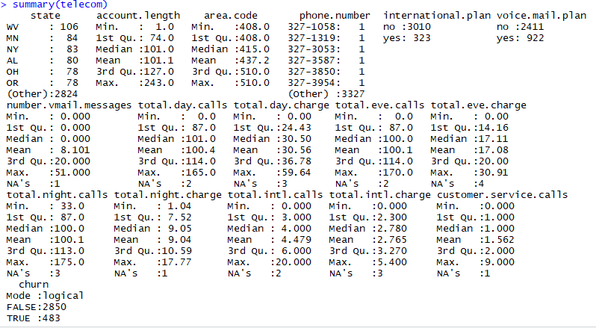
BUSINESS ANALYTICS CAPSTONE PROJECT REPORT
DATA EXPLORATION
Descriptive Analysis :-
Brief Summary Report of Dataset to Find Missing Values and various other Statistical Measures. Data is not equally distributed for churn as observed and missing value count is very.

Slide 10
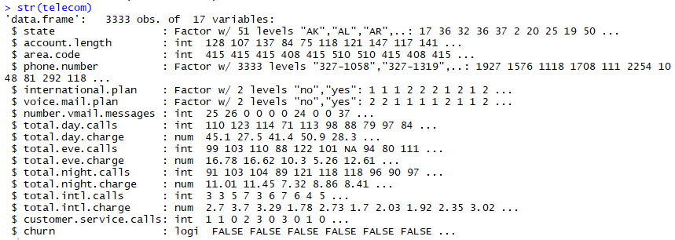
BUSINESS ANALYTICS CAPSTONE PROJECT REPORT
DATA EXPLORATION
Data Structure Of Dataset to understand better how data is collected, how to handle dataset, what transformation are required, how to read the dataset, what is meaning of each variable.

Slide 11

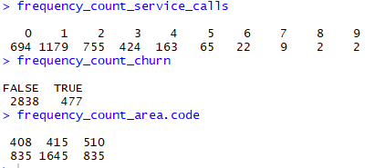
BUSINESS ANALYTICS CAPSTONE PROJECT REPORT
DATA EXPLORATION
Missing Values are omitted because percentage of missing values are low as observed from summary report. Only 17 rows are omitted.
Maximum consumers are from area code of 415.
Maximum consumers service calls once, twice and thrice.
Maximum consumers are False Churn.

Slide 12
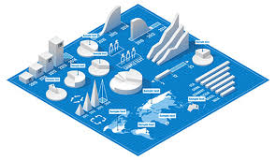
BUSINESS ANALYTICS CAPSTONE PROJECT REPORT
3. DATA VISUALISATION

Slide 13
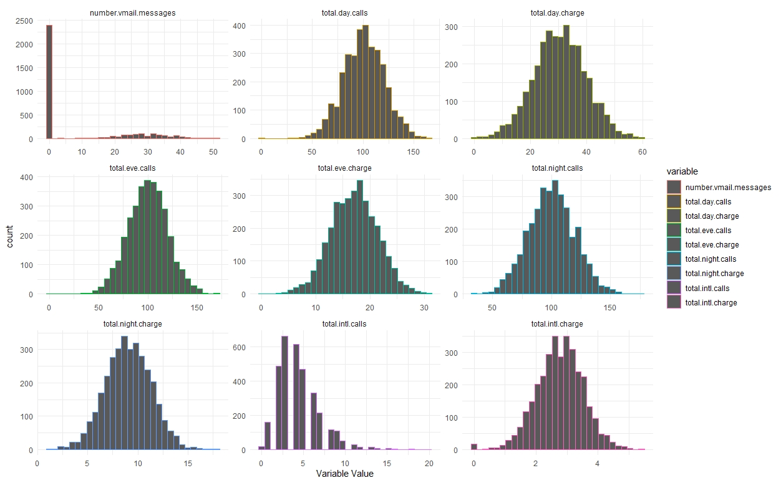
BUSINESS ANALYTICS CAPSTONE PROJECT REPORT
DATA VISUALISATION
Most of numerical variables are approximately normally distributed.

Slide 14
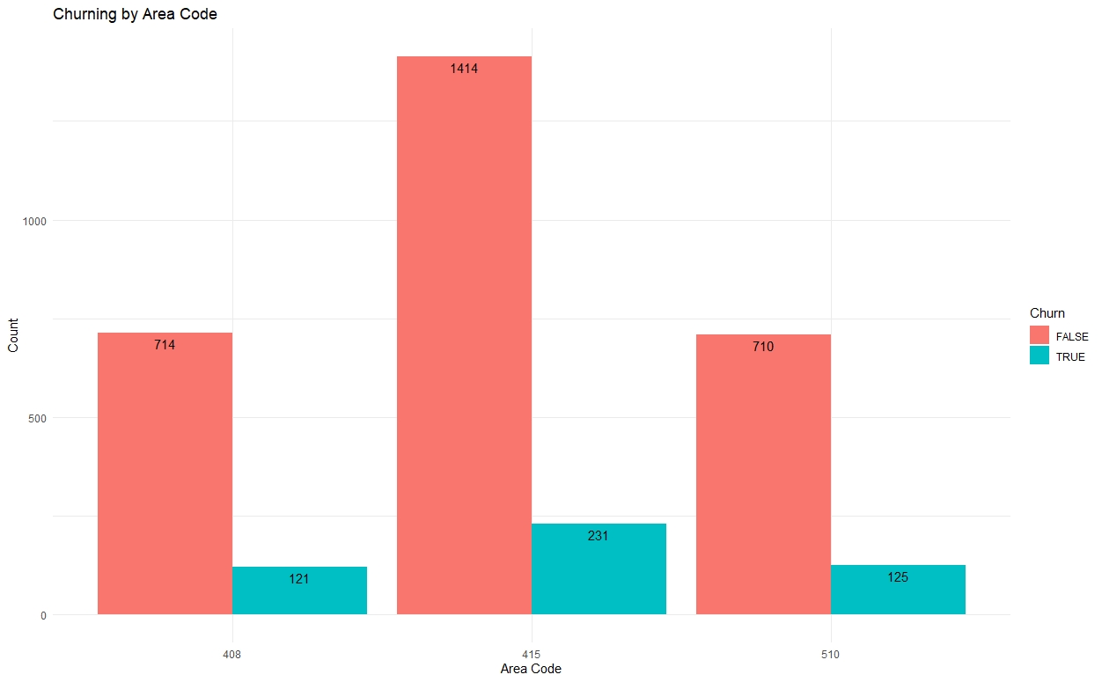
BUSINESS ANALYTICS CAPSTONE PROJECT REPORT
DATA VISUALISATION
As seen from below Bar Chart Area Code 415 have maximum consumers but churning is percentage area is constant.
This implies churning is not depending on location.

Slide 15
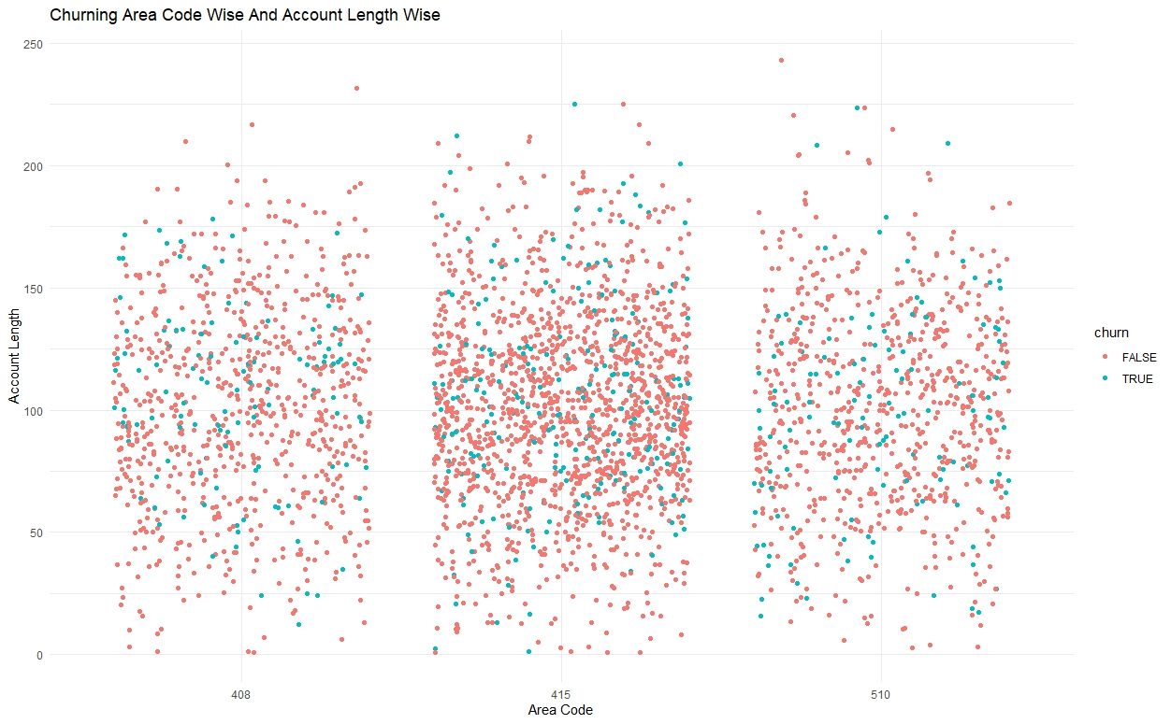
BUSINESS ANALYTICS CAPSTONE PROJECT REPORT
DATA VISUALISATION
Consumers who has been with company for period range from 50 to 150 are most churning.

Slide 16
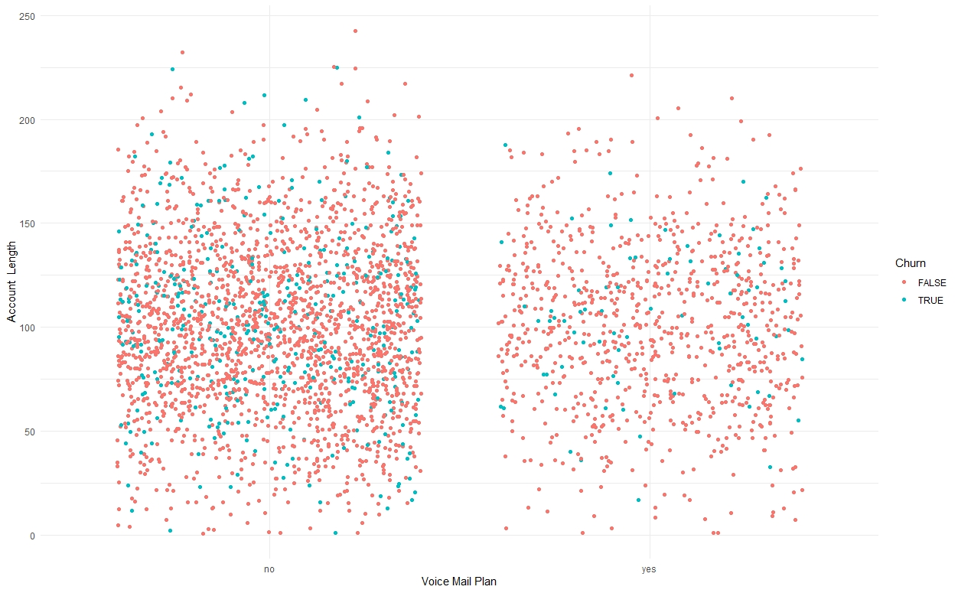
BUSINESS ANALYTICS CAPSTONE PROJECT REPORT
DATA VISUALISATION
Consumers who doesn’t have voice mail plan and account length more than 75 are most churning.

Slide 17
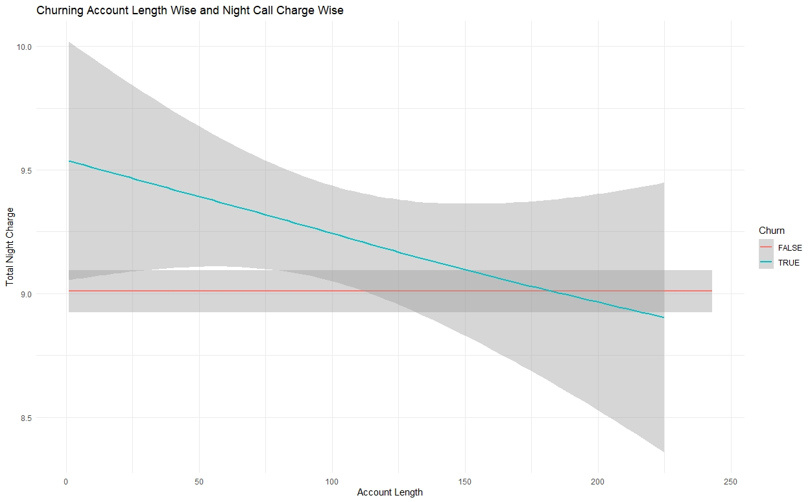
BUSINESS ANALYTICS CAPSTONE PROJECT REPORT
DATA VISUALISATION
As consumer subscription period increases total night charge gets decreases for churning out customers.

Slide 18
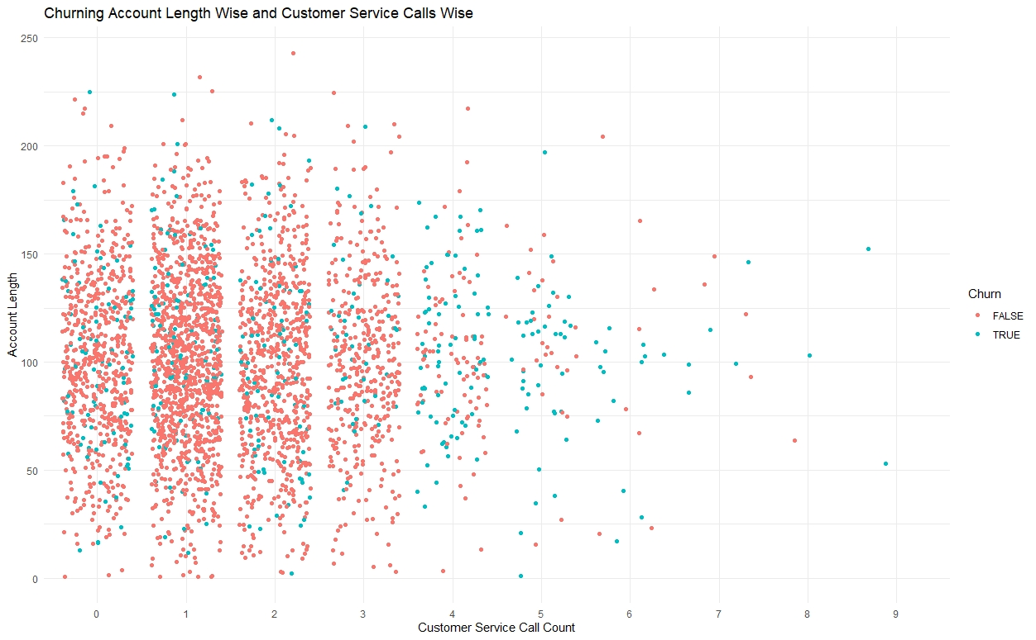
BUSINESS ANALYTICS CAPSTONE PROJECT REPORT
DATA VISUALISATION
Consumers who called more than 3 times to service centre are most churning.

Slide 19
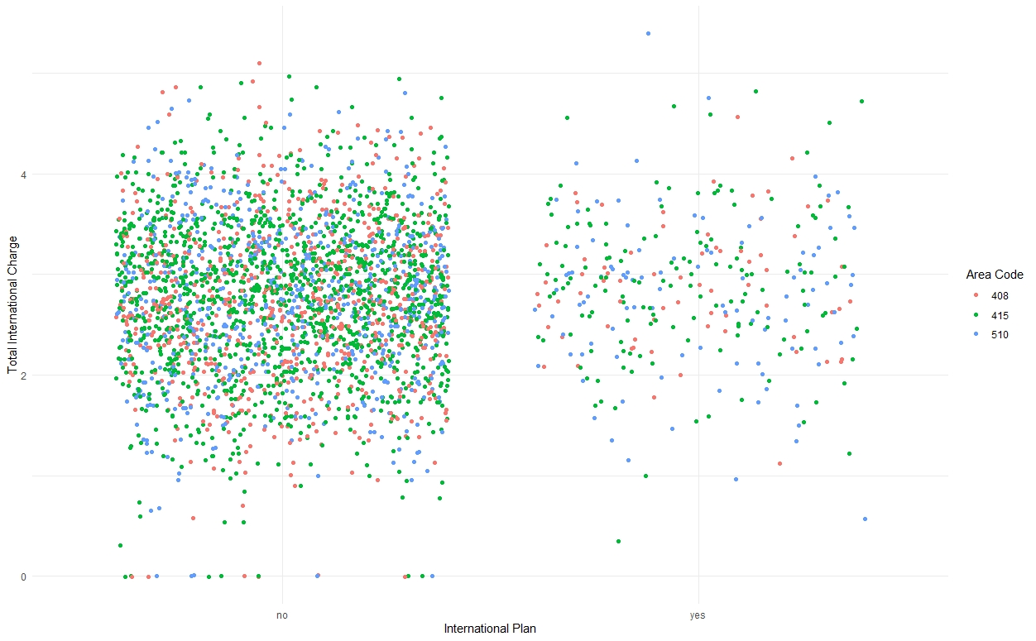
BUSINESS ANALYTICS CAPSTONE PROJECT REPORT
DATA VISUALISATION
Consumer who have International plan and international charge more than 2 are most churning out. This implies check international plan rates.

Slide 20
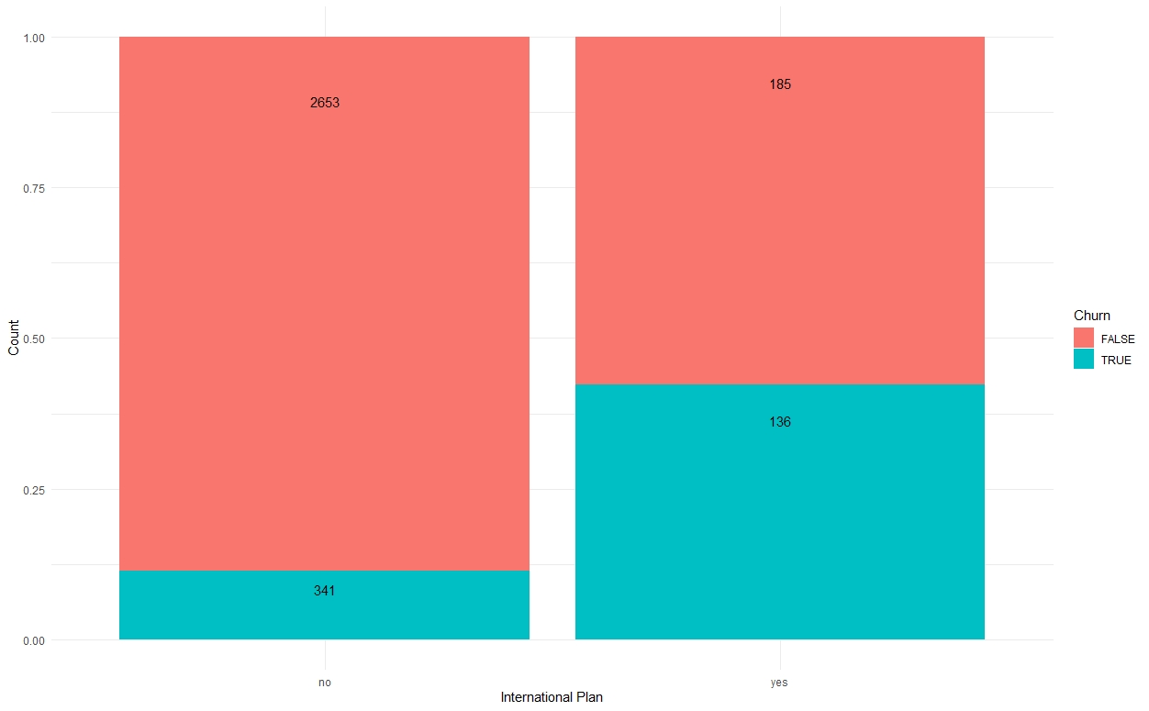
BUSINESS ANALYTICS CAPSTONE PROJECT REPORT
DATA VISUALISATION
Consumer who have international plan are most churning. Monitor international plan.

Slide 21
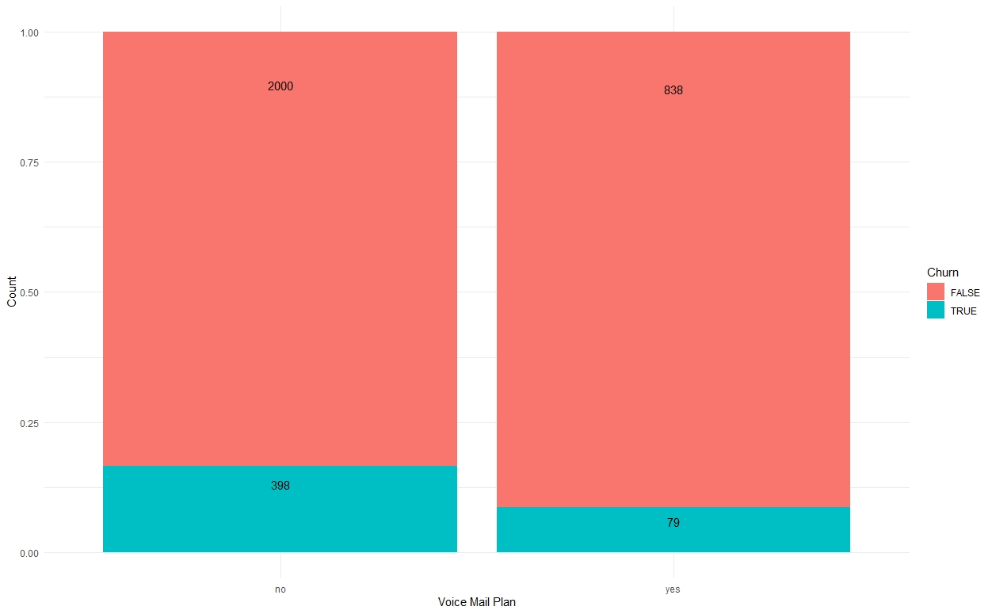
BUSINESS ANALYTICS CAPSTONE PROJECT REPORT
DATA VISUALISATION
Consumers who doesn’t have voice mail plan are most churning out.

Slide 22

BUSINESS ANALYTICS CAPSTONE PROJECT REPORT
4. DATA MODELLING

Slide 23
BUSINESS ANALYTICS CAPSTONE PROJECT REPORT
DATA MODELLING
For predicting potential consumers who are going to quit the Telecom services, we are going to use two classification techniques known as Logistic Regression and Random Forest and Evaluate each models on Precision, Sensitivity, Specificity and AUC.
We use these models and validate our results using Test Dataset on Precision, Sensitivity, Specificity and AUC.

Slide 24
BUSINESS ANALYTICS CAPSTONE PROJECT REPORT
DATA MODELLING
Sensitivity (also called the true positive rate, the recall, or probability of detection in some fields) measures the proportion of actual positives that are correctly identified as such (e.g., the percentage of sick people who are correctly identified as having the condition).
Specificity (also called the true negative rate) measures the proportion of actual negatives that are correctly identified as such (e.g., the percentage of healthy people who are correctly identified as not having the condition).
Precision (also called positive predictive value) is the fraction of relevant instances among the retrieved instances.
A receiver operating characteristic curve, or ROC curve, is a graphical plot that illustrates the diagnostic ability of a binary classifier system as its discrimination threshold is varied.
The area under the ROC Curve is called AUC.

Slide 25
BUSINESS ANALYTICS CAPSTONE PROJECT REPORT
DATA MODELLING
Evaluations Metrics For Training and Test Dataset
LR = Logistic Regression Model
ORF = Optimized Random Forest
NOBRF = Non optimize Balanced Random Forest
OBRF = Optimized Balanced Random Forest.
All 4 models produce similar results on Training and Test Dataset.
Out 4 models best model is Optimized Balanced Random Forest because it has best combination of Precision, Recall, Specificity and AUC.
Model Evaluation Metrics
Training Dataset
 | LR | ORF | NOBRF | OBRF
Metric | Values
Accuracy | 0.76637931 | 0.95301724 | 0.902155172 | 0.90387931
Misscal Error | 0.23362069 | 0.04698276 | 0.097844828 | 0.09612069
Precision | 0.341176471 | 0.91254753 | 0.606911447 | 0.612691466
Recall or Sensitivity | 0.711656442 | 0.73619632 | 0.86196319 | 0.858895706
Specifity | 0.775325978 | 0.9884654 | 0.908726179 | 0.911233701
AUC | 0.8169 | 0.9238 | 0.9128 | 0.9082
Model Evaluation Metrics
Test Dataset
 | LR | ORF | NOBRF | OBRF
Metric | Values
Accuracy | 0.783919598 | 0.95678392 | 0.908542714 | 0.912562814
Misscal Error | 0.216080402 | 0.04321608 | 0.091457286 | 0.087437186
Precision | 0.391891892 | 0.94262295 | 0.657894737 | 0.672043011
Recall or Sensitivity | 0.768211921 | 0.7615894 | 0.82781457 | 0.82781457
Specifity | 0.786729858 | 0.99170616 | 0.922985782 | 0.927725118
AUC | 0.8305 | 0.9097 | 0.9069 | 0.9082

Slide 26

BUSINESS ANALYTICS CAPSTONE PROJECT REPORT
5. INSIGHTS DERIVED AND RECOMMENDATIONS

Slide 27
BUSINESS ANALYTICS CAPSTONE PROJECT REPORT
INSIGHTS DERIVED AND RECOMMENDATIONS
Insights :-
Consumers who doesn’t have voice mail plan are most churning out.
Consumers who have international plan and international charge more than 2 are most churning out.
Consumers who contacted service centre more than 3 times most churning out.
As the subscription period increase the total night charge decreases for churning out consumers.
Most consumers are from Area Code 415.
Recommendations :-
Monitor Service centre performance and resolves consumers queries/issues before consumer contacts for the same issue/query.
Provide flexible or customizable Voice Mail Plans to consumers.
Review and Revise International Plan.

Slide 28
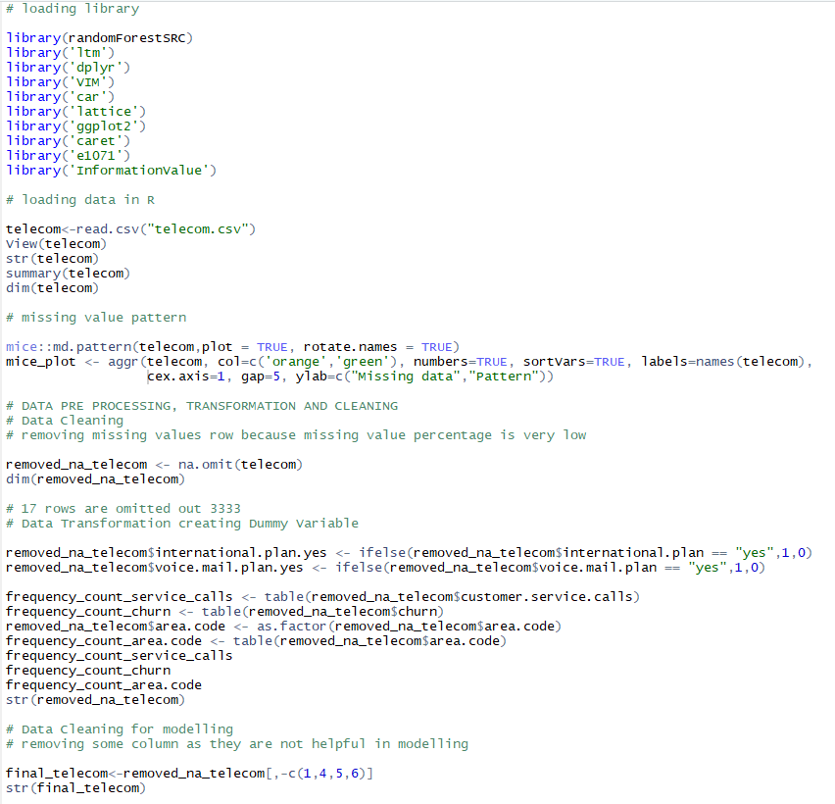
I. COMPILATION OF R CODE

Slide 29
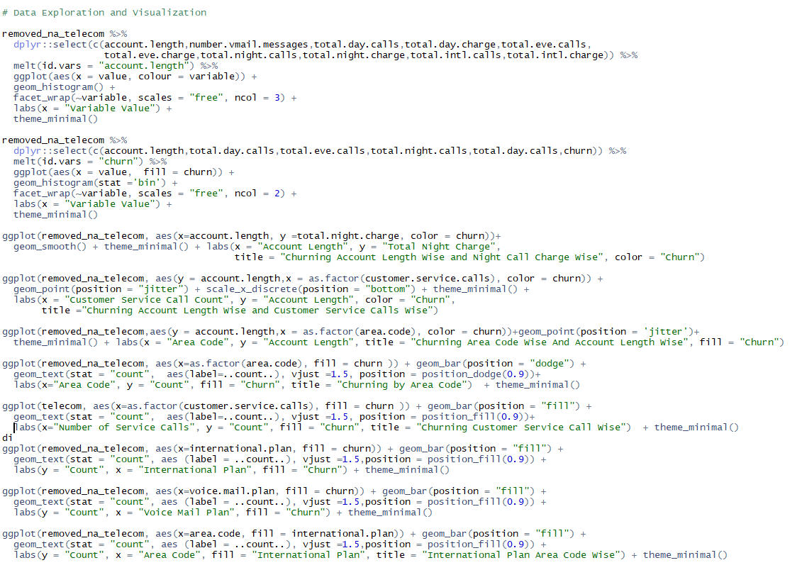
I. COMPILATION OF R CODE

Slide 30
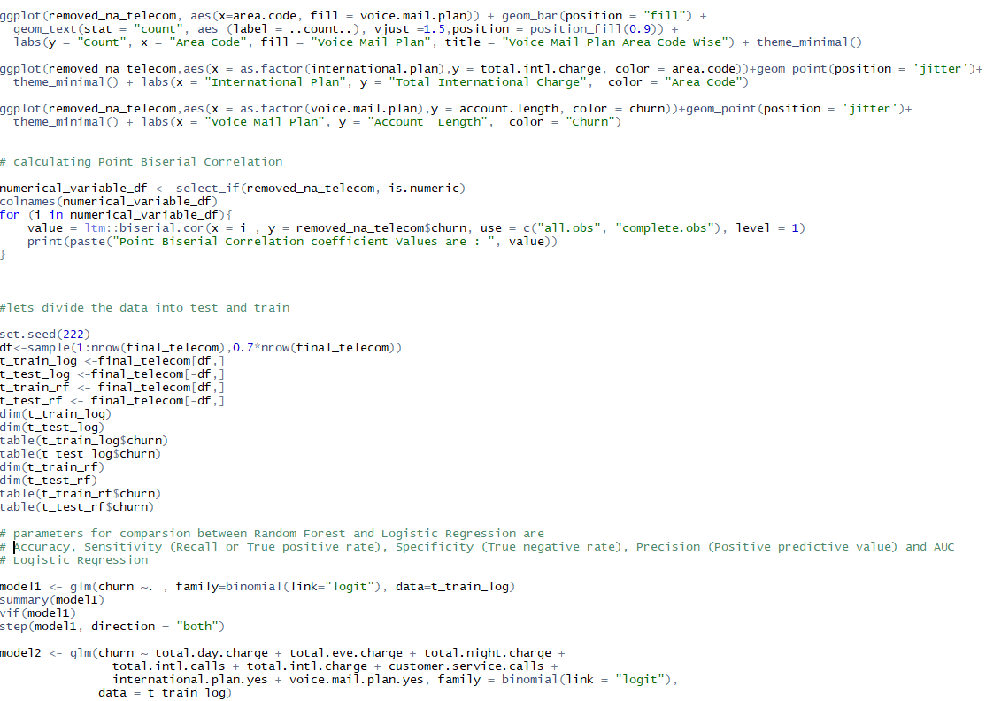
I. COMPILATION OF R CODE

Slide 31
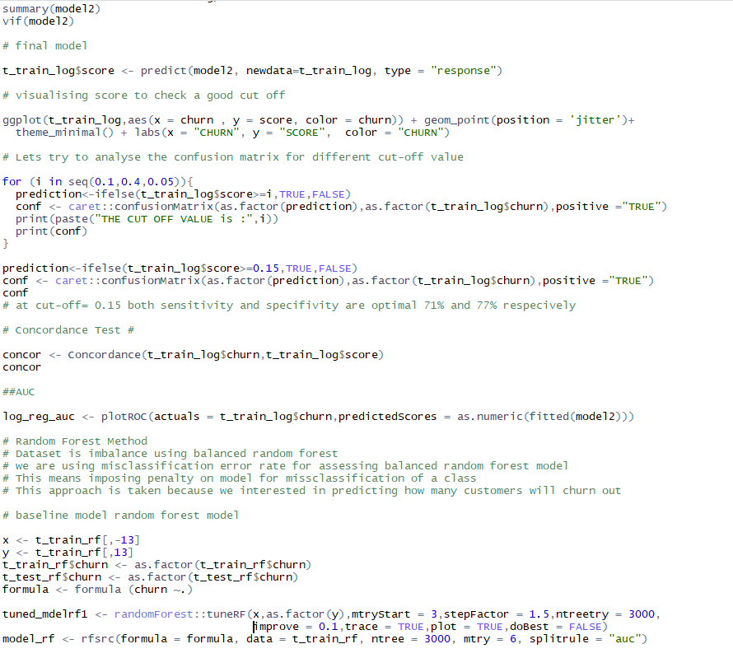
I. COMPILATION OF R CODE

Slide 32
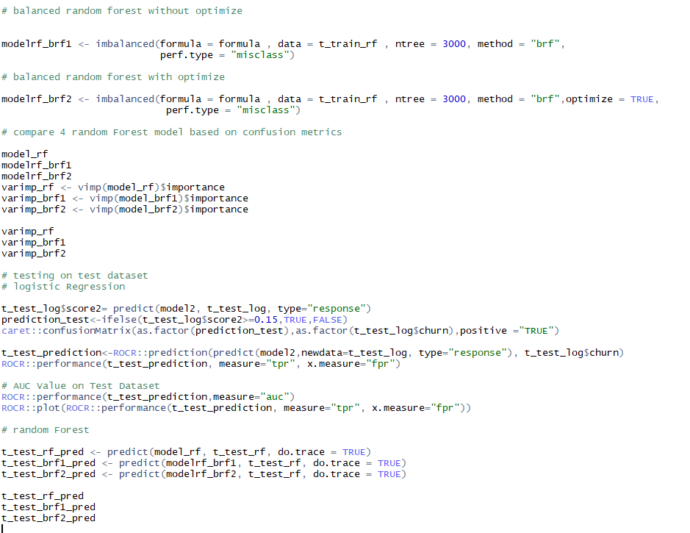
I. COMPILATION OF R CODE

