Slide 1
Report on
Business Analytics Capstone Project
(Using R)
Domain – Healthcare
Project ID : CP3
Satish Rawat

Slide 2

BUSINESS ANALYTICS CAPSTONE PROJECT REPORT
Lower Back Pain Prediction
1. AN INTRODUCTION

Slide 3
BUSINESS ANALYTICS CAPSTONE PROJECT REPORT
1.1 Project Brief
Lower back pain can be caused by a variety of problems with any parts of the complex, interconnected network of spinal muscles, nerves, bones, discs or tendons in the lumbar spine.
Our Goal in this project is to predict whether a incoming patient is suffering from lower back pain or not.
To build predictive model, we will use clustering technique and validate the model on internal metric like silhouette width.
We compare 3 clustering technique for different number of cluster and find the best clustering technique and optimal number of cluster using silhouette width as metric.

Slide 4
BUSINESS ANALYTICS CAPSTONE PROJECT REPORT
1.2 Objective of the Study
Lower Back Pain, also called lumbago, is not a disorder. It’s a symptom of several different types of medical problems. It usually results from a problem with one or more parts of the lower back, such as:
Ligaments
Muscles
Nerves
The bony structures that make up the spine, called vertebral bodies or vertebrae
Lower back pain can also occur due to a problem with nearby organs, such as the kidneys.
Cluster analysis or clustering is the task of grouping a set of objects in such a way that objects in the same group (called a cluster) are more similar (in some sense) to each other than to those in other groups (clusters)
Our goal is to build a model which can identify/segregate an incoming patient into normal or abnormal.
As Dataset does not contain the output labels validation of model is difficult. So, models are internally evaluated using silhouette width as evaluation metric and best model is selected which have highest value of silhouette width.

Slide 5
BUSINESS ANALYTICS CAPSTONE PROJECT REPORT
1.3 Approach of the Study
Load Dataset.
Check for missing values and outliers.
Treat missing values and outliers.
Data Exploration and Data visualisation.
Make a predictive model using relevant statistical modelling technique.
Evaluate and validate model using silhouette width of model as evaluation metric.

Slide 6
BUSINESS ANALYTICS CAPSTONE PROJECT REPORT
Approach of the Study
In This Project, we are going to use different Clustering Techniques like Hierarchical Clustering, Kmeans Clustering Technique and PAM Clustering Technique.
Clustering Techniques are widely used for classification problems such as Customer Segmentation, Classification of images, Customer Segregation and much more.
Model is build using best clustering technique and optimal number cluster using silhouette width as the metric.
The silhouette value is a measure of how similar an object is to its own cluster (cohesion) compared to other clusters (separation). The silhouette ranges from −1 to +1, where a high value indicates that the object is well matched to its own cluster and poorly matched to neighboring clusters. If most objects have a high value, then the clustering configuration is appropriate. If many points have a low or negative value, then the clustering configuration may have too many or too few clusters.

Slide 7
BUSINESS ANALYTICS CAPSTONE PROJECT REPORT
1.4 Scope and Limitation of the Study
Scope :-
This project helps us to identify potential patients which are suffering from lower back pain and this information helps us to provide better treatment to patients.
Limitation :-
Dataset does not contain output labels due to which external validation is not possible.
Clusters need to Labelled using external expertise advice of domain to use this model.

Slide 8

BUSINESS ANALYTICS CAPSTONE PROJECT REPORT
2. DATA EXPLORATION AND VISUALISATION

Slide 9
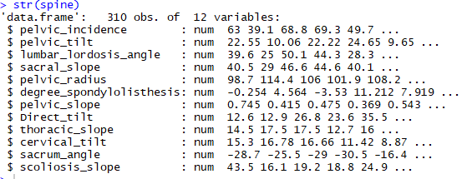
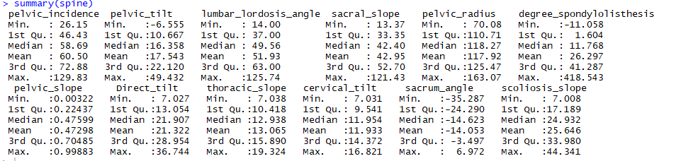
BUSINESS ANALYTICS CAPSTONE PROJECT REPORT
DATA EXPLORATION
Dataset Contains 310 observations and 12 variables.
Dataset is complete no missing value found in dataset.
Mean and Median of all variables are close except of Degree of Spondylolisthesis.
If Mean and Median are close this implies that dataset has symmetrical distribution.

Slide 10
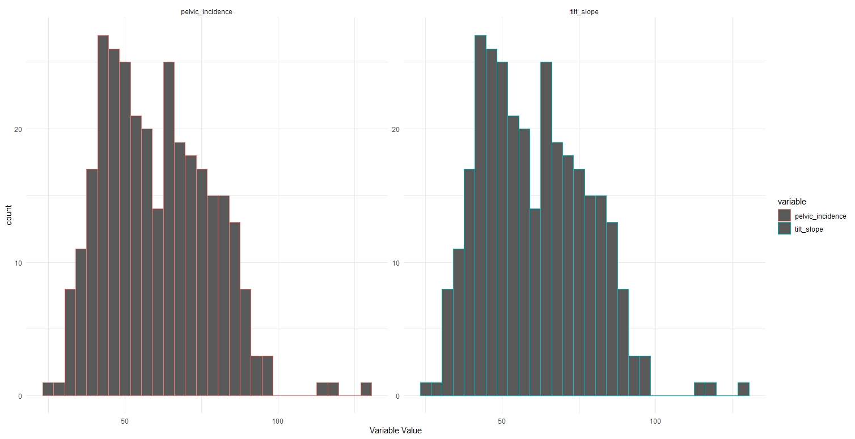
BUSINESS ANALYTICS CAPSTONE PROJECT REPORT
DATA EXPLORATION AND VISUALISATION
Sum of Pelvic Tilt and Sacral Slope is equal to Pelvic Incidence.
Pelvic Incidence column is from Original Dataset and Tilt Slope is the Sum of variables column in Dataset.

Slide 11
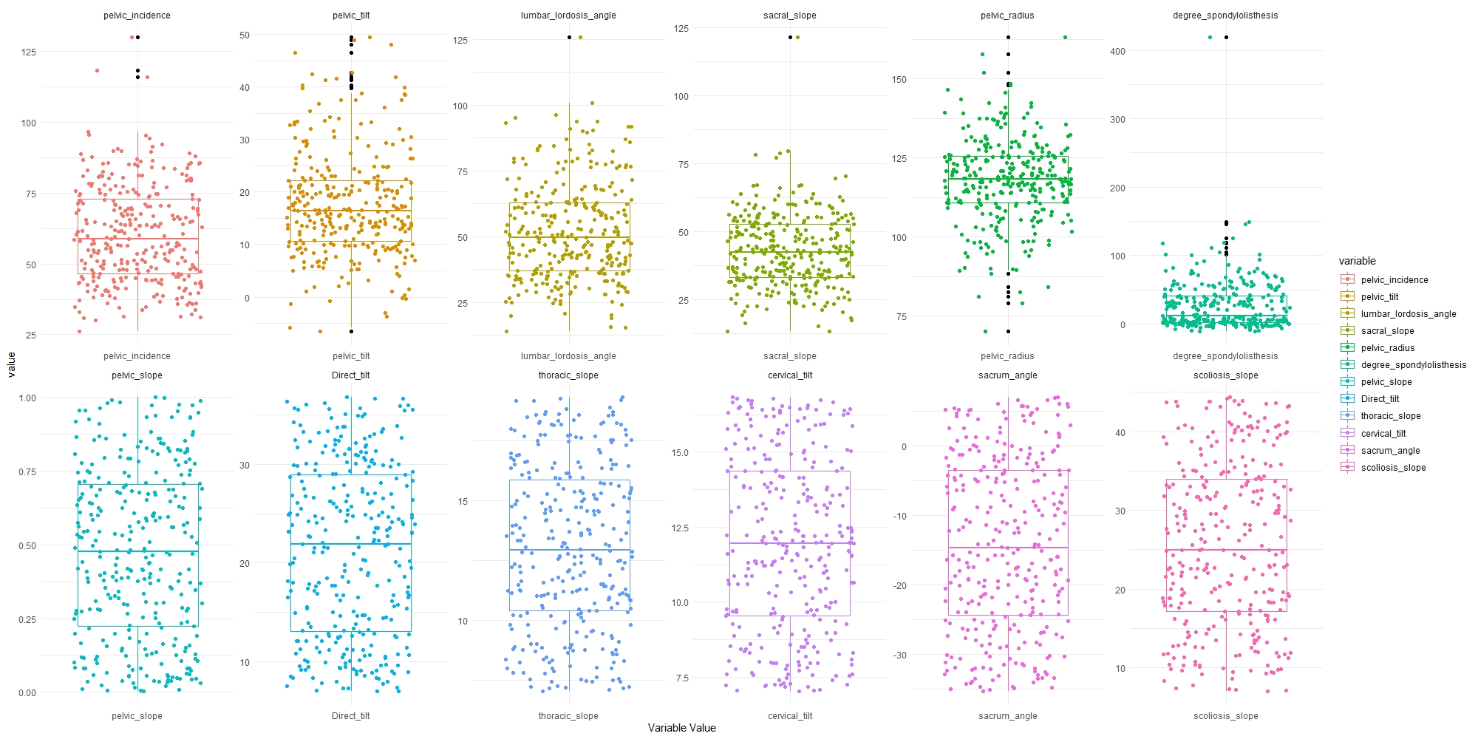
BUSINESS ANALYTICS CAPSTONE PROJECT REPORT
DATA EXPLORATION AND VISUALISATION
Top 6 Variables contains outliers.

Slide 12
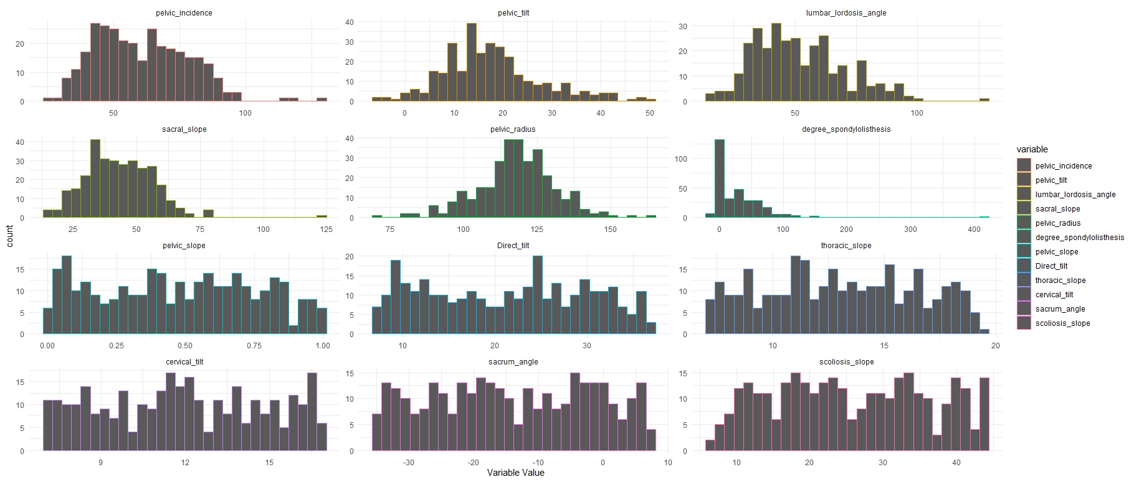
BUSINESS ANALYTICS CAPSTONE PROJECT REPORT
DATA EXPLORATION AND VISUALISATION
Most of the Variables are symmetrically distributed.

Slide 13
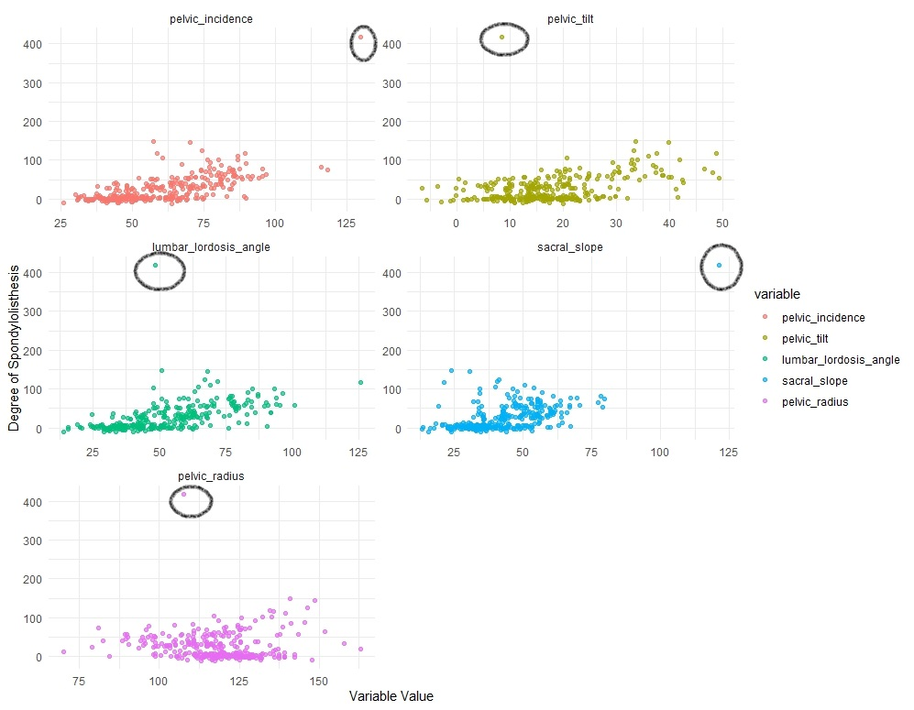
BUSINESS ANALYTICS CAPSTONE PROJECT REPORT
DATA EXPLORATION AND VISUALISATION
One Value is very high in Degree of Spondylolisthesis and after comparing that outlier using Bivariate Analysis, concluded that remove the entire row from the dataset.
Keeping all the outlier as cases of extreme abnormality.

Slide 14

BUSINESS ANALYTICS CAPSTONE PROJECT REPORT
3. DATA CLEANING AND PREPARATION

Slide 15
BUSINESS ANALYTICS CAPSTONE PROJECT REPORT
DATA CLEANING AND PREPARATION
Only 1 row is omitted from dataset.
Outliers are not removed to consider all the cases of abnormality.
Dataset is scaled using Z-transformation (mean of 0 and Standard deviation of 1).

Slide 16

BUSINESS ANALYTICS CAPSTONE PROJECT REPORT
4. DATA MODELLING

Slide 17
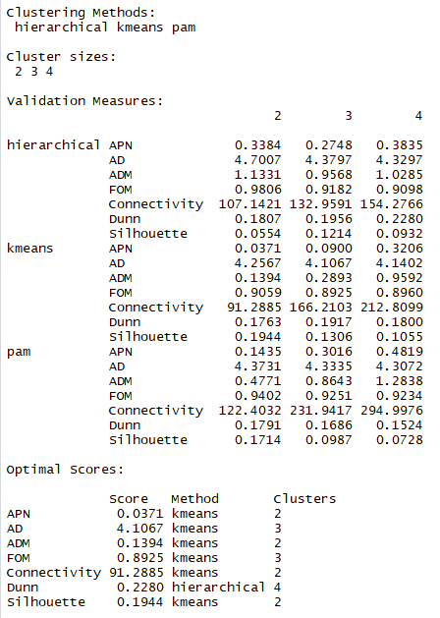
BUSINESS ANALYTICS CAPSTONE PROJECT REPORT
DATA MODELLING
Checking If Dataset is clusterable or not using Hopkins statistic. If the value of Hopkins statistics is less than 0.5 then the dataset is clusterable.
Comparing 3 Clustering Techniques to find best clustering technique and number of cluster using silhouette width as the metric.
Kmeans with 2 cluster is best as per silhouette width as metric.

Slide 18
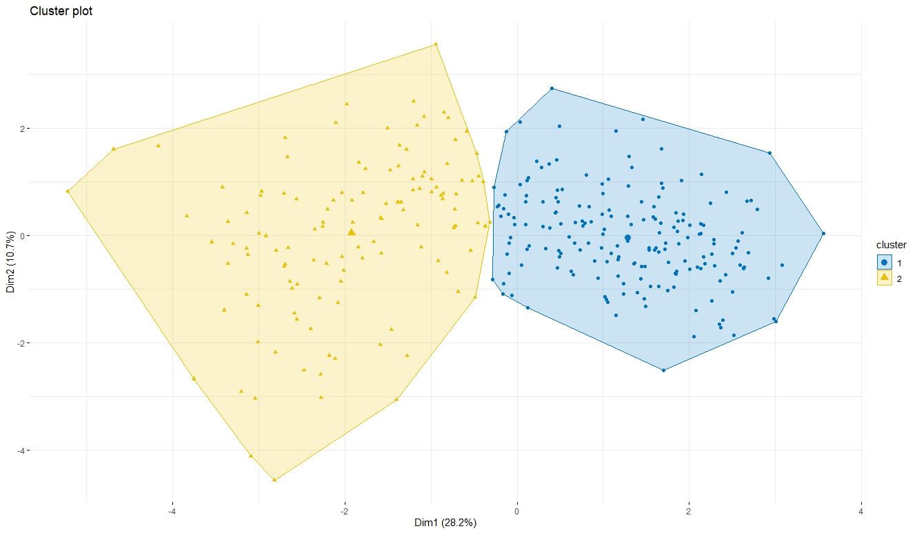
BUSINESS ANALYTICS CAPSTONE PROJECT REPORT
DATA MODELLING
As seen in the plot Kmeans clustering method able to create 2 distinct cluster along PCA1 and PCA2.
We have to labels these cluster using external help to identify.

Slide 19
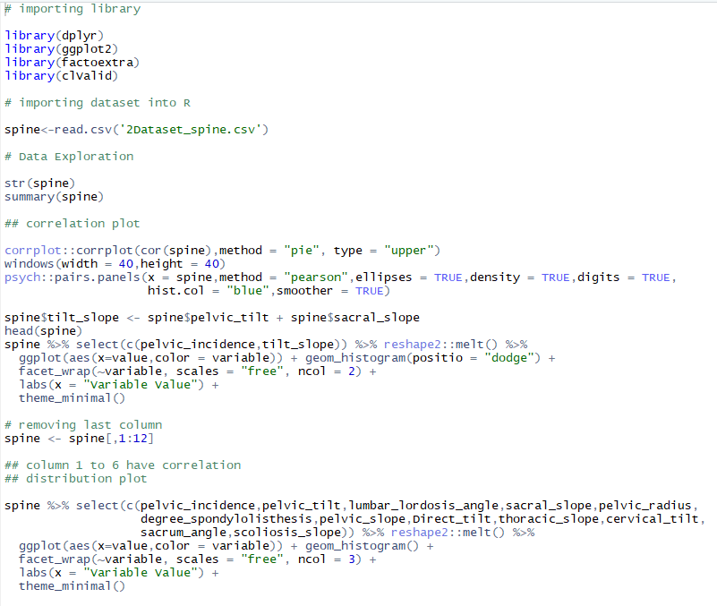
I. COMPILATION OF R CODE

Slide 20
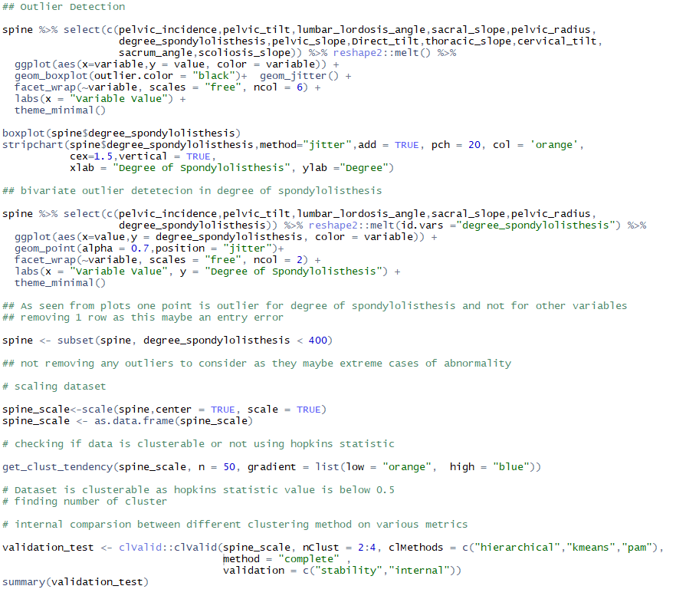
I. COMPILATION OF R CODE

Slide 21
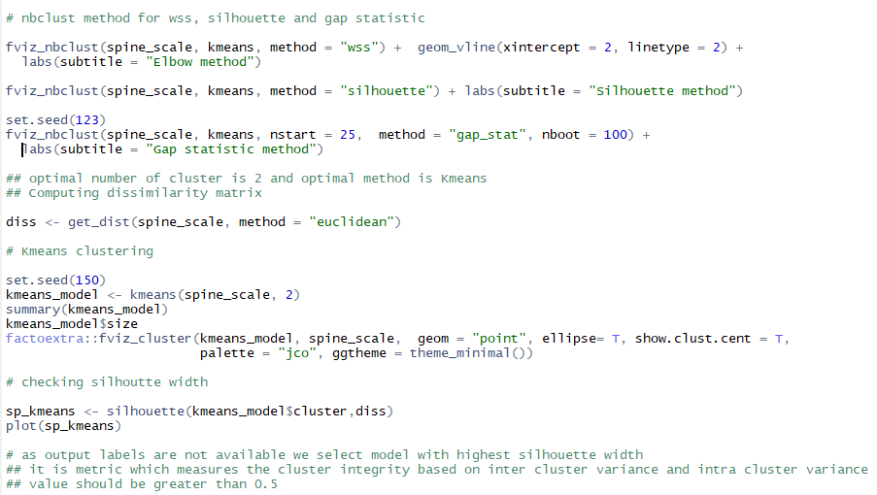
I. COMPILATION OF R CODE

