Slide 1
Final review DIABETES PREDICTION USING DATA MINING TECHNIQUES
satish
20mca1046

Slide 2
Problem definition
Diabetes is chronic disease in the world which can cause many complications.
There are many proposed methodologies for finding whether a person has diabetes or not.
Here in this work, we are proposing various methods on how to find the person is having diabetes using diabetes dataset and solving it using machine-learning algorithms.
We are doing a comparison study of the machine learning algorithms to verify which algorithm is giving better accuracy for the prediction of the disease.

Slide 3
IMPLEMENTATION
Data pre-processing transforms the data without any missing value and null value.
The hidden pattern and relation between the pattern in the large dataset is found.
These are steps that has been followed while find accuracy and prediction for given dataset.
Data cleaning
Data integration
Data transformation
Exacting pattern
Visualization the data

Slide 4
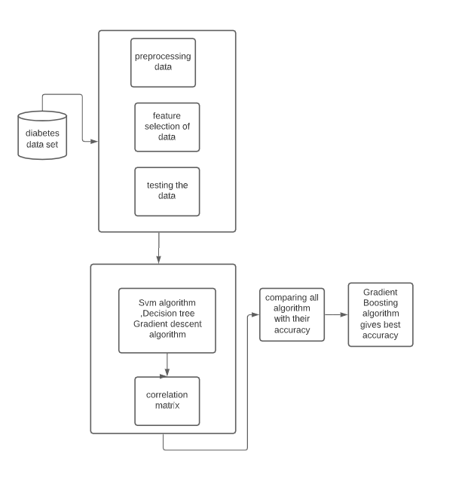
Proposed model

Slide 5
software used for implementation
Jupiter notebook
Python language
Anaconda software

Slide 6
Dataset
PIMA dataset is originally collected from National Institute of Diabetes and Kidney Diseases.
The main point of dataset to predict whether the patient having diabetes or not based on certain value included in the dataset.
Columns in PIMA dataset
Pregnancies
Glucose
Skin thickness
Insulin
Body mass index
Link for dataset :https://www.kaggle.com/uciml/pima-indians-diabetes-database

Slide 7
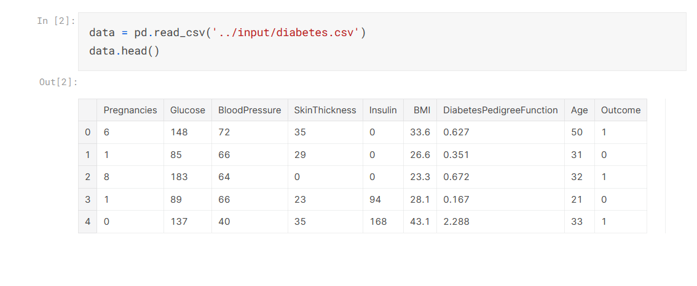
PIMA Dataset

Slide 8
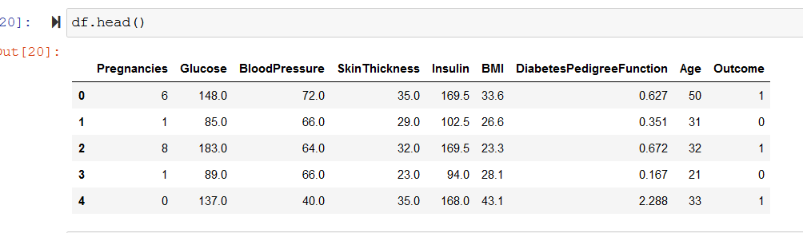
Preprocessing the dataset
For preprocessing the dataset we want check is there any null values present in the dataset.
If there is any null value we want to change the value by using mean and median of data of particular column
After preprocessing the dataset

Slide 9
Algorithms
Gradient boosted machines (GBMs) is extremely popular machine learning algorithm that have proven successful across many domains
Advantages:
Often provides predictive accuracy that cannot be beat.
Lots of flexibility - can optimize on different loss functions and provide several hyper parameter tuning options that make the function fit very flexible.
Handles missing data - imputation not required.

Slide 10
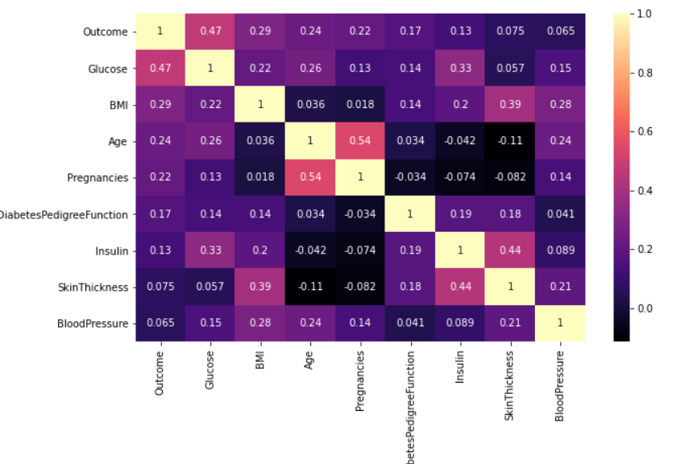
Correlation matrix
A correlation matrix is simply a table which displays the correlation coefficients for different variables.
The matrix depicts the correlation between all the possible pairs of values in a table.
It is a powerful tool to summarize a large dataset and to identify and visualize patterns in the given data.
correlation matrix of PIMA dataset

Slide 11
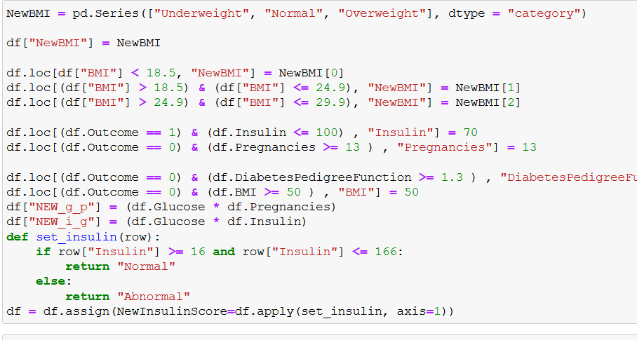
FEATURE ENGINEERING
In this section, we aim to create new variables based on some independent variables in the data set.
We aim to increase the prediction success of the model with the created variables
creating of new columns

Slide 12
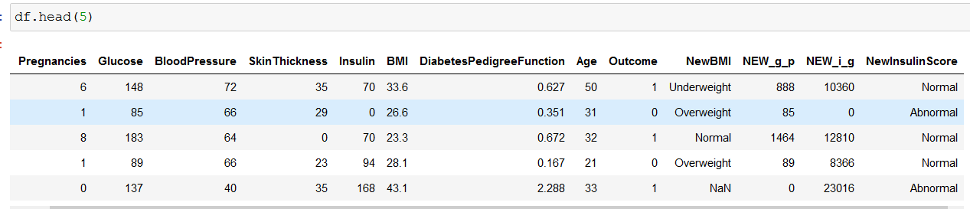
The data set consist of new created column in
New BMI
New g_p(combination of glucose and pregnancies)
New I_g(combination of Insulin and glucose)
New insulin score

Slide 13
Hot Encoding
It refers to splitting the column which contains numerical categorical data to many columns depending on the number of categories present in that column.
Each column contains “0” or “1” corresponding to which column it has been placed.

Slide 14
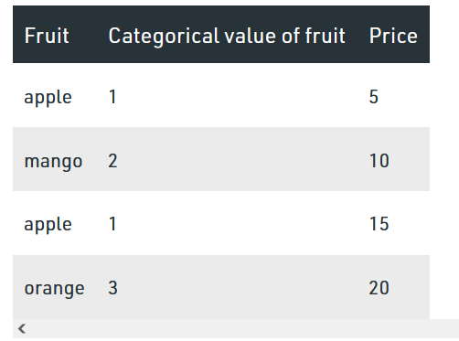
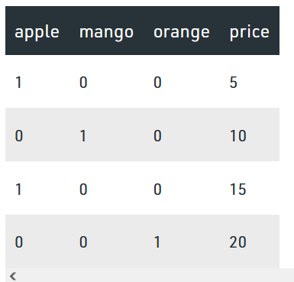
Before Encoding
After Encoding

Slide 15
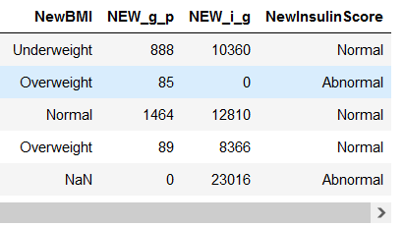
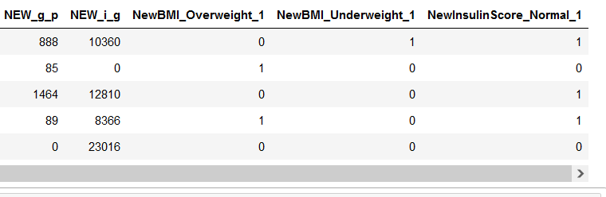
Before Encoding
After Encoding

Slide 16
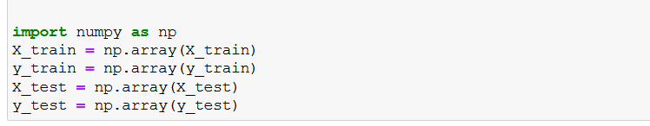
Assign the data set column to x and y and we are splitting the data in 70:30 ratio

Slide 17
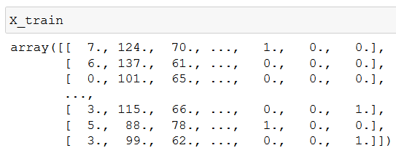
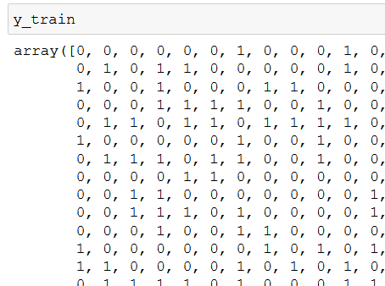
From the splitting data dividing the data into x train and y train

Slide 18
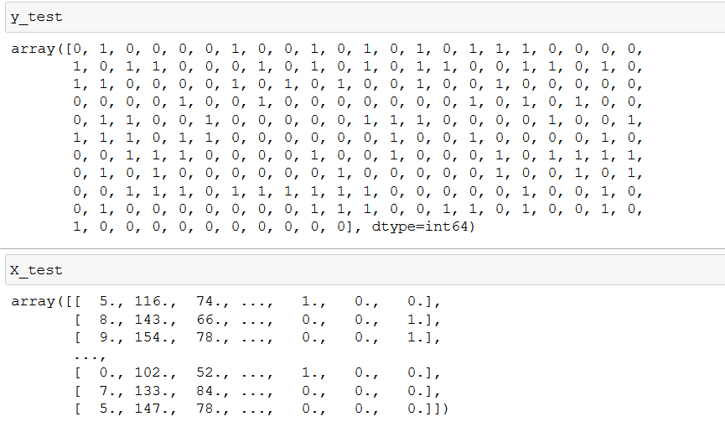
This is our testing data for gradient boosting model

Slide 19
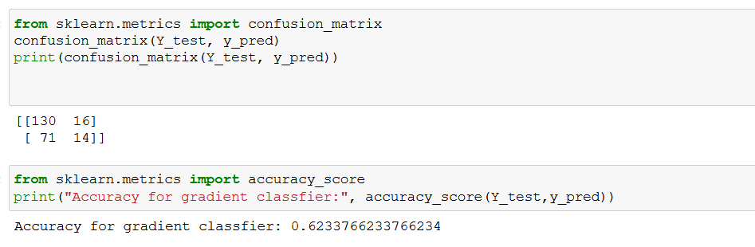
After splitting the data Finding the accuracy with confusion matrix getting accuracy as 62%

Slide 20
To over come using the k fold cross validation to improve the model accuracy
k-Fold Cross-Validation
It is common to evaluate machine learning models on a dataset using k-fold cross-validation.
The k-fold cross-validation procedure divides a limited dataset into k non-overlapping folds.
Each of the k folds is given an opportunity to be used as a held-back test set, whilst all other folds collectively are used as a training dataset.
A total of k models are fit and evaluated on the k hold-out test sets and the mean performance is reported.

Slide 21
The general steps follows in k fold cross validation:
Shuffle the dataset randomly.
Split the dataset into k groups
For each unique group:
Take the group as a hold out or test data set
Take the remaining groups as a training data set
Fit a model on the training set and evaluate it on the test set
Retain the evaluation score and discard the model

Slide 22
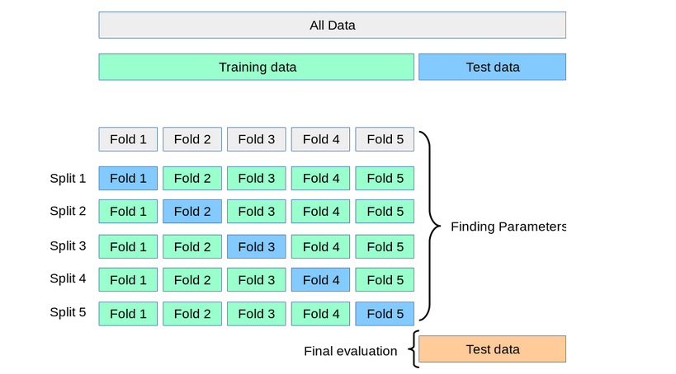
Working model of K fold cross validation

Slide 23
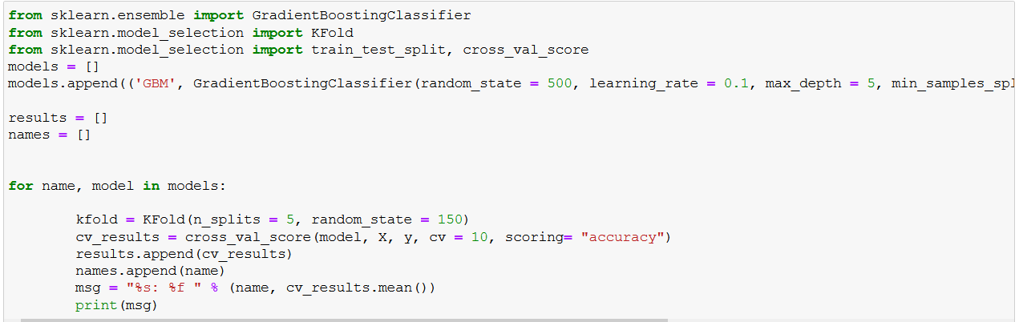
The Accuracy of Gradient Boosting classifier

Slide 24
Decision Tree

Slide 25
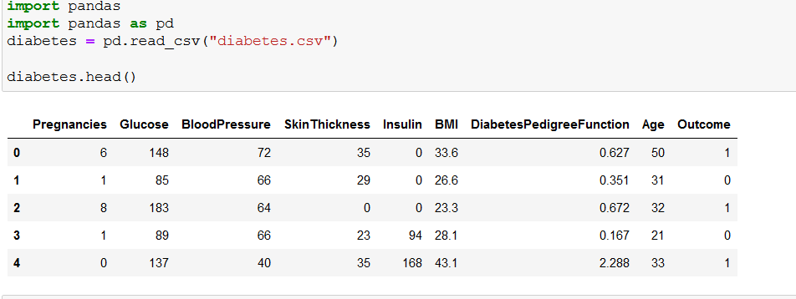
Loading the dataset into Jupiter notebook

Slide 26
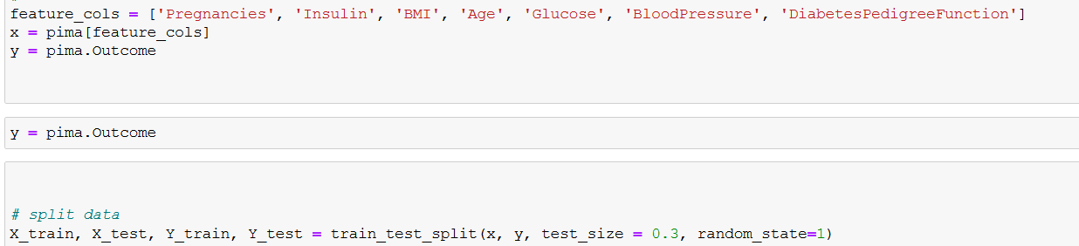
assign the data set column to x and y and we are splitting the data in 70:30 ratio

Slide 27
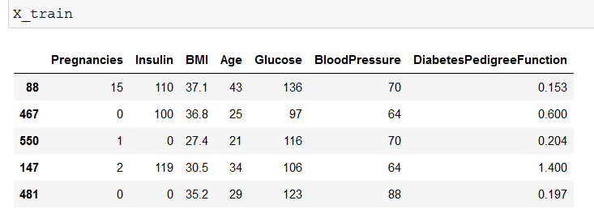
X_train values

Slide 28
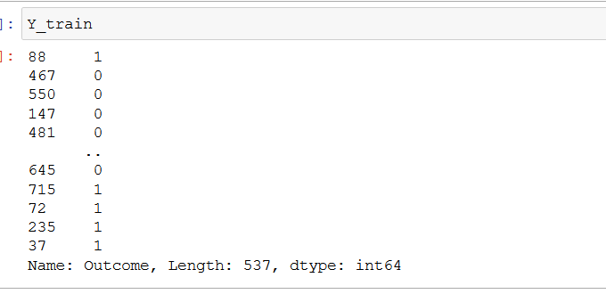
Y-Train values

Slide 29
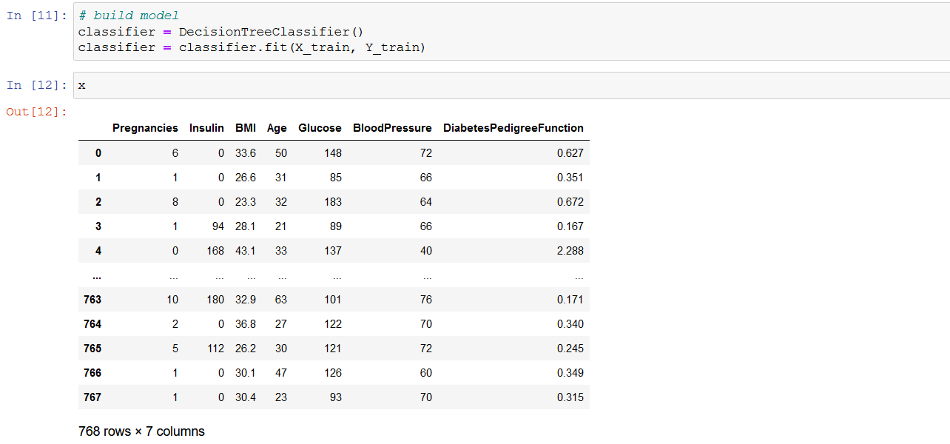
Building the decision tree for PIMA dataset using x train and y train values.

Slide 30
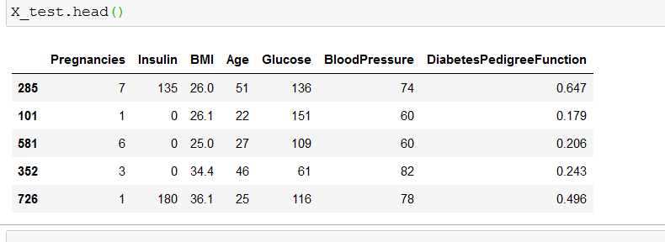
After implemented decision tree I can get X_test value

Slide 31
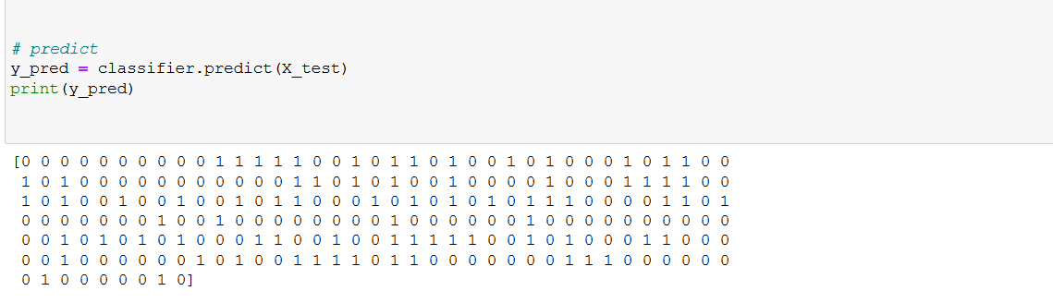
From the decision tree I predicted the diabetes
1 means the person is diabetic
0 means a person is not.

Slide 32
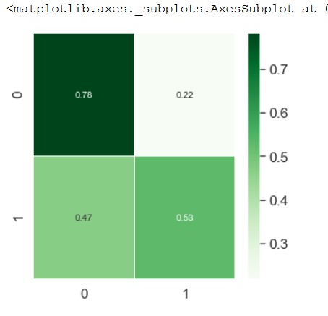
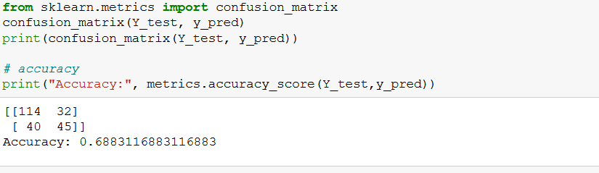
Confusion matrix and accuracy of decision tree
accuracy score
confusion matrix

Slide 33
Support vector machine

Slide 34
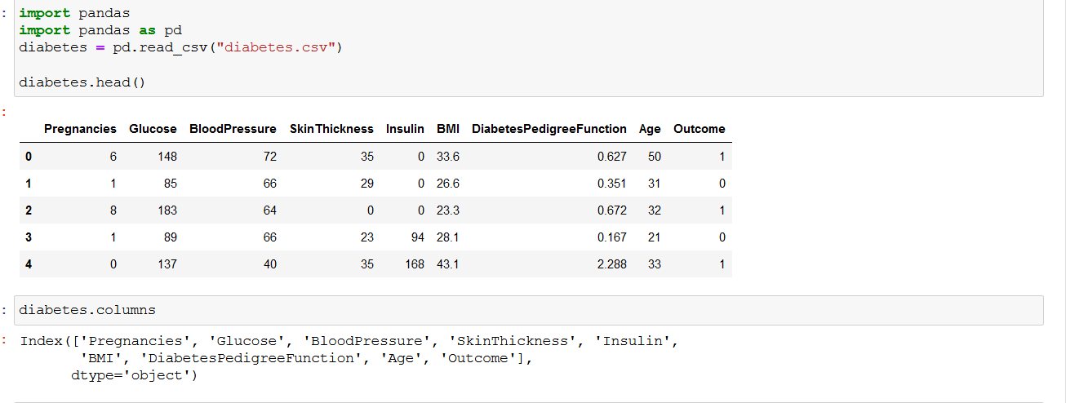
Loading the dataset into Jupiter notebook

Slide 35
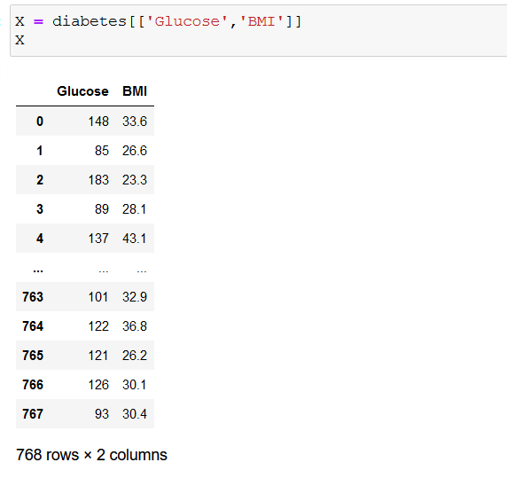
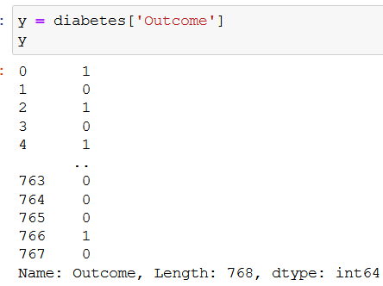
And I am store the dataset values in x and y variable

Slide 36
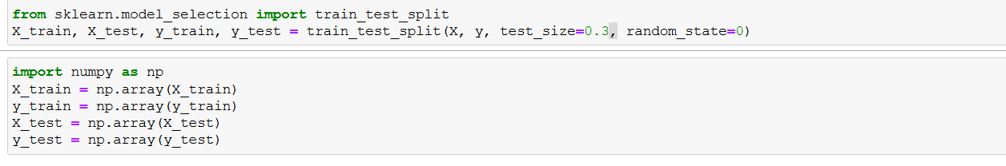
Splitting the x and y and storing in the x_train and y_train as 70:30 ratio

Slide 37
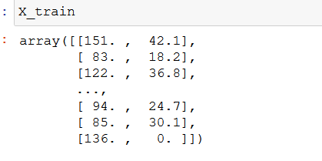
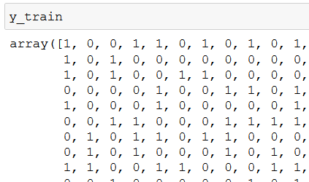
The value are x_train and y_train
x_train
y_train

Slide 38
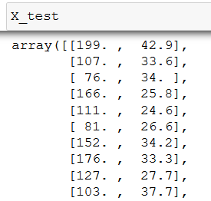
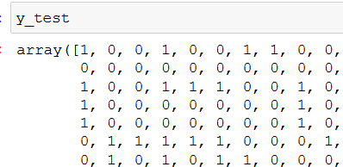
The value are X-test and y_test
X-test
y_test

Slide 39
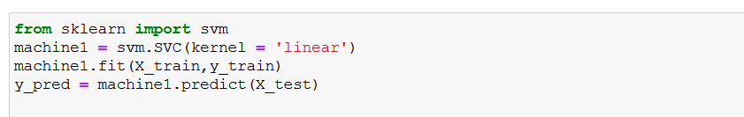
Loading the SVM algorithm in Jupiter note and passing the value as xtrain and ytrain as linear svm model

Slide 40
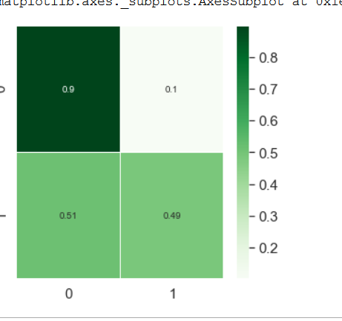
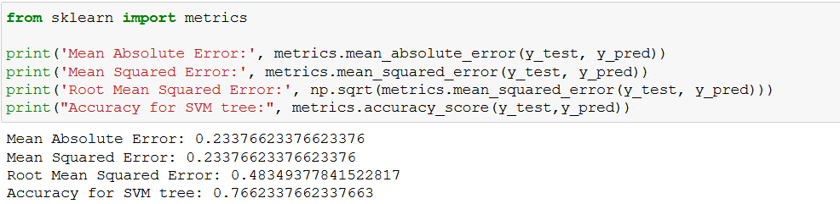
After loading svm and finding accuracy using confusion matrix
confusion matrix
accuracy score

Slide 41
Implementation with UI interface for predicting diabetes using T-kinter

Slide 42
Installation
Package should be install before executing in cmd
numpy==1.13.3
pandas==0.22.0
scipy==1.0.0
scikit-learn==0.19.1
PyQt5==5.9.2
Installed all this package using cmd as adminstrator

Slide 43
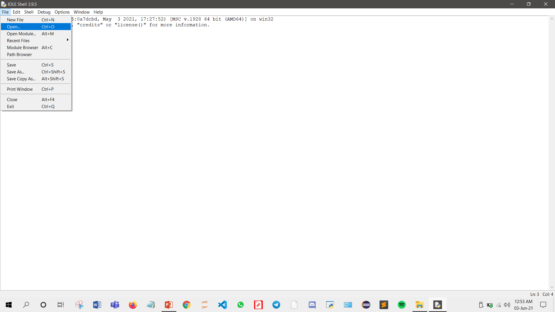
Python IDE

Slide 44
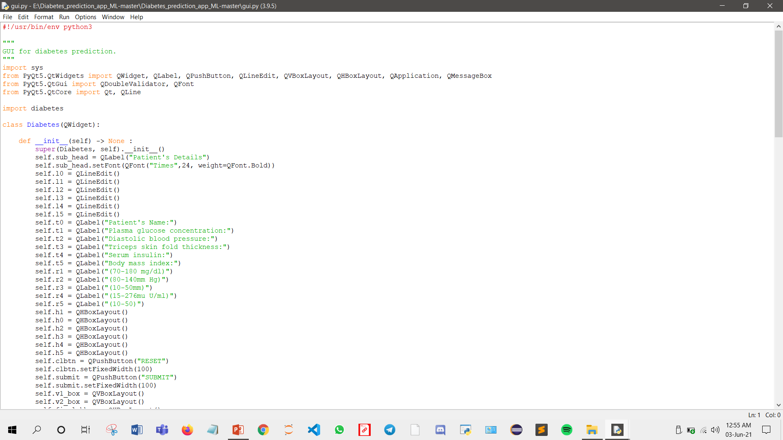
Open the python file in python Ide

Slide 45
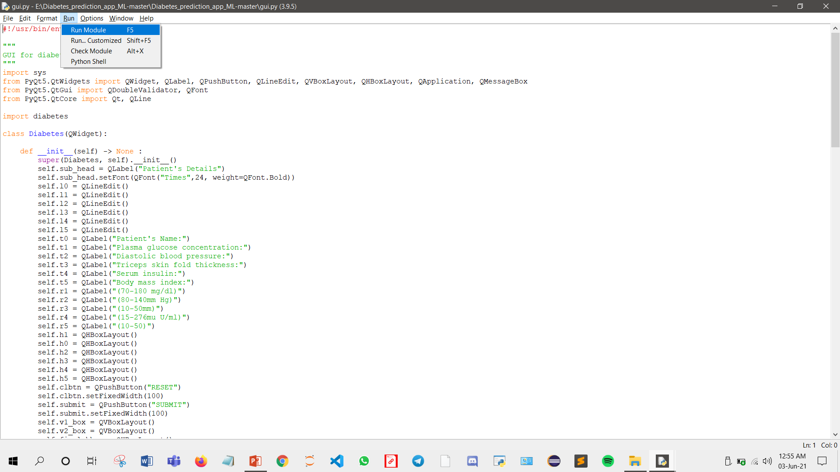
Run the python file and all the run all module

Slide 46
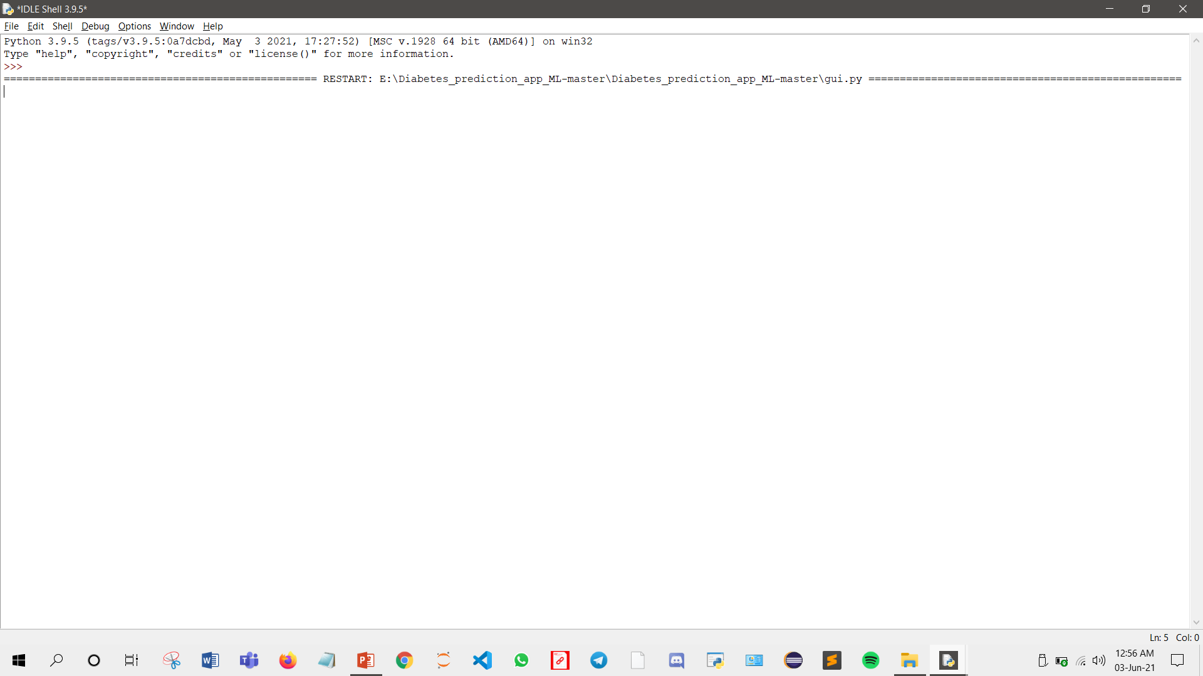
Running the Ide to open the GUI

Slide 47
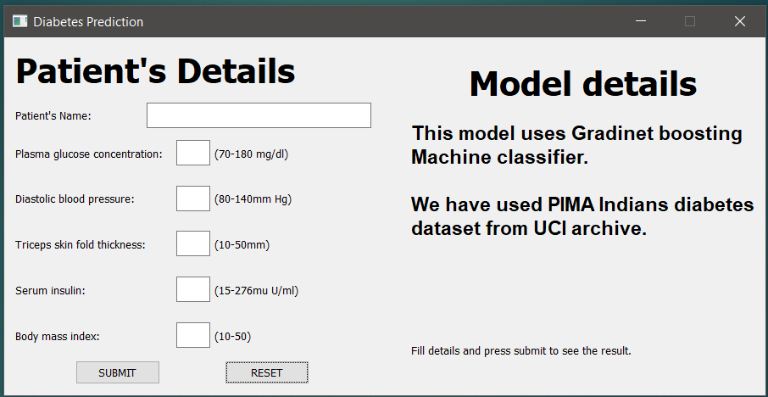
GUI interface for diabetes prediction

Slide 48
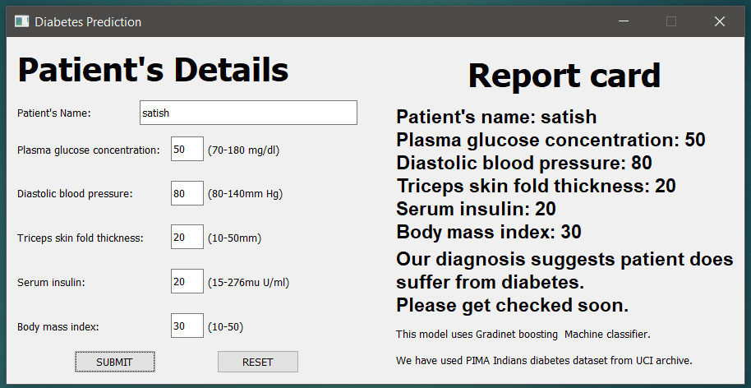
After entering detail the GUI give report for diabetes prediction

Slide 49
Accuracy comparison Table
S_NO | Model | Accuracy
1 | Gradient Boosting Classifier | 91%
2 | Support vector machine | 76%
3 | Decision Tree | 68%

Slide 50
CONCLUSION
Gradient Boosting classifier, Decision tree,support vector machine classification machine learning models were used to predict the onset of diabetes within five years in women with Pima Indian heritage who were given medical details about their bodies.
As a result of comparing the established models; It was observed that the model with the highest result was gradient descent boosting (0.91).

Slide 51
Thank you

Slide 52
