Slide 1
Demand Forecasting
In a business historical data can be analyzed to improve demand forecasting by using various methods like time series analysis.
Why Demand Forecasting
Inventory management.
Decrease of business risk.
Proper distribution of resources.
Improve pricing.
Avoid wastage of resources.

Slide 2

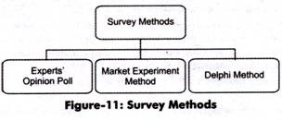
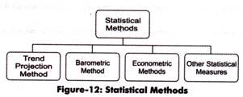
Techniques of Demand Forecasting

Slide 3
What we are doing..?
Selecting one manufacturing product from the “Retail” Industry.
Example:- Footwear, Water bottles, Any Branded Industry like Nike, Puma, Adidas etc...
And trying to get the historical data from that Industry.
Using that sales data we can going to predict the next quarter or next month sales.
For this prediction we are going to use the machine learning algorithms that listed below

Slide 4
Machine Learning Algorithms
Linear Regression :- The most basic machine learning algorithm that can be implemented on this data is linear regression. The linear regression model returns an equation that determines the relationship between the independent variables and the dependent variable.
k-Nearest Neighbors:-Another interesting ML algorithm that one can use here is kNN (k nearest neighbours). Based on the independent variables, kNN finds the similarity between new data points and old data points
Auto ARIMA:- ARIMA is a very popular statistical method for time series forecasting. ARIMA models take into account the past values to predict the future values. There are three important parameters in ARIMA:
p (past values used for forecasting the next value)
q (past forecast errors used to predict the future values)
d (order of differencing)
Prophet:-Prophet, designed and pioneered by Facebook, is a time series forecasting library that requires no data preprocessing and is extremely simple to implement. The input for Prophet is a dataframe with two columns: date and target (ds and y).
Prophet tries to capture the seasonality in the past data and works well when the dataset is large.

Slide 5
References:
https://dspace.mit.edu/bitstream/handle/1721.1/117612/Chan_Kharfan_2018_Capstone.pdf?sequence=1&isAllowed=y (2011)
https://www.semanticscholar.org/paper/Application-of-machine-learning-techniques-for-Carbonneau-Laframboise/1edfaf279f01d6ea3469b20c57cff6fa69dec219 (2008)
https://ieeexplore.ieee.org/document/7281443 (2015)

