Slide 1
Forecasting NIKE Revenue Data: A Comparison of Popular Regression Libraries
John Ramirez
Heet Madhu
Satish Rella
Varshaditya Samala

Slide 2
Introduction
Dozens of regression libraries are available for download and use
Widely used in industry for forecasting and optimization purposes
How well do these available libraries perform?

Slide 3
Problem
Given an arbitrary set of data, how well can out-of-the-box regression libraries predict a target value?
Chosen dataset:
NIKE Quarterly financial data (1995 – 2019)
Target Value (dependent variable): ‘Revenue’
Chosen libraries for comparison:
Sklearn.LinearRegression
Sklearn.KNearestRegressor
PMD-ARIMA
FBProphet

Slide 4
Analysis
NIKE dataset consists of 99 observations with 41 columns each
After data cleaning, 85 observations remained
Plotting quarterly revenue with observation dates revealed an increasing trend in revenue

Slide 5
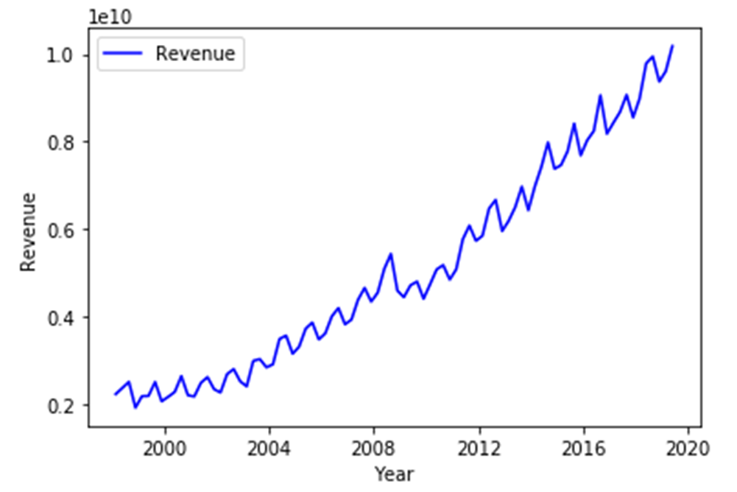
Analysis – Revenue Plot

Slide 6
Analysis
Dataset consisted of dependent variable ‘Revenue’ and 40 independent variables
Checked for correlation between our dependent and independent variables
13 independent variables correlated strongly with the dependent variable
Reduced dataset to the 13 strongly correlated independent variables plus ‘Revenue’ and date

Slide 7
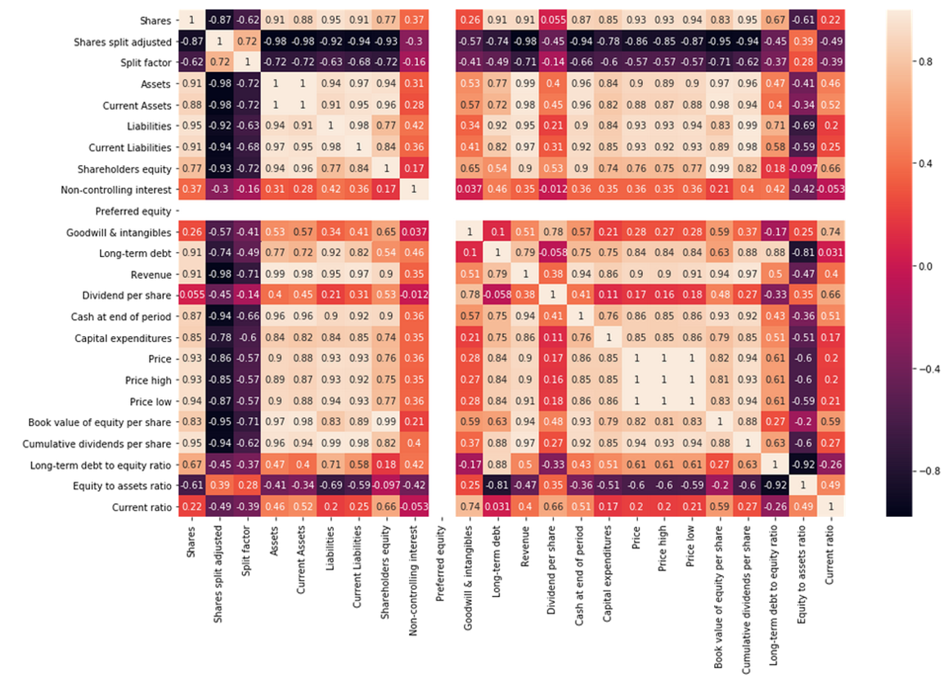
Analysis – Correlation Map

Slide 8
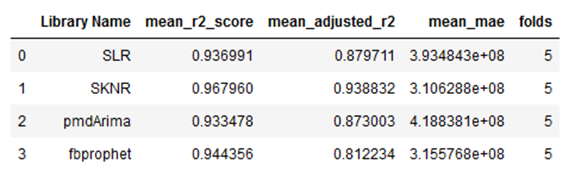
Analysis – Cross Validation
Used KFold to perform cross validation on each of our models using training data
Number of folds was 5

Slide 9
Analysis – Cross Validation
KNearestRegressor model had highest adjusted R^2 score (~94%)
LinearRegression and ARIMA models had second highest adjusted R^2 scores (~87%)
FBProphet had lowest adjusted R^2 score (~81%)

Slide 10
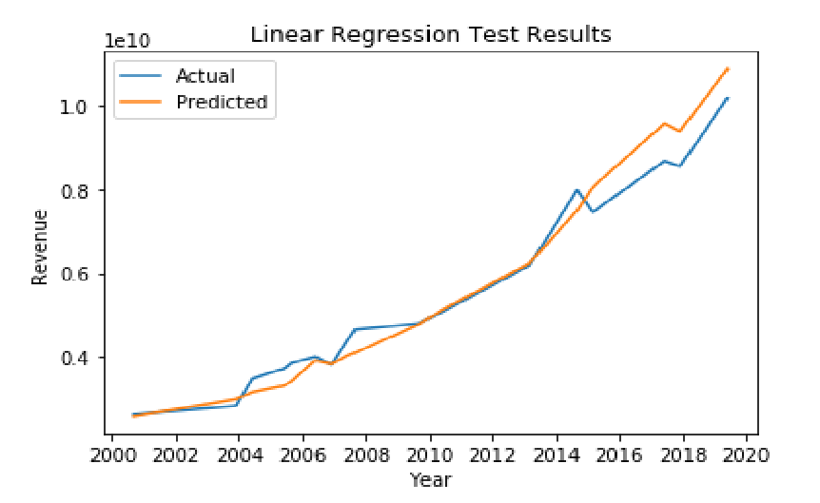
Test Performance – LinearRegression
No fine tuning, used out of box model
Plotted test result for LinearRegression model

Slide 11
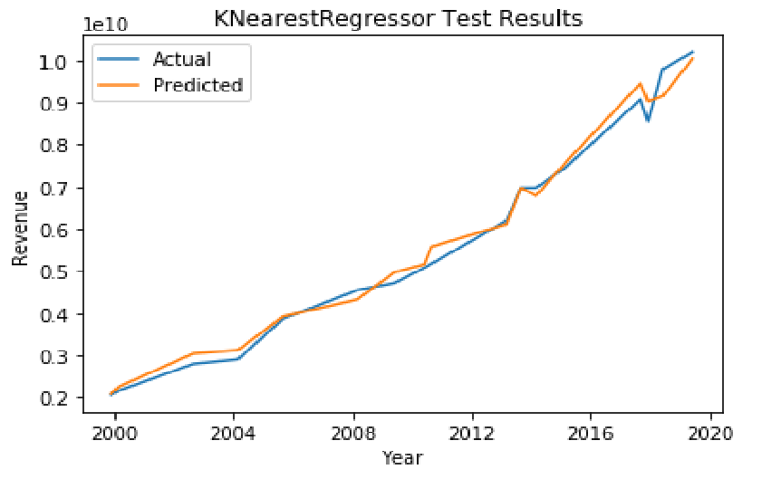
Test Performance – KNearestRegressor
No fine tuning, used out of box model
Plotted test result for KNearestRegressor model

Slide 12
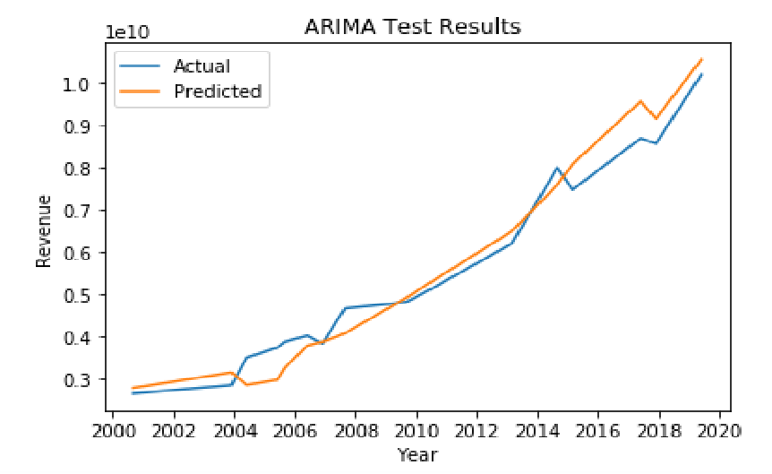
Test Performance – PMDARIMA
No fine tuning, used out of box model
Plotted test result for ARIMA model

Slide 13
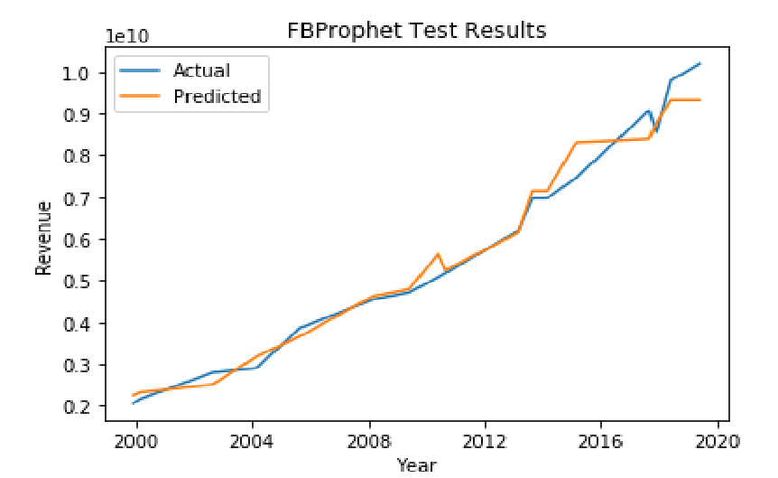
Test Performance – FBProphet
No fine tuning, used out of box model
Plotted test result for FBProphet model

Slide 14
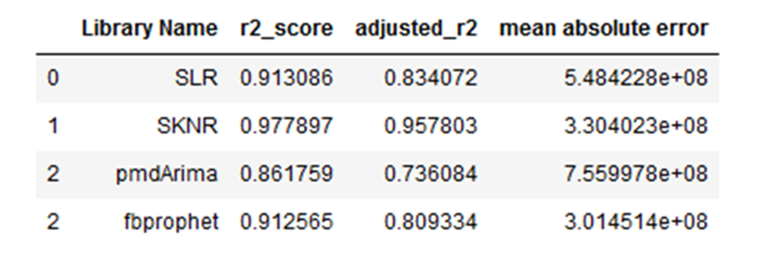
Results – Test Performance
Tested each model with testing dataset and recorded scores

Slide 15
Results – Test Performance
KNearestRegressor model had highest adjusted R^2 score (~96%)
High adjusted R^2 scores could be indicative of overfitting
LinearRegression had second highest adjusted R^2 score (~83%)
FBProphet had third highest adjusted R^2 score (~81%)
ARIMA had the lowest (~74%)

Slide 16
Summary
Reduced dataset to independent variables that were strongly correlated to the dependent variable
Compared four models
Sklearn.LinearRegression
Sklearn.KNearestRegressor
FBProphet
PMD-ARIMA
Cross Validation Comparison
KNearestRegressor had highest adjusted R^2 score (~94%)
FBProphet had lowest adjusted R^2 score (~81%)

Slide 17
Summary
Test Comparison
KNearestRegressor had the highest adjusted R^2 score (~96%)
ARIMA had lowest adjusted R^2 score (~74%)
KNearestRegressor model may have been overfit

Slide 18
Conclusion
KNearestRegressor performed the best out-of-the-box, model may have been overfit
LinearRegression and FBProphet performed roughly the same
ARIMA performed the worst
Size of dataset may have impacted model performances

