Slide 1
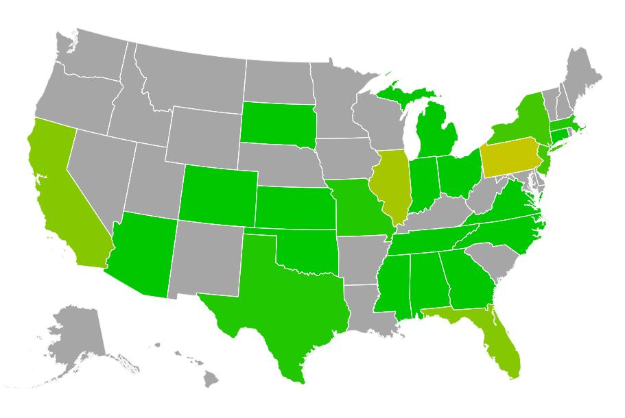
RECALL.IT
FOODS DRUGS DEVICES
#FDA RECALLS TWITTER FEED
CLASS 1
CLASS 2
CLASS 3
ONGOING COMPLETED TERMINATED
286 14 1
CLASS I DRUG: a dangerous or defective product that predictably could cause serious health problems or death.
VISUAL (ONGOING) DATA (ALL)
CITY AND STATE INFO
DC RI MA PA NY

Slide 2
FDA RECALLS TWITTER FEED
DC RI MA PA NY

