Slide 1
PHOTO CAPTURE
Presented by V B V Satish
(Reg No: 37110848)
Guided by Dr. S. Prince Mary

Slide 2
OBJECTIVE
This project aims to detect the number of faces and capture the images of the faces that comes before the camera.
The objective of our project is to design software that can detect human faces.
Implement the project using Python with necessary libraries

Slide 3
SOFTWARE REQUIREMENTS
Any OS
Haar Cascades Data File
Ram (Minimum 4GB)
Anaconda Navigator
OpenCV-Python

Slide 4
OpenCV
CV2 OpenCV (Open Source Computer Vision Library) is an open source computer vision and machine learning software library.
It will also support Windows, Linux, Mac OS and even the Android operating systems.
It supports a some of the programming languages namely: Python, Java, C and C++.
Being a BSD-licensed product, OpenCV makes it easy for businesses to utilize and modify the code.
We are going to use the “DetectMultiscale” module from OpenCV.

Slide 5
Features of OpenCV Library
Read and write images.
Capture and save videos.
Process images (filter, transform)
Detect specific objects such as faces, eyes in the videos or images.
Analyse the video, i.e. estimate the motion in it, subtract the background, and track objects in it.

Slide 6
Parametres
Parameter Name | Description
Cascade | It can be loaded from XML or YAML file using Load().
Image | Matrix of the type CV_8U containing an image where objects are detected
Objects | Vector of rectangles where each rectangle contains the detected object the rectangles may be partially outside the original image.
numDetections | Parameter specifying how much the image size is reduced at each image scale
ScaleFactor | Parameter specifying how much the image size is reduced at each image scale
minSize | Minimum possible object size. Objects smaller than that are ignored.
maxSize | Maximum possible object size. Objects larger than that are ignored.

Slide 7
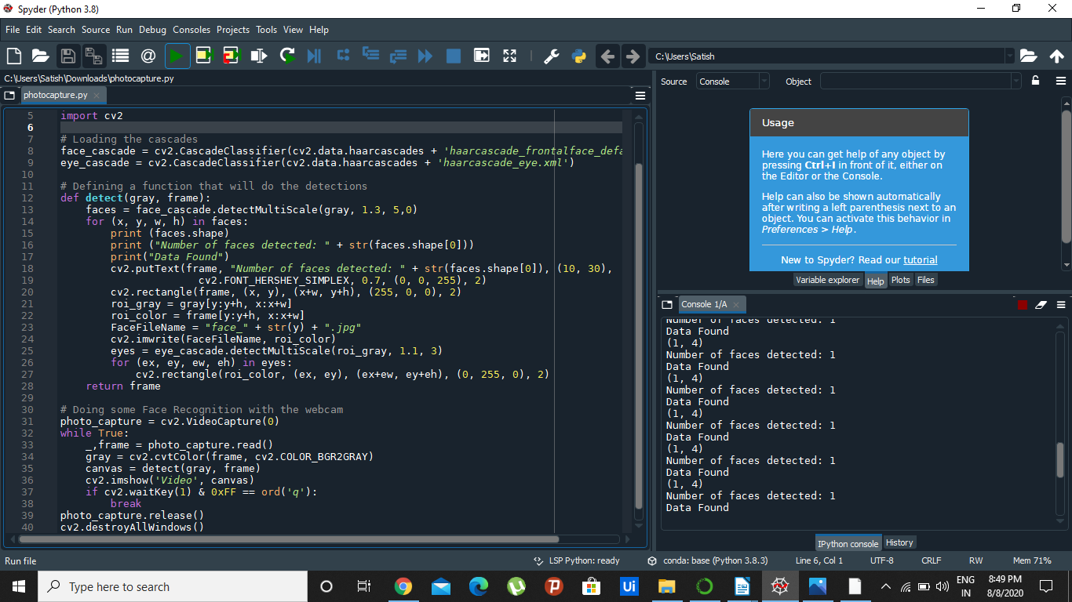
Code Snippet

Slide 8
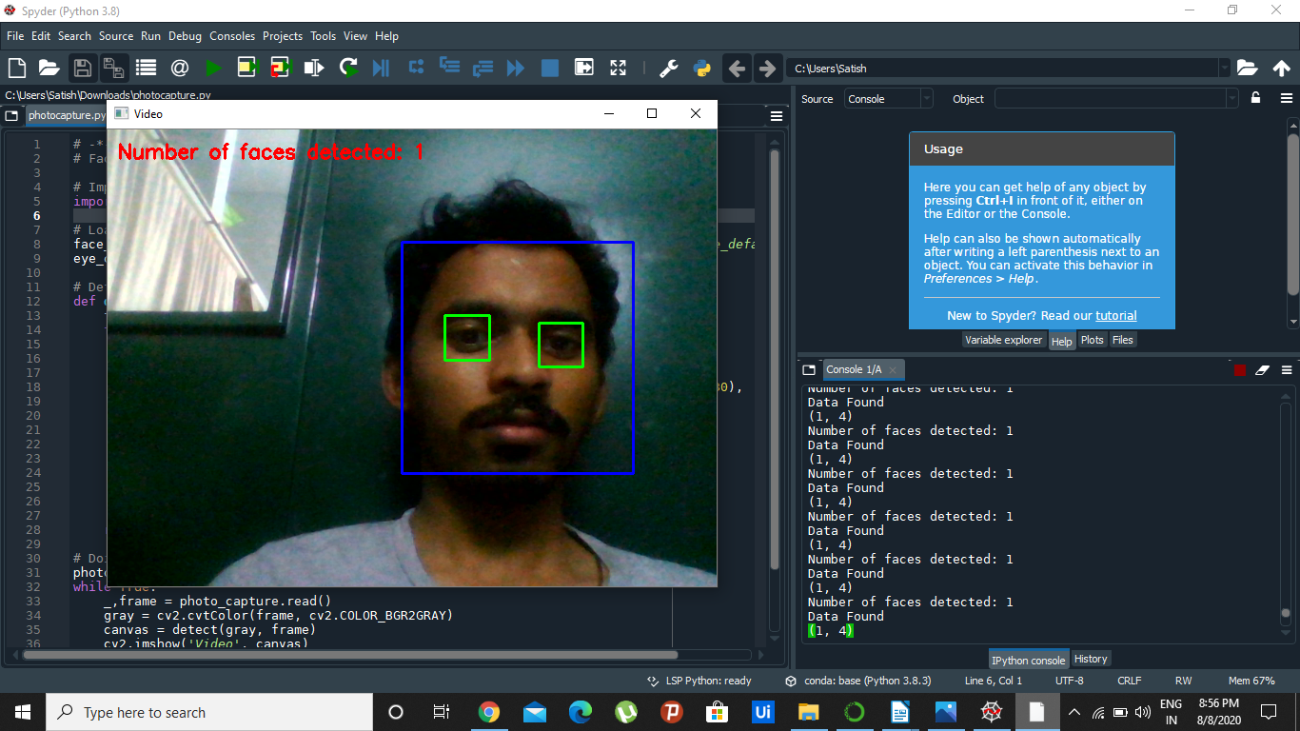
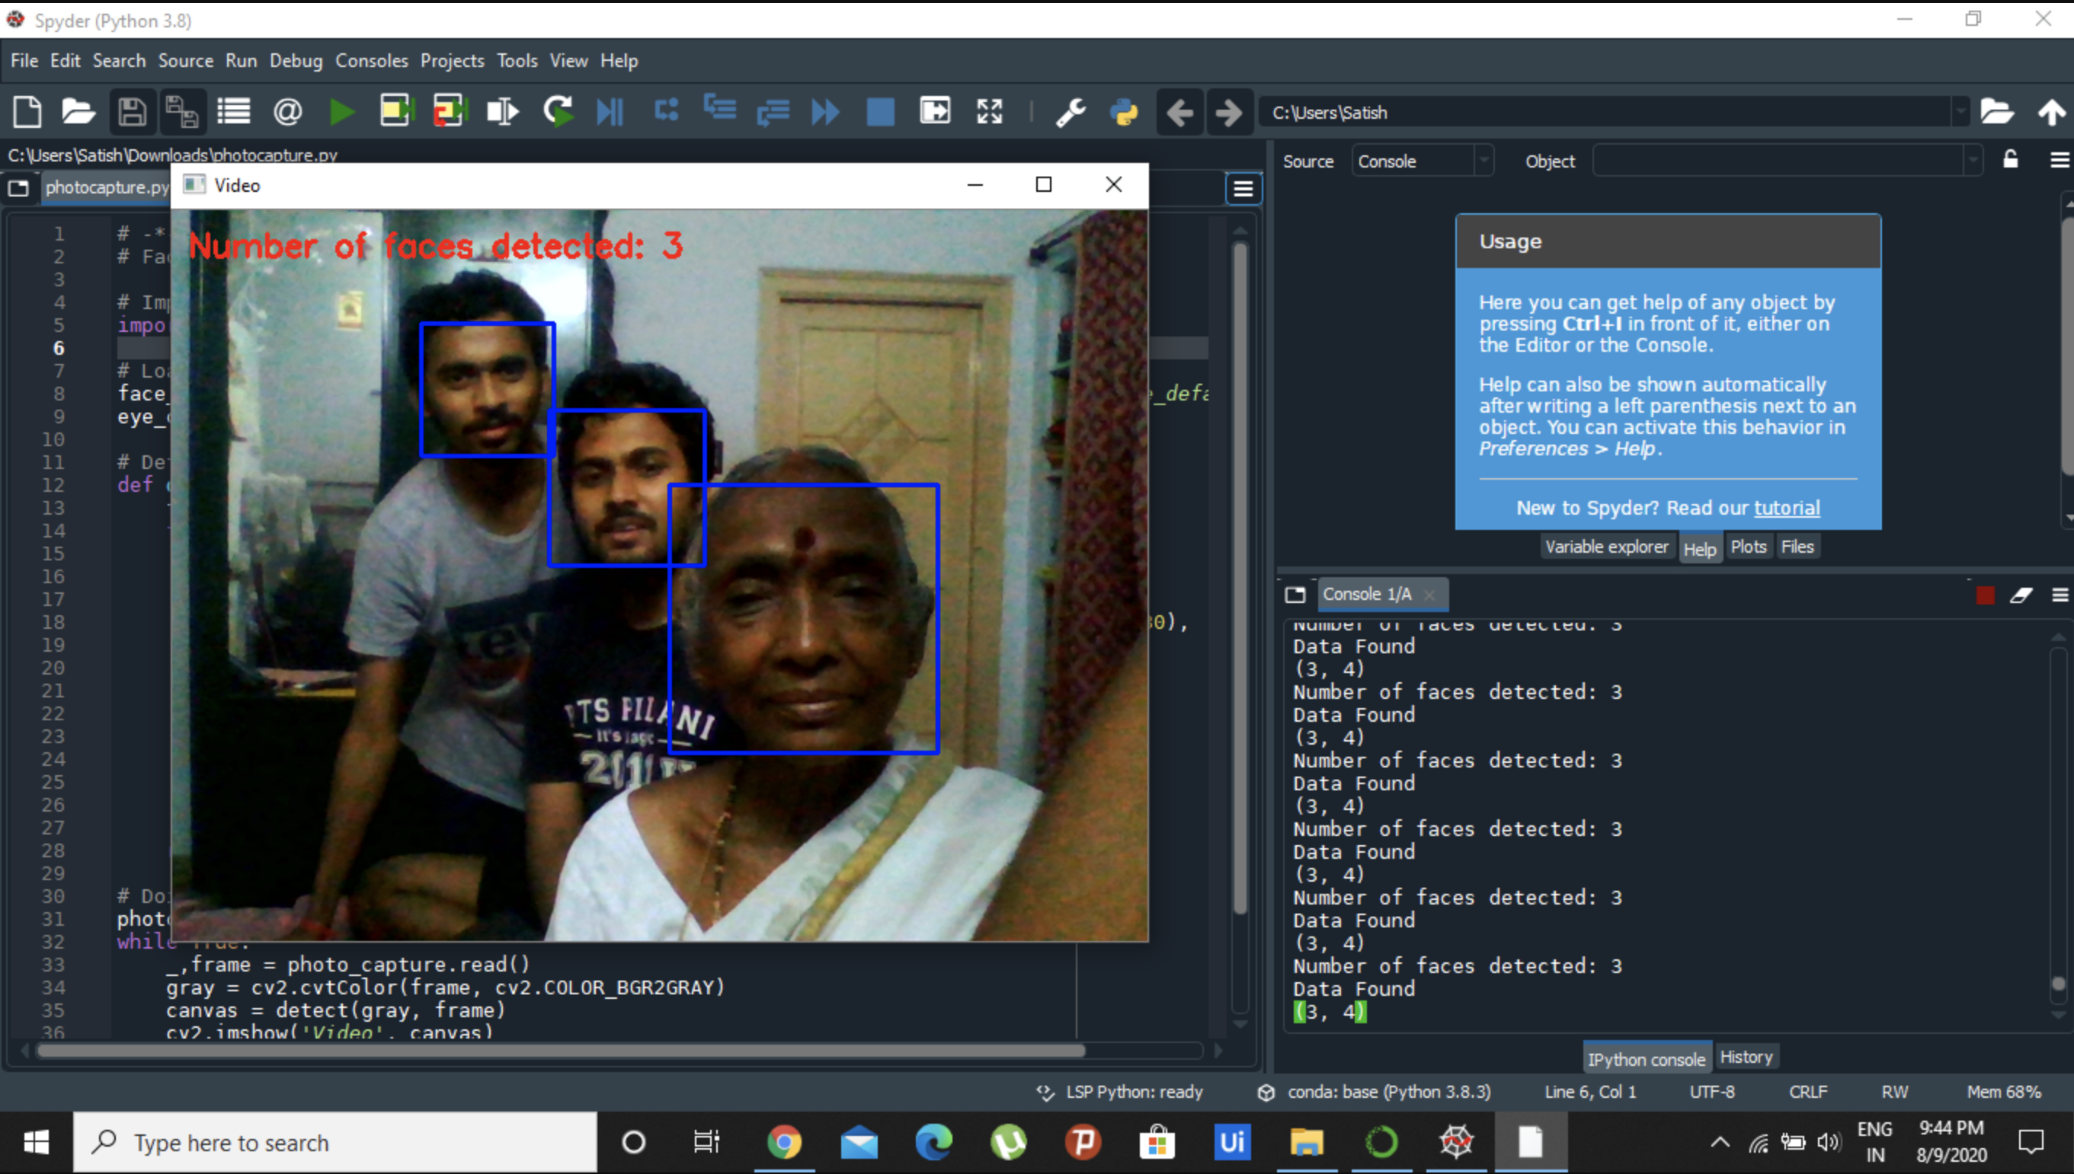
Results and Discussion

Slide 9
References
Git Repo Link: https://github.com/satish2902/photocapture

