Slide 1
Exploratory Data analysis of US accident records
Satish Agrawal
Bellevue University
DSC 530

Slide 2
This is a countrywide traffic accident dataset, which covers the entire United States. The data is continuously being collected from February 2016, using several data providers. Currently, there are about 3.0 million accident records in this dataset.
Format of the data is in CSV (comma separated values) file.
US-Accidents: A Countrywide Traffic Accident Dataset

Slide 3
ID – An unique id for each accident
Source – Source of the data reported from.
Severity - Shows the severity of the accident, a number between 1 and 4, where 1 indicates the least impact on traffic (i.e., short delay as a result of the accident) and 4 indicates a significant impact on traffic (i.e., long delay).
Start_time and End_time – Start and end times of the accidents in local time zone
Start and end Lat/long – GPD coordinates of start of the accidents and end of the accidents
Distance – length in miles of the of the road affected by the accident
Discription – a natural language discripton of the accident.
Address – described by multiple columns to identify the exact location. Includes city name, state abbreviation (e.g. NE, IA etc.), country (USA), zip code, street number and name and time zone of the location.
Airport code - Denotes an airport-based weather station which is the closest one to location of the accident.
Weather timestamp - Shows the time-stamp of weather observation record (in local time).
Weather data – temperature(F), wind chill (F), humidity %,pressure, visibility, wind speed, wind direction, precipitation, weather condition ( e.g. cloudy, thunderstorm, rain or snow etc.)
Location data – More information about the surroundings. For example, if there was a traffic signal near by, a stop sign, round about, station, railway, junction turning stop, traffic calming device, speed bump and few other information related to the surroundings of the accident.
Variables in the dataset

Slide 4
Traffic Signal
Weather Condition
Wind Speed (mph)
Visibility (mi)
Temperature (F)
Severity
Variables selected for EDA from the dataset

Slide 5
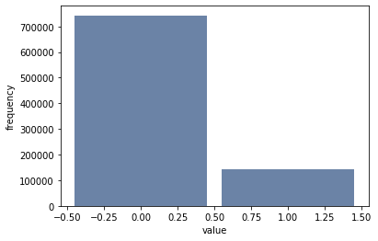
This variable in the dataset indicated if there was a traffic signal near the accident. It is either 1 or 0. It is one if there was a signal present otherwise zero. It is believed that traffic signals help regulate the traffic and there are less number of accidents around traffic signals.
Variables selected for EDA from the dataset
Traffic Signal

Slide 6
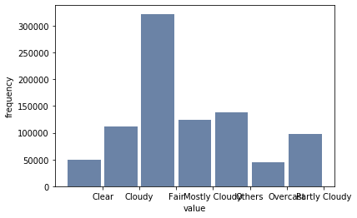
This variable describes the weather condition at the time of the accident. For example cloudy, rain, snow, thunderstorm etc. This variable has variety of values. This project believes that weather condition plays an important role in accidents.
Variables selected for EDA from the dataset
Weather Condition

Slide 7
This variable has a decimal point value for the speed of the wind. This is another weather related data point which may play a role in accidents.
Mean 7.4294385905
Standard Deviation 5.30068889
Variance 28.097302727
Variables selected for EDA from the dataset
Wind Speed (mph)

Slide 8
This variable provides the visibility in miles at the time of the accident.
Mean 9.101511466910514
Variance 7.942416344406279
Standard Deviation 2.8182292923760266
Variables selected for EDA from the dataset
Visibility(mi)

Slide 9
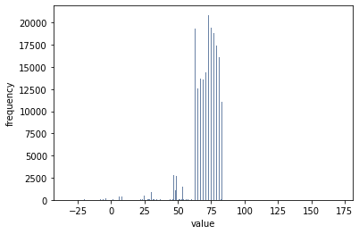
This variable provides the temperature at the time of accident.
Mean 61.503567771204374
Standard Deviation 19.233740137254276
Variance 369.9367596674261
Variables for EDA from the dataset
Temperature(F)

Slide 10
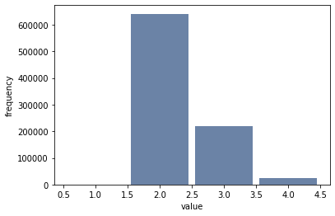
This variable provides the severity of the accident. Severity is categorized in four categories from 1 to 4, 4 being the most severe.
Variables selected for EDA from the dataset
Severity

