Slide 1




ENTERPRISE CODE QUALITY PLATFORM
Review Shield
AI-Powered Code Review, Org-Wide
Move faster. Build better. Ship with confidence.
GitLab
GitHub
BitBucket
Prepared for Leadership • Organization-wide rollout

Slide 2




THE CHALLENGE
Code review is critical — and a bottleneck
How much time does your team spend on code reviews every week? Reviews protect quality, but at scale they slow delivery and strain engineers.
Delayed reviews
Reviewer fatigue
Inconsistent standards
Fragmented tooling
PRs wait in queues for an available reviewer, stretching cycle time and time-to-merge.
Human attention drifts on long or repetitive diffs — real issues slip through to production.
Quality varies by reviewer and repo, creating friction and uneven enforcement.
Review processes are scattered across GitLab, BitBucket and GitHub with no shared view.
02

Slide 3




WHY CHANGE
Manual peer review vs. AI peer review
Manual Peer Review
AI Peer Review — Review Shield
Turnaround in hours or days
Instant feedback the moment a PR opens
Quality varies by reviewer & mood
Consistent standards across every repo
Limited by working hours
Available 24/7, never fatigued
Reviewer reads files in isolation
Whole-codebase context via Graph RAG
Effort scales linearly with PR volume
Scales to 1000s of PRs at low marginal cost
03

Slide 4

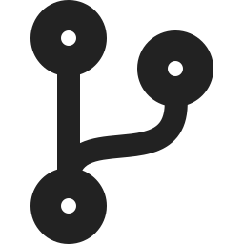
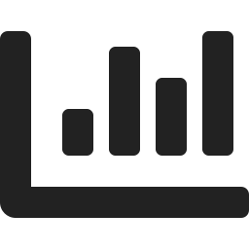
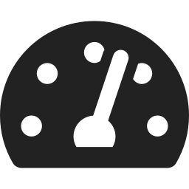
INTRODUCING
Review Shield brings it all together
One centralized, AI-powered platform replacing fragmented review processes — with intelligent automation and real-time visibility across the whole organization.
AI-Powered Reviews
Multi-VCS Support
Comprehensive Dashboards
Actionable Metrics
Instant, intelligent feedback that catches issues before they reach production.
Works seamlessly across GitLab, BitBucket, GitHub — and more.
Track adoption, activity and impact across every team and repo.
Time saved, issues found, acceptance ratios — all at your fingertips.
04

Slide 5

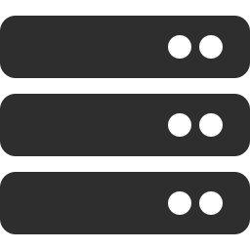

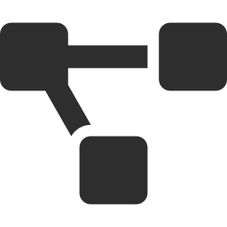









SOLUTION DESIGN
The end-to-end review flow
1
Create webhooks
Register Core Review & Merge webhooks per repo (name + URL) in GitLab, BitBucket or GitHub.
PIPELINE AT A GLANCE
2
Trigger via Jenkins
Webhook URL hits the Jenkins URL, launching an AI peer review for each PR / MR.
VCS Webhook
Clone & build Graph RAG
The repo is cloned and indexed into a code Graph RAG of files, symbols & dependencies.
▼
3
Jenkins Trigger
Diff + retrieve context
Extract the PR / MR diff, then pull the connected context for it from the Graph RAG.
▼
4
Clone + Graph RAG
Submit the change to the LLM together with its Graph RAG context for a deep review.
▼
5
Review with the LLM
LLM Review
▼
6
Comments & summary
Generate inline review comments and a concise PR summary back on the PR / MR.
Comments + Summary
▼
7
Merge check → dashboard
The Merge webhook verifies fixes and streams the data to the Review Shield dashboard.
Review Shield Dashboard
05

Slide 6




THE DIFFERENTIATOR
Context-aware reviews with code Graph RAG
Most tools review a diff in isolation. Review Shield indexes the whole codebase as a graph — functions, classes, imports, call paths — then retrieves the change’s connected context before the LLM ever sees it.
Diff-only review
Graph RAG context-aware review
Sees only the changed lines, blind to the rest
Pulls callers, callees & related modules for the change
Misses cross-file and downstream breakage
Catches cross-file regressions and broken contracts
Cannot judge intent or architectural fit
Reviews against real architecture & conventions
Generates noisy, low-context comments
Fewer false positives, sharper, actionable comments
06

Slide 7






PLATFORM CAPABILITIES
Everything leadership needs to see
AI Review Activity
Compute vs. Human Effort
Issue Severity & Categories
Monitor review trends and volume over time, by team and repo.
See exactly where AI creates leverage versus manual effort.
Understand what matters most — by severity and type.
Adoption & Leaderboards
Top Repositories
Real-Time Metrics
Gamify quality and drive healthy adoption across the org.
Identify hotspots, trends and the most active codebases.
Avg. review time, acceptance ratio and time saved, live.
07

Slide 8




PROVEN IMPACT
What pilot teams are seeing
60%
24/7
~5
100%
faster review cycles
always-on coverage
FTE-months freed / month*
of PRs reviewed consistently
Plus: significant developer time reclaimed, issues caught before production, and uniform standards enforced across every repository.
* Modeled at 420 PRs/month, 2.0h human vs 0.05h AI per review — see the savings model on the next slide.
08

Slide 9

THE MATH — PART 1
How we measure human effort saved
Every saving is auditable: a transparent formula stack turns each reviewed PR into measurable hours — then into dollars.
Layer 1 — Per-review savings
Deriving T_human
Saved_PR = T_human − T_AI
The atomic unit — the time delta on every single PR.
T_human = T_base(LOC)
× K_complexity × K_familiarity
× K_risk + T_context
Layer 2 — Monthly aggregate
Saved_month = Saved_PR × (PRs/day × working_days)
K_complexity
Scales the per-PR delta across real PR throughput.
Cyclomatic complexity of the change
K_familiarity
Reviewer ownership — up to 2× if unfamiliar
Layer 3 — Financial translation
K_risk
Cost_saved = Saved_month × senior_eng_rate
Scrutiny tier: /payments, /auth demand more
Converts hours into dollars at a fully-loaded rate.
T_context
Fixed per-PR overhead (5–15 min)
09

Slide 10


THE MATH — PART 2
What it means in dollars & FTE
420
1.95 h
~820 h
~5.1
PRs reviewed / month
saved per PR
freed per month
FTE-months / month
FTE_months = Monthly_hours_saved ÷ 160
Review time per PR (hours)
~$98K
Quality guardrails reported alongside savings:
direct labor saved per month — ~$1.18M / year
Issue escape rate — defects that slip past review
Assumes a $120/hr fully-loaded senior-engineer rate.
False-positive rate — AI comments dismissed
Coverage parity — languages & rules vs. baseline
10

Slide 11



ROADMAP
Where Review Shield is heading
Auto-correct, fix & merge
Scale 5 → 1000 repos
Graceful fallback
AI suggestions can auto-apply safe fixes
Low-risk PRs can be merged automatically
Humans stay in the loop for higher-risk changes
Queue-based ingestion & parallel Jenkins agents
Shared, cached multi-tenant Graph RAG indexes
Pooled token budgets & rate-limit management
If Jenkins / LLM fails or token limits are hit…
…teams fall back to human peer review seamlessly
No hard dependency — merges are never blocked
11

Slide 12





GET STARTED
Onboard a new repo in minutes
1
Register the repo
Open the Configure portal and add the repository — name + URL.
CORE WEBHOOKS
2
Create the Core Review webhook
Point PR / MR open & update events to the Jenkins trigger URL.
Review webhook
repo + URL → Jenkins URL
Fires per PR / MR to trigger the AI peer review.
3
Create the Merge webhook
Route merge events to Review Shield so fixes & metrics are captured.
Merge webhook
4
Verify a test PR
Open a sample PR and confirm an AI review and summary post back.
merge event → Review Shield
Verifies fixes and feeds the dashboards.
5
View dashboards on Zion
Track adoption, activity and impact on the Zion internal portal.
Configured once per repo, in GitLab, BitBucket or GitHub.
12

Slide 13


Let’s elevate code quality — organization-wide
This isn’t just about code. It’s about empowering teams to move faster, build better, and ship with confidence.
Configure your repository
Set up webhooks in no time
Visit the Zion portal
Dashboards & metrics, org-wide
Review Shield • Enterprise AI Code Review

