Slide 1

Streams

Slide 2
What?
Imperative vs functional
What are Streams?
Stream operations - Intermediate & Terminal
Chaining operations
Processing Order
Combining OOP and Functional
Advanced operations
Best practices
Why Streams?

Slide 3
Imperative Vs Functional
How?
Complex
Side effects
Mutable state
What?
Simpler
Avoids side effects
Favors immutability (no variables)
Functions are first class citizens
Pass functions, return functions..
ImperativeVsFunctional.java

Slide 4
Stream
Stream of names (Strings)
Sequence of elements
Operation on elements
Stream of integers
1
Mowgli
2
Lilly
3
Max
4
Panda
5
Daisy

Slide 5
Operation Types
Intermediate Operations
Returns a stream
Multiple operations can be chained
Terminal Operation
Returns a non-stream
Source
Intermediate
Operation 1
Intermediate
Operation 1
Intermediate
Operation 1
Terminal
Operation

Slide 6
Get Started
elements
IntStream stream = IntStream.of(1, 2, 3, 4, 5); stream.forEach(System.out::println);
Operation on each element
GetStarted.java

Slide 7
Operation map
n -> 2 * n
Source
Target
1
2
map input to output
2
4
3
6
4
8
5
10
IntStream.of(1, 2, 3, 4, 5)
.map(n -> 2 * n) .forEach(System.out::println);

Slide 8
Filter
n -> n%2 == 1
Source
Target
Filter elements which doesn’t meet criteria
1
1
2
3
3
4
5
5
IntStream.of(1, 2, 3, 4, 5)
.filter(n -> n % 2 == 1) // odd number .forEach(System.out::println);

Slide 9
Processing Order
Stream.of("Mowgli", "Lilly", "Max", "Panda", "Daisy") .filter(name -> name.startsWith("M")) .map(name -> name.toUpperCase()) .forEach(System.out::println);
Filter
Map
Mowgli
Mowgli
MOWGLI
Lilly
Max
Max
MOWGLI
Panda
Daisy

Slide 10
Processing Order
All operations are merged
Lazy evaluation (performance optimized)
For findFirst() – checks one at a time. Stops when found.
Sorted – waits for all elements

Slide 11
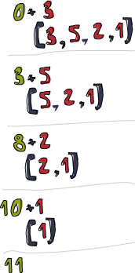
Reduce
Starting value
Lambda to fold
IntStream.of(3, 5, 2 , 1)
.reduce(0, (subtotal, element) -> subtotal + element)

Slide 12
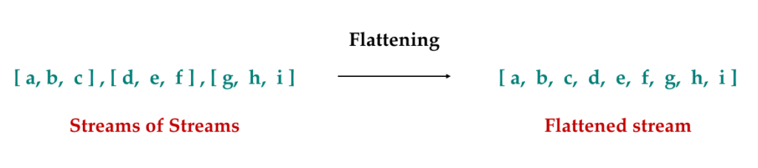
FlatMap
Flattens stream of streams to a stream
Few Example
Lines having words
Books having Trades

Slide 13
Operations
Intermediate
filter()
map()
sorted()
anyMatch()
findFirst()
distinct()
skip()
flatmap()
Terminal
forEach()
collect()
reduce()
count()
sum()
min()
max()

Slide 14
Advanced Operations
GroupBy()
summingDouble()
GroupingByExample.java

Slide 15
Why Streams
Much simpler to develop - What vs How
Easier to understand
Less code == Fewer bugs
Runs faster (most of the times)
Combines OOP and Functional Programming
WhyStreams.java

