Slide 1
Data Visualization

Slide 2
Options
Pandas internal plot functions. – not many features
Matplotlib
Seaborn built on top of matplotlib, adds more features and makes the graph prettier.

Slide 3
Setup needed
# import the libraries you need
import pandas as pd
import matplotlib.pyplot as plt
%matplotlib inline
import seaborn as sns
print("Setup Complete")
# fetch the dataset
data = pd.read_csv("data.csv")
# examine the data
Data.head()
#plot the data

Slide 4
Plots with us?
Bar
Histograms
Density curves
Kde cureve
Scatter plot

Slide 6
Artificial Intelligence & Machine Learning

Slide 7
What and Why Machine Learning?
Major difference between humans and machines:
Machines unlike humans cannot learn from past experience
What is machine learning?
Enabling machines to learn from past experience to perform tasks.
Where can we use machine learning?
Recommendation system, fraud detection, self-driving cars, stock market prediction, voice recognition e.t.c.

Slide 8
Various algorithms used in machine learning
Supervised learning
Decision Trees
Linear Regression
Logistic regression
Support Vector machine
PCA
Un-supervised learning
K-mean clustering
Hierarchical clustering

Slide 9
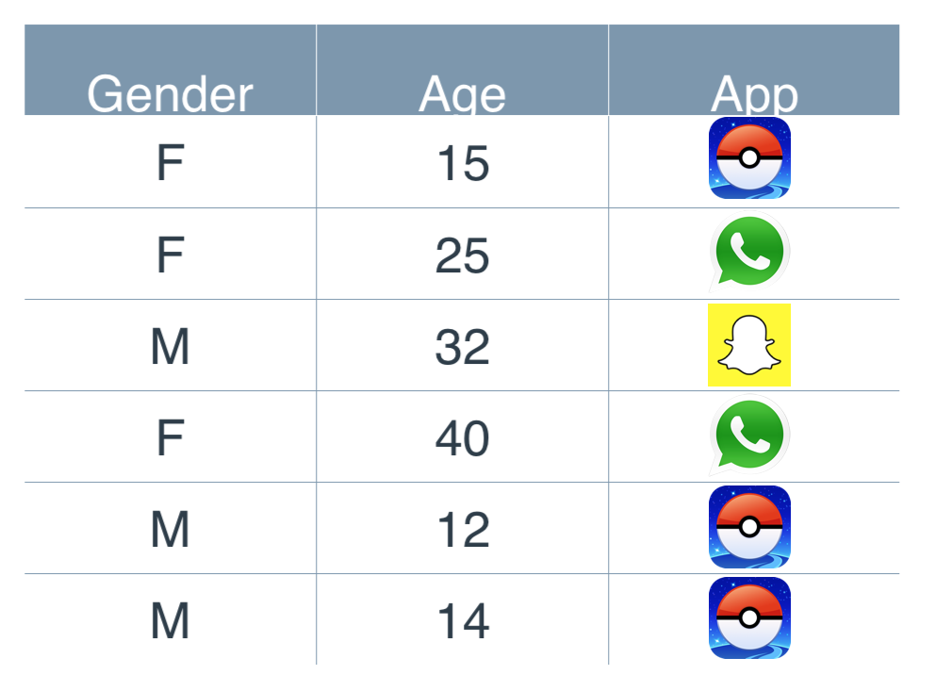
Decision Trees
User usage info
Based on attributes like age and gender we can predict what a user will install.
Look at age, it works better to predict if a person will download some given app.
Where as age acts as next level of deciding factor for installation.

Slide 10
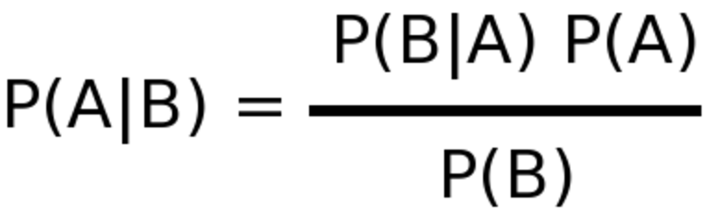
Naive Bayes
where A and B are events and P(B) != 0
P(A|B) is a conditional probability: the likelihood of event A occurring given that B is true.
P(B|A) is a conditional probability: the likelihood of event B occurring given that A is true.
P(A) and P(B) are the probabilities of observing A and B independently of each other; this is known as the marginal probability.

Slide 11
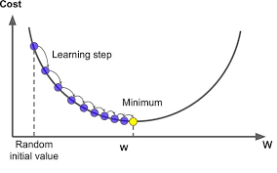
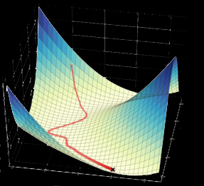
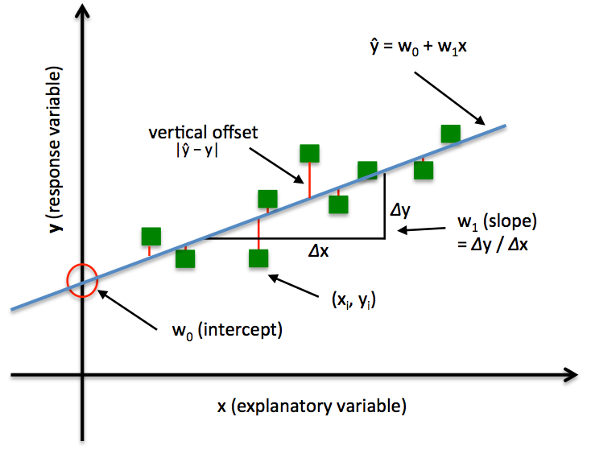
Gradient Descent
Can look into infinite number of dimensions
Slower the rate means better performance
Uses least square method.
Reduce the error by moving the line
Slow performance

Slide 12
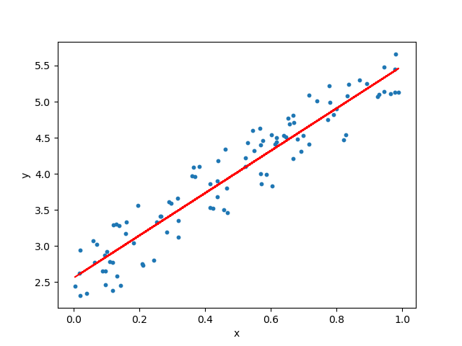
Linear Regression
Dependent variables are continues in nature
Establish the relationship between dependent and independent variable.
Can be linear, multi-linear
Y = w1x1 + w2x2 + … + b
e.g. predict the house prices.

Slide 13
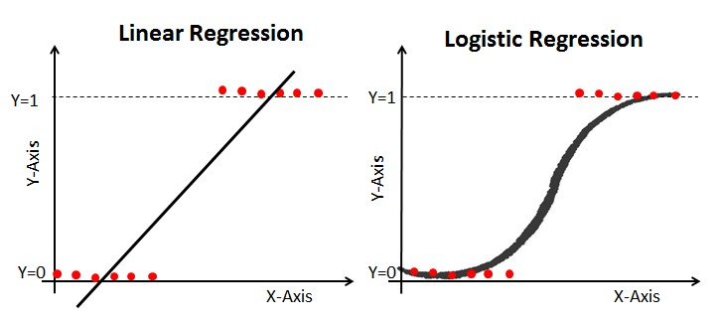
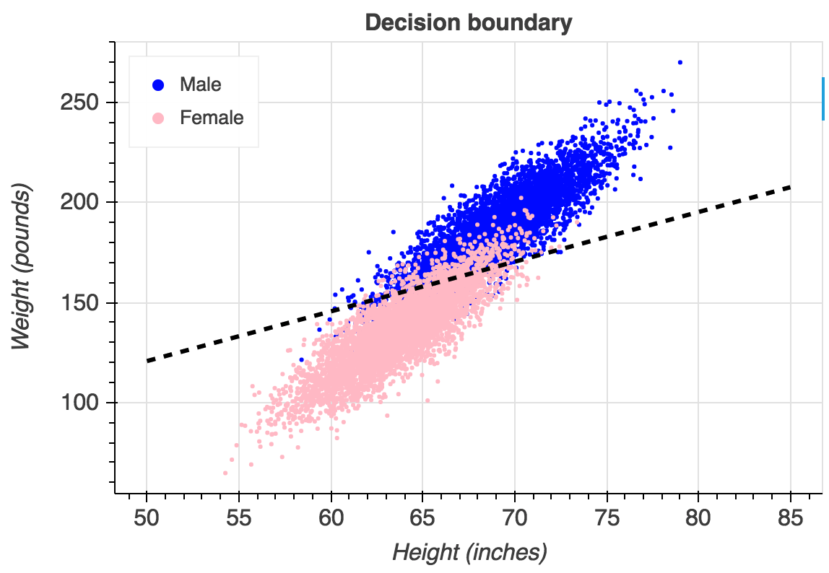
Logistic Regression
Dependent variable is binary (true(1), false(0))
Find the nest fitting model for the data
Independent variables can be continues or binary.
Punish the model whenever it does mistake.

Slide 14
Support Vector Machines(SVM)
Pays attention to point is close to boundary.

Slide 15
K-mean Clustering
Pick some random points and form the clusters of points closest to them.
Keep moving the centroids to center and re-arranging the clusters.
Number of cluster needs to be decided before hand.

Slide 16
Hierarchical Clustering
No need to know the number of clusters before hand.
Create the groups of points closest to each other and merge the points/clusters based on some distance rule into one cluster.

