Slide 1
Designing and Developing Business Intelligence Applications

Slide 2
BI Application Resource Planning
Role of BI Application Developer
-must develop, maintain, enhance core set of BI applications
-must provide usable, working, documented solutions
Who does the BI Applications Job?
Central group of BI developers creates and maintain BI applications

Slide 3
Lifecycle Timing
BI application process is two stage process
-Specification which is done after requirements gathering
-Development which is done after data access tool is selected , initial database design and initial data loading is done

Slide 4
BI Application Specification
Designing report template
Identifying and specifying applications
Designing navigation framework and portal
Get customers involved in specification process

Slide 5
Five major activities in BI apps specification
Create application standards and templates
Determine the Initial Application Set
Develop Detailed Application specifications
Design the Navigation Framework and Portal
Review and Validate the Applications and Model

Slide 6
Create application standards and templates
Determine Naming standards
-covers areas like naming, formatting and common fields
Create the Application Templates
people can find information quickly if presented in a consistent fashion.
Newspaper Example

Slide 7
need to have own format and content standards and use them consistently
standards at portal level and at individual document level

Slide 8
Standard elements needed in BI report or
Application
Report name
Report title
Report body
Column/row layout of data, including:
Data justification: Right justified for numbers, left justified for row
headers, right justified or centered for column headers.
Display precision: Dependent on data, so you must figure it out for all
your numeric fields.
Column and row heading format: Often bold, underlined, or colored to
distinguish them from report data (and test this in print form).
Background fills and colors.
Formatting of totals or subtotal breakout rows.

Slide 9
Header and footer
Report name.
Parameters and filters used.
Navigation category.
Report notes regarding any unusual definitions or content.
Page numbering.
Report run time and date.
Data source(s): Which dimensional model(s) sourced the data in the report, and was it the relational or OLAP database.
Confidentiality statement.
DW/BI reference: Name and logo.
Report file name

Slide 10
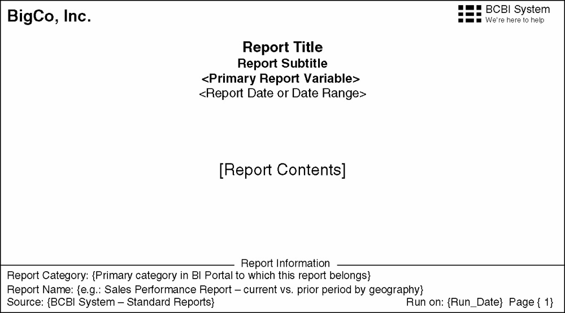
Example Standard Template

Slide 11
Create Dashboard and Analytic Application Templates
Dashboards and analytic applications are complex than simple standard reports
You should create a standard template for these
A typical dashboard or analytic application incorporates several different elements, including reports, charts, and special dashboard controls such as alert indicators.

Slide 12
Determine the Initial Application Set
Once standards and templates are created, the next step in the BI specification process is to develop the target list of reports.
A small set of high value reports is created that provide a range of report types
Ten or fifteen reports may be enough to start with for some organizations
some of these reports might be more complex analytic applications or might be grouped together for delivery through a dashboard
The process of generating the target list involves three tasks:
Identifying report candidates
Consolidating the candidate list
Prioritizes the Report List

Slide 13
Identify Report Candidates
Depending on how well you documented your interviews with managers, each interview write-up may have a list of potential reports
Requires involvement of core business users who are familiar with the initial business process.
Use a spreadsheet like the one shown in Figure to make a list of individual report requests, one request per line.
Include a name, type of report, row data elements, column data elements, measures, and additional attributes that might
help in the consolidation process, such as listing the groups or departments that are interested in the report.

Slide 14
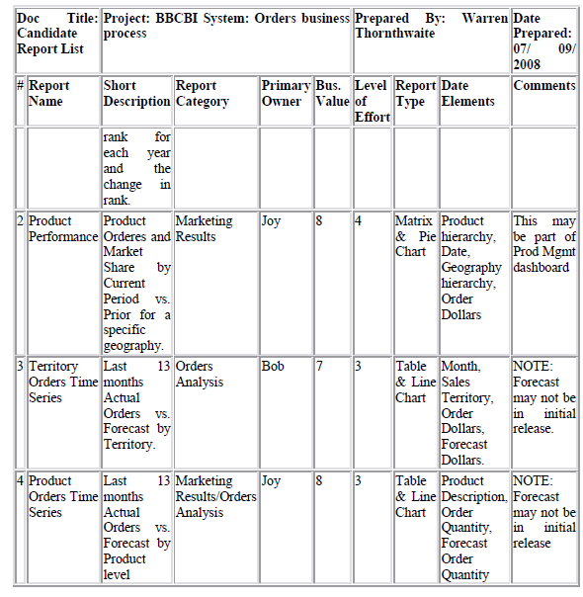
Sample Candidate Report List

Slide 15
Consolidate the Candidate List
Once the list is reasonably complete, refocus the group on consolidating the list
To identify those reports on the list that are essentially different versions
of the same report
Categorize according to the items in the spreadsheet — which data
elements does each report contain in each section?

Slide 16
Prioritize the Report List
Once you have the list of candidate reports, work with the users to assign a priority to each one.
Some of the factors to consider include business value, data availability,
degree of development difficulty, scope of use, and user importance.
Sometimes the CEO's report comes first, regardless of its true business value.
If you can't actually rank the reports, at least try to split them up into three groups: the As, Bs, and Cs.
Reports that provide high business value and are relatively easy to create make the A list.
Limit the A list to 15 reports or less
keep the B list handy if you have extra time, or for the next iteration, and encourage your users to work on the C list if they feel strongly about it.
The A list is what you plan to implement.

Slide 17
Develop Detailed Application Specifications
involve the business users
The specification process has two underlying
Purposes
first is to capture enough information
second is to ensure that the DW/BI
system is delivering something of value to the business community

Slide 18
best ways to specify the individual report/applications is to divide and conquer.
Split the target list of reports up among the available business and technical folks
each person work for their subset of the target list and bring the results back for group review

Slide 19
Each report/application have following set of documentation:
Mock up.
It is a physical example of the report, including all the visual components.
To create a mock up, start with your standard template and fill in the report-specific elements: rows, columns, calculations, and formatting.
User interactions
List all the points where the user can interact with the
report, including variables, parameters, lists, limits, drilldown paths, and links.

Slide 20
Datasets.
Describe the datasets that fill the various sections and components of the report, including the report body and selection lists that support user interactions.
Algorithms, advanced calculations, and business rules.
Include descriptions of any advanced analytics or data mining models that will be needed in the application.
Interactions with other reports/systems.
Describe interactions between reports and systems

Slide 21
Specify Application Content
The parameter-driven approach allows users to generate dozens or potentially hundreds of variations on the basic standard report.

Slide 22
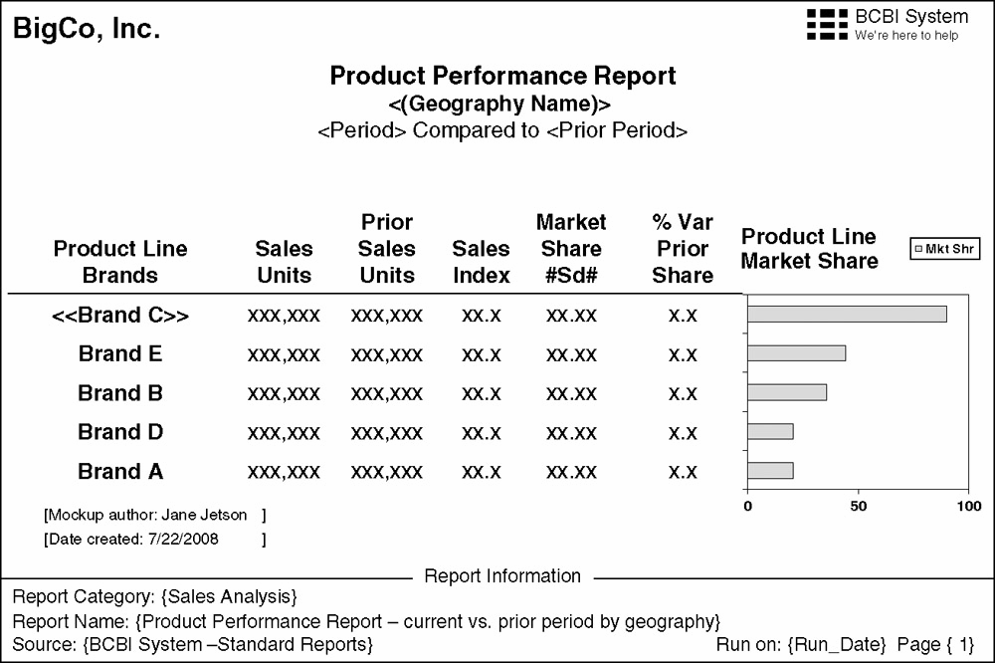
Sample report mock up

Slide 23
<> User entered parameter, typically selected from list
«» Drillable field
#Sd# Sort order indicator, (a)scending or (d)escending
{} Application entered variable, either from the system or metadata
\\\\ Link/URL to another report or documentation source
() Page or section break field
[] Report template comment

Slide 24
There are two parts to each BI application specification: a mock up and a definition.
The definition provides basic information about the report or application, and the
mock up provides a visual representation of how the content will look on the page.

Slide 25
The BI application definition includes the name, description or purpose, frequency,
parameters and their associated pick lists, user interactions, and default constraints.

Slide 26
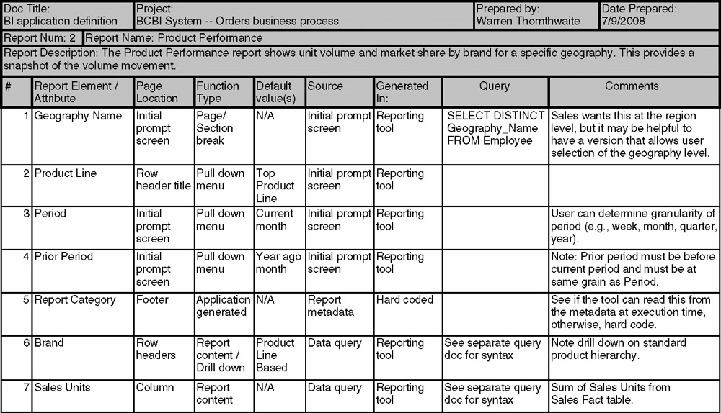
Example BI application definition

Slide 27
Design the Navigation Framework and Portal
If users create as many reports as the warehouse team, you can easily end up with 100 standard reports or more before you know it.
Even with meaningful naming standards, it would be difficult to navigate a list of 100 reports.
This concludes requirement of navigation framework and portal
It is a method for grouping and organizing these BI application objects.
Figure shows a simple navigation framework with sales related business processes like sales activity and sales pipeline at the top level of the BI portal.

Slide 28
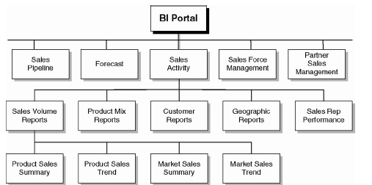
Simple application navigation framework

Slide 29
Review and Validate the Applications and Model
The BI application specs provide a good way to logically test the dimensional model
Take each report specification and verify that the attributes, constraints, hierarchies, measures, and appropriate grain all exist in the model.
Look at each report, compare it to the model and think about how you would write the SQL or OLAP queries for the report
Review with the Business
The next step is to hold an official review session with the core users and all other interested stakeholders.
Step through the documentation and any prototypes you put together that will help communicate the nature and content of the applications
These specifications will inevitably change when you get to the application
development phase

Slide 30
Business Intelligence Application Development
The specific BI application development tasks vary according to your BI tools and the applications you are building.
The application development process follows a standard software
development flow:
Prepare
Build
Test
Deploy

Slide 31
Prepare for Application Development
Install and Test the BI Tools
Populate BI Tool Metadata
Create Business Metadata
Test the BI Tools
Validate Your BI Application Interface Strategy
Set Up User Security
Set Up the Report Process Metadata System

Slide 32
Build the Applications
Follow the Core Process
Developing BI applications in most tools generally involves three major activities:
1) Defining the user interactions,
2) Creating the queries,
3) Formatting the results.

Slide 33
Design and Develop Analytic Applications
Typically targeted at a specific business process
Provide a means for the user to feed changes back into the
transaction system based on guidance from the analytic application
To build this kind of application in the standard front end tool
report building environment, it is to use a standard programming tool to weave the components together into a coherent application
An analytic application may be a program that paints the user interface (UI), manages the user interactions, displays report and graph components from your BI tool via the tool's API, and directs certain user selections to an operational system.

Slide 34
Design and Develop Operational BI Applications
Operational BI applications are usually custom developed to query the data
warehouse and the operational systems, and then enable the user to invoke transaction processes from within the BI application.
These applications provide operations workers with a richer context for decision making and more directed guidance on which decisions might be best.
Also called as closed-loop systems because they provide the user with the ability to act on that guidance immediately, usually by directly initiating an event in the transaction system.
Operational BI must be available for 24/7
operational BI applications can stress the performance levels of the DW/BI system
Though the operational and low latency requirements add to the excitement, the
process of developing operational BI applications is quite similar to developing the
analytic applications

Slide 35
Include Data Mining Models
It is one of the important potential component s in your BI applications
From the application perspective, this typically takes pre-defined data mining model with specific parameters, such as customer attributes or purchase history and returns the appropriate values, such as product recommendations or a fraud alert.
It starts with a business phase, exploring opportunities for applying data mining with business folks and verifying the existence of appropriate data to support those opportunities.
In a highly iterative process, the data miner requests descriptive datasets called observation sets or case sets.
These sets are fed into the data mining tool where the data miner selects different combinations of algorithms, parameters, and input variables.
These combinations are called models, and the goal is to create models that appear to be most correlated or predictive.
The best model (at least within the time allowed) is then moved into the operations phase.

Slide 36
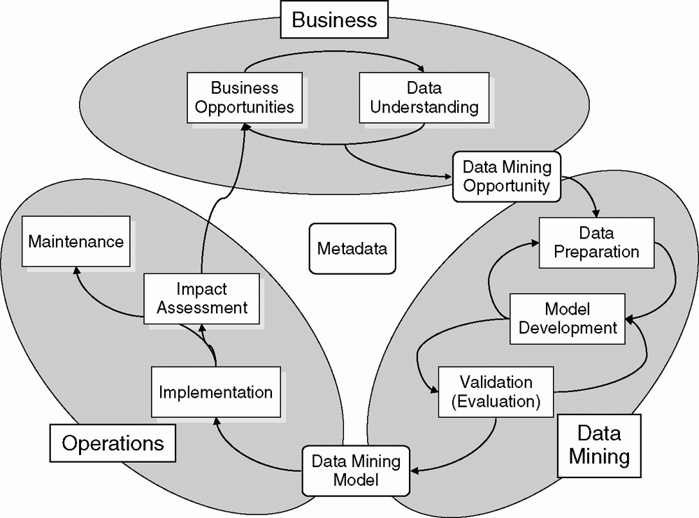
Data mining model development and implementation process

Slide 37
Create the Navigational BI Portal
Once you have more than a couple of reports, you have to provide a navigation
framework or BI portal that allows people to find the information they need
The overall BI portal will have multiple levels, each with its own purpose and design.
At the top level, the portal is primarily a navigation tool.
Top level of a BI portal is devoted to a framework for organizing the standard BI
applications and dashboards to help people find what they are looking for
The indented items in Figure are links to the actual reports

Slide 38
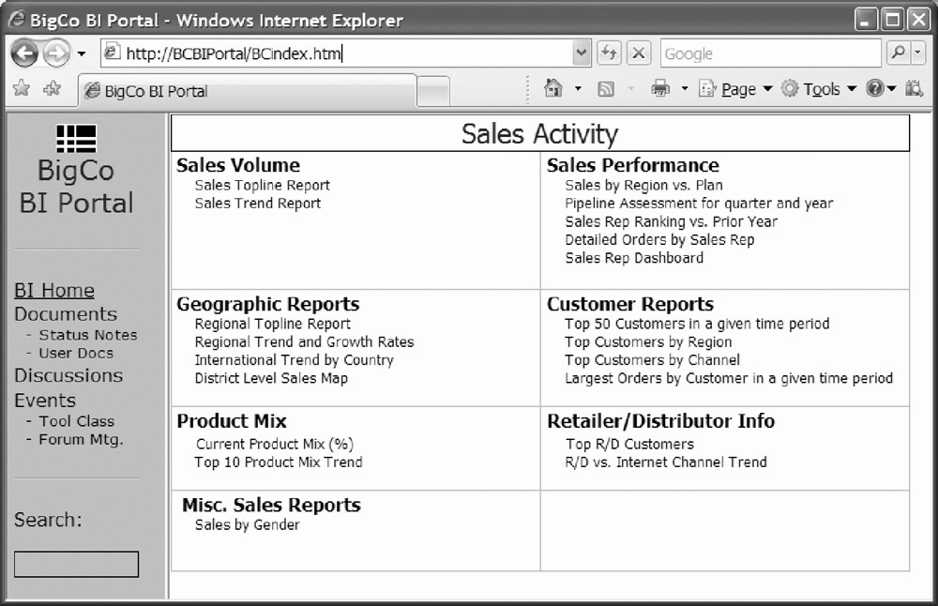
Sample second level portal page for the sales business process

Slide 39
Test and Verify the Applications and Data
Some of the most common issues you are likely to find include:
Meaningless descriptions
Duplicate dimension information
Incorrect dimensional relationships
Data not balancing
Performance tuning
The BI application developer must work closely with the ETL and database teams to work through these issues.

Slide 40
Business Intelligence Application Maintenance
BI applications are not a one-time project. The initial set, and all subsequent additions, will need to be maintained and enhanced.
This includes the following kinds of activities:
Adding new BI applications built by both business users and the DW/BI team.
Updating BI applications to include new data sources or changes to existing sources.
Monitoring BI application performance.
Removing unused BI applications based on the monitoring system, which
should capture usage by report name in the process metadata.

