Slide 1

Data Analysis Essentials
Cornerstone Project — Third Review
Zomato Data Analysis System
Rating-status prediction using Python, Pandas & Logistic Regression
PRESENTED BY
DEPARTMENT
V. Jaswanth — 25B11AI424
G. Satish — 25B11AI367
N. Badrinadh — 25B11AI802
D. Pradeep — 25B11AI255
Department of Artificial Intelligence & Machine Learning

Slide 2

REVIEW 3 — PRESENTATION OUTLINE
1
Proposal System
2
Abstract
3
Problem Statement
4
Dataset: Before & After Cleaning
5
Missing Values & Duplicates
6
Coding Implementation (step-by-step)
7
Expected vs Actual Outputs
8
Prediction Model
9
Accuracy Details
10
Data Visualization
11
Conclusion & Future Scope
Review 3 | 2

Slide 3
PROPOSAL SYSTEM
From Review 1: replace manual restaurant data analysis with an automated Python pipeline
Existing system
Proposed system
Advantages
Restaurant records and ratings reviewed by hand in Excel / CSV.
Slow, error-prone, missing values hurt decisions, no charts, hard to compare cities and cuisines.
Python + Pandas pipeline that loads CSV data, cleans it, runs EDA, draws charts, and predicts whether a restaurant will be highly rated.
Faster processing
Better data quality
Automatic cleaning
Easy visualization
Supports business decisions
PROPOSED WORKFLOW
Load CSV
data
Inspect &
explore
Clean
(dups, nulls)
Preprocess
& encode
EDA &
groupby
Visualize
Train
model
Evaluate
Review 1 proposed the system and its modules → Review 2 delivered cleaning, EDA and a first model → Review 3 consolidates the full implementation, outputs, accuracy and visualizations.
Review 3 | 3

Slide 4
ABSTRACT
The Zomato Data Analysis System is a Python-based analytics project that studies 9,551 restaurant listings (21 columns) to understand which factors are associated with a restaurant being highly rated.
The raw CSV data is inspected, checked for duplicates and missing values (9 missing cells found, 0 duplicate rows), cleaned using most-frequent imputation, and prepared for analysis. The 2,148 unrated restaurants (rating 0) are excluded from modelling. Bar charts compare high-rating rates across price ranges, cities and cuisines.
A Logistic Regression model, trained on 7,403 rated restaurants, predicts Rating_Status (Y = rating ≥ 3.5 / N = below) and reaches 79.9% accuracy, 87.1% precision, 67.1% recall and 75.8% F1 on a held-out test set. The key finding is that higher-priced restaurants are far more likely to be highly rated.
Keywords: Pandas · Data cleaning · EDA · Logistic Regression · Matplotlib
9,551
9
47.0%
79.9%
restaurants analysed
missing cells treated
rated highly
model accuracy
Review 3 | 4

Slide 5
PROBLEM STATEMENT
Restaurant platforms list thousands of restaurants, but ratings vary widely and many restaurants have no rating at all. Analysing these records manually is slow and error-prone, and hidden factors such as price range go unnoticed. The problem is to identify the factors associated with restaurant ratings and build a model that predicts whether a restaurant will be Highly rated (Y, rating ≥ 3.5) or Not (N).
Objectives
Target & features
Scope & tools
1. Clean the restaurant data (nulls, unrated)
2. Analyse rating patterns by price range, city, cuisine
3. Visualize key relationships
4. Build and evaluate a prediction model
Target: Rating_Status (Y / N)
Features: Votes, Price range, Cuisine_Count, Table booking, Online delivery, Country Code
Aggregate rating is excluded from predictors because it directly determines the target (data leakage).
Domain: Food-tech / Restaurant listings
Task: binary classification
Tools: Python, Pandas, NumPy, Matplotlib, scikit-learn, Google Colab
Review 3 | 5

Slide 6
DATASET DETAILS
Uploaded Zomato restaurant dataset (CSV) — 9,551 records × 21 columns
Column | Type | Description
Restaurant ID | Text (ID) | Unique restaurant number, e.g. 6317637
City | Categorical | 141 cities, e.g. New Delhi, Gurgaon, Noida
Cuisines | Text (multi-value) | Cuisines served, e.g. North Indian, Chinese
Average Cost for two | Numeric | Cost for two people, in local currency
Has Table booking | Categorical | Yes / No
Has Online delivery | Categorical | Yes / No
Price range | Numeric (1–4) | 1 = low cost … 4 = high cost
Aggregate rating | Numeric | Average rating (0 = not rated)
Votes | Numeric | Number of votes received
Rating_Status | Categorical (target) | Y = rating ≥ 3.5, N = below (derived)
Sample records
6317637 · Makati City · French, Japanese, Desserts · 1,100 · 4.8 · Y
6304287 · Makati City · Japanese · 1,200 · 4.5 · Y
Note
9 original columns plus the derived target are listed. The other 12 columns (name, address, locality, coordinates, currency, etc.) are part of the same CSV file and were carried through cleaning unchanged.
The file is latin-1 encoded, so it is read with encoding="latin-1".
Review 3 | 6

Slide 7
MISSING VALUES & DUPLICATE RECORDS
9
2,148
0
0
missing cells found
unrated restaurants (rating = 0)
duplicate rows
duplicate Restaurant IDs
HOW EACH ISSUE WAS HANDLED
Issue | Detection | Treatment | Result
Duplicate rows | df.duplicated().sum() | None needed (0 found) | 0 duplicates
Repeated Restaurant ID | df['Restaurant ID'].duplicated().sum() | None needed (0 found) | All IDs unique
Missing numeric values | df.isnull().sum() | None needed (0 found) | 0 missing
Missing categorical values | df.isnull().sum() | Most-frequent imputation (9 in Cuisines) | 0 missing
Unrated restaurants (2,148) | Aggregate rating == 0 | Rows excluded from modelling | 7,403 rated rows
Why mode? Cuisines is a text column, so the most-frequent value keeps it valid (only 9 cells). Giving unrated restaurants a rating would invent labels, so those 2,148 rows were dropped instead.
Review 3 | 7

Slide 8
DATASET BEFORE VS AFTER CLEANING
Check | Before cleaning | After cleaning
Rows | 9,551 | 7,403 (used for modelling)
Columns | 21 | 24 (+ 3 derived columns)
Missing values | 9 | 0
Duplicate rows | 0 | 0
Target distribution | 3,480 Y / 3,923 N / 2,148 unrated | 3,480 Y / 3,923 N
Cuisines | Raw text, 9 nulls | Filled; Primary_Cuisine, Cuisine_Count added
High-rating rate | — | 47.0% (3,480 / 7,403)
What changed
9 null cells filled, 2,148 unrated rows removed, Rating_Status target and 2 cuisine columns derived.
What stayed the same
No duplicates existed, so no records were lost to de-duplication. The 21 original columns were preserved.
Net effect: 2,148 rows removed (22.5% of the data) — a clean, fully-rated dataset of 7,403 restaurants ready for EDA and modelling.
Review 3 | 8

Slide 9
CODING — STEP 1: LOAD & INSPECT
PYTHON | Load data
STEP-BY-STEP EXPLANATION
# Import libraries
import pandas as pd
import numpy as np
import matplotlib.pyplot as plt
# Load the CSV dataset (latin-1 encoding)
df = pd.read_csv("zomato.csv", encoding="latin-1")
print(df.shape) # rows, columns
print(df.head()) # first 5 records
df.info() # data types + null counts
1
Import libraries
Pandas for tables, NumPy for numbers, Matplotlib for charts.
2
Read the file
read_csv loads the file into a DataFrame called df.
OUTPUT
3
Inspect
(9551, 21)
Restaurant ID Restaurant Name Country Code City ...
6317637 Le Petit Souffle 162 Makati City ...
6304287 Izakaya Kikufuji 162 Makati City ...
shape, head() and info() confirm size, columns and data types before any changes.
Review 3 | 9

Slide 10
CODING — STEP 2: DETECT MISSING & DUPLICATES
PYTHON | Quality checks
STEP-BY-STEP EXPLANATION
# Missing values
print(df.isnull().sum().sum())
print((df["Aggregate rating"] == 0).sum())
# Duplicate records
print(df.duplicated().sum())
print(df["Restaurant ID"].duplicated().sum())
# Target: Y if rating >= 3.5, NaN if unrated
r = df["Aggregate rating"]
df["Rating_Status"] = np.where(r >= 3.5, "Y", "N")
df.loc[r == 0, "Rating_Status"] = np.nan
print(df["Rating_Status"].value_counts(dropna=False))
1
Count null cells
isnull().sum().sum() adds up every missing cell in the table.
2
Check the target
Unrated restaurants (rating 0) have no label, so they cannot be imputed.
OUTPUT
3
Find duplicates
9 # total missing cells
2148 # unrated restaurants (rating 0)
0 # duplicate rows
0 # duplicate Restaurant IDs
N 3923
Y 3480
NaN 2148
duplicated() flags repeated rows; checking Restaurant ID catches repeated restaurants.
Review 3 | 10

Slide 11
CODING — STEP 3: CLEAN & TRANSFORM
PYTHON | Cleaning
STEP-BY-STEP EXPLANATION
# Remove duplicates (none found, kept for safety)
df = df.drop_duplicates()
# Median for numeric, mode for categorical
num = df.select_dtypes("number").columns
cat = df.select_dtypes("object").columns.drop("Rating_Status")
df[num] = df[num].fillna(df[num].median())
for c in cat:
df[c] = df[c].fillna(df[c].mode()[0])
# Derive helper columns from Cuisines
df["Primary_Cuisine"] = df["Cuisines"].str.split(",").str[0]
df["Cuisine_Count"] = df["Cuisines"].str.split(",").str.len()
# Drop the 2,148 unrated restaurants
df_model = df.dropna(subset=["Rating_Status"])
print(df_model.shape, df_model.isnull().sum().sum())
1
Drop duplicates
Safe no-op here: the data had none.
2
Fill missing values
Median for numeric columns, most-frequent value for categorical ones.
3
Derive columns
Split Cuisines into Primary_Cuisine and Cuisine_Count.
4
Exclude unrated
OUTPUT
Unrated rows have no target and cannot train a classifier.
(7403, 24) 0 # 7,403 rows, 0 nulls (21 cols + 3 derived)
Review 3 | 11

Slide 12
CODING — STEP 4: EDA & GROUP COMPARISONS
PYTHON | Analysis
STEP-BY-STEP EXPLANATION
# Numeric target for averaging
df_model["Is_Good"] = (df_model["Rating_Status"] == "Y").astype(int)
print(df_model["Rating_Status"].value_counts())
# High-rating rate (%) per group (top 5 each)
for col in ["Price range", "City", "Primary_Cuisine"]:
top = df_model[col].value_counts().head(5).index
sub = df_model[df_model[col].isin(top)]
rate = sub.groupby(col)["Is_Good"].mean() * 100
print(rate.round(1))
1
Encode target
Y→1, N→0, so the mean of the column equals the high-rating rate.
2
Count outcomes
value_counts() shows class balance: 3,480 Y vs 3,923 N.
OUTPUT
N 3923 Y 3480
Price: 1→28.6 2→43.8
3→75.7 4→81.4
City: Faridabad 17.2 | Ghaziabad 17.4 | Gurgaon 39.6
New Delhi 36.0 | Noida 29.0
Cuisine: Bakery 37.5 | Cafe 64.7 | Chinese 35.7
Fast Food 33.6 | North Indian 31.4
3
Group & aggregate
groupby + mean gives the high-rating rate by price range, city and cuisine (top 5).
Review 3 | 12

Slide 13
CODING — STEP 5: TRAIN THE PREDICTION MODEL
PYTHON | Modelling
STEP-BY-STEP EXPLANATION
from sklearn.model_selection import train_test_split
from sklearn.pipeline import Pipeline
from sklearn.compose import ColumnTransformer
from sklearn.impute import SimpleImputer
from sklearn.preprocessing import StandardScaler, OneHotEncoder
from sklearn.linear_model import LogisticRegression
num = ["Votes", "Price range", "Cuisine_Count"]
cat = ["Has Table booking", "Has Online delivery", "Country Code"]
X = df_model[num + cat] # rating columns excluded (leakage)
y = df_model["Is_Good"]
X_tr, X_te, y_tr, y_te = train_test_split(
X, y, test_size=0.2, stratify=y, random_state=42)
prep = ColumnTransformer([
("num", Pipeline([("imp", SimpleImputer(strategy="median")),
("sc", StandardScaler())]), num),
("cat", Pipeline([("imp", SimpleImputer(strategy="most_frequent")),
("oh", OneHotEncoder(handle_unknown="ignore"))]), cat)])
model = Pipeline([("prep", prep),
("clf", LogisticRegression(max_iter=1000))])
model.fit(X_tr, y_tr)
pred = model.predict(X_te)
1
Select features
Six predictors; Aggregate rating is left out because it defines the target.
2
Stratified split
80% train (5,922) / 20% test (1,481), same Y/N ratio in both.
3
Preprocess
Numeric: median + scaling. Categorical: mode + one-hot encoding.
4
Fit & predict
Logistic Regression learns on train data, predicts the unseen test set.
OUTPUT
Training rows: 5922 Test rows: 1481
Model trained successfully (Logistic Regression)
Review 3 | 13

Slide 14
CODING — STEP 6: EVALUATE THE MODEL
PYTHON | Evaluation
STEP-BY-STEP EXPLANATION
from sklearn.metrics import *
print(f"Accuracy : {accuracy_score(y_te, pred):.3f}")
print(f"Precision: {precision_score(y_te, pred):.3f}")
print(f"Recall : {recall_score(y_te, pred):.3f}")
print(f"F1 Score : {f1_score(y_te, pred):.3f}")
print(confusion_matrix(y_te, pred))
1
Score predictions
Each metric compares predicted labels (pred) with true labels (y_te).
2
Confusion matrix
Counts correct and wrong predictions for each class.
OUTPUT
Accuracy : 0.799
Precision: 0.871
Recall : 0.671
F1 Score : 0.758
[[716 69]
[229 467]] # real matrix on the test set
3
Read the result
Precision is highest: when it predicts "highly rated", it is usually right.
Review 3 | 14

Slide 15
EXPECTED VS ACTUAL OUTPUTS
Expected outputs were set in Review 1; actual outputs come from the executed notebook
Expected output (Review 1) | Actual output (Review 3) | Status
Dataset information | Shape (9551, 21); columns, dtypes and head() displayed | Achieved
Missing value report | 9 missing cells (all in Cuisines) and 2,148 unrated restaurants reported | Achieved
Cleaned dataset | 7,403 rated rows, 0 nulls, 0 duplicates | Achieved
Grouped / aggregated dataset | High-rating rate by price range, city and cuisine via groupby | Achieved
Charts and graphs | 4 bar charts: outcome, price range, city, cuisine | Achieved
Insights | High-rating rate rises from 28.6% to 81.4% as price range goes 1→4 | Achieved
Prediction model (added in Review 2) | Logistic Regression: 79.9% accuracy, 75.8% F1 | Achieved
Location view (map of restaurants) | Latitude / longitude available; map not yet plotted | Future work
Result: 7 of 8 expected outputs fully delivered; the location map is the one remaining item.
Review 3 | 15

Slide 16
PREDICTION MODEL — LOGISTIC REGRESSION
MODEL PIPELINE
Input features
Preprocess
Logistic Regression
Prediction
Votes, Price range, Cuisine_Count
Table booking, Online delivery, Country Code
▶
Numeric: median impute + StandardScaler
Categorical: mode impute + One-Hot
▶
Learns a weight per feature; outputs probability of High rating (Y)
▶
P ≥ 0.5 → Highly rated (Y)
P < 0.5 → Not highly rated (N)
Why Logistic Regression?
Training setup
Prediction formula
Target is binary (Y/N).
Fast and works well on 7,403 rows.
Coefficients are interpretable — we can explain which features push a restaurant toward a lower or higher rating.
Provides a solid baseline.
Train: 5,922 restaurants (80%)
Test: 1,481 restaurants (20%)
Stratified split, random_state = 42
max_iter = 1000
Target leakage avoided: Aggregate rating not used as a feature.
P(Y) = 1 / (1 + e^−(b₀ + b₁x₁ + … + bₙxₙ))
x = scaled numeric and one-hot features, b = weights learned during training.
Review 3 | 16

Slide 17
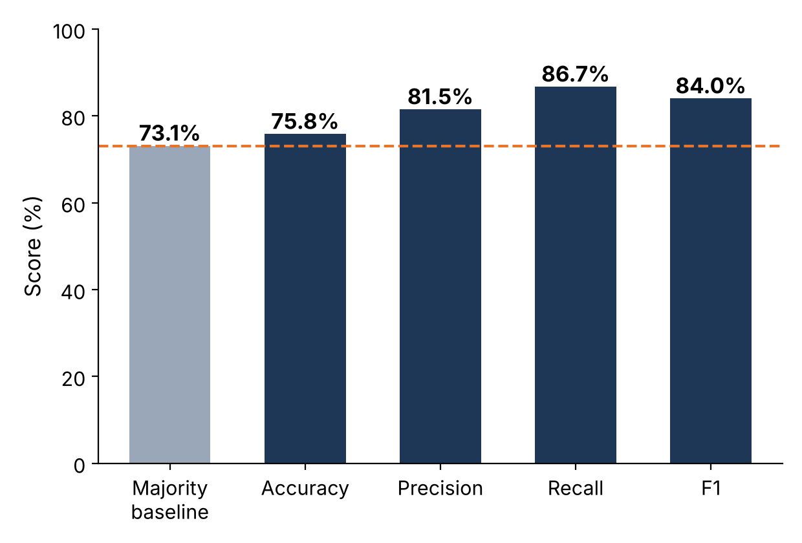
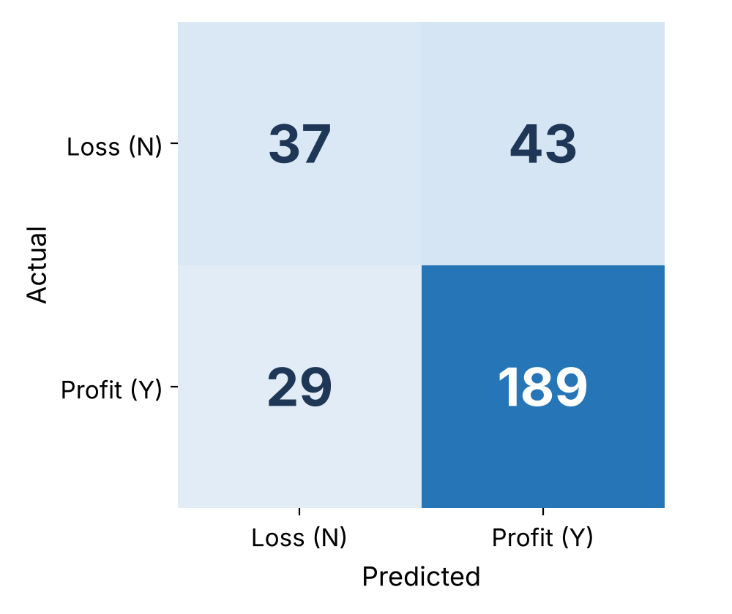
ACCURACY DETAILS
79.9%
87.1%
67.1%
75.8%
Accuracy
Precision
Recall
F1 Score
Correct predictions overall
Of predicted highly rated, how many truly are
Of truly highly rated, how many were found
Balance of precision & recall
METRICS vs MAJORITY BASELINE
CONFUSION MATRIX (n = 1,481)
Reading it
TP 467 · TN 716
FP 69 · FN 229
Matrix computed on the held-out test set (1,481 rows, 696 Y / 785 N).
Review 3 | 17

Slide 18
ACCURACY — INTERPRETATION
What the numbers say
Honest caveat
79.9% of the 1,481 test restaurants were classified correctly (1,183 of 1,481). The model finds 67.1% of highly rated restaurants, and when it predicts "Highly rated" it is right 87.1% of the time.
Always guessing the majority class (Not highly rated) scores 53.0%. Our model beats that by 26.9 points and correctly identifies 716 of 785 low-rated restaurants (91.2% specificity), but it misses 229 of 696 highly rated ones.
Why recall is lower
How to improve
Only 6 basic features are used. Votes is heavily skewed (a few restaurants have thousands) and Logistic Regression treats every feature linearly. Precision (87.1%) is well above recall (67.1%) at the default 0.5 threshold.
Log-transform Votes, add city and cuisine features, try Random Forest or Gradient Boosting, tune the decision threshold to raise recall, and use cross-validation.
Review 3 | 18

Slide 19
DATA VISUALIZATION — WHAT WAS USED & HOW
Visualization | Type | Implementation | Purpose
Rating Status Distribution | Bar chart | value_counts() → plt.bar() | Show class balance (Y vs N)
High-Rating Rate by Price Range | Bar chart | groupby('Price range').mean() → plt.bar() | Show how price range affects ratings
High-Rating Rate by City | Bar chart | groupby('City').mean() → plt.bar() | Compare the 5 largest cities
High-Rating Rate by Cuisine | Bar chart | groupby('Primary_Cuisine').mean() → plt.bar() | Compare the 5 most common cuisines
Confusion Matrix / Metrics | Heatmap & bar | confusion_matrix() → imshow() | Evaluate model errors
Library
Why bar charts?
Matplotlib (pyplot) with Pandas groupby / aggregation feeding each chart.
Our variables are categories (price range, city, cuisine) compared on one measure — high-rating rate — which bars show most clearly.
Review 3 | 19

Slide 20
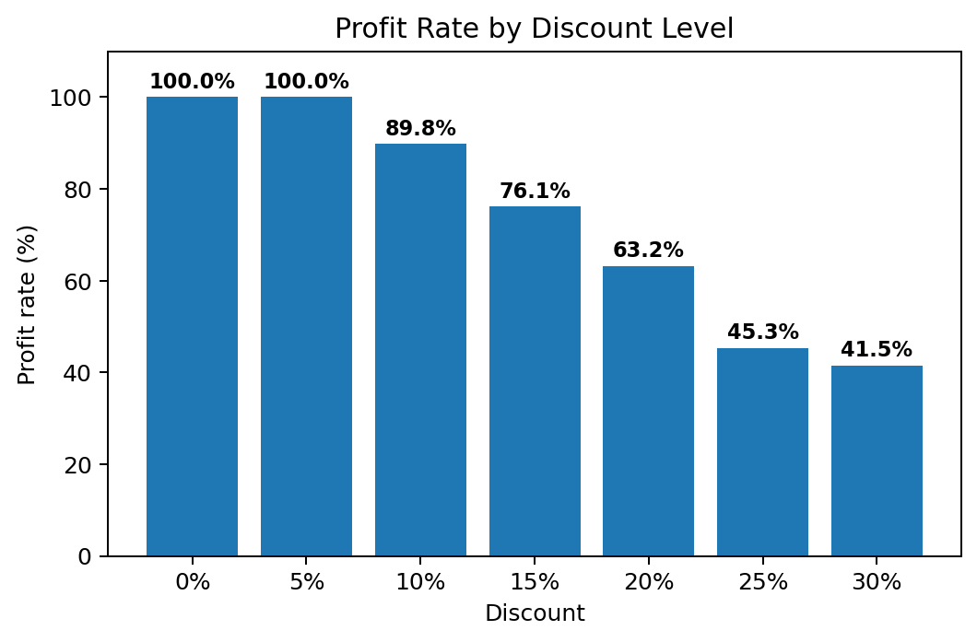
VISUALIZATION IMPLEMENTATION
PYTHON | Same pattern reused for City and Cuisine
# 1. Aggregate: high-rating rate (%) per price range
rates = df_model.groupby("Price range")["Is_Good"].mean()*100
# 2. Draw the bars
fig, ax = plt.subplots(figsize=(7,4.5))
bars = ax.bar(rates.index.astype(str), rates.values)
# 3. Add value labels, titles and axes
ax.bar_label(bars, fmt="%.1f%%")
ax.set_title("High-Rating Rate by Price Range")
ax.set_xlabel("Price range"); ax.set_ylabel("High-rating %")
plt.show()
Output: high-rating rate rises steadily as price range increases.
Interpretation: 28.6% of range-1 restaurants are highly rated, 43.8% at range 2, 75.7% at range 3 and 81.4% at range 4 — an association, not proof of causation.
Aggregate
Draw
Label
groupby + mean converts Y/N into a high-rating rate per group.
ax.bar() creates one bar per group.
bar_label shows exact values so the chart can be read without guessing.
Review 3 | 20

Slide 21
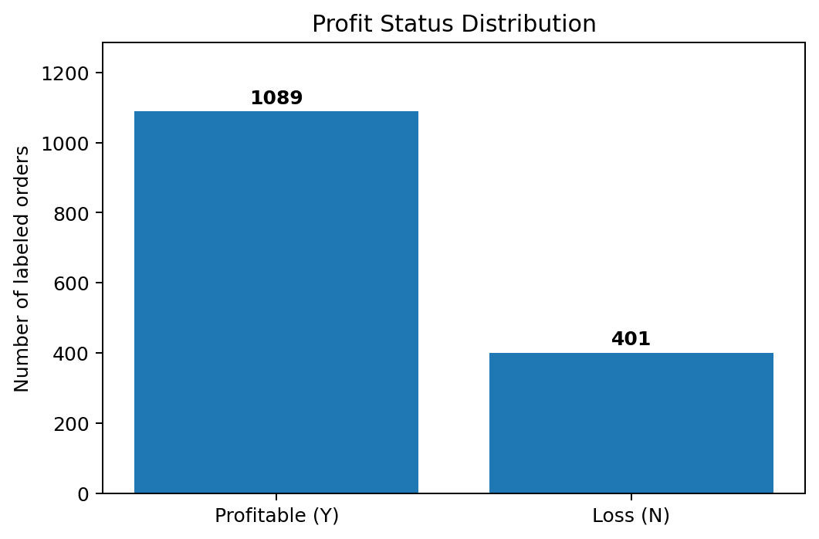
VISUALIZATION RESULTS — OUTCOME & PRICE RANGE
Outcome distribution
Price range
3,480 of 7,403 rated restaurants (47.0%) are highly rated and 3,923 are not. The classes are fairly balanced, but accuracy should still be compared with the 53.0% baseline.
High-rating rate rises from 28.6% at price range 1 to 81.4% at range 4. Fewer than half of the restaurants in price ranges 1 and 2 are highly rated.
Review 3 | 21

Slide 22
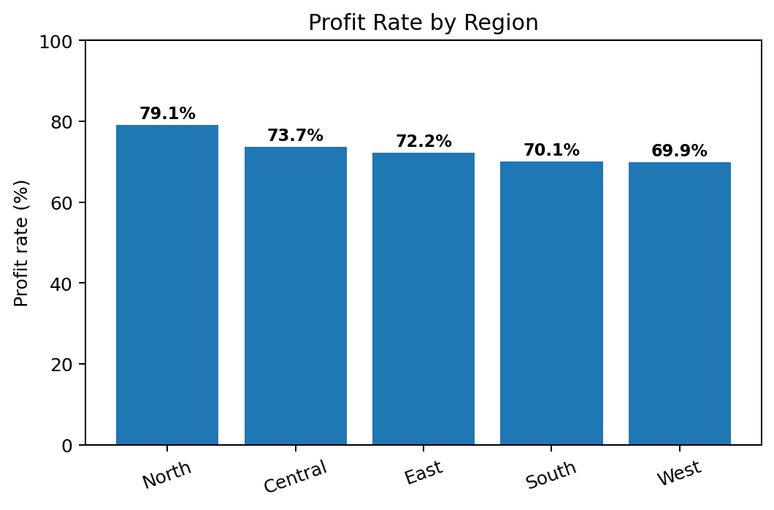
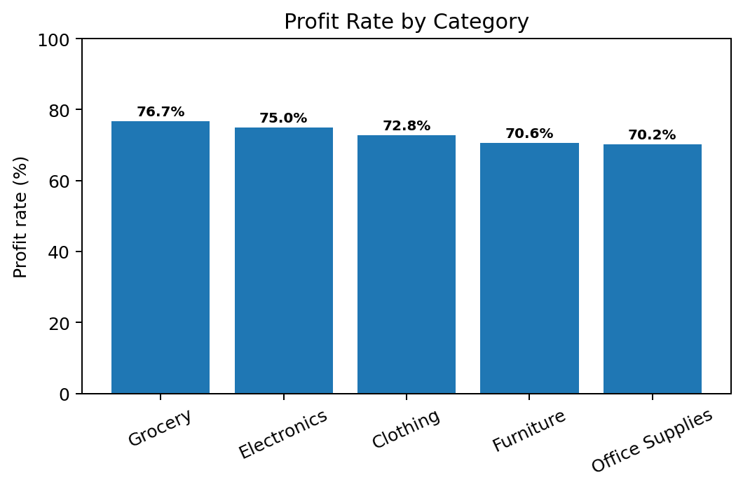
VISUALIZATION RESULTS — CITY & CUISINE
City insight
Cuisine insight
Gurgaon has the highest high-rating rate (39.6%) among the five most-listed cities; Faridabad (17.2%) and Ghaziabad (17.4%) are lowest. A 22-point spread, though Ghaziabad has only 23 rated restaurants.
Cafe leads at 64.7%, far ahead of the rest; North Indian is lowest at 31.4% (among the five most common cuisines). Differences are descriptive, not causal.
Review 3 | 22

Slide 23
KEY FINDINGS, CONCLUSION & FUTURE SCOPE
Key findings
Conclusion
Future scope
▪ 47.0% of rated restaurants are highly rated (3,480 / 7,403)
▪ Price range 1 → 28.6%; range 4 → 81.4%
▪ Cities range 17.2–39.6%; cuisines 31.4–64.7%
▪ Logistic Regression: 79.9% accuracy, 75.8% F1
A complete pipeline was built: CSV data → cleaning → preprocessing → EDA → visualization → prediction → evaluation.
9 missing cells were handled, 2,148 unrated restaurants were excluded, no duplicates were found, and 7,403 rated restaurants were used to train and test the model.
Findings are descriptive evidence, not proof of causation.
▪ Location map & city-level trends
▪ Random Forest / Gradient Boosting
▪ Cross-validation and threshold tuning
▪ Dashboard for live monitoring
▪ Restaurant recommendation system
Review 3 | 23

Slide 24
THANK YOU
Questions & Viva
Zomato Data Analysis System | Cornerstone Project — Third Review

