Slide 1
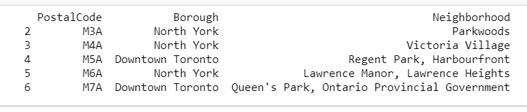
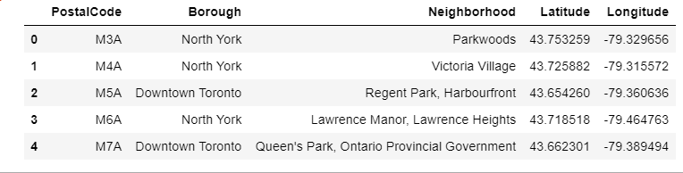
Battle of Neighbourhood Analysis
1) The dataset for Canada postcode is fetched from wiki link use Beautifulsoup library.
2) The above dataset is then enriched to bring Latitude and Longitude data for each post code.

Slide 2
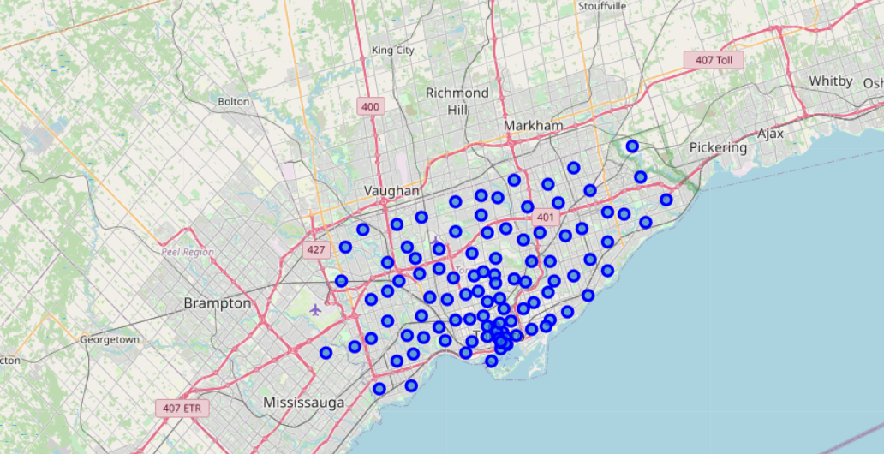
3) Using folium library coordinates for Canada were set and below map is pulled for available longitudes and latitudes.

Slide 3
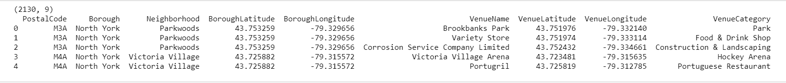
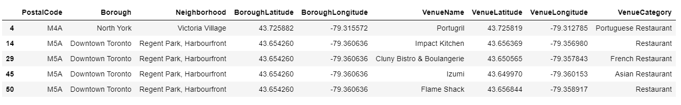
4) Below data is pulled from Foursquare database. The data is specific to Venue.
5) The data from Foursquare is filtered to capture only restaurants data.

Slide 4
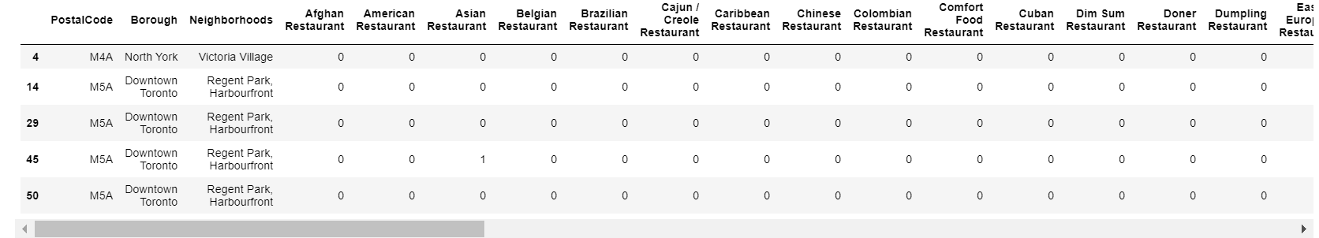
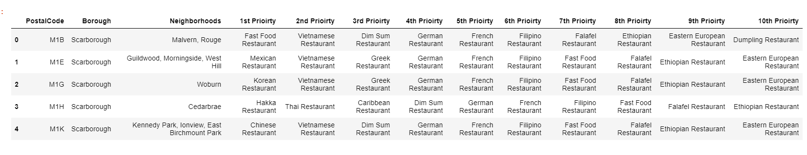
6) Using One Hot encoding the data is converted from Categorical form to numeric form
7) The data is then processed to determine top priority restaurant type by cuisine for each postal code.

Slide 5
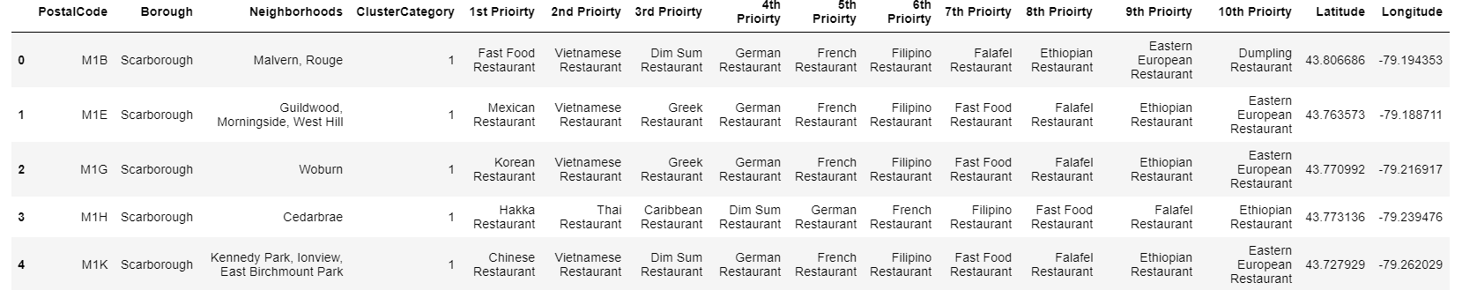
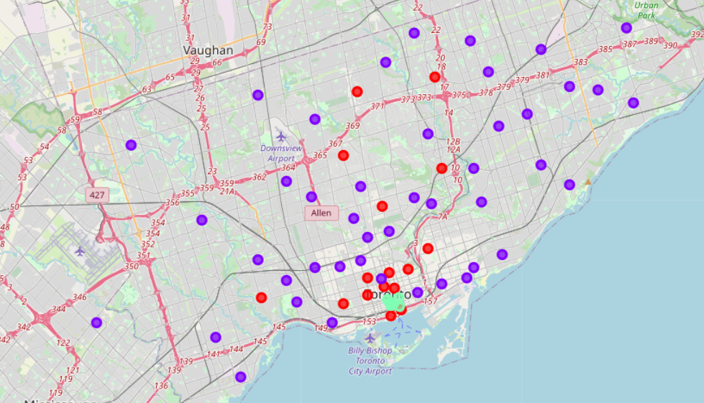
8) Using KMeans clustering, clusters are identified to group similar restaurant types together.
9) Below image highlights identified clusters.

Slide 6
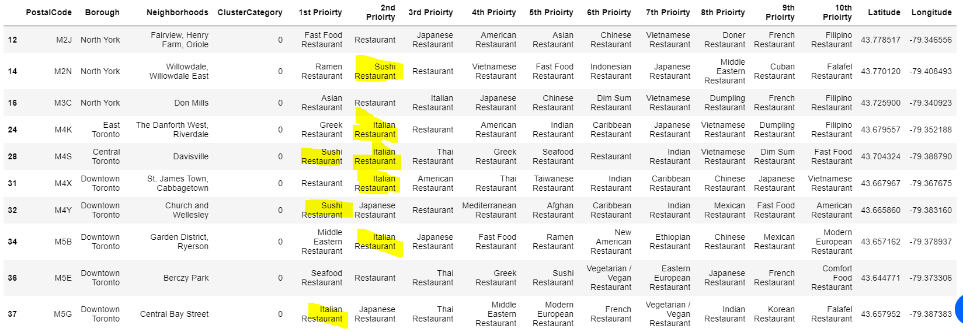
10) Based on the analysis, it is found that cluster 0 has top priority of Italian & Sushi restaurants, cluster 1 mainly consists of Vietnamese, Indian and Chinese restaurants and cluster 2 consists of American restaurants.

