Slide 1

ARTIFICIAL INTELLIGENCE CSCI 6660 TERM PROJECT
BY
Venkata Sai Rakesh Madisetty.
Satish Reddy Palakolanu.
Navakanth Reddy Bovilla.

Slide 2
DETECTING THE COLOR USING ARTIFICIAL INTELLIGENCE

Slide 3
Statement of project objectives
In this color detection project, we will create an application that will allow you to retrieve the name of a color by just clicking on it.
So, we'll have a data ﬁle with the color name and values for this. Then we'll compute the distance between each color and select the one with the least distance.

Slide 4
K - Means algorithm. Unsupervised algorithm. In K means each cluster is associated with a centroid Main aim of the K means is to minimize the sum of distances between the corresponding clusters
Algorithm

Slide 5
Approach
We are using K-means algorithm.
The RGB values are converted to Hexa values.
Numpy,matplot lib,Sklearn,cv2 libraries are used in our project.
OpenCV and pandas are used in this project.
Python is the popular language for ai and machine learning, so we are using python in this project.
PyCharm is being used in this project.
Pandas is used to load the desired data set.
OpenCV is used for image processing

Slide 6
Deliverables
Colors are composed of three main colors: red, green, and blue. Each color value in a computer is deﬁned as a number between 0 and 255. So, how many different ways can we deﬁne a color? The solution is 16,581,375 divided by 256*256*256. A color may be represented in around 16.5 million distinct ways. In our dataset, we must associate the values of each color with their respective names. But we don't have to map every value. We'll be using a dataset containing RGB values and their related names.

Slide 7
Evaluation methodology
Since the project will be done using OpenCV and pandas it can be evaluated by containing this 2 modules and any image of your choice is enough to test the working of the project.

Slide 8
Data Set
Colors Over 800 identifications Attributes: Color Color_name Hex R G B

Slide 9
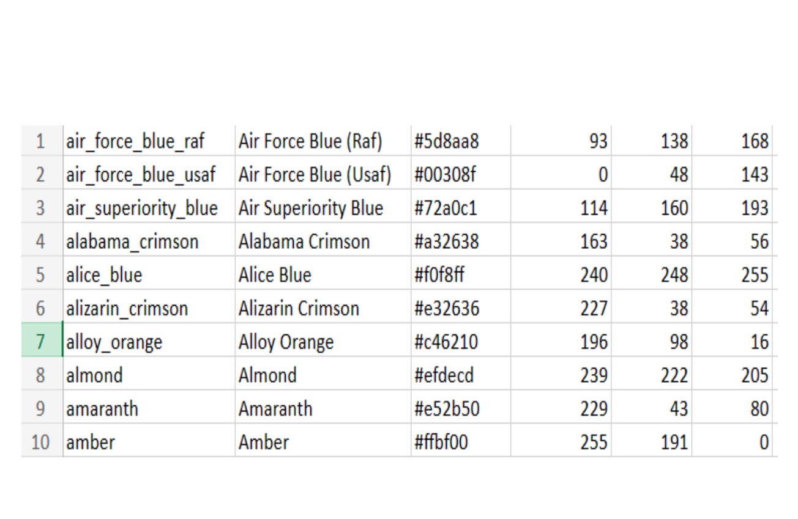
Dataset Sample

Slide 10
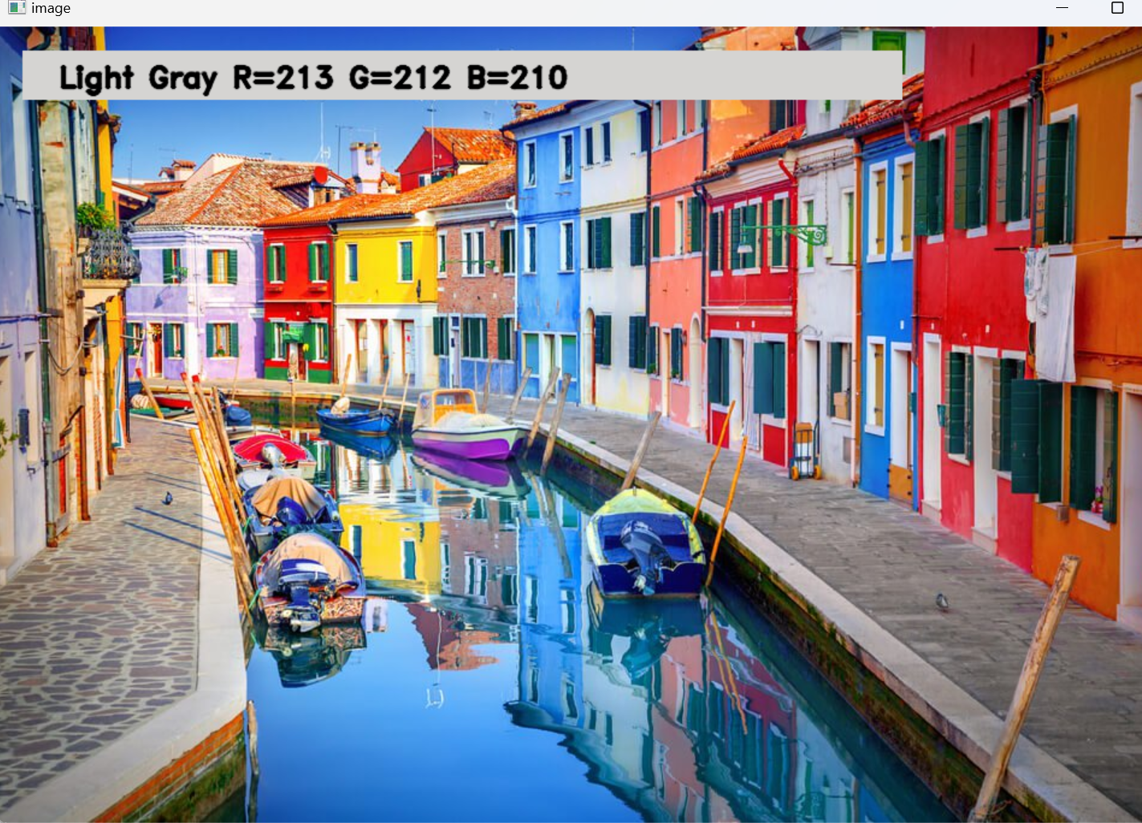
The output generated by the code, which will be in image providing a convenient way to see the visual representation of the data
Result

Slide 11
The given code creates a color detection application OpenCV and PIL libraries. User can identify the name of the color in a image by double clicking on a specific pixel. The script reads the color from a CSV file and employs K means algorithms to find the closest color match based on the RGB values. It calculates the minimum distance from the clicked pixel to predefined color in the dataset, determining the most matching color. The script then overlays a rectangle and text on the image, providing a visual representation of the detected color including its name and RGB values.
Conclusion

Slide 12


