Slide 1






E-COMMERCE MANAGEMENT SYSTEM DATABASE
Project Group - 18
DAMG6210 – DATABASE MANAGEMENT AND DATABASE DESIGN.
Priyanka Ramesh
Bhagya Trivedi
Satish Paraddi
V. Chaitanya
Praveen Jagadishan
Under the guidance of
Prof. Manuel Montrond.

Slide 2
PROBLEM STATEMENT
Mission Statement/Objectives
● Build an E-Commerce Database system to manage, store and retrieve data pertaining to an E-Commerce Platform.
● The E-commerce Database system will provide real-time tracking of online purchase operations.
● Provides an online platform for all the interested retailers who supply different types of products, to sell and make a profit.
● Maintains the customer and orders specific customer information, which is helpful for customer support and analytics.
● It will also maintain the Product catalog that provides information about the product categories.
● Maintains an inventory of products which lets the customers know about the product availability.
Buying and selling goods is a common activity all throughout the world.
A platform that enables clients to purchase various products from various categories is necessary to meet daily customer demand.
Users of e-commerce platforms can purchase goods at the best price and have them delivered to their doorsteps around the clock.
Additionally, it offers the seller the chance to trade the goods to any location in the world.

Slide 3
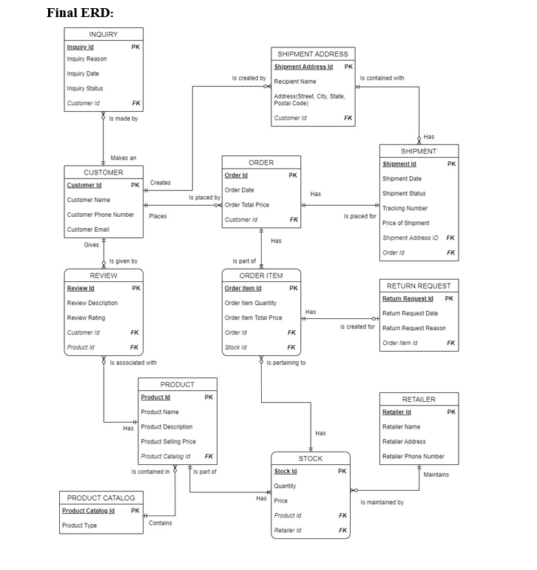

Slide 4
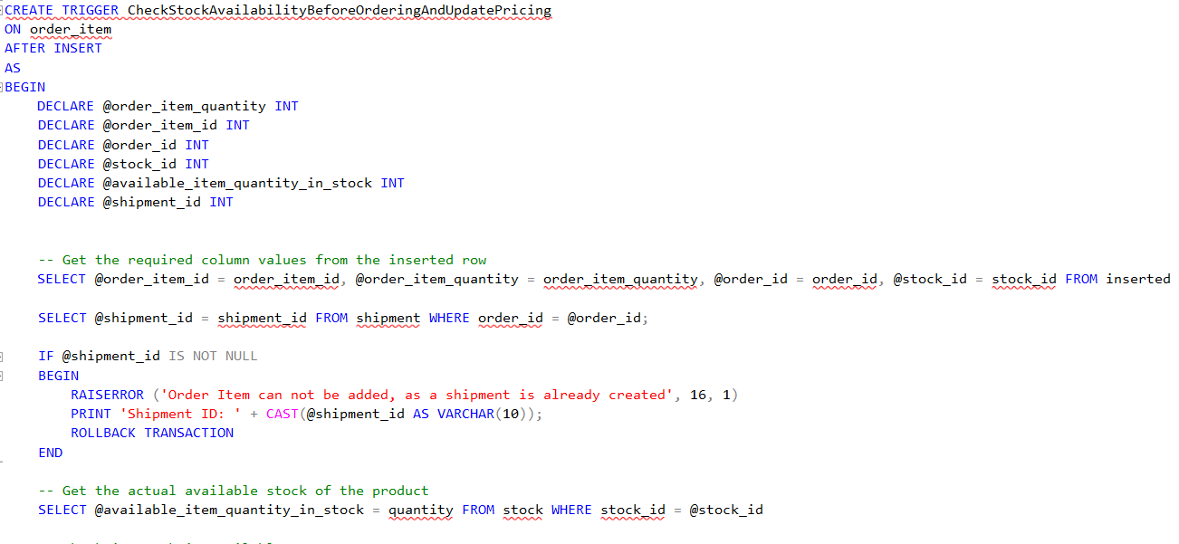
Trigger

Slide 5
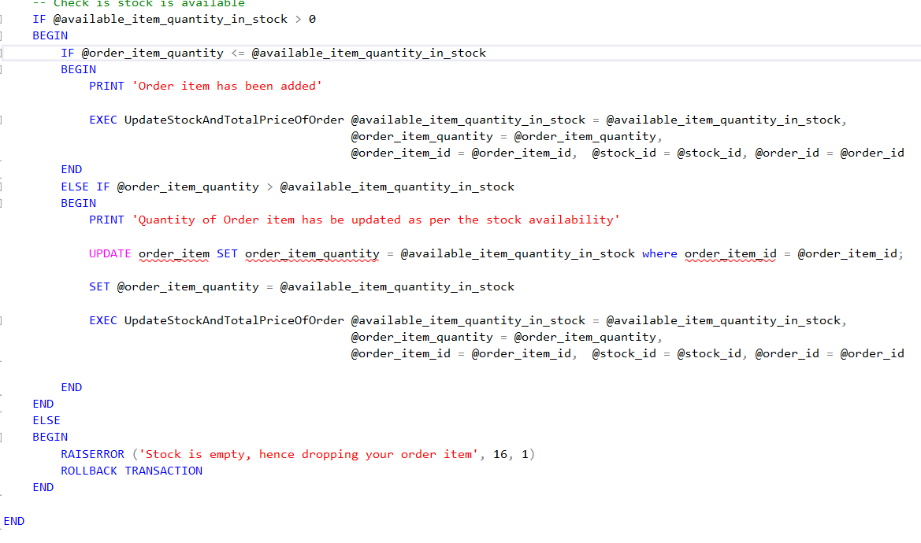
Trigger (Continued)

Slide 6
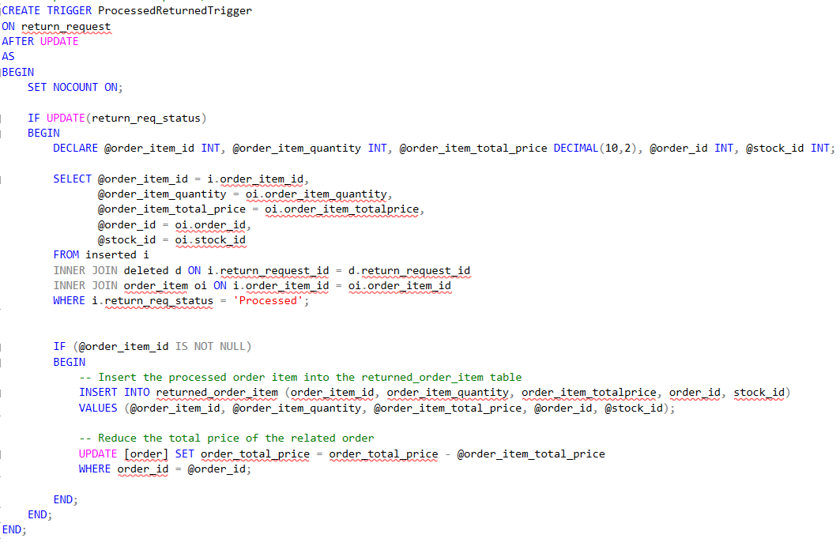
Trigger (that updates the stock after a return request is processed)

Slide 7
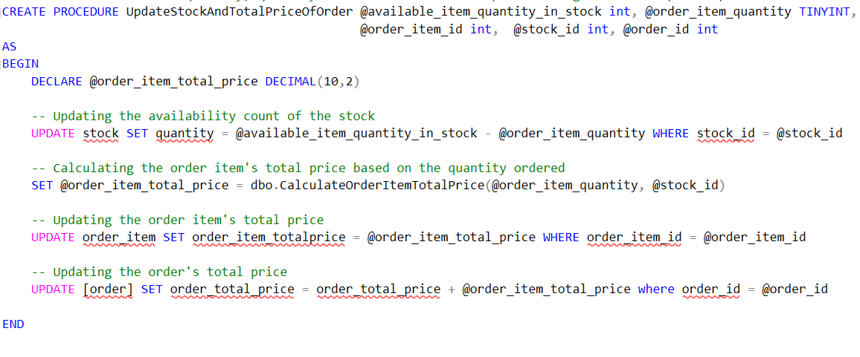
Procedure

Slide 8
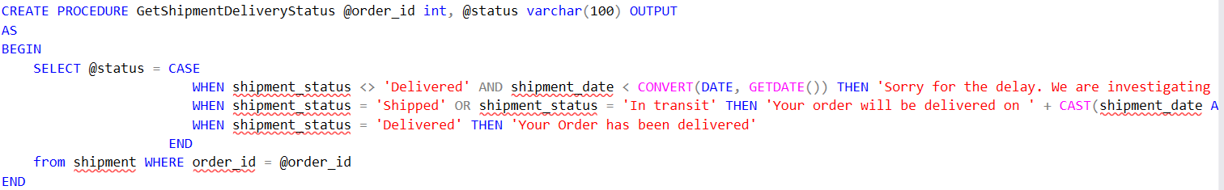
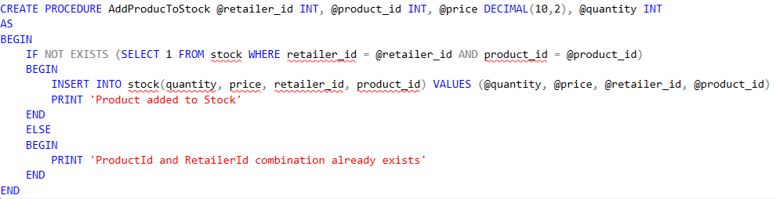
Procedures

Slide 9
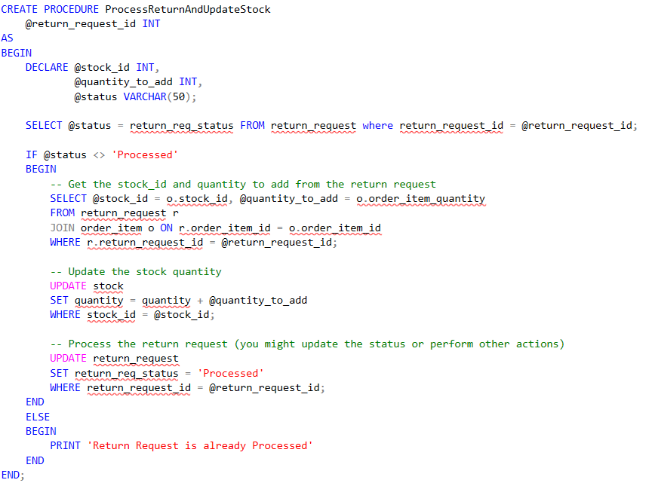
Procedures

Slide 10
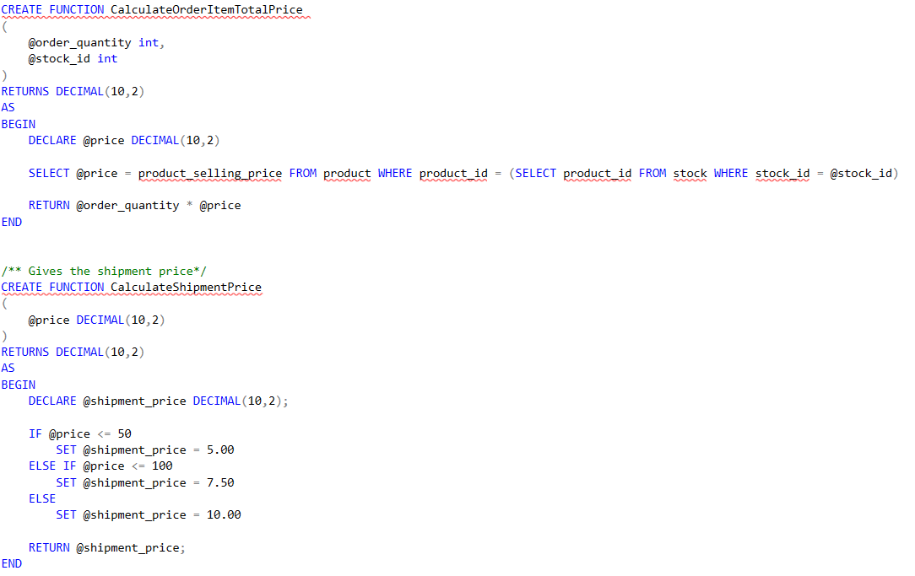
Functions

Slide 11
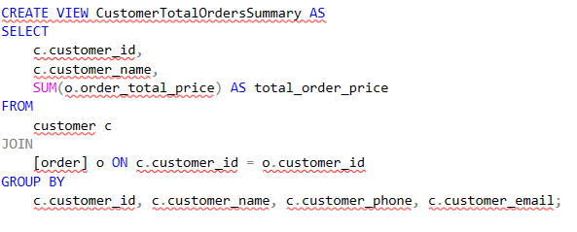
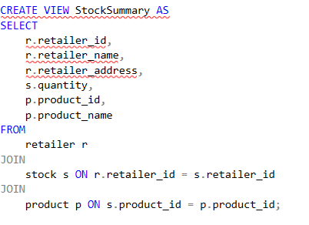
Views

Slide 12
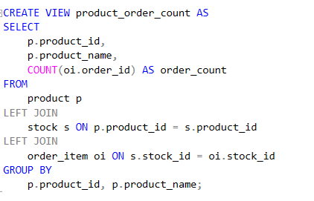
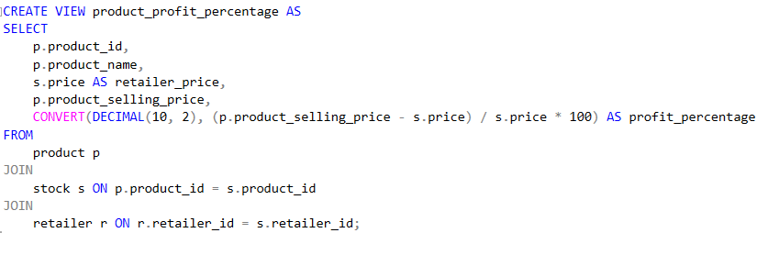
Views

Slide 13
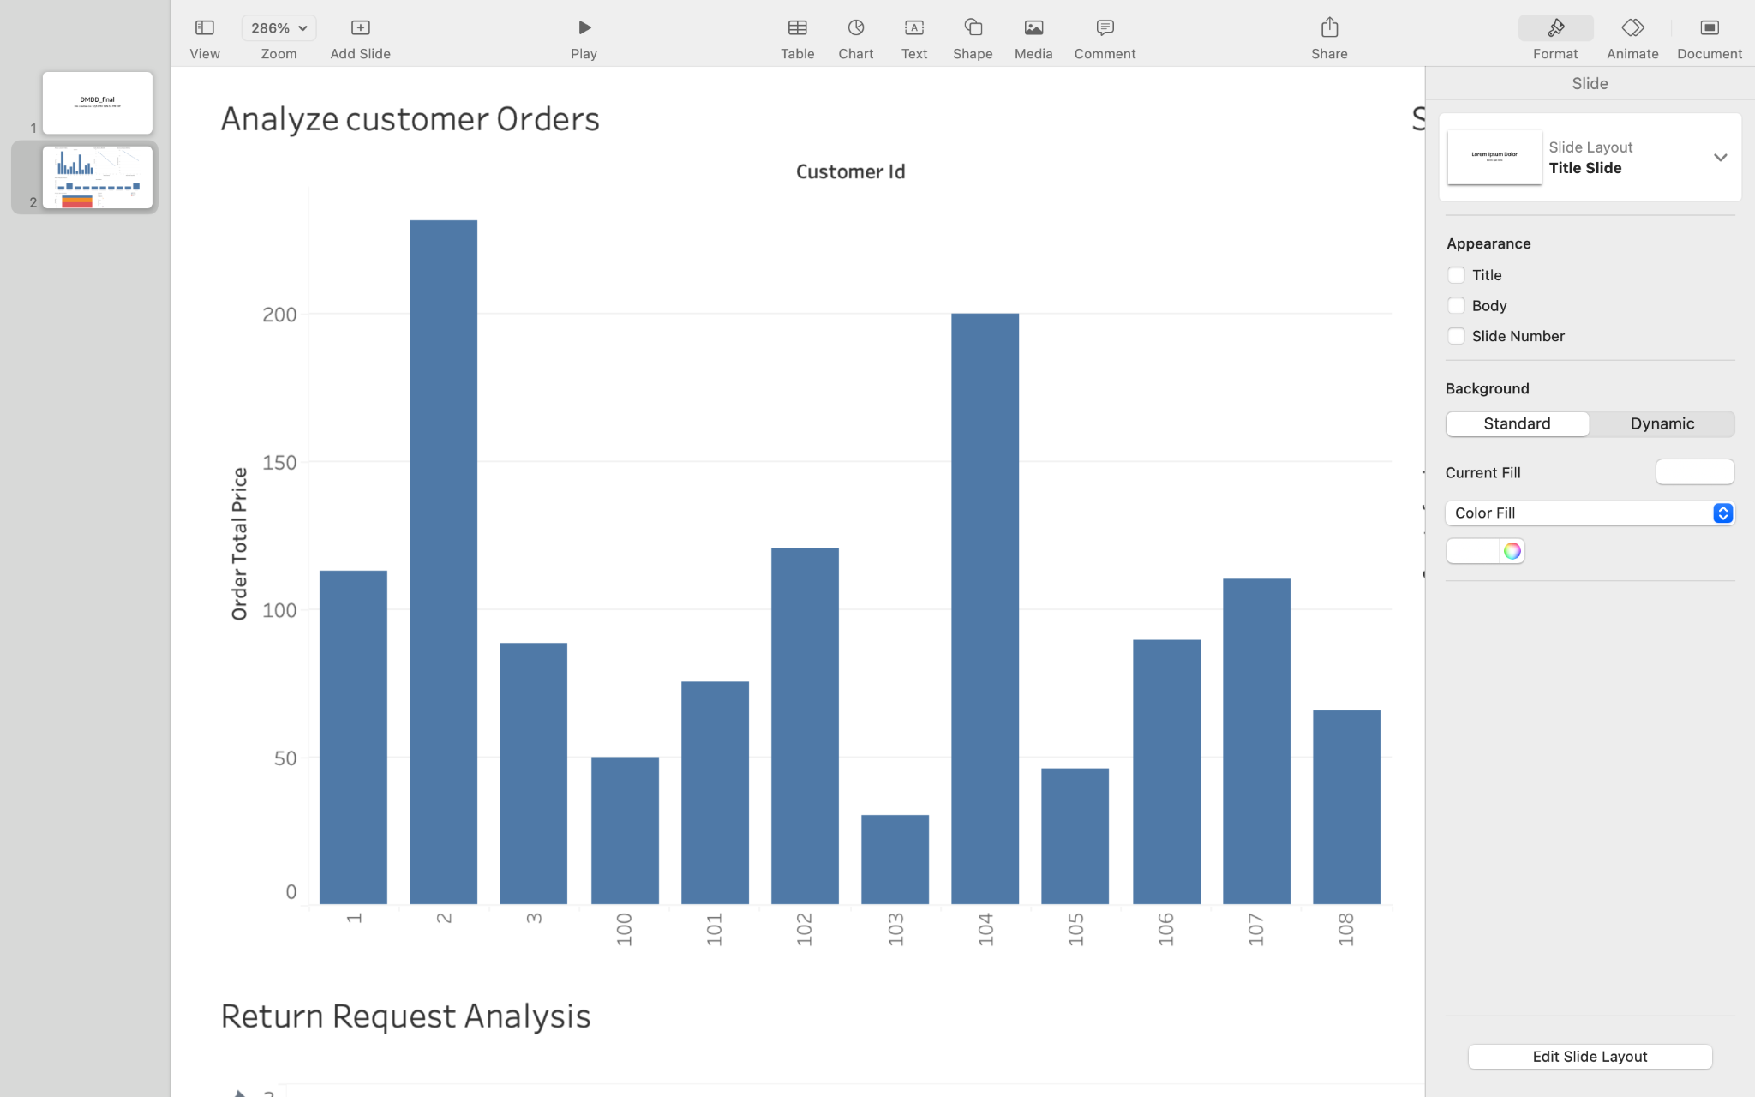
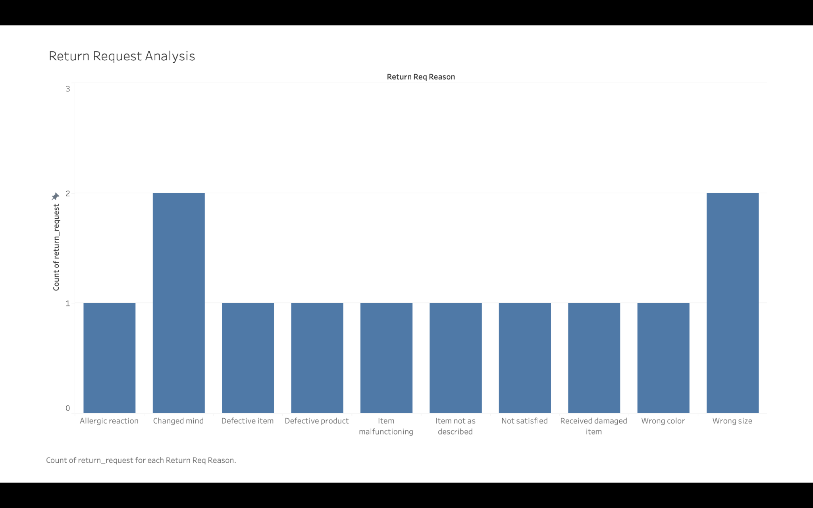
This bar graph depicts the total order price of each customer by their order and it is based upon the the customer id. By this we can easily conclude the customer who has spent the highest and who has spent the lowest.
This bar graph illustrates the request reason and the highest reason for which products are being returned. By which we can decide the most occurrence and rectify it.

Slide 14
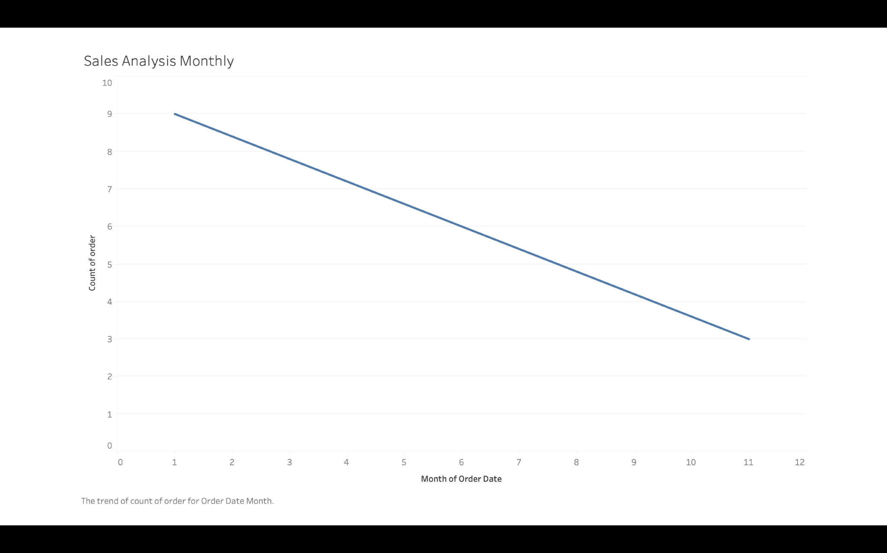
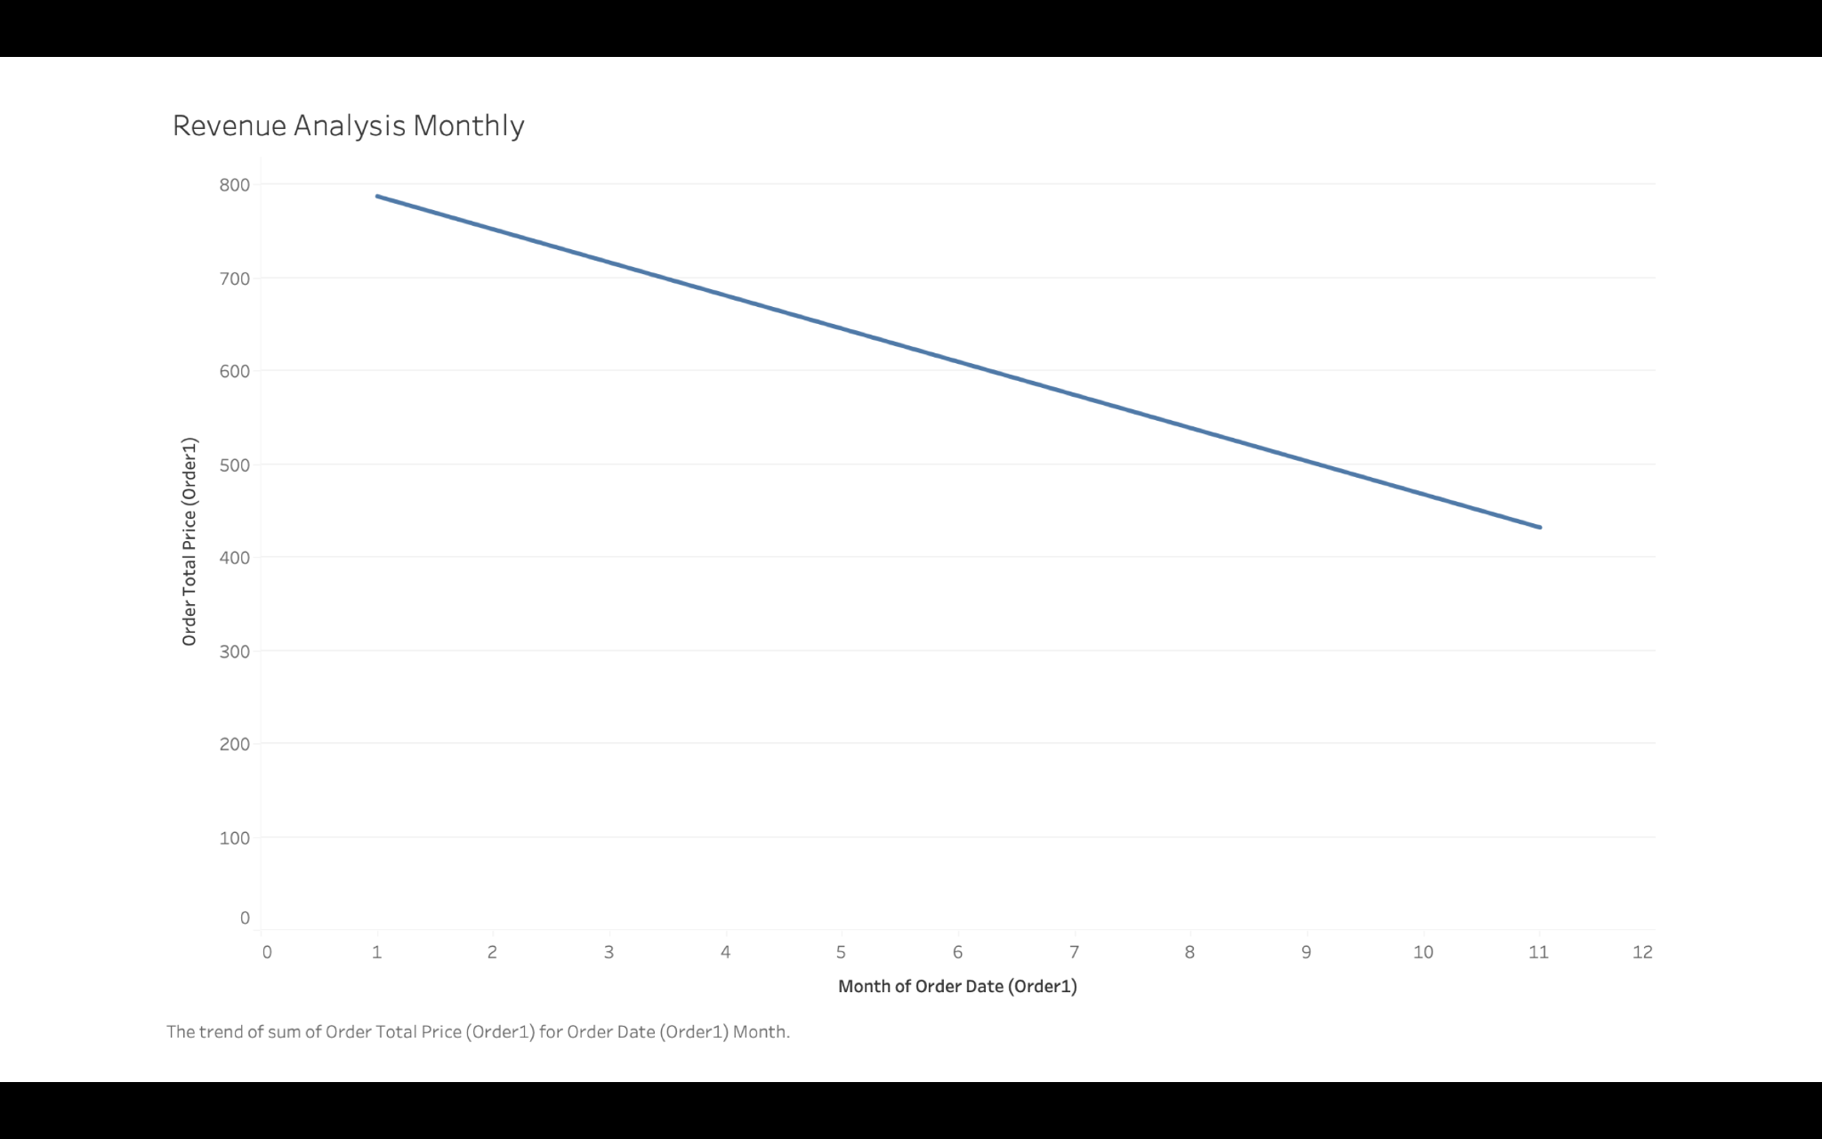
This line graph shows the total orders made by all the customers in a month and we can see a decline in the orders made.
The line graphs depicts the revenue generated by all the selling all the products in an month and we can see that there is a decline in revenue as the month proceeds.

Slide 15
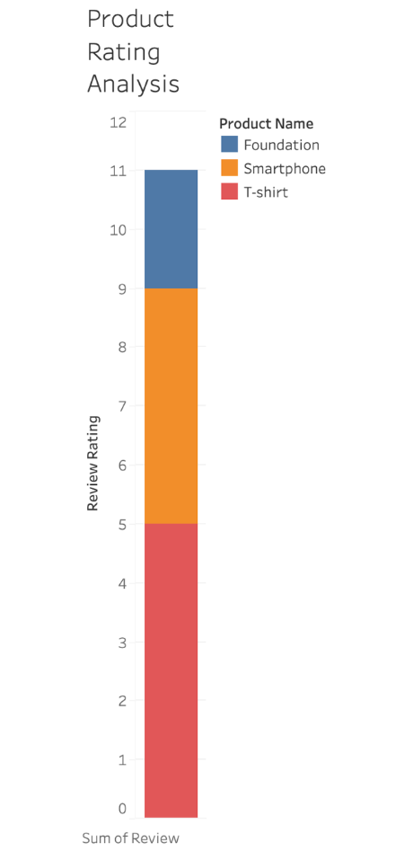
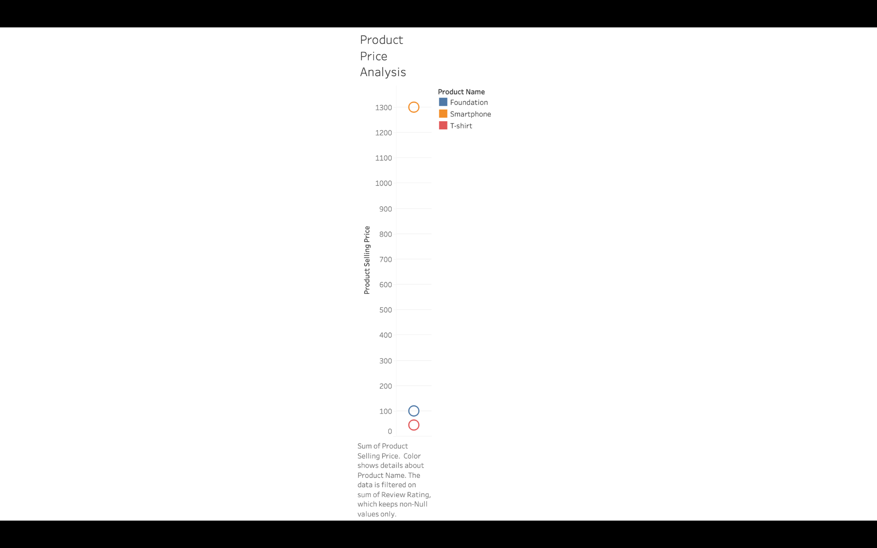
This horizontal bar illustrates the individual rating for each of the products sold by the company it is an accumulate type bar graph.
This circle view scatter plot shows the distribution over the product and it’s price with the y axis with the product price value over an interval of 100 each.

Slide 16
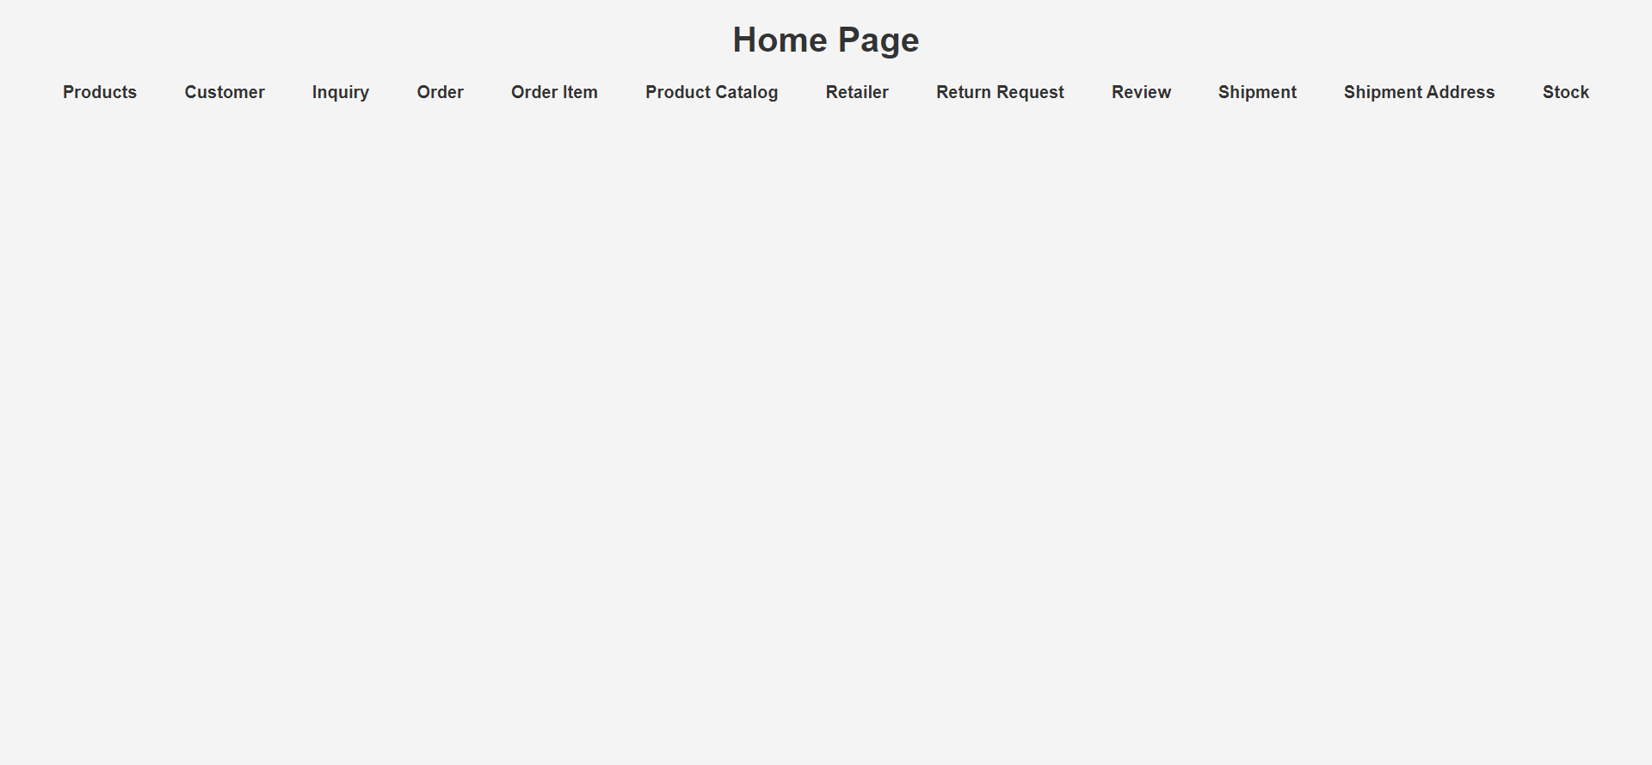
GUI

Slide 17
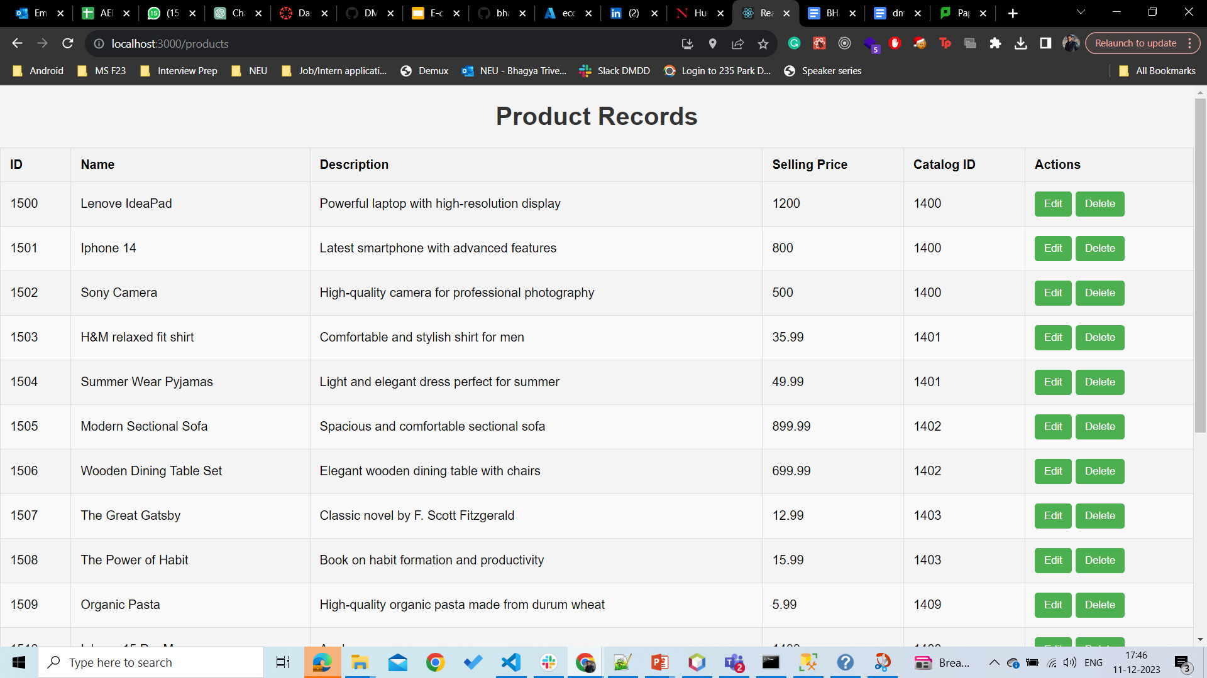
GUI

Slide 18
THANK YOU
Github Repository
https://github.com/bhagyatrivedi/DMDD_Project_Group18

