Slide 1


EXPERTEASE

Slide 2

CONTENT
01
DESCRIPTION
02
FEATURES
03
PAGES
04
OUR TEAM
05
THANK YOU

Slide 3

DESCRIPTION
ExpertEase is a web app driving progress towards UN SDG 4: Quality Education by connecting students with professionals for mentorship, sharing resources, and fostering discussions on academic and career development, aiming to solve global educational challenges.

Slide 4



FEATURES
An inclusive forum fostering discussions and resource sharing on all aspects of education
Connect with mentors for personalized guidance on diverse education topics through booked slots.

Slide 5

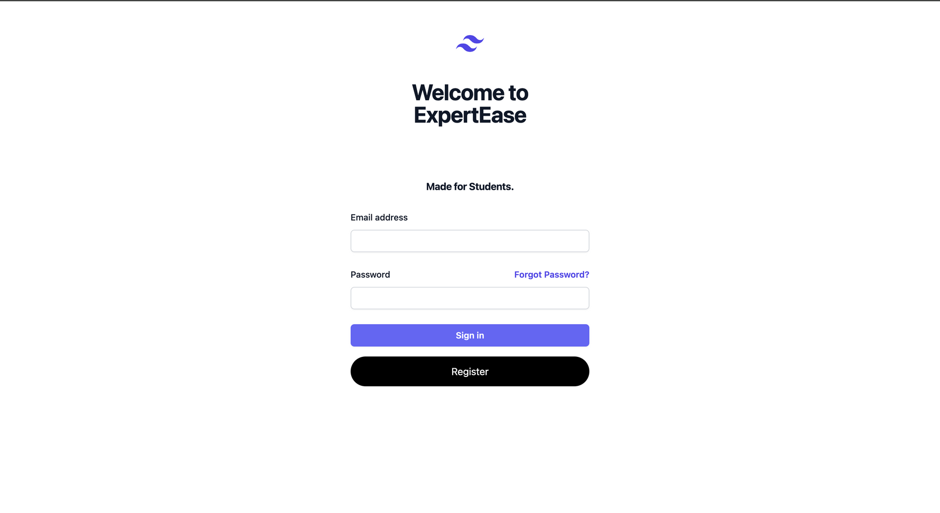
PAGES

Slide 6
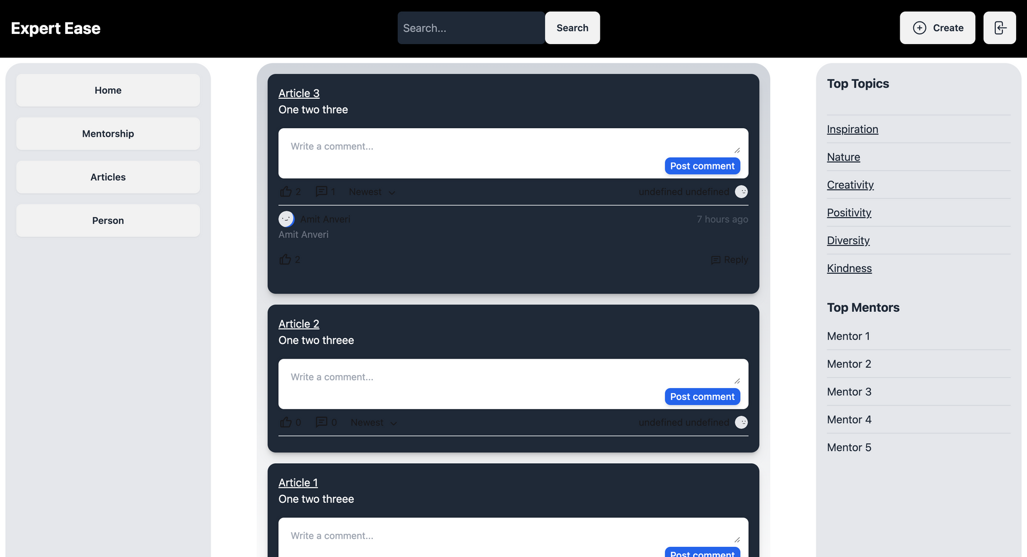
PAGES

Slide 7
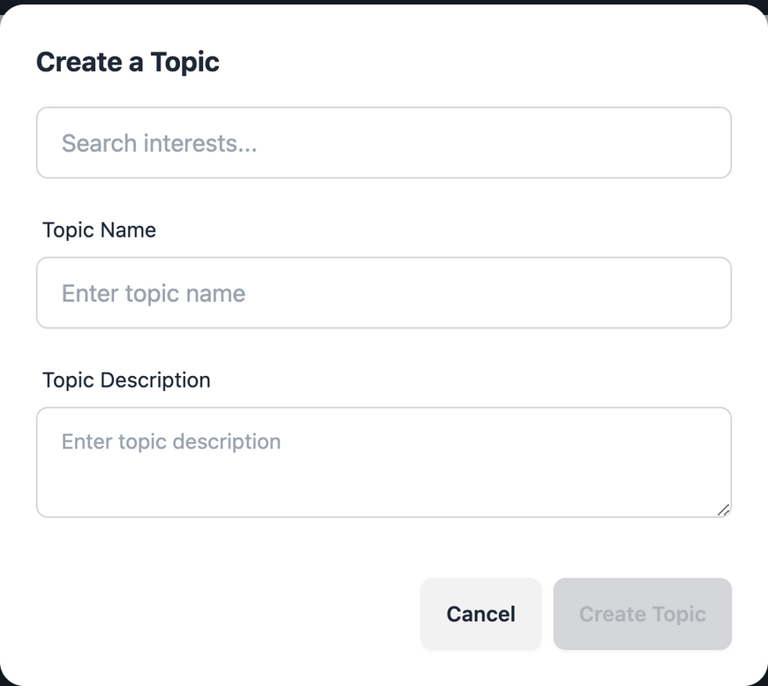
PAGES

Slide 8
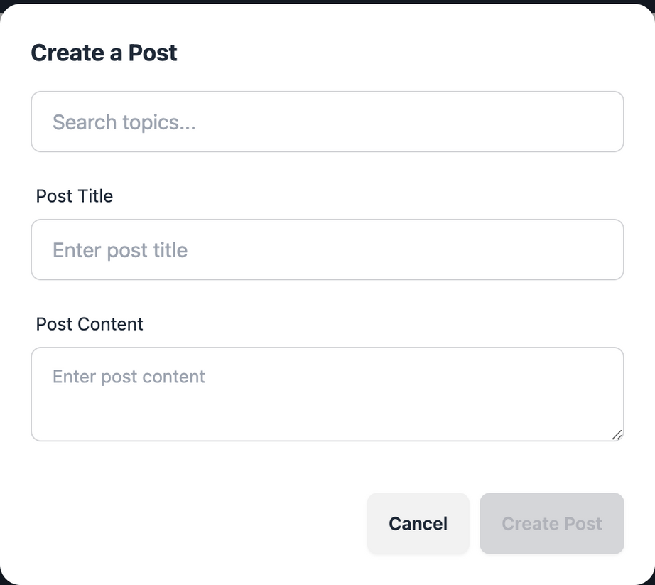
PAGES

Slide 9
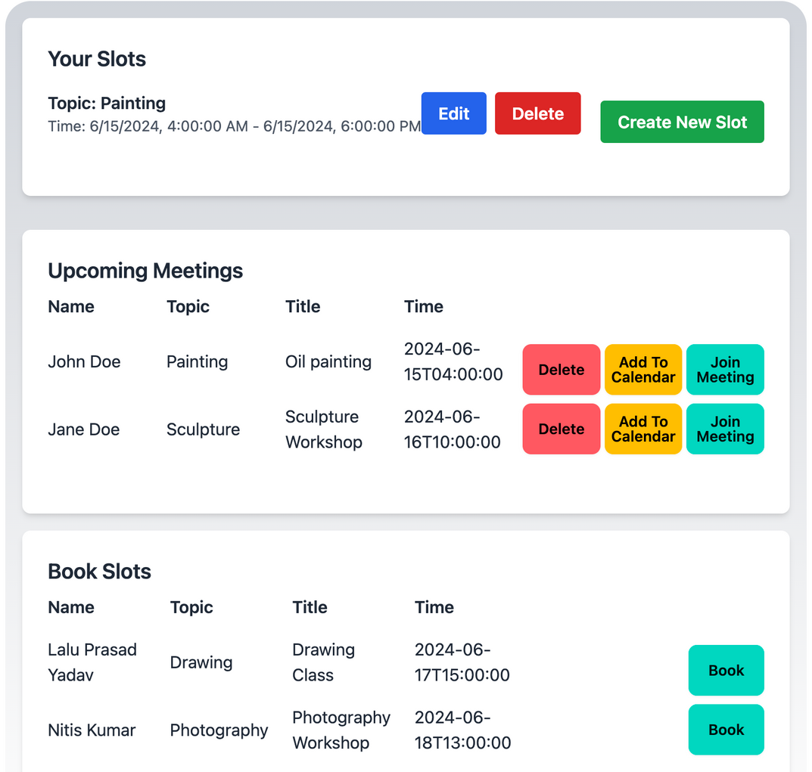
PAGES

Slide 10
OUR TEAM
Anirudh Jagadish
Sathish Mallikarjuna Paraddi
Aditya Ranjan Singh
Amit Anveri
002743405
002834380
002471528
002847662

Slide 11
THANK YOU

